Slide 1
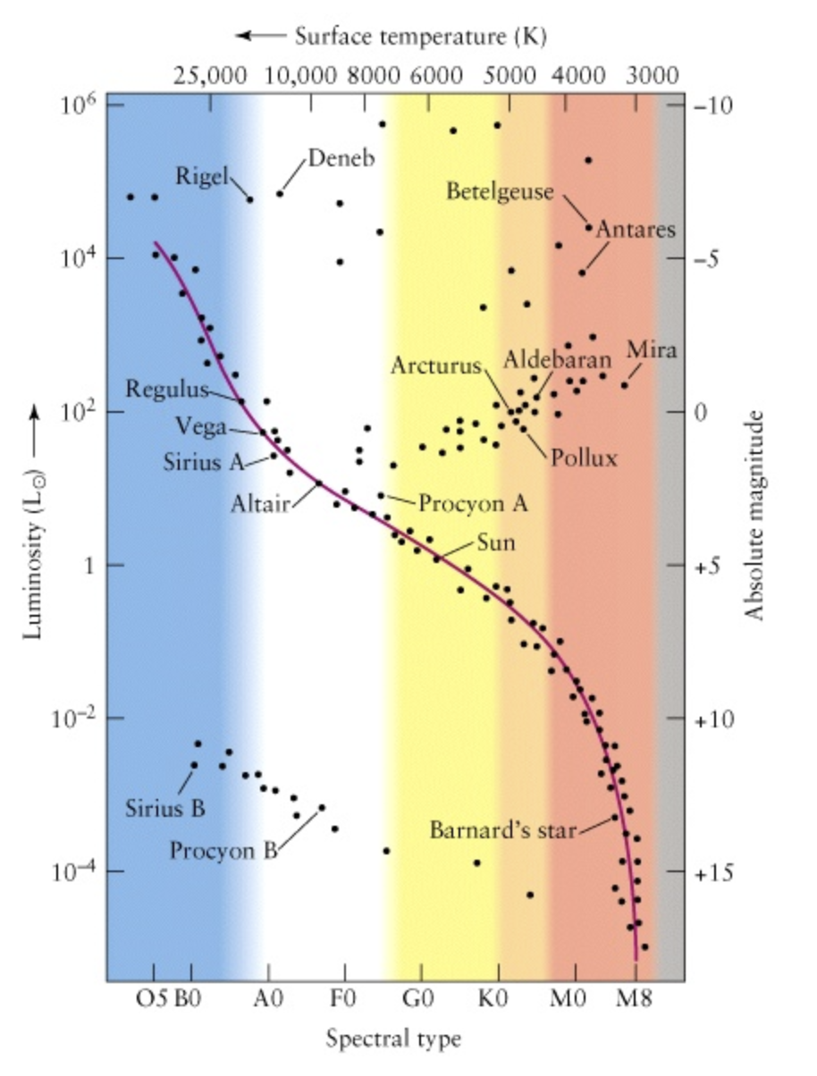
Astronomy 122
Homework 2: Hertzsprung-Russell Diagram (HR diagram)
Due: by the end of February 12, 2024
It is preferred that you turn the assignment in through course website on CANVAS. However, hardcopy will be accepted
Name and Date:
To the right is shown a Hertzprung-Russell (HR) Diagram. The HR diagram was developed in the 1910s credited to Ejnar Hertzprung and Henry Norris Russell with an early form used by Rosenberg. In theoretical HR diagrams, the Luminosity of a star is compared to its effective temperature. Equivalently, in its observational form, the absolute magnitude is compared to the spectral class (or color) of the star.
Here, we construct theoretical HR diagrams using samples of stars obtained in a couple of different ways. In this manner, we can infer some properties of stars based solely upon how they are distributed in an HR diagram.
There are, in fact, many other ways in which to sample stars allowing other features of stars to be inferred. The HR diagram was (and is) one of the most useful tools developed to explore the structure and evolution of stars.

Slide 2
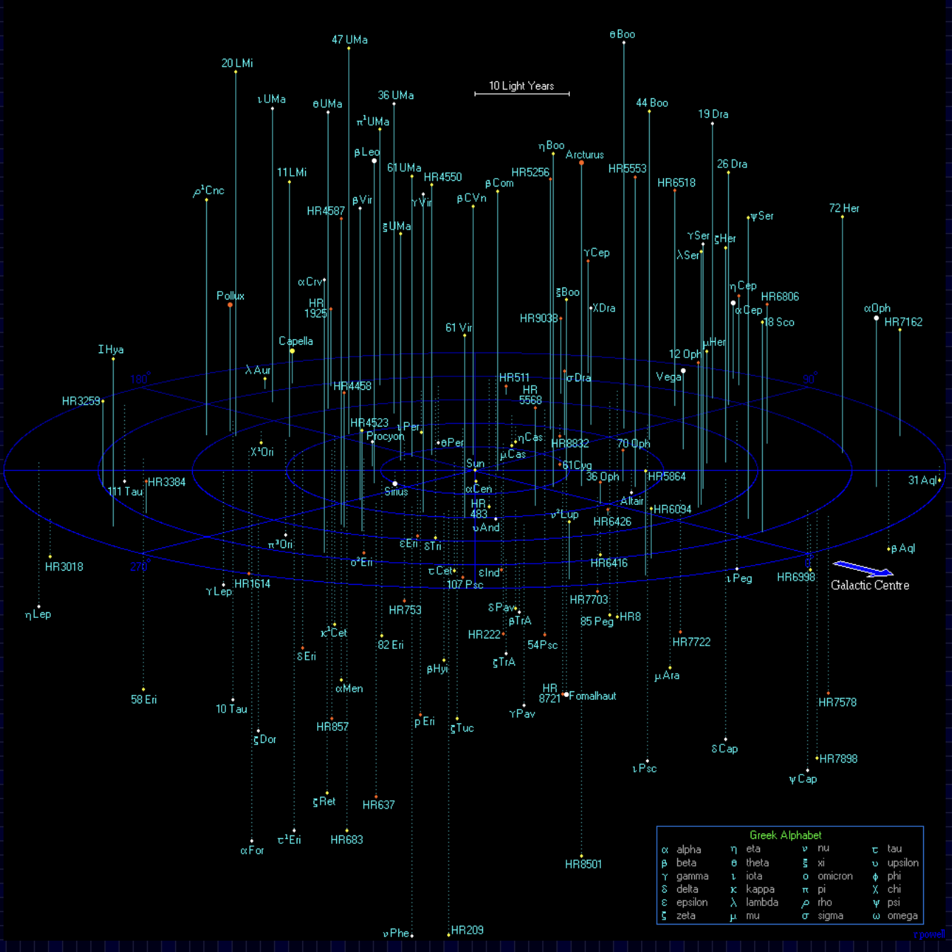
I. At left are shown stars contained within a sphere of radius 50 light years surrounding the Earth, the Solar Neighborhood.
The Earth is located at the center of the distribution.133 stars are shown. There are actually 2,000 systems in this sphere, roughly 10 % are shown (the brighter ones).
We are missing mainly red, low luminosity stars, red dwarfs from the sample.

Slide 3
Follow the link to find data similar to that used to make the plot on the previous slide a list of the brightest as seen from the Earth:
https://lavinia.as.arizona.edu/~dmccarthy/GSUSA/activities/8g%20Nearest%20and%20Brightest%20Act%20150.pdf
You see large tables containing lists of stars within 26 light years of the Earth and the brightest stars as seen in the night sky. The tables contain many quantities; the relevant ones are the effective temperature Teff and stellar luminosity, Luminosity. The Teff are in Kelvin (K) and luminosities in multiples of the luminosity of the Sun.
I have extracted these quantities and placed them comma separated files (.csv) and text files (.txt) at the low site:
https://pages.uoregon.edu/imamura/122/homeworks/hertzsprung_russell.html

Slide 4
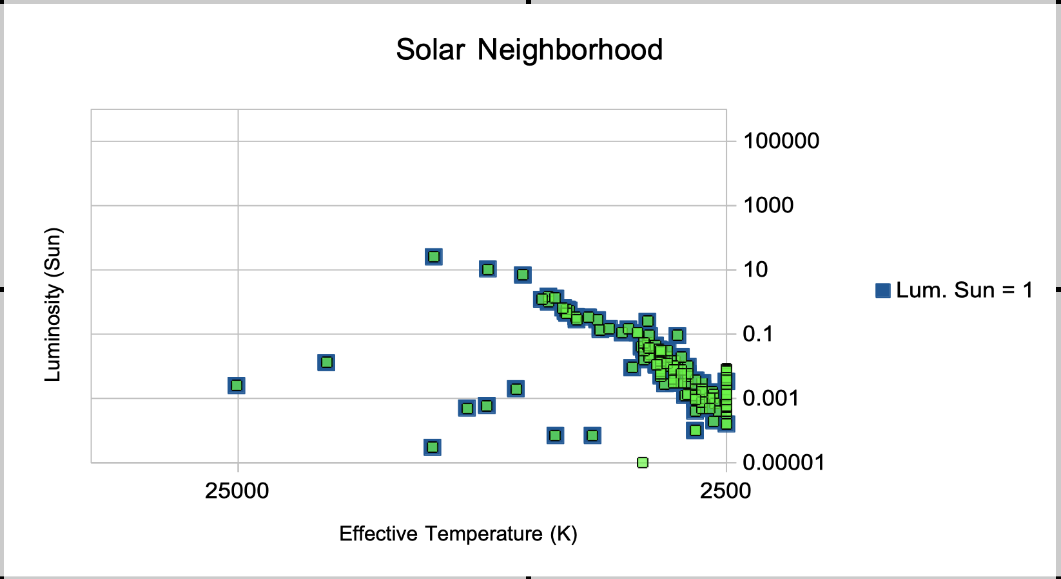
For the first Hertzsprung-Russell diagram, use the Solar Neighborhood stars, the set of stars closest to the Sun to make an HR diagram. Specifically, for the plot, use the stars within 26 light years of the Sun. Remember that the temperature is largest on the left decreasing rightward. The HR diagram for the Solar Neighborhood will look like
Circle examples of Main Sequence stars, Giant stars, Supergiant stars, and white dwarfs stars if found on your HR diagram.

Slide 5
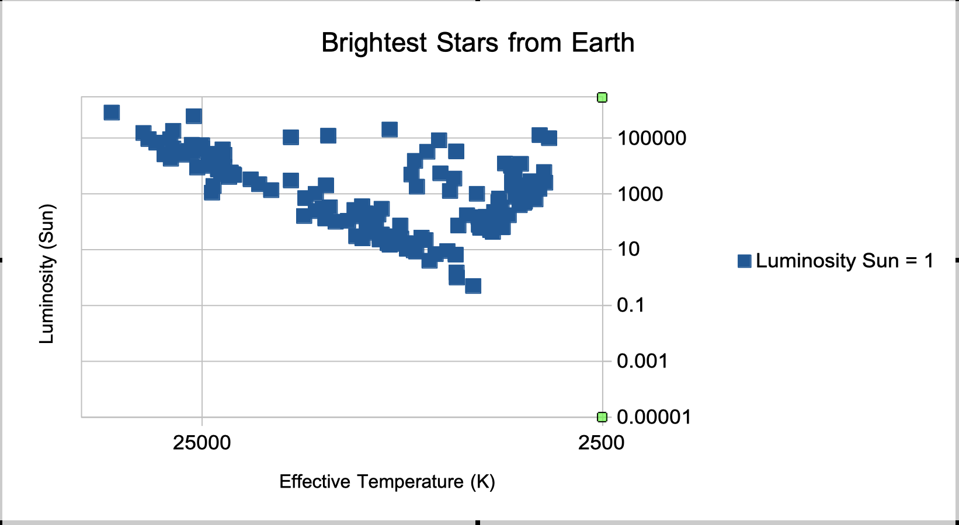
2. For the next Hertzsprung-Russell diagram, use the Brightest stars as seen from the Earth, the set of stars that appear brightest in the sky and make an HR diagram. The HR diagram for the Brightest stars looks like
Circle examples of Main Sequence stars, Supergiant stars, Giant stars, and white dwarfs stars if found on your HR diagram.

Slide 6
3. How do the Hertzsprung-Russell diagrams made for Parts (1) and (2) differ in appearance or do they appear nearly identical? To compare them easily, simply plot both sets of stars on one plot. What kinds of stars dominate each HR diagram? Look at how hot are the stars in each HR diagram, how luminous are the stars in each diagram, whether the HR diagrams are dominated by giant stars or main sequence stars, how the masses of the stars compare in the two HR diagrams.
4. Based upon your HR diagrams, what can you conclude about what are the most common types of stars in the Milky Way galaxy? Are they low mass or high mass stars?
5. Based upon your HR diagrams, what might you conclude about the kinds of stars an observer in another galaxy, such as Andromeda, would find dominated the starlight from the Milky Way galaxy if they took a short exposure snapshot of the Milky Way?

Slide 7
I used OpenOffice a freeware software package (with the functionality of Microsoft’s Office Suite of tools) to create the HR diagrams. I did not use Apple’s Numbers in this case because it does not have a built-in way to flip axes. In the following pages, I describe how I made the plots. You may choose to follow my template, or feel free to use any software of your liking or to make plots by hand.

Slide 8
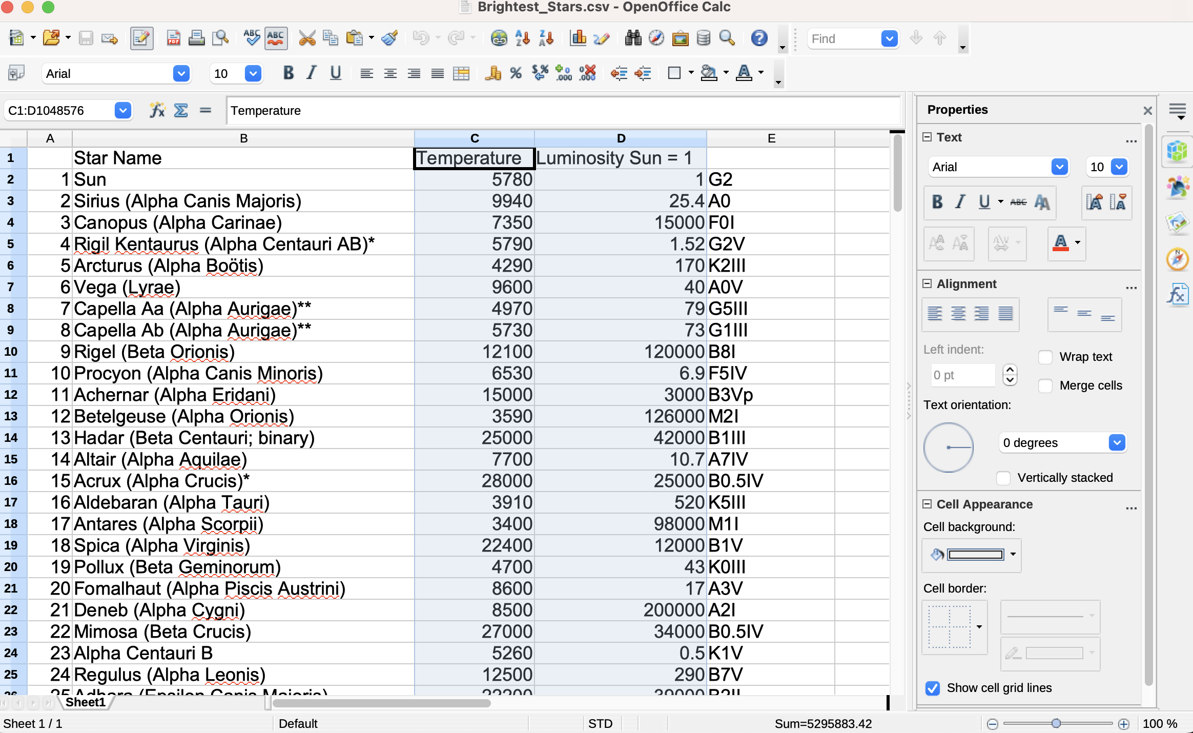
I used OpenOffice to create the HR diagrams. I did not use Apple’s Numbers because it does not have a built-in way to flip axes.
The first step in making a plot is to choose the columns for the x-axis and the y-axis.

Slide 9
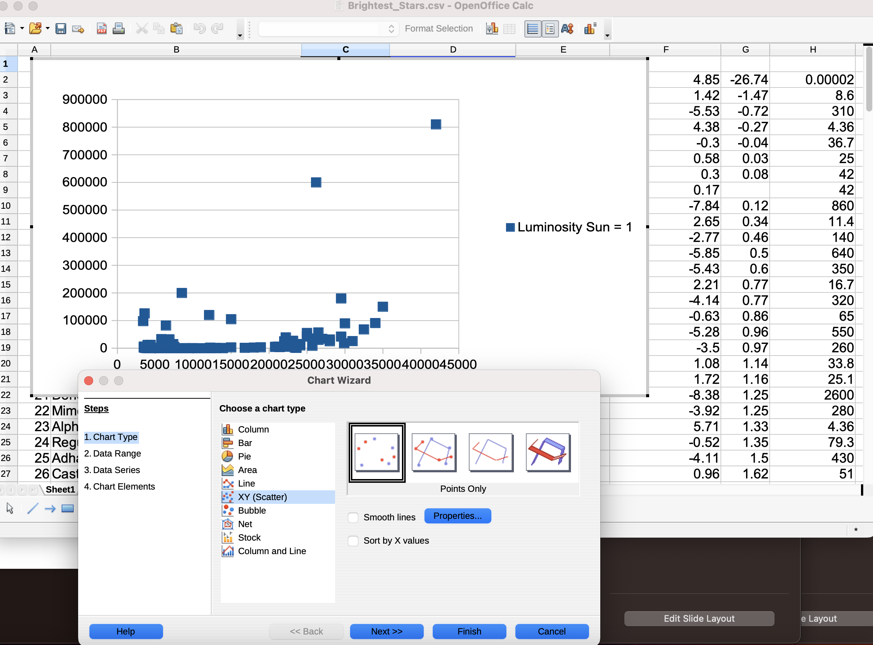
We wish to make what is referred to as a Scatter Plot. So, click on the Chart Icon. And then choose XY (Scatter).

Slide 10
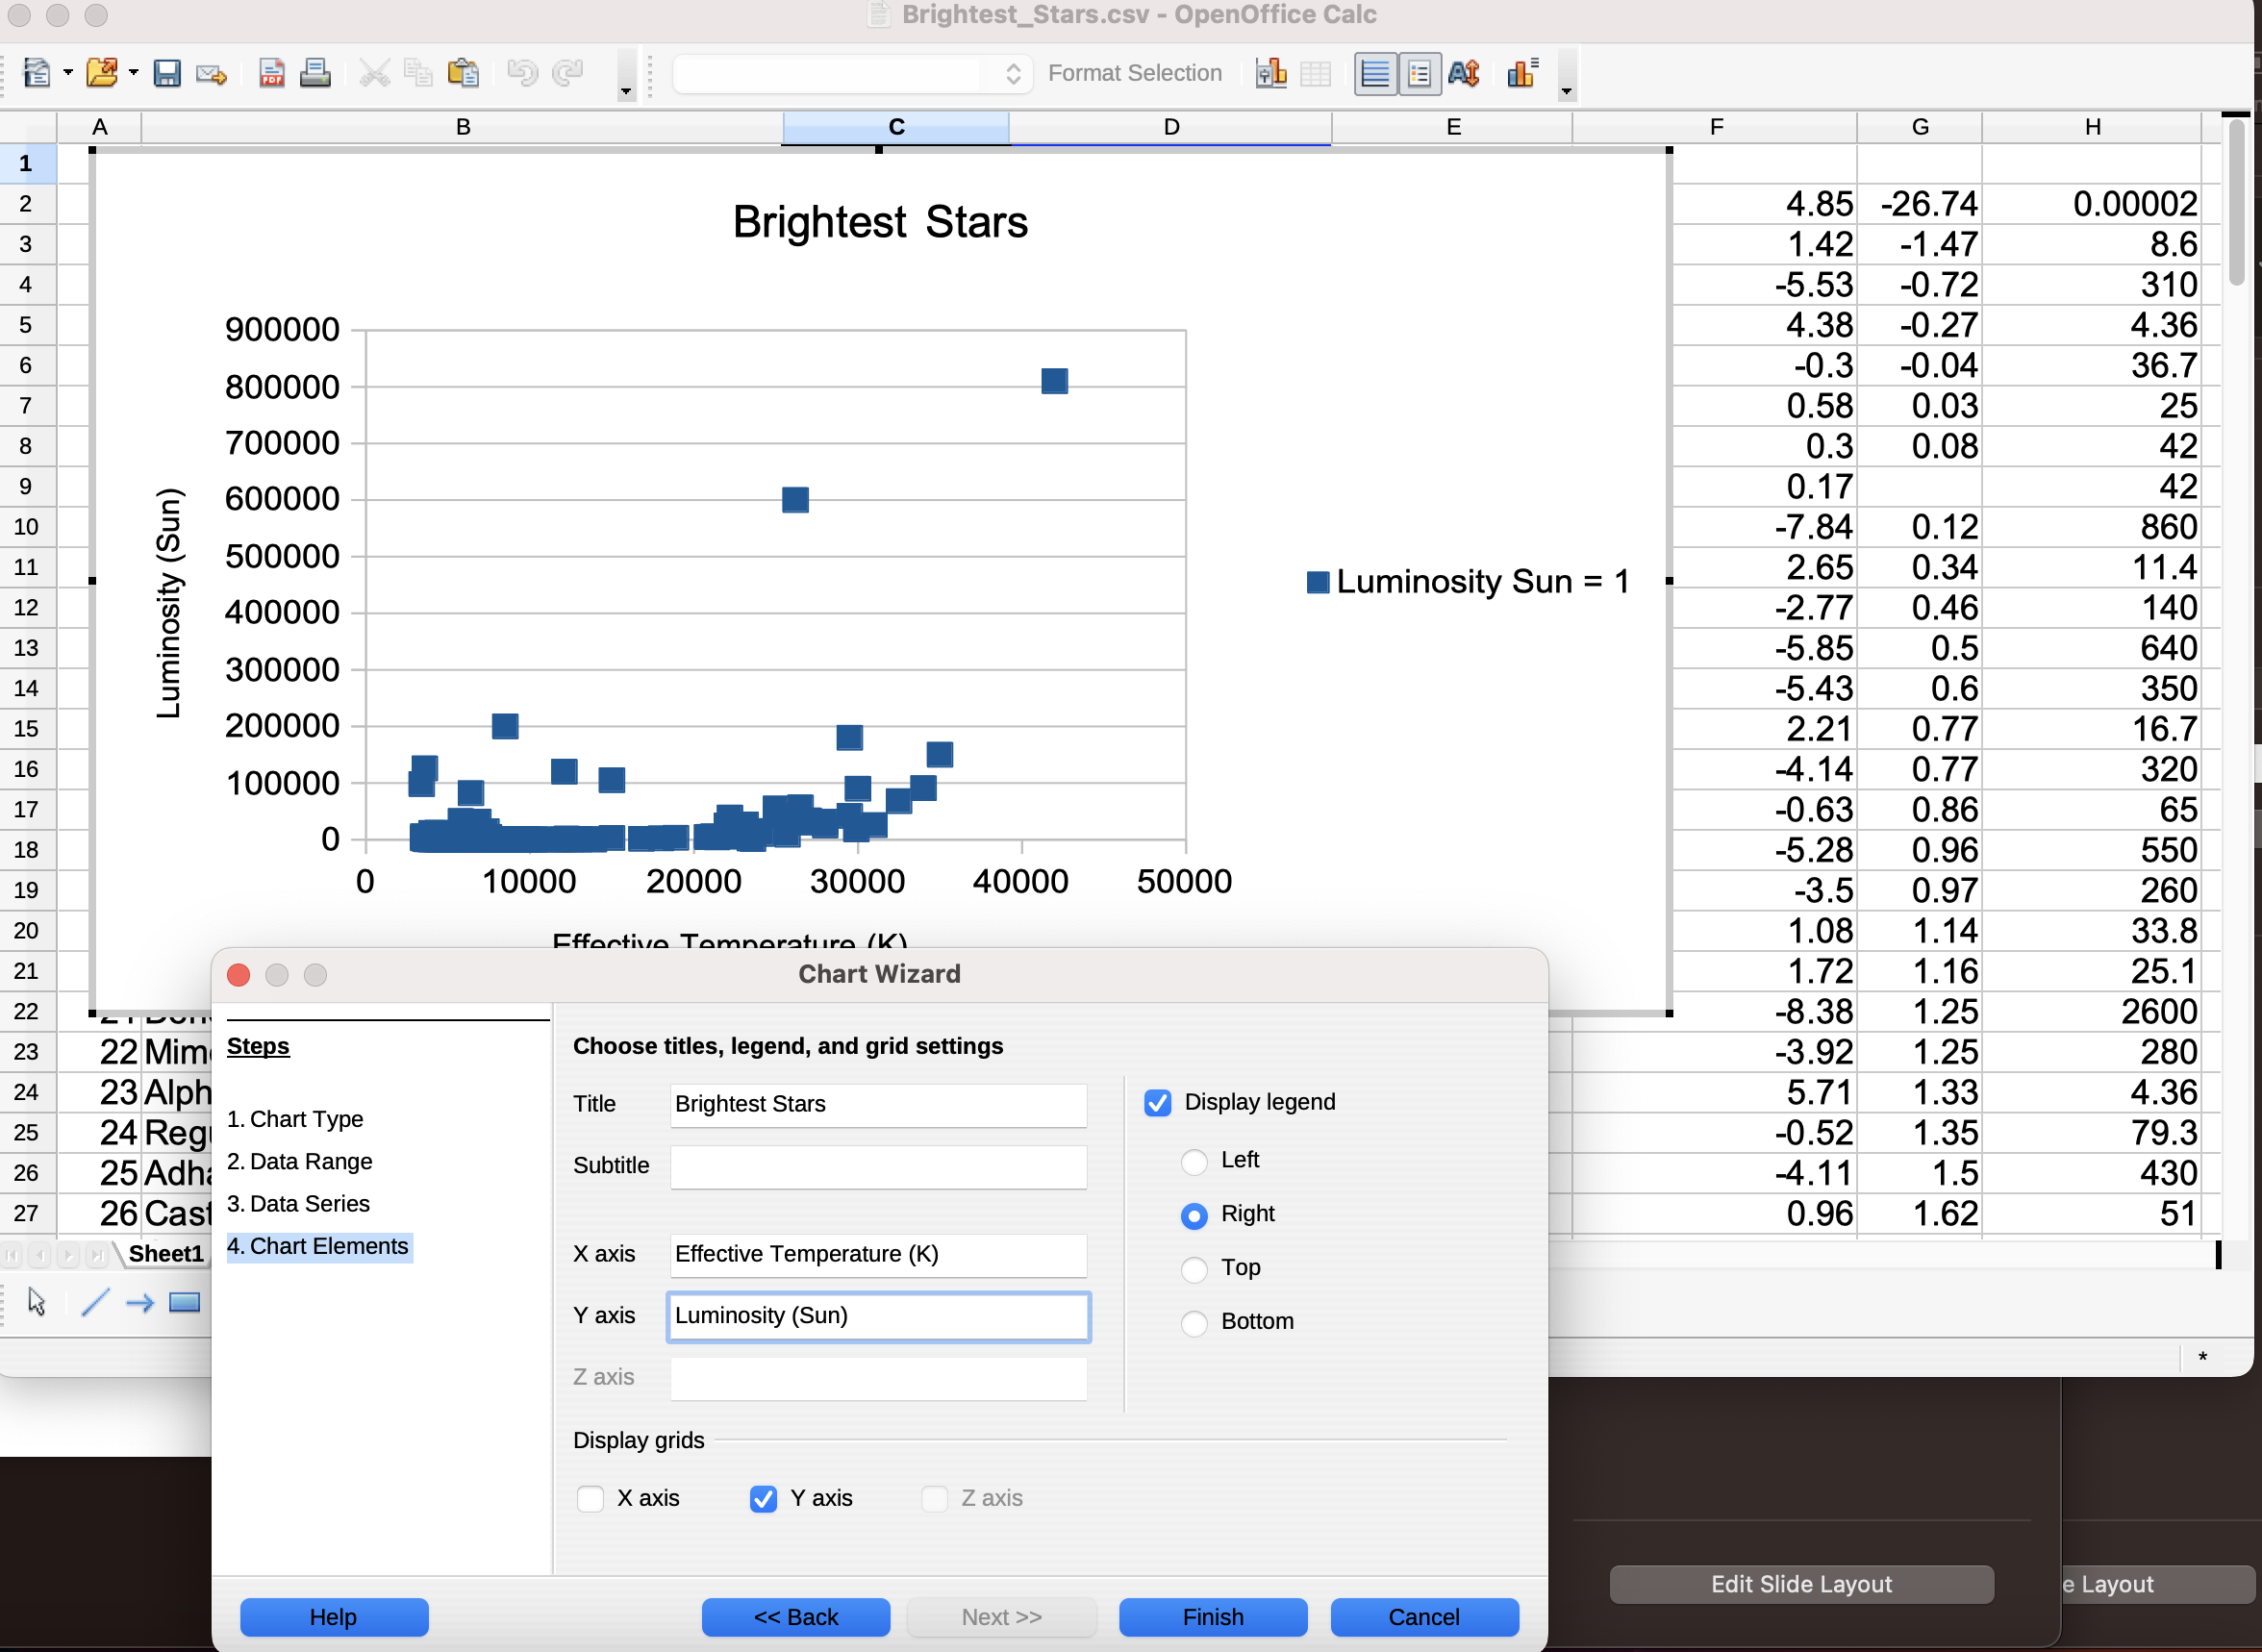
To add titles and label, click Chart Elements. Then add the title and axis labels.

Slide 11
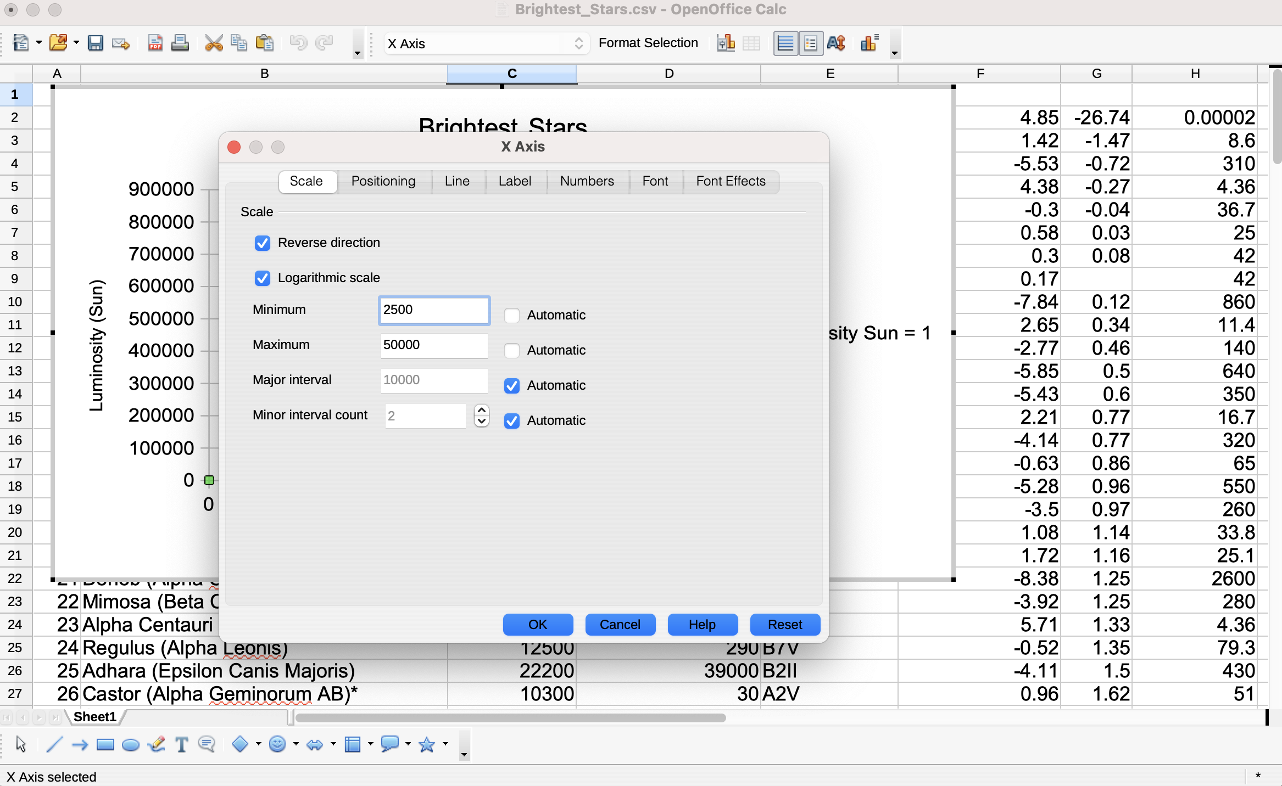
To modify the axis labels, tick marks, ranges, scales, and directions, double-click on the appropriate axis. For example on the x-axis, we bring up.

Slide 12
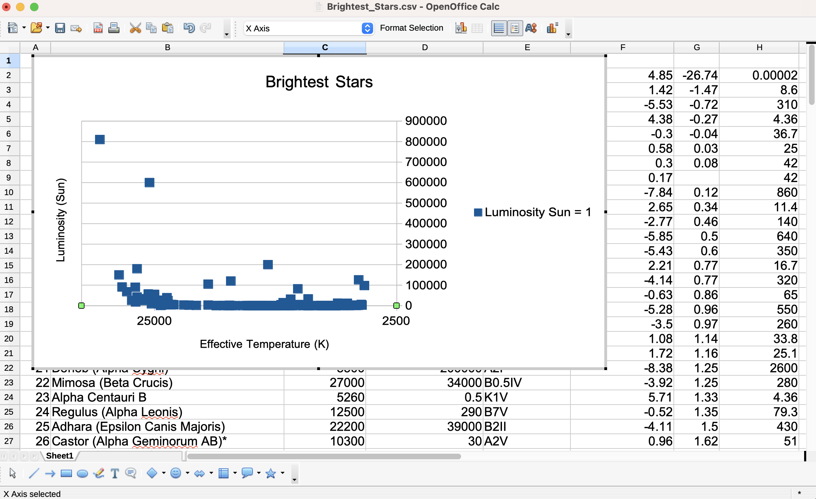
To modify the axis labels, tick marks, ranges, scales, and directions, double-click on the appropriate axis. For example on the x-axis, we change the appearance as shown to the right.

Slide 13
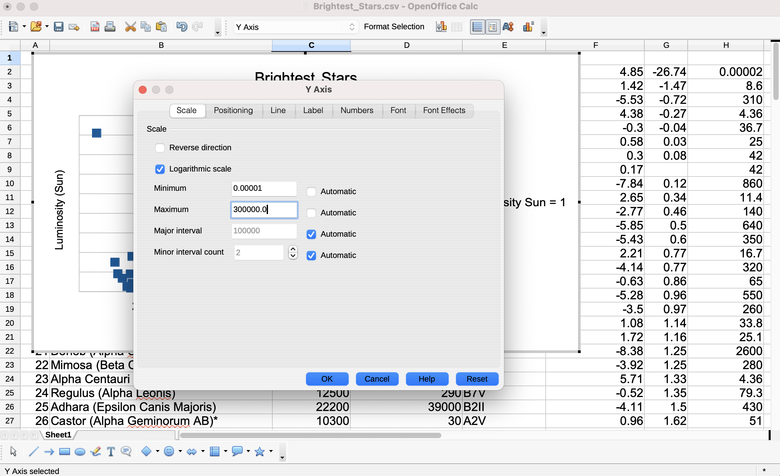
We modify the y-axis labels, tick marks, ranges, scales, and directions, similarly. Double-click on the y-axis. We change the appearance as shown to the right.

Slide 14
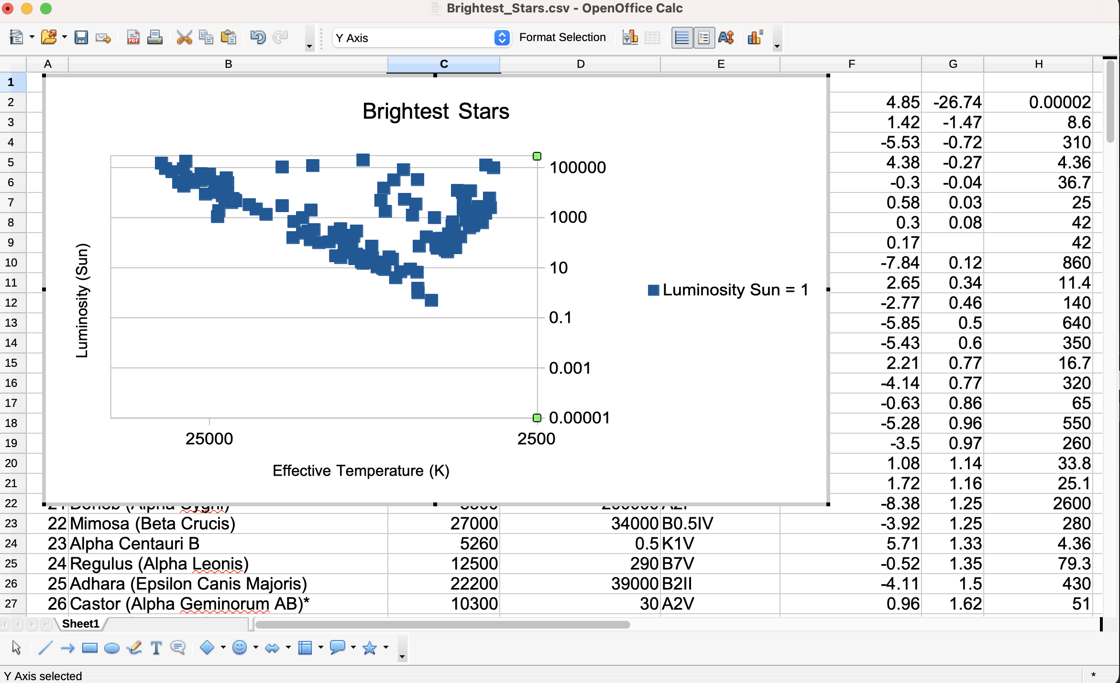

Slide 15
