Slide 1
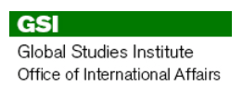
International Guest Apartment
Guest Apartment Overview
An affordable, temporary solution for 2-12 week stays
Spencer View Apartments (24th and Patterson)
3 bedrooms, 1 bath
Fully Furnished (including linens, towels, and kitchen utensils)
Includes utilities and weekly cleaning (no phone or cable)
Rates: $250 per week
Notes:
Intended for int’l guests who may have a harder time finding a short term rental from overseas. stays longer than a hotel but shorter than what could be leased at a regular apartment. Ideal for families.
1 bedroom with double bed
1 bedroom with 2 twin beds
1 very small bedroom with 1 twin bed

Slide 2
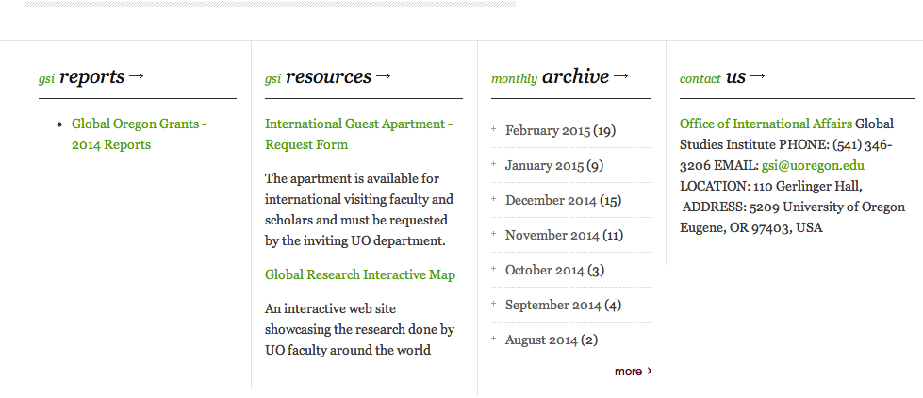
International Guest Apartment
Reservations
Request made by host department on GSI website: http://gsi.uoregon.edu

Slide 3
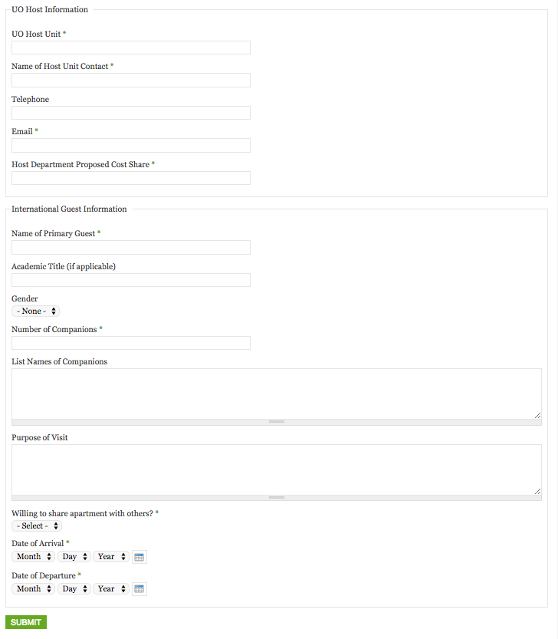

Slide 4
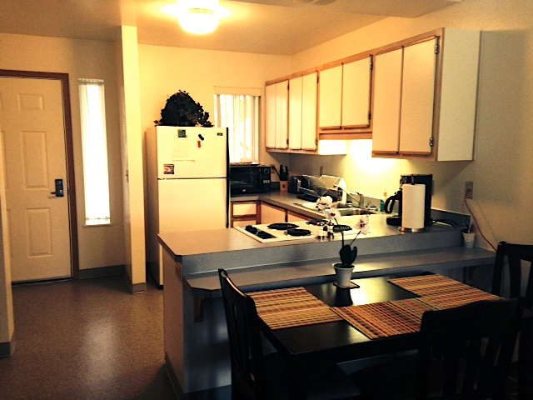
International Guest Apartment
Visitor must be here on business
(teaching, research, etc.)
Notes:
Due to high volume of requests, we cannot extend stays for personal time. In rare instances where the apartment is available for extended time, personal time usage may incur taxation reporting and withholding. It will be billed separately from the business portion of their stay.

Slide 5
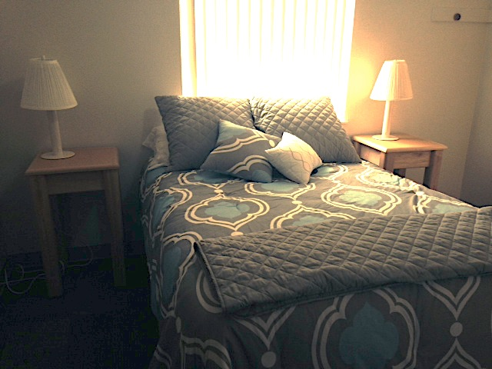
International Guest Apartment
Payment can be made through a JV or paid by check or cash by the visitor

Slide 6
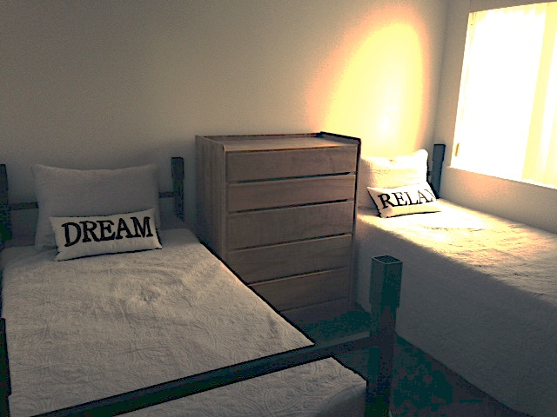
International Guest Apartment
Regardless of the manner of payment, rules for staying in the Guest Apartment follow UO travel policy and Accounts Payable rules
Notes:
For foreign nationals, this includes copies of passport, I-94, and W8 BEN (we take care of)

Slide 7
International Guest Apartment
GSI Responsibilities
Issue keys and provide an introduction to the apartment during business hours
Interface with Spencer View and Housing managers about apartment issues
Collect the necessary visa paperwork from the visitors
Collect apartment payments and/or JV charges to the departmental index
Notes:
Intended for int’l guests who may have a harder time finding a short term rental from overseas. stays longer than a hotel but shorter than what could be leased at a regular apartment. Ideal for families.

Slide 8
International Guest Apartment
Host Department Responsibilities
Help scholar get settled into Eugene and the UO
Inform GSI of any scheduling changes to the reservation
Pay any applicable taxes for renting the apartment for personal use
Notes:
Intended for int’l guests who may have a harder time finding a short term rental from overseas. stays longer than a hotel but shorter than what could be leased at a regular apartment. Ideal for families.

Slide 9
International Guest Apartment
Final Thoughts
The apartment book very quickly, so reserve early.
Due to high demand, we are in the process of securing 2 additional apartments, giving us a total of 3 guest apartments.
Even if the apartments are booked, we keep a waiting list in case any reservation gets cancelled.

