Slide 1
University of Oregon Travel Program

Slide 2
About Enterprise Holdings
$19.4 billion
90,000
1.7 million
in annual revenue
employees
vehicles
9,000
more than
75
fully staffed neighborhood and airport locations
countries and territories
Only U.S.
investment-grade
car rental company
One of America’s Largest Private Companies
according to Forbes

Slide 3
U.S. Fleet
Fleet larger than all U.S. competitors combined
Source: Auto Rental News – Fact Book 2015
*ARN estimate
Notes:
U.S. rental fleet only

Slide 4
Benefits of Emerald Club membership at National and Enterprise

Slide 5
Emerald Club Tiers
- Earned or Invited Membership
- 25+ rentals or 85+ days
- Executive Selection
- Guaranteed Upgrade
- Guaranteed Car with 24-hour notice
- Earned Membership
- 12-24 rentals or 40-84 days
- Executive Selection
- Guaranteed Upgrade
- 0-11 rentals or 0-39 days
- Emerald Aisle
Notes:
- Membership is complimentary and available to every traveler
- Travelers bypass the counter and choose their own car from the Emerald Aisle or Emerald Club Executive area
- Automatic upgrades, no blackout dates and guaranteed car for higher tier members
- Drop & Go℠ for express car return through the delivery of e-receipts
- Emerald Club members can earn rental credits at participating Enterprise Rent-A-Car® locations*
- Choice of rewards (we can waive Frequent Flyer if you’d like)
- Increased benefits and rewards at higher tier levels
- Status matching to ensure a smooth transition into our loyalty club
- Dedicated toll-free reservations
* ENTERPRISE SERVICE WILL BE PROVIDED

Slide 6
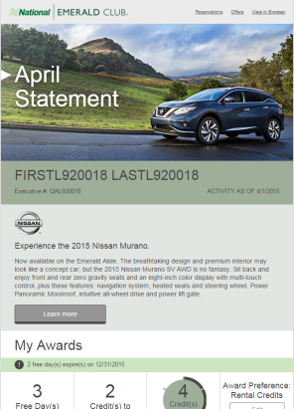
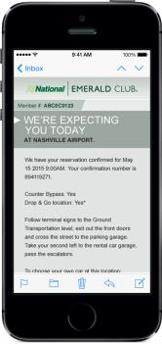
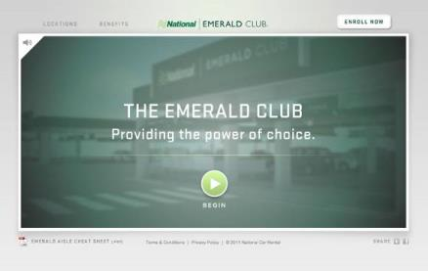
Emerald Club Member Communications
6
Communications Preference Center
Personalized e-statements
Arrival & Return Alerts
Drop & Go™ e-receipts
Emerald Aisle Microsite
Notes:
COMMUNICATIONS PREFERENCE CENTER
This feature allows members to take control of the information they would like to receive including program announcements, promotions, e-statements, etc.
PERSONALIZED E-STATEMENTS
These monthly email statements provide Emerald Club members important account information including reward balance, tier status, and upgrades.
ARRIVAL ALERTS
An email is sent to the member one hour prior to the anticipated arrival reminding them of their reservation number and provides wayfinding to the rental location.
RETURN ALERTS
EMERALD AISLE MICROSITE
This microsite is designed for the first time renter education and being used by new corporate accounts. This can be customized for your company with a special enrollment link embedded. It provides a virtual tour of the Emerald Aisle; can be customized

Slide 7
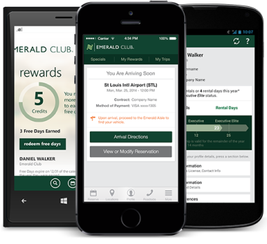
National Car Rental App
Single point of contact to manage rentals from reservation to return. Features allow you to:
Make, modify and cancel reservations
Track, extend itineraries
Manage profile
Map pickup and drop off locations
View Emerald Club membership card
Access roadside assistance and customer service
Take advantage of Virtual Aisle at select locations
Notes:
National continues to differentiate itself by carefully researching and integrating the important tools and on-the-go utility essential to today’s business travelers. Its primary goal is to focus on making business travelers more efficient when they’re on the road, offering speed, choice and control.

Slide 8
Emerald Club Benefits- Airport Travel at National Car Rental
U of O Management:
Midsize compliance
Free choice
Policy compliance
Hardcoded profile
Increase adoption %
Traveler control
Employee satisfaction
Traveler:
Vehicle choice
Counter bypass
Fast and efficient
Status matching
Free upgrades
Drop & GoSM
Emailed receipts
Arrival and return alerts
Recognized at more than 6,500 North American locations
Notes:
For more than 60 years, National has specialized in exceeding the needs of the business traveler with services and products designed to make each business trip more productive. By building a reputation as the car rental brand dedicated to speed and vehicle choice, we have become one of the largest rental car brands in the world.
At National, we’re doing our part to make things easier by changing the way business travelers rent cars – with the Emerald Club®. Membership gives travelers the services and perks designed to get them in, out and on their way faster than ever before.
DEDICATED TO SERVING BUSINESS TRAVELERS WHO:
- Want a fast, frictionless rental process.
- Appreciate being able to choose their own car.
Value customizing their rental preferences and rewards.
Helps enforce your company’s midsize car policy by only charging the midsize rate even if a traveler chooses a larger vehicle from the Emerald Aisle

Slide 9
Emerald Aisle at National: 3 Easy Steps
1.
Reserve and Pay for a Midsize Car
2.
Bypass the Counter
3.
Choose any Car
Notes:
Reserve a Midsize
Always reserve a midsize car to begin your Emerald Aisle experience
Bypass the Counter
Go straight to the Emerald Aisle; the keys are in the cars
Choose Any Car
Any size, color, make or model on the Emerald Aisle is yours at the reserved midsize rate

Slide 10
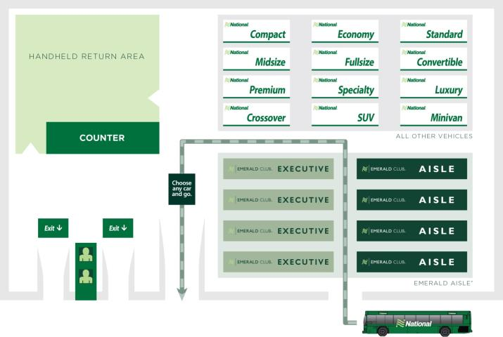
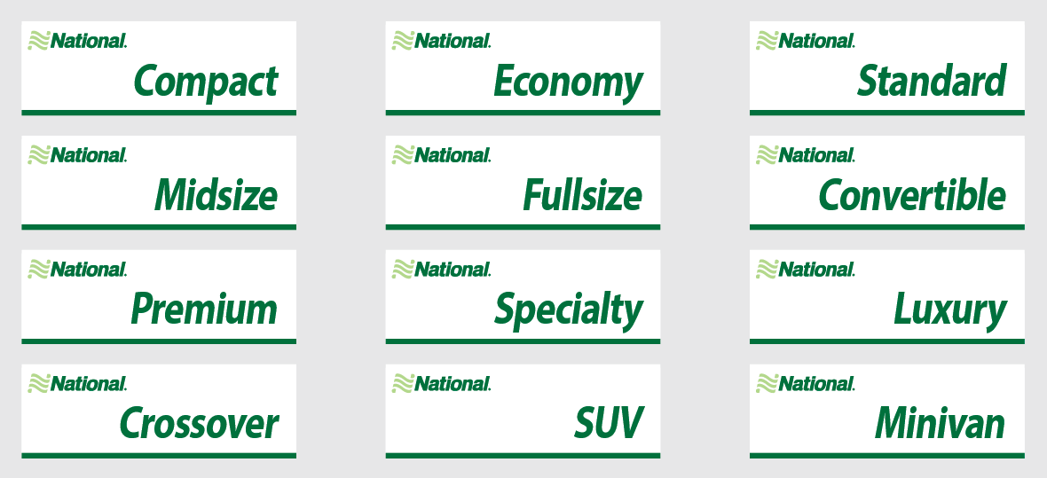
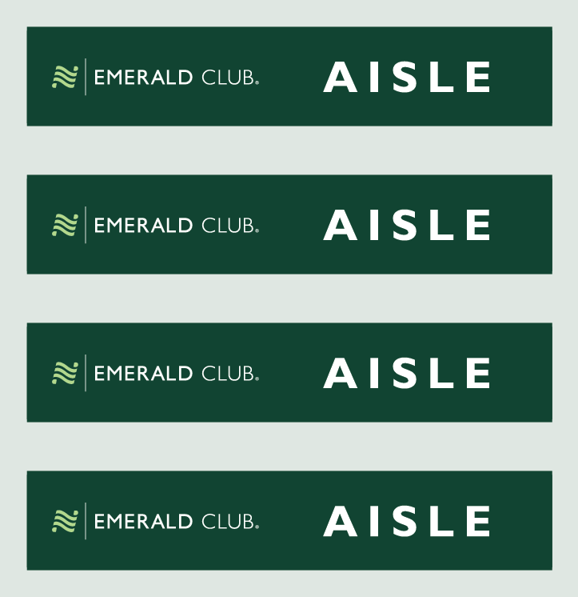
Emerald Club Lot Design
This is an example for illustration purposes; not all lots will look the same.

Slide 11
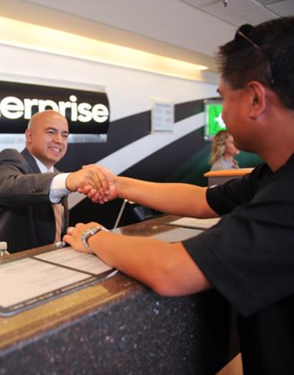
Benefits: Enterprise Rent-A-Car
Savings
State of Oregon contracted rates
No charge one-way rentals under 500 miles
Long-term rental discounts
Convenience
More than 5,500 fully staffed locations within 15 miles of 90% of the U.S. population
Free pick-up from the office or home
Speed
Traveler profile is loaded onto Emerald Club member number
11

Slide 12
Base Rental Rates 2014 (30 Days Or Less)
Class | Daily Rate | Weekly | 1 Month
Economy/Compact | 31.15 | 155.75 | 623.00
Intermediate/Standard | 33.04 | 165.20 | 660.80
Full-size | 35.62 | 178.10 | 712.40
Standard Hybrid | 47.14 | 235.70 | 942.80
Premium/Luxury | 59.01 | 295.05 | 1180.20
Mini Van | 53.47 | 267.35 | 1069.40
Medium SUV | 54.51 | 272.55 | 1090.20
Large SUV | 84.22 | 421.10 | 1684.40
Small Pick-Up | 48.66 | 243.30 | 973.20
Half Ton Pick-Up | 52.80 | 264.00 | 1056.00
Half Ton Cargo Van | 42.86 | 214.30 | 857.20
12 Passenger Van | 100.42 | 502.10 | 2008.40

Slide 13
Long Term Rental Rates 2014 (31+ Days)
Class | 31-90 Days | 91-160 Days | 161+ Days
Economy/Compact | 20.77 | 19.73 | 19.10
Intermediate/Standard | 21.95 | 21.54 | 20.71
Full-size | 23.75 | 22.67 | 22.15
Standard Hybrid | 31.42 | 29.86 | 28.91
Premium/Luxury | 38.82 | 37.26 | 36.23
Mini Van | 35.20 | 34.16 | 33.12
Medium SUV (5 Pass) | 35.20 | 34.16 | 33.13
Large SUV (7-8 Pass) | 55.17 | 52.41 | 50.76
Small Pick-Up | 32.09 | 30.54 | 29.51
Half Ton Pick-Up | 34.68 | 33.13 | 32.09
Half Ton Cargo Van | 27.95 | 26.66 | 25.88
12 Passenger Van | 65.66 | 62.36 | 60.39
➢Additional Information before you rent long term
To request a rental under the State of Oregon long term rates please e-mail Clinton.D.Fulcher@ehi.com .

Slide 14
Terms & Conditions
Young Renter: Minimum rental age is 18 for travelers renting vehicles for official business purposes. No additional charges will be assessed for youthful drivers.
** Minimum 21 years or older for vehicles with a total capacity of 10 or more people.
Mileage: All vehicle classes include unlimited free miles as long as the vehicle does not leave the U.S.
One-Way Rentals:
One-way rentals 500 miles or less incur no additional charges.
For one-ways 501 miles a $125.00 drop fee will be added to the rates.
One-ways are available online at National Car Rental.
For one-ways through Enterprise, please call the renting branch directly to determine availability.
Exclusions: Base Rental Rates do not include applicable taxes, surcharges, refueling, or delivery charges.

Slide 15
Driver Protection Products
Damage Waiver (DW): Full coverage with $0.00 deductible included in rates listed.
Liability: 1,000,000.00 CSL included in rates listed.

Slide 16
Geographic Surcharges
$6.06 | CALIFORNIA: Los Angeles Metro, San Diego Metro, San Francisco Metro, Oakland Metro, Sacramento Metro, Riverside Metro, San Bernardino Metro TEXAS: Midland Metro, Lubbock Metro, Austin Metro, College Station Metro, Houston Metro, Dallas/Ft Worth Metro, San Antonio Metro, Brownsville/Corpus Christi Metro
$7.07 | VERMONT: Burlington Metro, NEW YORK: Albany Metro
$10.10 | ALASKA: Fairbanks, Anchorage, Juneau
$15.15 | NEW YORK: Long Island Metro, Westchester Metro, Newark Metro
$23.23 | NEW YORK: New York City Metro

Slide 17
Enterprise Contacts
Clint Fulcher – Program Director
503-913-3188 or Clinton.D.Fulcher@ehi.com
Chris Carcich – New Account Setup & Support
503-612-8194 or Christopher.E.Carcich@ehi.com
Michelle Barnes – Account Support & General Inquiries
503-612-8136 or Michelle.K.Barnes@ehi.com

Slide 18
Q & A

