Slide 1
Business Travel and the Sharing Economy
Presented by:
Jerry Underwood
Vice-President, Account Management
Direct Travel

Slide 2
What we’re talking about…
Sharing economy: what is it?
Sharing economy: who is it?
Sharing economy by the numbers
Ratings and reviews
Pros and cons of sharing economy
Key considerations
Q&A

Slide 3
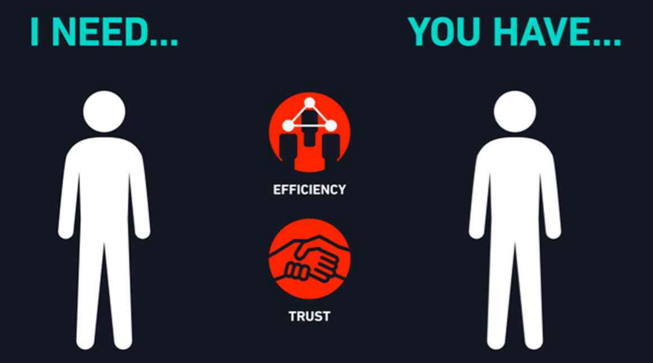
The SharingEconomy is a socio-economic ecosystem built around the sharing of human and physical resources, including the shared creation, production, distribution, trade and consumption of goods and services by different people and organizations.

Slide 4
Travel and the sharing economy

Slide 5
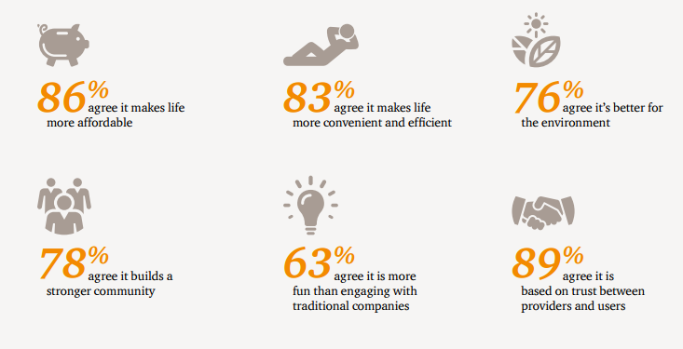
Sharing Economy By The Numbers
Airbnb | uber
Listings in nearly 200 countries | Operations in 63 countries
Nearly 30 million guests | Over 300 cities
10% of bookings coming from business travelers | 90% of passengers are picked-up within 10 minutes vs. 30-40% for traditional taxis
67% savings on New York City lodging vs. hotel | uberX option can be up to 40% cheaper than taxi
Source: pwc.com / 2015

Slide 6
Ratings and Reviews
Cornerstone of the sharing economy experience
Drives decisions of both buyers and sellers
Mutual incentive for high reviews/ratings
Creates online “reputation”
“Sharing” users more trusting of reviews than those posted to non-sharing sites
Ratings and reviews create trust amongst buyers and sellers

Slide 7
To share or not to share…
Pros | Cons
Convenience | Up-front payment
Cost | Stringent cancellation policies
Product availability | Trip disruption resources
“Bleisure” component | Lack of loyalty programs
Custom experience | Inconsistent product quality
Integrated itinerary | Fragmented itinerary

Slide 8
Key considerations
Safety and security
Are you a full-service or self-service traveler
Schedule flexibility
Experienced vs. non-experienced traveler
Travel policy
Payment and reimbursement
Technophile or technophobe
Liability of buyer and seller

Slide 9
Thank you / Q&A

