Slide 1
Looking Ahead: Proactive Travel Planning During COVID-19
Resources for Delegates & Travelers

Slide 2
Agenda
Look at what travelers need to know before they travel
Explore travel planning resources from:
Our four main US Carriers: American, United, Alaska, and Delta
Travel Management Companies (TMC’s)
TripIt Pro
Government Websites
Share a reminder about REAL ID
As a group, discuss ideas on how to prepare for the university’s future return to business travel
https://ba.uoregon.edu/travel/

Slide 3
What do travelers need to know before they go?
Can I travel to my business location? Are the borders open?
Will I need to obtain a visa to travel there?
Will I need to quarantine before I travel or after I arrive?
Will I be required to test for COVID-19 and show proof of a negative test to travel to my business location?
Will I be required to have a vaccination? How will I show documentation?
Are there other local rules I will need to follow at my business location (mask mandates, meetings outside, limited number of meeting attendees, restaurant closures, etc.)
Can I return to the US and will I need to test and/or quarantine when I arrive home?

Slide 4
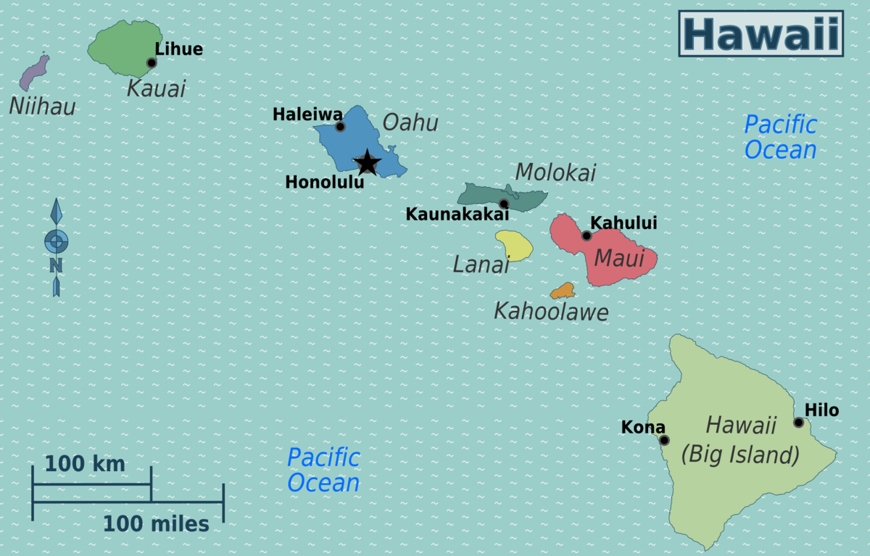
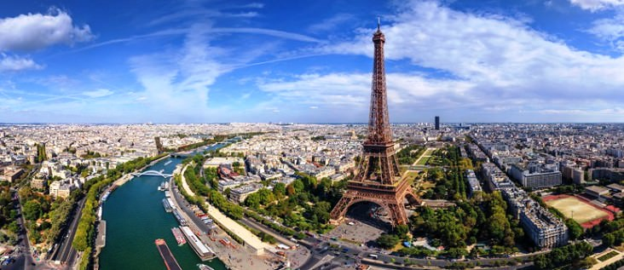
There is a lot of information out there, where do I begin?
International Travel
U.S. Department of State https://travel.state.gov/content/travel/en/traveladvisories/ea/covid-19-information.html
https://travel.state.gov/content/travel/en/traveladvisories/traveladvisories.html
Domestic Travel
CDC Travel Planner https://www.cdc.gov/coronavirus/2019-ncov/travelers/travel-planner/index.html

Slide 5
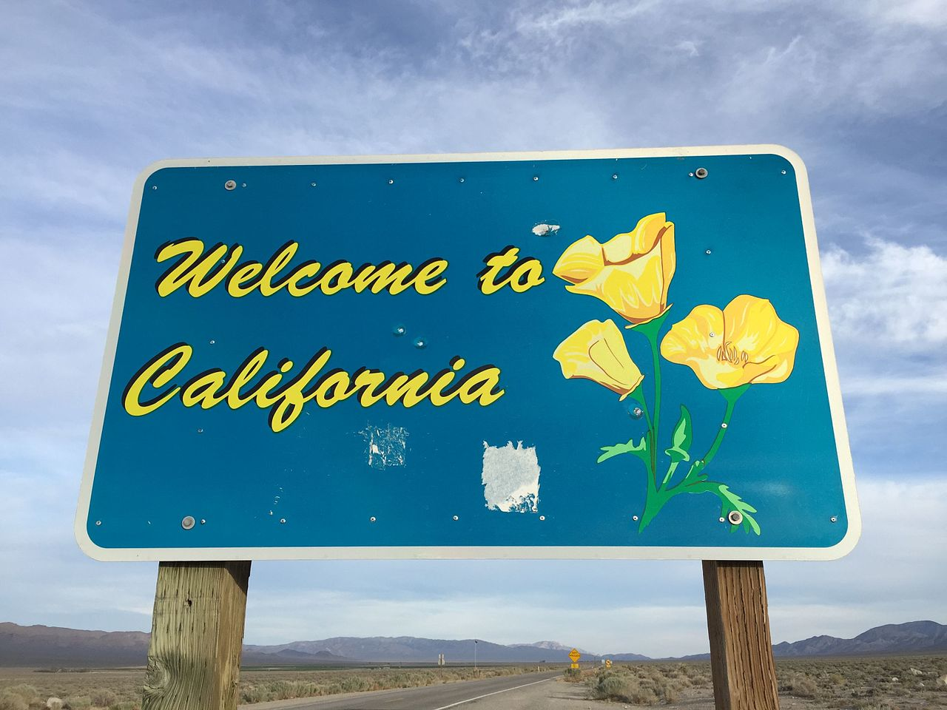
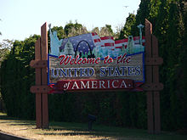
Delta Airlines
U.S. and World Maps https://www.delta.com/us/en/plan-your-next-trip/where-we-fly
Travel Updates https://www.delta.com/us/en/travel-update-center/flying-what-you-need-to-know/us-entry-requirements
Testing Locations https://www.delta.com/us/en/travel-update-center/flying-what-you-need-to-know/coronavirus-testing-locations
This Photo by Unknown Author is licensed under CC BY-SA

Slide 6
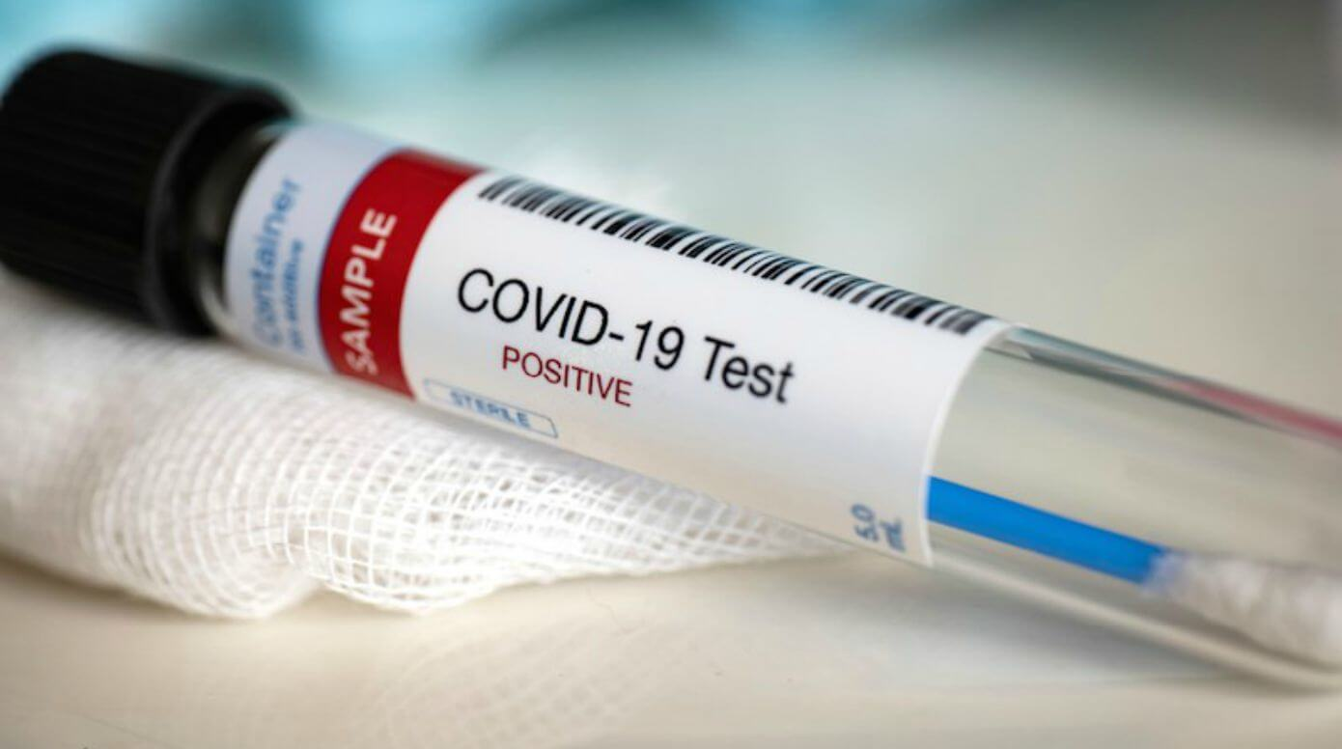
Alaska Airlines
Home page for quick access to mask information and special travel instructions https://www.alaskaair.com/
Testing requirements by region https://www.alaskaair.com/content/next-level-care/covid-testing?int=AS_HomePage_BR1_L2||2021_CV_AW||-prodID:Awareness&lid=HomePage_BR1_testing
Chicago https://www.chicago.gov/city/en/sites/covid-19/home/emergency-travel-order.html

Slide 7
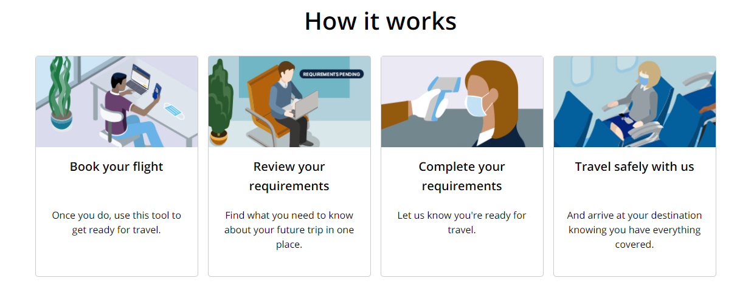
United
Travel within the United States and International Travel https://www.united.com/ual/en/us/fly/travel/restrictions-map.html
Travel Updates https://www.united.com/ual/en/us/fly/travel/notices.html#ustravelers
Travel-Ready Center https://www.united.com/en/us/travelreadycenter

Slide 8
American Airlines
Information https://www.aa.com/i18n/travel-info/coronavirus-updates.jsp
Do I need a visa? https://apply.joinsherpa.com/explore/USA?affiliateId=americanairlines
Travel Restrictions? https://apply.joinsherpa.com/explore/USA
Verifly https://go.daon.com/american

Slide 9
Traveler Page https://www.dt.com/traveler-information/
https://pages.uoregon.edu/baoforms/bao_drupal_6/sites/ba.uoregon.edu/files/travel/tripit.pdf
https://www.tripit.com/web/blog/news-culture/covid19-guidance-travel-plans.html?us=tripithouse&um=banner&un=ISC_COVIDGuidance_300x250&uc=FreePro&ut=May_10
REAL ID and TSA Pre-check
https://www.tsa.gov/real-id
https://www.tsa.gov/coronavirus
https://www.oregon.gov/odot/Forms/DMV/7476.pdf
Traveler must have REAL ID by Oct. 1, 2021

Slide 10
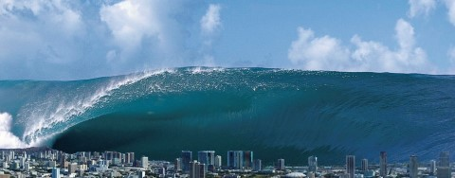
Planning for the future
We do not have a date for a return to travel, BUT when UO opens travel we expect a tidal wave!

Slide 11
Preparing for the tidal wave group discussion
Have travel delegate roles transferred to new personnel? Are you new to travel delegation?
How will your department prepare? How will you prepare or assist travelers?
Will you change your style of service to travelers (concierge, traveler self serve, hybrid)?
Do your travelers know how to get support from your department delegates and/or the Travel Office?
Do you have new employees that have not yet traveled for the UO?
Will your department travel less than before, will it be the same, or do you expect an increase in travel?
Do you plan to hold department trainings for your team of delegates and/or travelers?
What information will be helpful to travelers? How do they want to receive this information?
Check off lists
Step by step manuals
Short training videos
Zoom group presentation
In person training

Slide 12
Thank you for attending!

