Slide 1
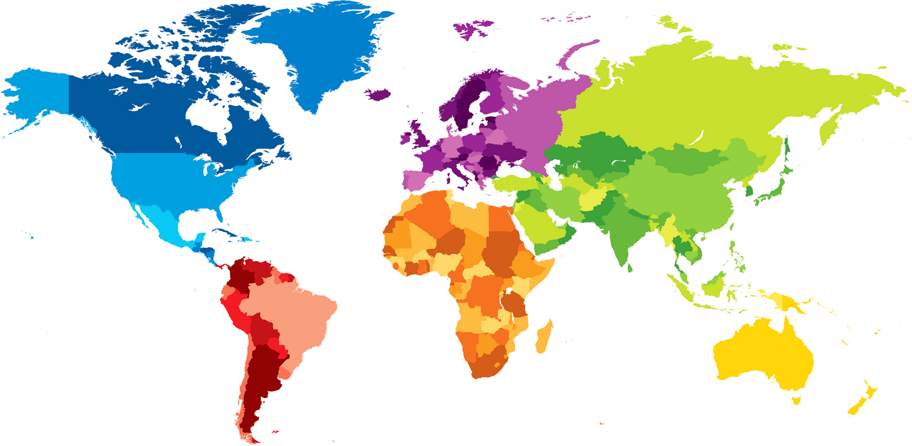
The World Awaits!
A Discussion On UO International Business Travel

Slide 2
Getting off the ground:
Profile settings: Visa and passport renewal reminders
CIBT Visa https://ba.uoregon.edu/travel/travel-resources
UO Contracted Travel Agents are a great resource!
Can provide Fly America Act compliant airfare
Will assist with comparison quotes when including personal time
Will pair best price with best itinerary, anticipate airline agreements and airfare schedule for smooth travel
Knowledgeable on visa requirements and current pandemic rules affecting travel
Example-traveling to Papua New Guinea during the pandemic

Slide 3
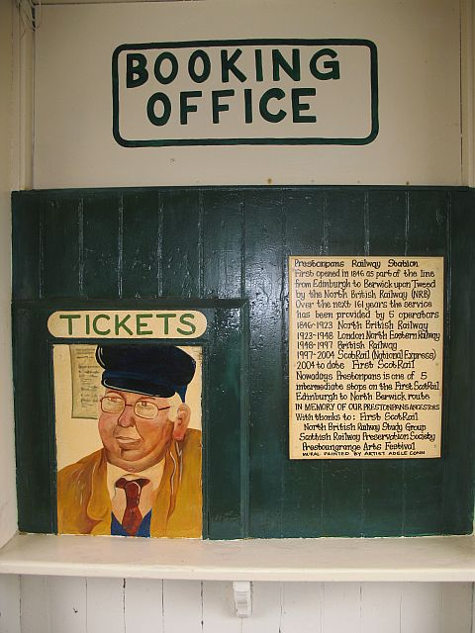
Booking For International Travel
Travel Policy and Economy Plus/Business Class
https://ba.uoregon.edu/travel/air-car-lodging-meals/air-travel
Federal Grants and Travel-Fly America Act
https://research.uoregon.edu/manage/awards/guidance-requirement/fly-america-act
https://research.uoregon.edu/sites/research1.uoregon.edu/files/2019-12/form_15_fly_america_0.pdf
Adding personal time and when to get a quote
https://ba.uoregon.edu/travel/air-car-lodging-meals/air-travel
This Photo by Unknown Author is licensed under CC BY-SA

Slide 4
Smart Trip Planning
Know your destination, review options,and consider whole cost
Example: Rome vs Milan
Cost comparison train/rental car and direct flight
Anticipate expenses, have a plan for how you will pay, and have a back up plan
One Card
Have a challenging situation? Contact the travel office so we can brainstorm together
Avoid non-refundable pre-pay options
Avoid third party sellers (Expedia, Priceline, etc.)

Slide 5
Insurance While Traveling Abroad
International Travel Registration and Insurance
Registered through Concur Request
https://safety.uoregon.edu/international-travel-registration-and-insurance-cards
Coverage includes accident and sickness, security evacuations, emergency medical evacuations, and travel assistance
Insurance for Car Rentals Abroad
https://safety.uoregon.edu/vehicle-use
https://ba.uoregon.edu/travel/air-car-lodging-meals/vehicles#envelope-5347
Some international vehicle rentals have mandatory insurance requirements. Documentation of mandatory insurance is required for reimbursement. Remember that additional insurances are not reimbursable
Enterprise Contract does not include CDW/LDW on international car rentals

Slide 6
Travel Policy Nuts and Bolts (shikumi, tuercos y tornillos, karanga na bolts, muttern und schrauben, dadi e bulloni, alsawamil walmasamir, et nucis fulminandum, ecrous et boulons)
Travel and research logs https://ba.uoregon.edu/travel/air-car-lodging-meals/general-travel-information
UO Meal, incidental, and lodging per diem rates for international travel follow the US Department of State
Lodging per diem rate includes the combined rate and taxes
International lodging single vs. double occupancy
For international travel, laundry expenses and certain gratuities are covered as part of the incidental per diem and may not be claimed separately
https://ba.uoregon.edu/travel/air-car-lodging-meals/lodging-meals-and-other#envelope-2428
Vaccination and testing, claim through insurance first, provide Explanation of Benefits as documentation, present any remaining expenses through Concur on an expense report
https://ba.uoregon.edu/travel/air-car-lodging-meals/general-travel-information#envelope-2436 Miscellaneous Expenses

Slide 7
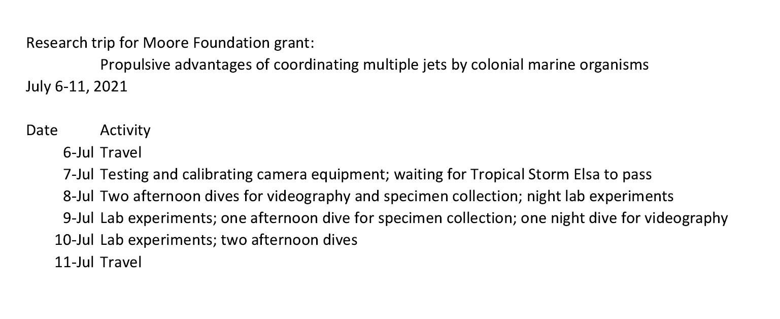

Slide 8
More Policy Nuts and Bolts
Receipts in a foreign language and currency: Please have your traveler provide the detail of the receipt in English including date of expense, vendor, what was purchased.
Use currency converter in Concur or you can show credit card statement
Form for foreign service providers

Slide 9
International Travel During Covid
International Business Travel Process-CDC Level 4
The university will not approve travel to a country listed in Level 4 High Risk without an exception granted by the Office of the Provost. Requests for travel to a Level 4 High Risk Country will be reviewed for consideration within 60 days of departure.
International Travel Exception Request (form)
A destination analysis and risk assessment is performed, please allow for up to 7 days to complete
Travelers must send a Travel Exception Request to the Travel Advisory Group if their destination’s level increases after approval
https://www.cdc.gov/coronavirus/2019-ncov/travelers/map-and-travel-notices.html
Know testing and vaccination requirements and documentation requirements
Be aware of quarantine regulations
Know your resources (hospitals, clinics, and testing sites) if you get sick while traveling
What to do if you have to cancel-
Contact the travel agent first to cancel airfare and learn the rules for using the credit
Reach out to Travelsafe@uoregon.edu to let them know your trip has been cancelled
Contact vendors directly to make sure your car and hotel reservations are cancelled
Launch an expense report from request for any existing expenses (airfare, agency fees, conference registrations paid with the One Card)

Slide 10
Q & A
What questions do you have?
Did you learn something new today?
What information will you use from today’s presentation?
Do you have any stories or international travel situations to share?

