Slide 1
Nat turner: Uprising and Aftermath
History 350
April 28, 2015

Slide 2
Reminders and Announcements
Navigating around History 350
  Syllabus is the first item in Blackboard Documents
  Links to PowerPoints will be posted on the syllabus before each class. Scroll down to the date of the class and click on the date. The syllabus will also lead you to some readings, assignment information, etc.
  The second Discussion Forum (on Nat Turner’s revolt) is now online. Deadline is May 12. Deadline for your post to the first forum (on Paine) is midnight tonight.
  There will be four forums during the term. You need to respond to three of them.
  Instructions and options for the short paper due May 26 are in the Assignments section of Blackboard. I recommend that you look them over fairly soon.

Slide 3
Announcements: Nat Turner: A Troublesome Property
Nat Turner: A Troublesome Property is a “docudrama” about the most famous U.S. slave rebellion leader. I’ll show it in class thisThursday, April 30. I’ve put a copy of the DVD on reserve: If you miss that class, I strongly recommend that you watch it in the Knight Library AV room, on the third floor. It’s about sixty minutes long.
In the remaining class time on April 30 (and maybe for a few minutes more), I’ll hold a brief midterm exam review session. Attendance at the review is optional.

Slide 4
Announcements: Midterm Exam
May 5
I’ve posted the instructions and possible essay questions for the midterm exam at http://pages.uoregon.edu/dapope/350midtermessays.htm.

Slide 5
Some Websites of Interest: Slave Revolts
“The Abolition Project” section on slave resistance
Archeology of the Quilombo dos Palmares, African-Brazilian rebel community
Creativity and Resistance—Smithsonian Institution exhibit on Maroon (escaped slave) colonies in the Americas
Website for Nat Turner: A Troublesome Property (film we’ll see on May 1)
Brief description and documents on Gabriel Prosser’s conspiracy, Richmond, 1800
Religion and Denmark Vesey’s rebellion, Charleston, SC, 1822
A recent online article on “The Five Greatest Slave Rebellions in U.S. History”.
Frederick Douglass’s great 1852 speech: “What, to the Slave, is the Fourth of July?”

Slide 6
The Setting: David Walker’s Appeal
Link to Walker’s appeal
Walker, born in North Carolina, was a free African American living in Boston
His Appeal to the Colored Citizens of the World, published 1829
"America is as much our country, as it is yours.--Treat us like men, and there is no danger but we will all live in peace and happiness."
“I ask you, had you not rather be killed than to be a slave to a tyrant, who takes the life of your mother, wife, and dear little children? Look upon your mother, wife and children, and answer God Almighty; and believe this, that it is no more harm for you to kill a man, who is trying to kill you, than it is for you to take a drink of water when thirsty; in fact, the man who will stand still and let another murder him, is worse than an infidel….”

Slide 7
The Setting: Abolitionism and “Immediate Emancipation”
Shift from optimism that slavery would fade away to belief that slavery was a sinful institution that American whites needed to reject immediately.
William Lloyd Garrison begins publication of The Liberator January 1831: “I will be as harsh as truth, and uncompromising as justice... I am in earnest, I will not equivocate, I will not excuse, I will not retreat a single inch, and I will be heard.”
Rejection of schemes for colonization of former slaves outside the United States
Nonviolence—emancipation by “moral suasion”

Slide 8
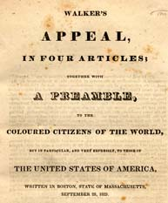
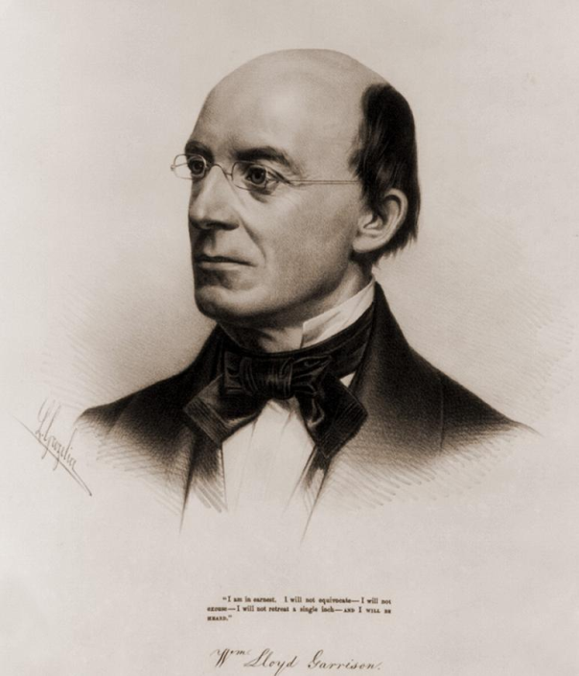
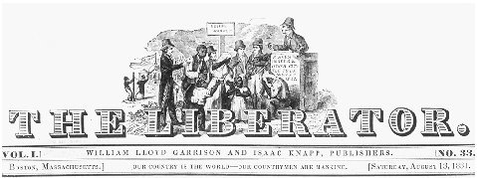
David Walker’s Appeal/William Lloyd Garrison and The Liberator

Slide 9
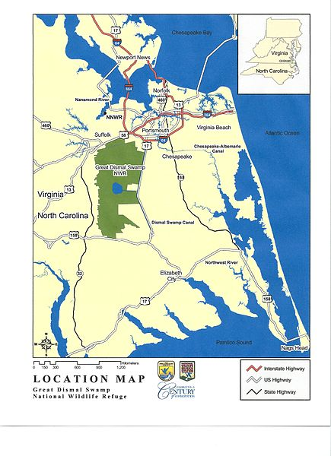
The Setting: Southampton County, Virginia 1831
Great Dismal Swamp
Population
Slavery in Virginia
  Local conditions
Free Black community

Slide 10
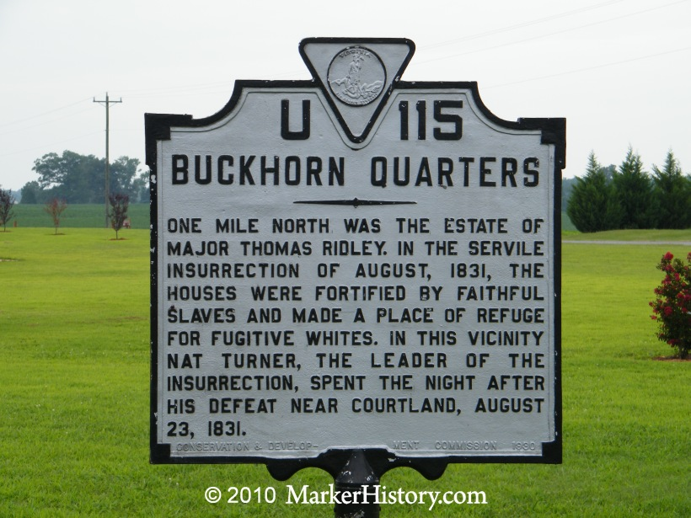
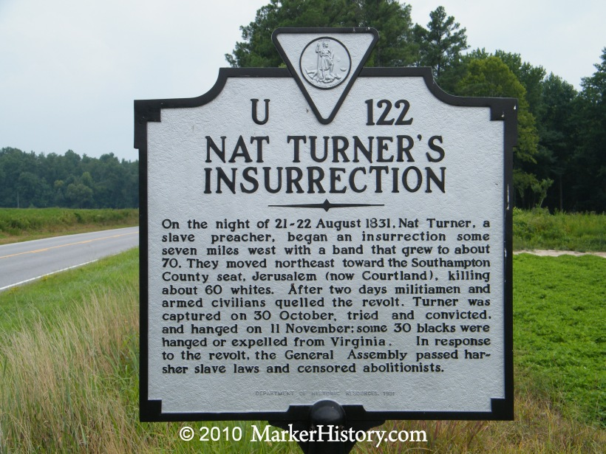
Roadside Turner

Slide 11
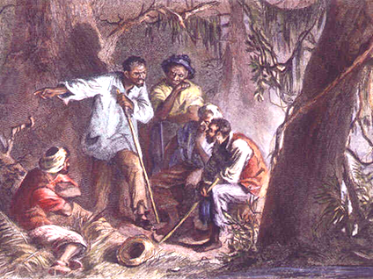
Making Nat Turner
Childhood and before
Preparing for greatness? “Having soon discovered [myself] to be great, I must appear so, and therefore studiously avoided mixing in society, and wrapped myself in mystery, devoting myself to fasting and prayer.”
Turner as preacher
Image of Turner preaching

Slide 12
Turner’s Goals
Vengeance?
Escape?
Overthrow?
“The Spirit instantly appeared to me and said the Serpent was loosened…and that I should take [Christ’s yoke] on and fight against the serpent, for the time was fast approaching when the first should be last and the last should be first.”

Slide 13
The Revolt
Preparation and recruitment
Timing
Strategy and Tactics
  A famous historian has written: “…Revolutionaries …must conclude that they will have no prospects until the cost of collaboration rises to the level of the cost of rebellion…. And it serves no purpose to pretend that ‘innocent’—personally inoffensive and politically neutral—people should be spared. The oppressor needs nothing so much as political neutrality to do business as usual…. He who wills liberation in a context that does not permit peaceful change wills revolutionary terror. No slave revolt that hesitated to invoke terror had a chance.”
  Another famous historian (who’s on the political left) wrote that Turner was “quite possibly mad.”

Slide 14
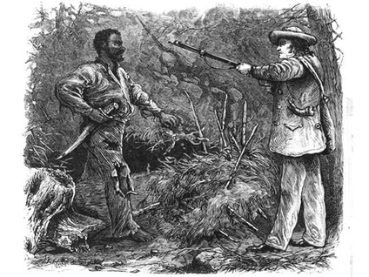
Turner’s Revolt Defeated
Capture, trial and execution
  At right: sketch of Turner’s capture
Repressive violence
Thomas Gray’s “The Confessions of Nat Turner”

Slide 15
The Aftermath: Emancipation or Repression?
Virginia Debates Slavery
  Governor Floyd: : "Before I leave this government, I will have contrived to have a law passed gradually abolishing slavery in this state, or at all events to begin the work by prohibiting slavery west of the blue ridge Mountains.“
  In the end, slave codes were strengthened; prohibitions on schools, religious gatherings and preaching.
  Thomas Dew and the Positive Good Defense of Slavery: “No insurrection of this kind can occur where the blacks are as much civilized as they are in the United States….[T]he negro of the United States has imbibed the principles, the sentiments, and feelings of the white; in one word, he is civilized—at least comparatively.”

Slide 16
Alabama Slave Code: 1833
Here are some parts of Alabama’s “slave code”, laws enacted two years after the Turner revolt:
  S31. Any person who shall attempt to teach any free person of color, or slave, to spell, read or write, shall, upon conviction thereof by indictment, be fined in a sum not less than two hundred fifty dollars, nor more than five hundred dollars.
  S10. If any white person, free negro, or mulatto, shall at any time be found in company with slaves, at any unlawful meeting, such person being thereof convicted before any justice of the peace, shall forfeit and pay twenty dollars for any such offence, to the informer, recoverable with costs before such justice.
  S37. It shall not be lawful for more than five male slaves, either with or without passes, to assemble together at any place off the proper plantation to which they belong; and if any slaves do so assemble together, the same shall be deemed an unlawful assembly.

Slide 17
Alabama Slave Code (continued)
  S42. If any slave or free person of color shall preach to, exhort, or harangue any slave or slaves, or free persons of color, unless in the presence of five respectable slave-holders, any such slave or free person of color so offending, shall, on conviction before any justice of the peace, receive, by order of said justice of the peace, thirty-nine lashes for the first offence, and fifty lashes for every offence thereafter; and any person may arrest any such slave or free person of color, and take him before a justice of the peace for trial:
S4. No slave shall be admitted a witness against any person, in any matter, cause, or thing whatsoever, civil or criminal, except in criminal cases, in which the evidence of one slave shall be admitted for or against the evidence of another slave.

Slide 18
The Aftermath: Anti-Slavery Responses
William Lloyd Garrison: “We are horror-struck at the late tidings….” [but]:
  “I do not justify the slaves in their rebellion; yet I do not condemn them and applaud similar conduct in white men. I deny the right of any people to fight for their liberty….Of all men living, however, our slaves have the best reason to assert their rights by violent means.”
An African American newspaper in Albany, NY: “Their struggle for freedom is the same in principle as the struggle of our fathers in ‘76. I hope they may achieve their liberty eventually by fair and honorable means, in a brave and manly conflict with their masters.”

Slide 19
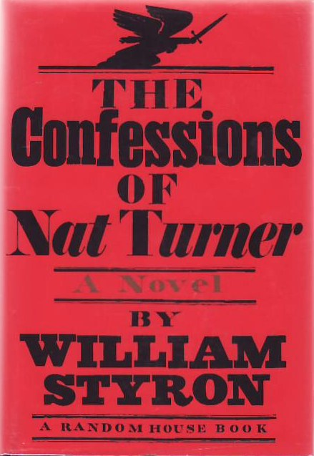
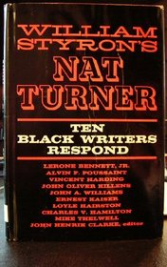
Nat Turner in Memory and Imagination
Turner as inspiration: African American journalist T. Thomas Fortune writes in 1889: “Nat Turner was a black hero. He preferred death to slavery. He ought to have a monument.”
William Styron and The Confessions of Nat Turner (published 1967)

Slide 20
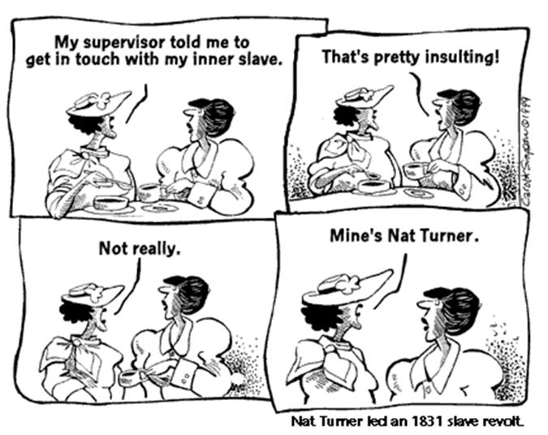

Slide 21
Garrison, Pacifism and Anti-Slavery
Garrison: “This nation is destined to perish because in wading through blood and carnage to independence, it at the outset discarded the Prince of Peace, and elected George Washington to be its Savior….It is a fruitless attempt at self-government, totally distinct from the government of God in Jesus Christ….”
Moral suasion, anti-slavery and anti-racism

Slide 22
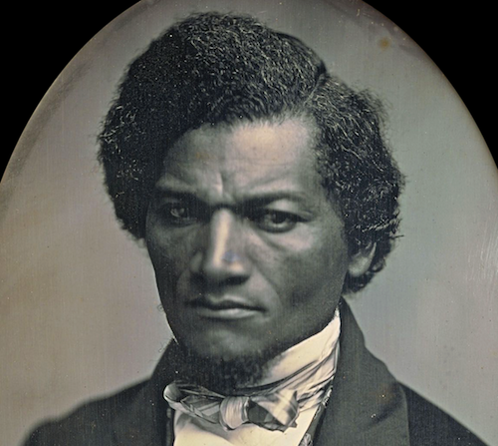
Anti-Slavery: Frederick Douglass, Violence and Resistance to Slavery
“Slaveholders have no rights more than any other thief or pirate. They have forfeited even the right to live, and if the slave should put every one of them to the sword tomorrow, who dare pronounce the penalty disproportionate to the crime?”

Slide 23
Anti-Slavery: Frederick Douglass on Violence as a Failing Strategy
1847 “The slave is in the minority, a small minority, the oppressors are an overwhelming majority….The one is weak; the other is strong….With the facts of our condition before us, it is impossible for us to contemplate any appeal to the slave to take vengeance on his guilty master, but with the utmost reprobation. Your committee regard any counsel of this sort as the perfection of folly, suicidal in the extreme, and abominably wicked.”

Slide 24
The “Slave Power” and the Extension of Slavery’s Reach
In the forty years before the Civil War, conflict over the expansion of slavery in the West threatened national unity. Before 1861, political compromises patched up the controversies.
Fearing they were under antislavery attack, Southern slaveholders became more aggressive in seeking protections for slavery and opportunities to expand.
This in turn ignited Northern fears that the entire nation would come under the domination of slaveholders—the “Slave Power.” This led in 1854 to the formation of the Republican Party, committed to slowing or stopping the spread of slavery.
In 1850, a Congressional compromise led to a strengthened Fugitive Slave Act, making it easier for slaveholders to capture escaped slaves and return them to bondage.

Slide 25
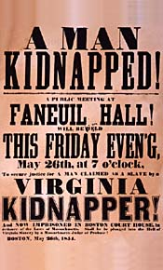
Resisting the Recapture of Fugitives: Anthony Burns, Boston 1854
Anthony Burns had escaped from Virginia to Boston in 1854. When he was recaptured, a large crowd attempted to rescue him but failed. Reportedly, 50,000 Bostonians watched him returned to slavery.

Slide 26
Douglass: “The True Remedy for the Fugitive Slave Bill”
Following the Anthony Burns recapture, 1854:
  “A good revolver, a steady hand, and a determination to shoot down any man attempting to kidnap. Let every colored man make up his mind to this and live by it, and if needs be, die by it. This will put an end to kidnapping and to slaveholding, too.”
  “Oh! That we had a little more of the manly indifference to death which characterized the Heroes of the American Revolution.”

Slide 27
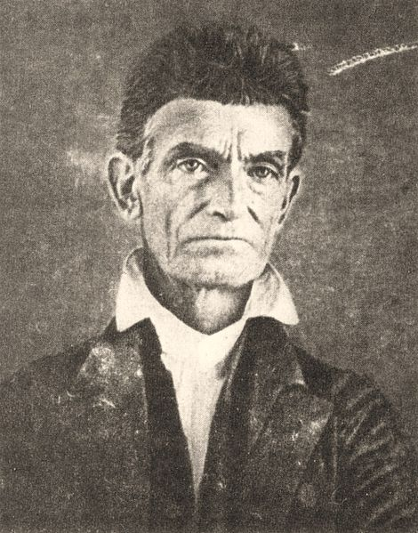
John Brown and the Harper’s Ferry Raid 1859
John Brown’s longstanding hatred of slavery grew into a conviction that it was his duty to attempt to launch and lead a slave revolution.
Despite his personal eccentricities, he convinced some leading opponents of slavery to support him, though he didn’t reveal his plan’s specifics to them.
Frederick Douglass was one of the “Secret Six” who backed Brown.

Slide 28
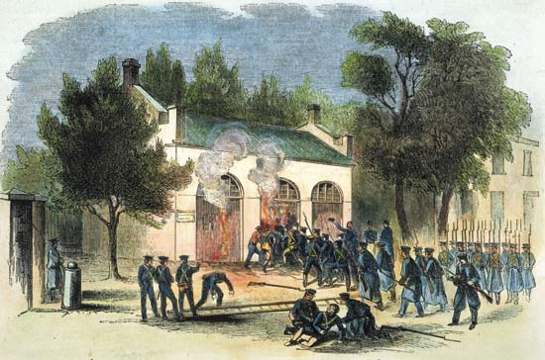
John Brown and the Harper’s Ferry Raid 1859
In October 1859, Brown and a handful of associates launched a raid on a U.S. armory in northern Virginia, hoping to provoke a slave uprising.
In about two days, U.S. troops crushed the uprising and captured Brown.
Before Brown was executed, he became a hero to many in the North for his display of courage and commitment in opposing the “slave power.”
A year later, Abraham Lincoln was elected President. Eleven states seceded and the Civil War began in April 1861.
U.S. Marines led by Colonel Robert E. Lee smash down the entrance to the arsenal where
John Brown and the other raiders had seized.

