Slide 1
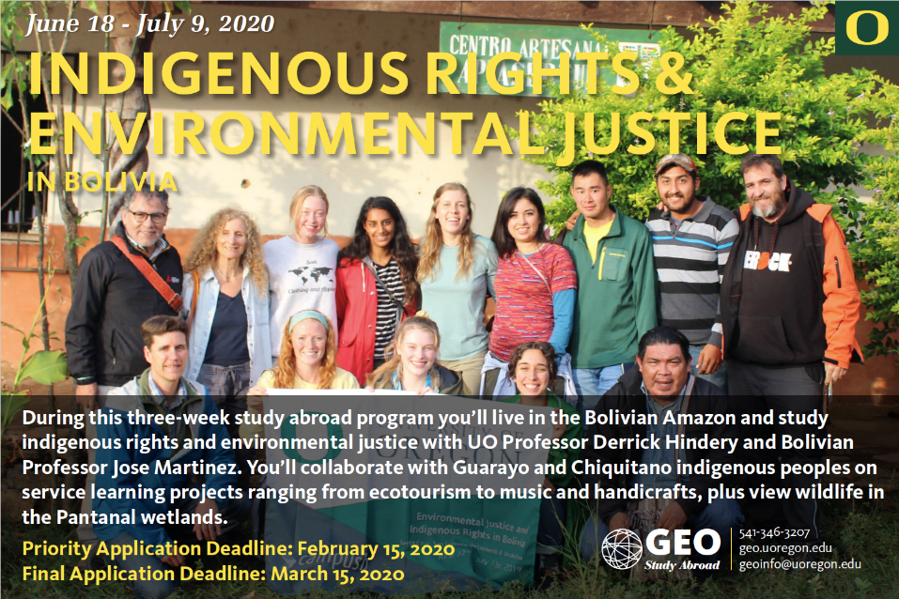

Slide 2
This study abroad program is part of broader collaboration between the University of Oregon and indigenous peoples of Bolivia, developed by Professor Hindery and indigenous leaders Bienvenido Zacu Mborobainchi (Guarayo leader), Carlos Cuasace (Chiquitano leader) and Waldo Mina Quiroga, Jose Martinez (Bolivian Sociology Professor), among others.

Slide 3
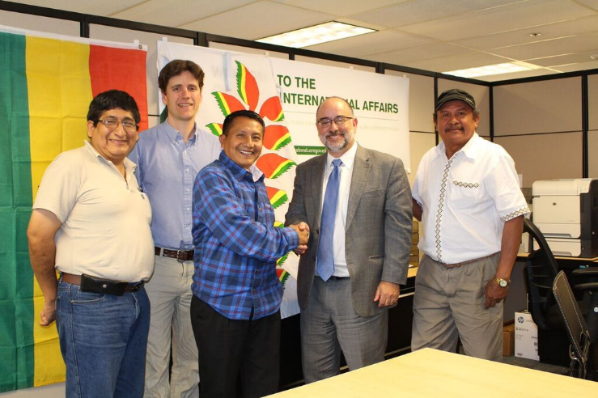
Meeting with Dennis Galvan, Vice-Provost of Office of International Affairs, University of Oregon, Spring 2015

Slide 4
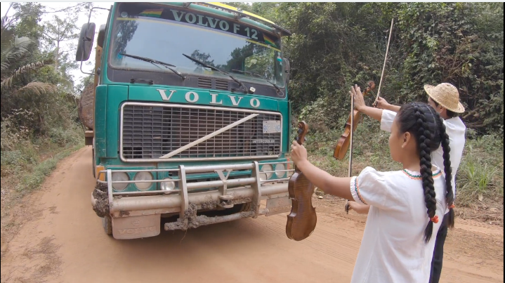
4 MINUTE VIDEO ABOUT THE PROGRAM:
https://vimeo.com/378907597
Guarayo indigenous youth protesting logging truck in their territory in the Bolivian Amazon, advocating for music over environmental degradation

Slide 5
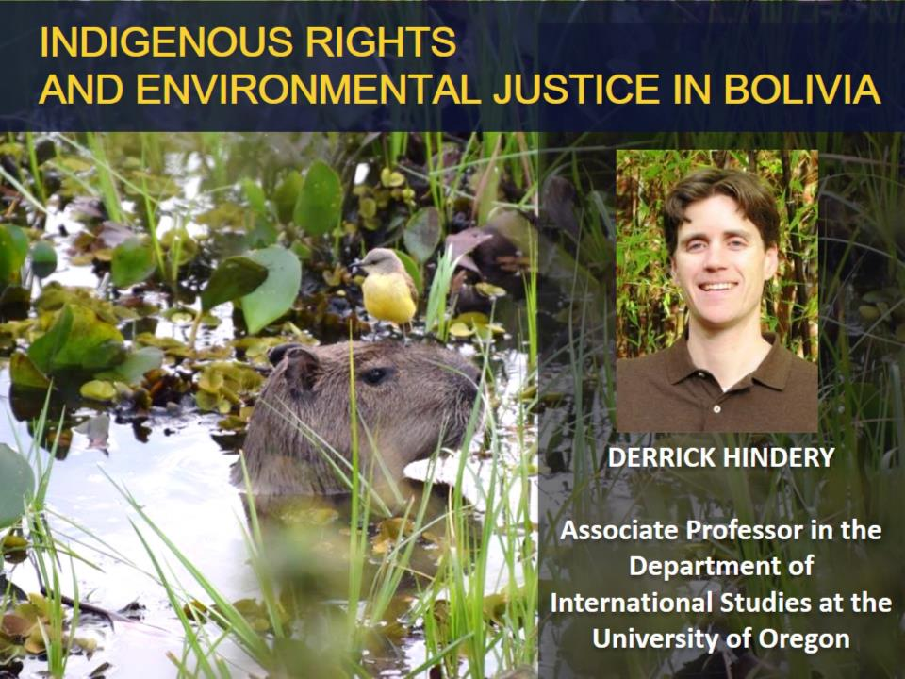
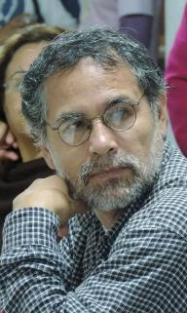
INDIGENOUS RIGHTS
AND ENVIRONMENTAL JUSTICE IN BOLIVIA
JOSE MARTINEZ
Head of Sociology
Gabriel René Moreno Autonomous University (UAGRM)
dhindery@uoregon.edu

Slide 6
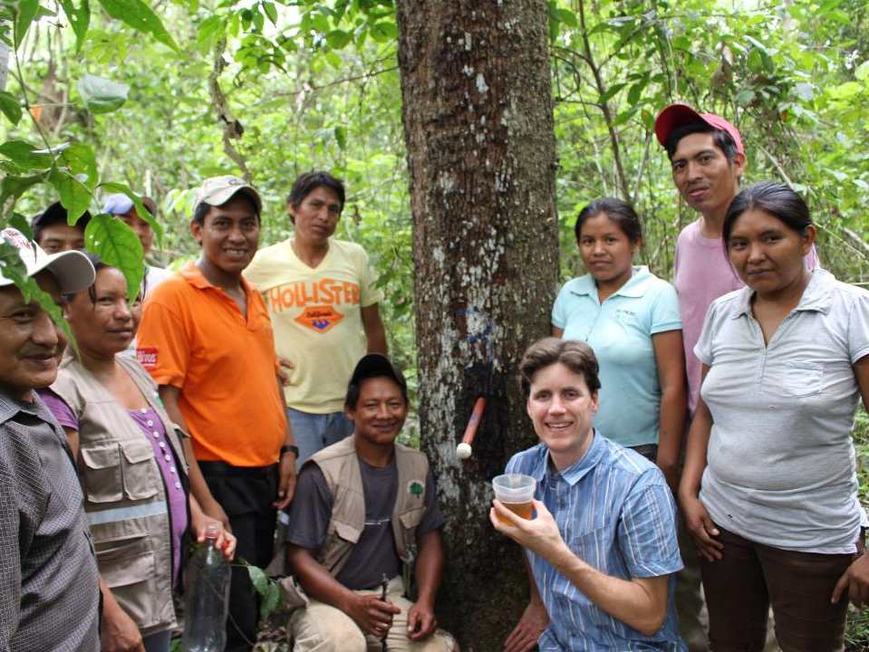
INDIGENOUS RIGHTS
AND ENVIRONMENTAL JUSTICE IN BOLIVIA
Indigenous Rights and Environmental Justice
in Bolivia
June 18 – July 9, 2020
Arrival in Santa Cruz, Bolivia
Stay in Chiquitano/Monkox indigenous community (Chiquitano Forest)
Stay in Guarayo indigenous community (Amazon forest)
Excursion to Pantanal Wetlands
Tuition includes all meals, transportation, insurance, and cultural activities included in the program

Slide 7
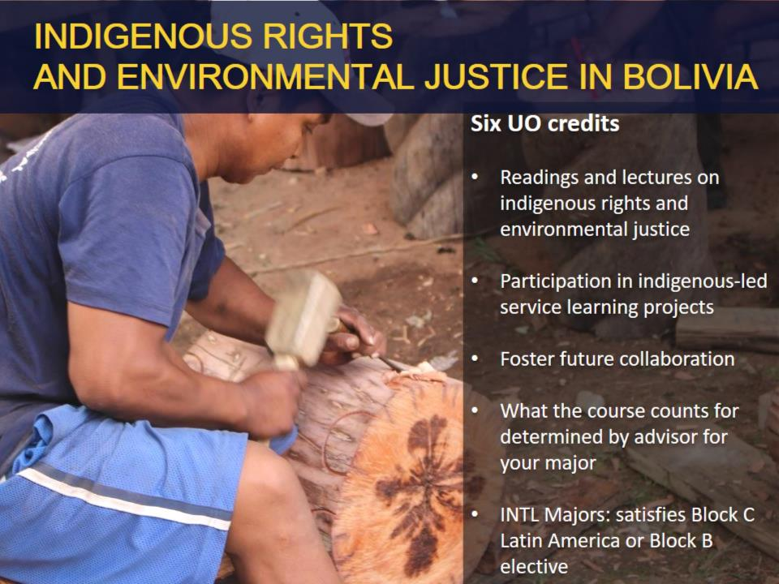
INDIGENOUS RIGHTS
AND ENVIRONMENTAL JUSTICE IN BOLIVIA
And various professional concentrations: ID, IEI, ICAD, IDIR, IGH, IB, IEC, IGI, INPM, ITRS, ILHR, IJ, IMDR, ICR, ILAM

Slide 8
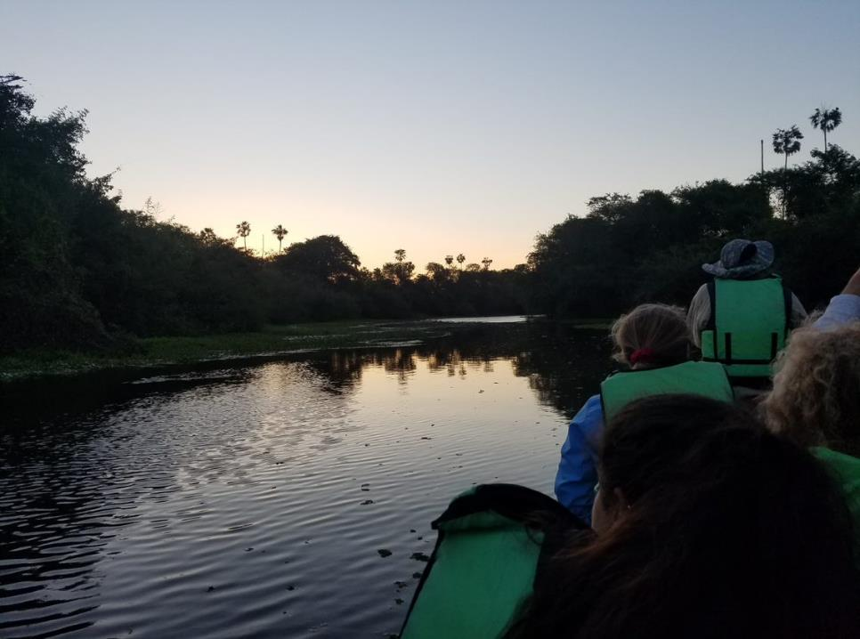
PRIORITY DEADLINE
FEBRUARY 15, 2020
Start an application
Check financial aid and scholarship opportunities
Visit drop-in hours or schedule an advising appointment
Application Process
Apply online: geo.uoregon.edu/scholarships

Slide 9
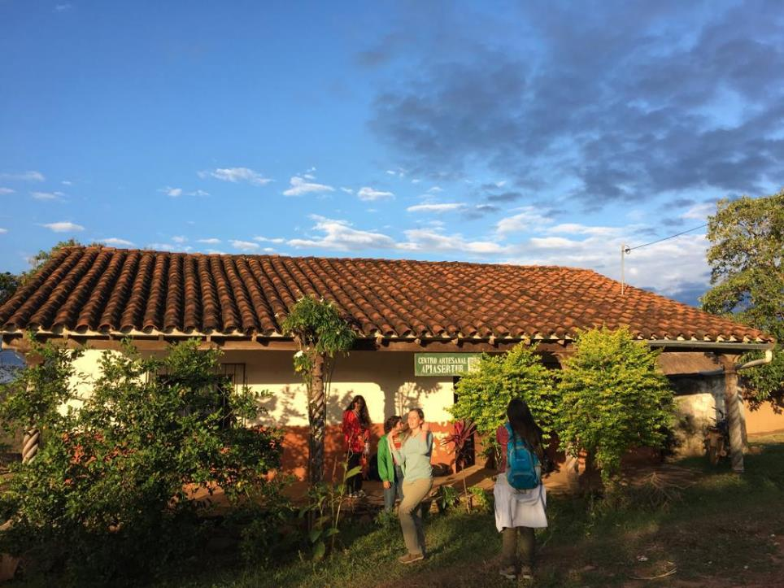
FUNDING YOUR EXPERIENCE ABROAD
Most forms of financial aid apply
Program budget online
GEO and external scholarships available
  Program Funding
  Gilman Scholarship
  Diversity abroad scholarships

Slide 10
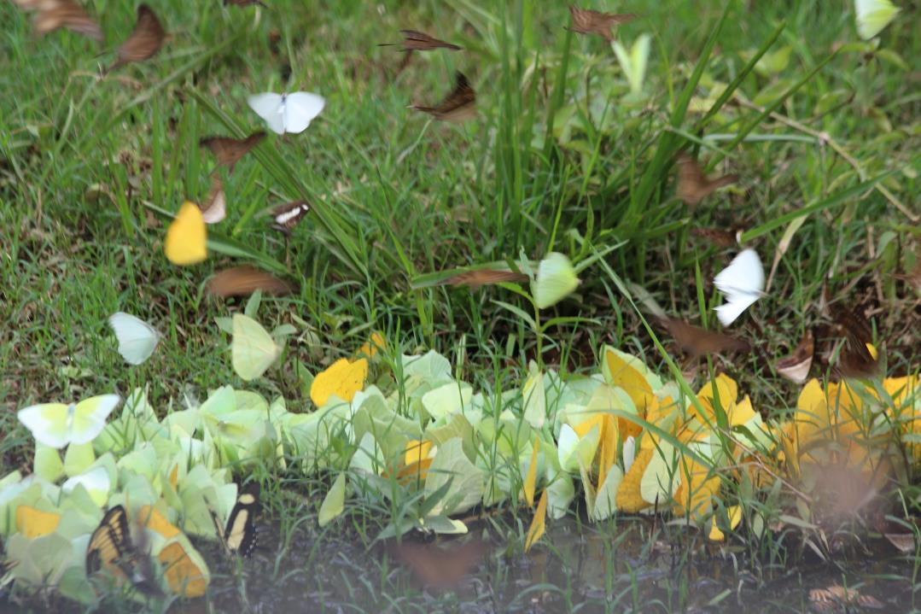
Notes:
Picture source: https://upload.wikimedia.org/wikipedia/commons/e/e3/Oviedo_-_Calle_Suarez_de_la_Riva.JPG

Slide 11
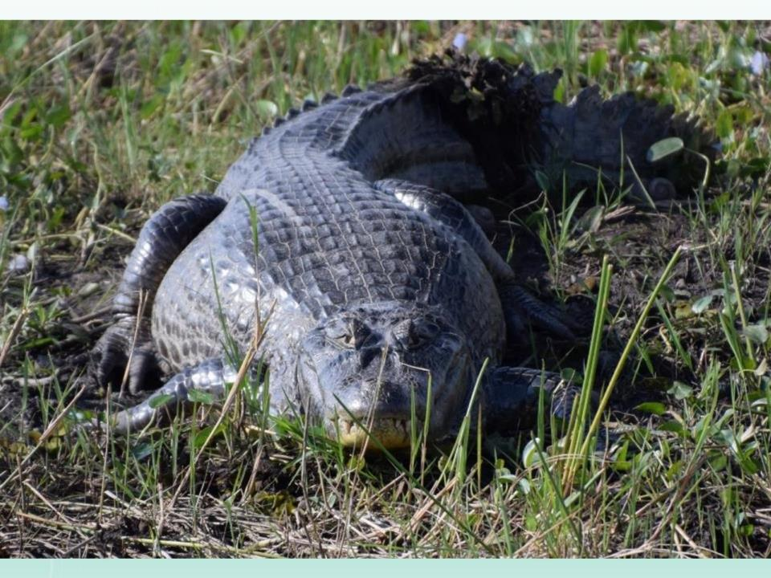
Pantanal Wetlands:
1 of world's largest wetlands
over 120 mammal species
650 bird species
90 reptile species
40 amphibian species
260 fish species
1030 butterfly species
1650 vascular plant species

Slide 12
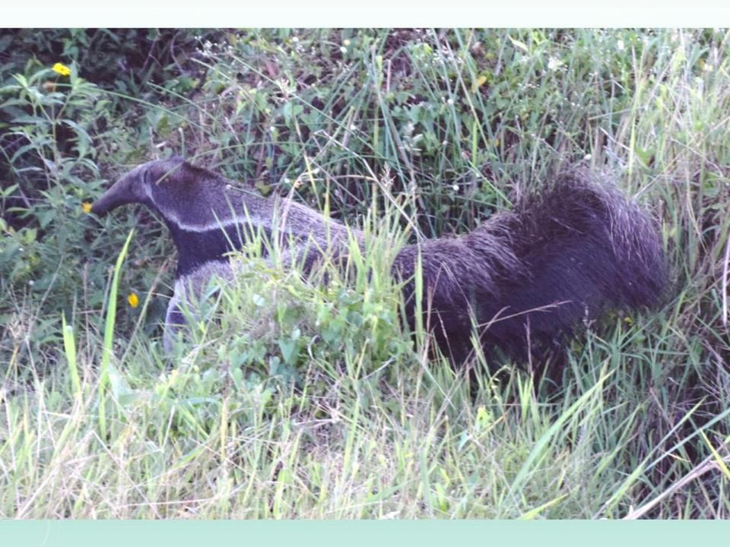

Slide 13
INDIGENOUS RIGHTS
AND ENVIRONMENTAL JUSTICE IN BOLIVIA

Slide 14
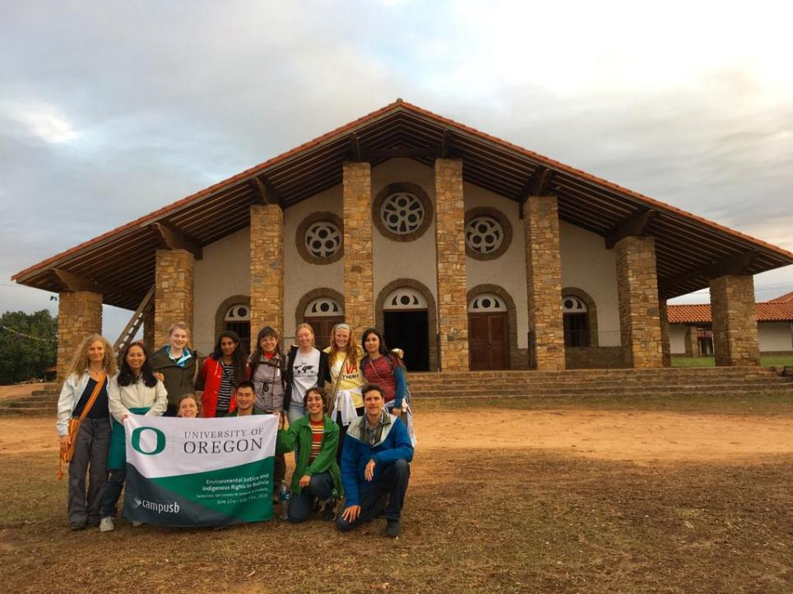
INDIGENOUS RIGHTS
AND ENVIRONMENTAL JUSTICE IN BOLIVIA

Slide 15
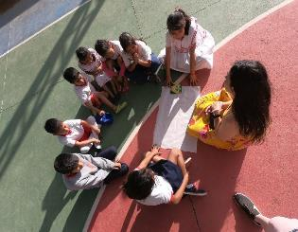
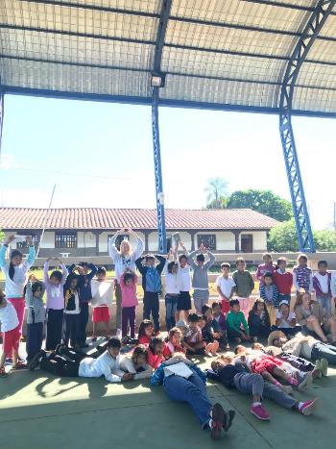
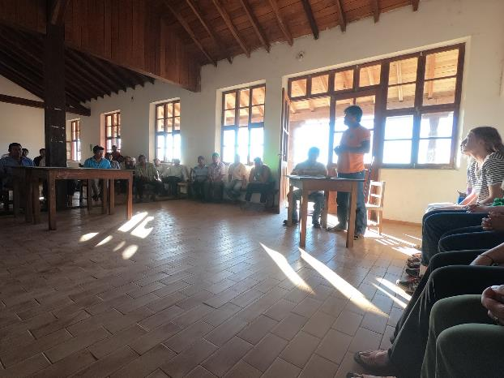
INDIGENOUS RIGHTS
AND ENVIRONMENTAL JUSTICE IN BOLIVIA
Left to Right:
First Class;
Community Meeting;
Leadership Discussion
LomerÍo Territory:
Community Collaboration

Slide 16
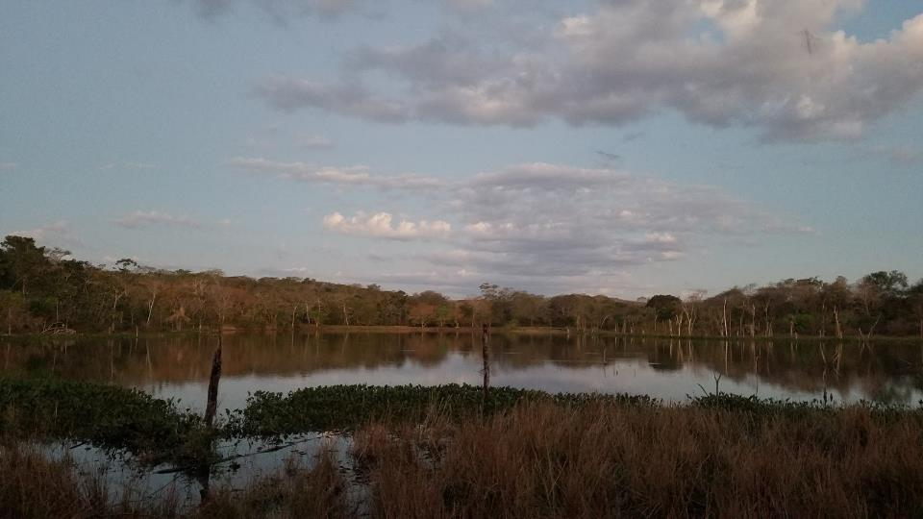
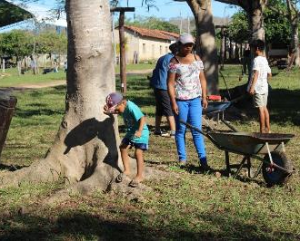
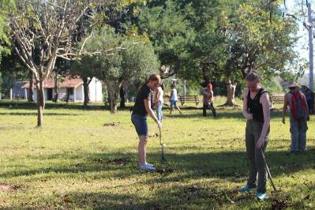
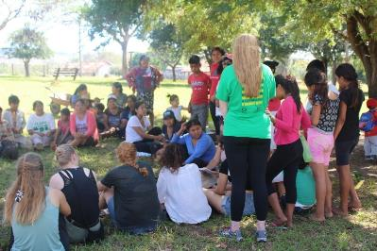
INDIGENOUS RIGHTS
AND ENVIRONMENTAL JUSTICE IN BOLIVIA
LomerÍo Territory Community Projects (while in Bolivia and ongoing remote support):
Invasive species removal and plaza clean up
Website creation (Monkox Nation and Lomerio indigenous organization)
Amazon Fire relief fundraising

Slide 17
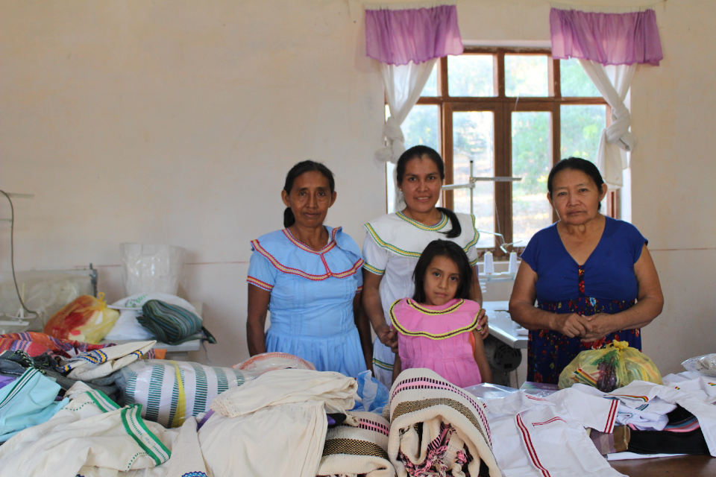
Women’s handicraft cooperative in
Lomerio indigenous territory

Slide 18
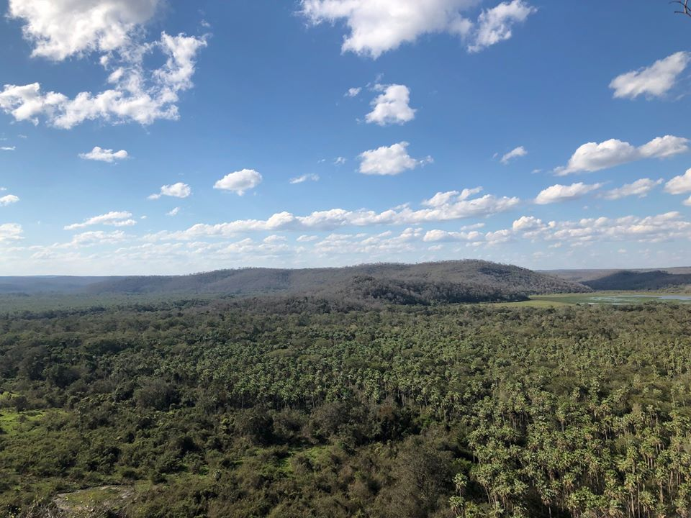
INDIGENOUS RIGHTS
AND ENVIRONMENTAL JUSTICE IN BOLIVIA
Chiquitano Dry Forest
The last best conserved dry tropical forest in the world

Slide 19
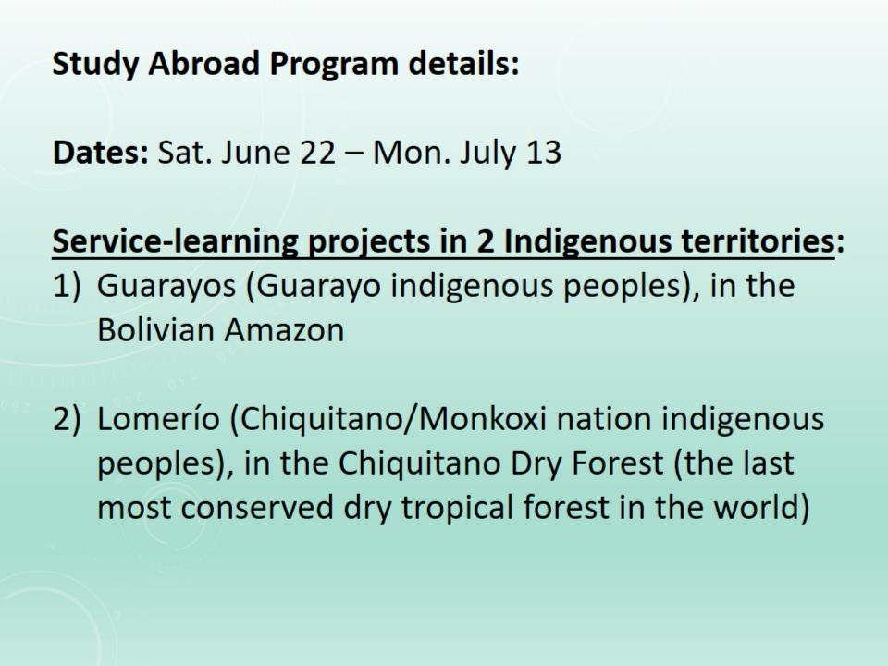
June 18 – July 9, 2019

Slide 20
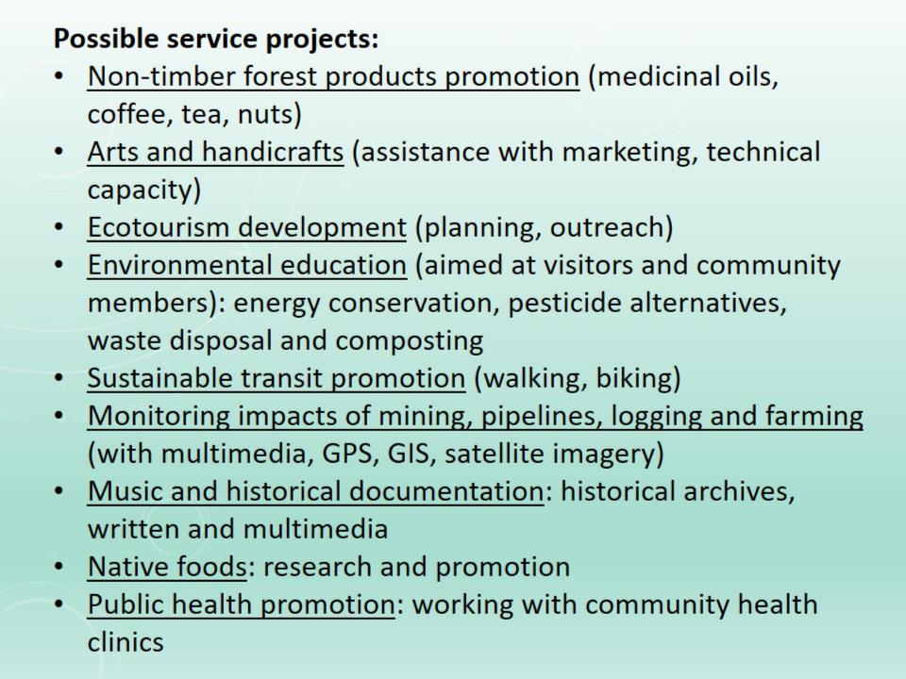

Slide 21
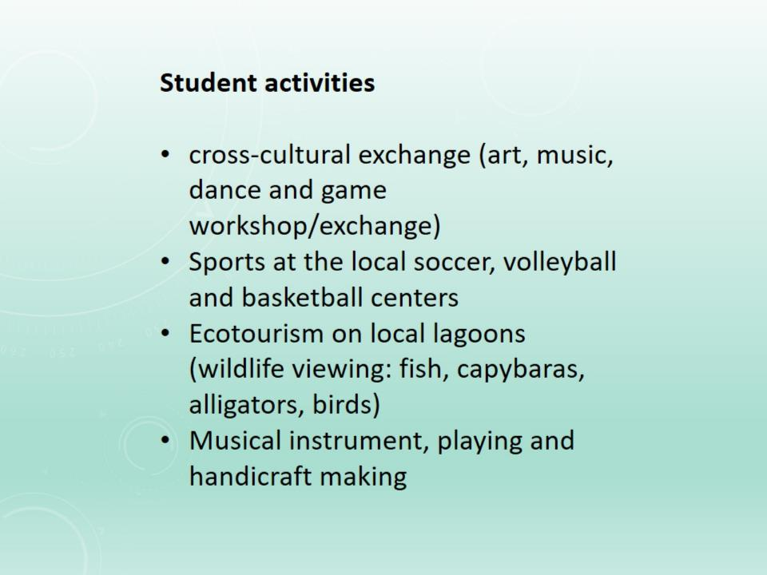

Slide 22
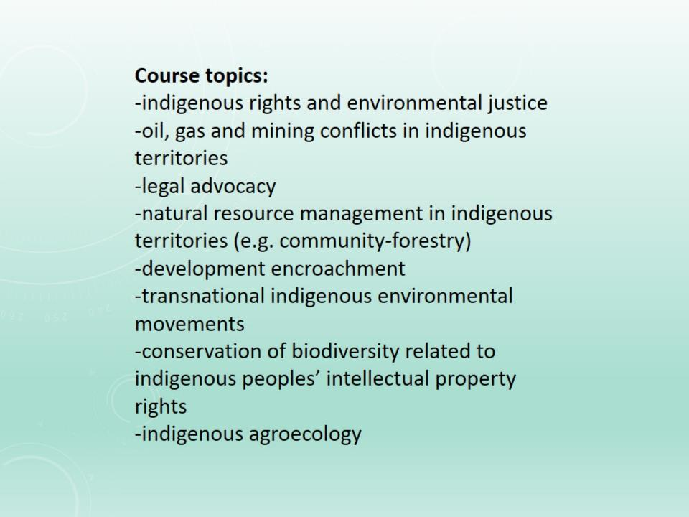

Slide 23
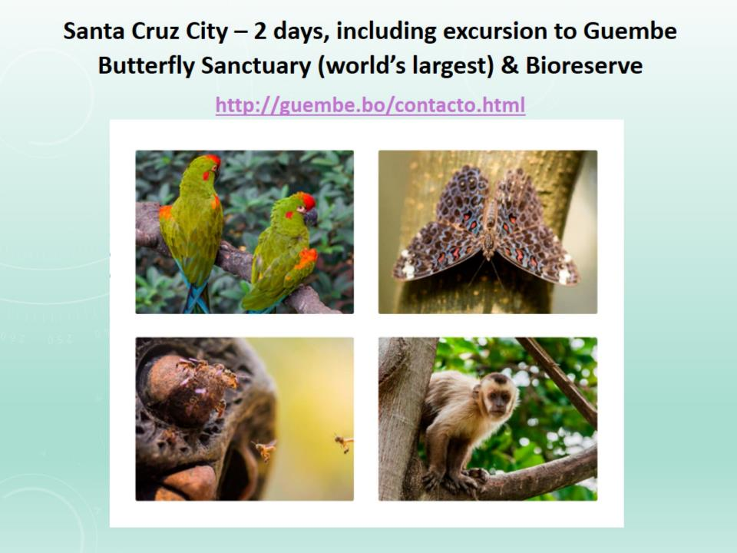

Slide 24
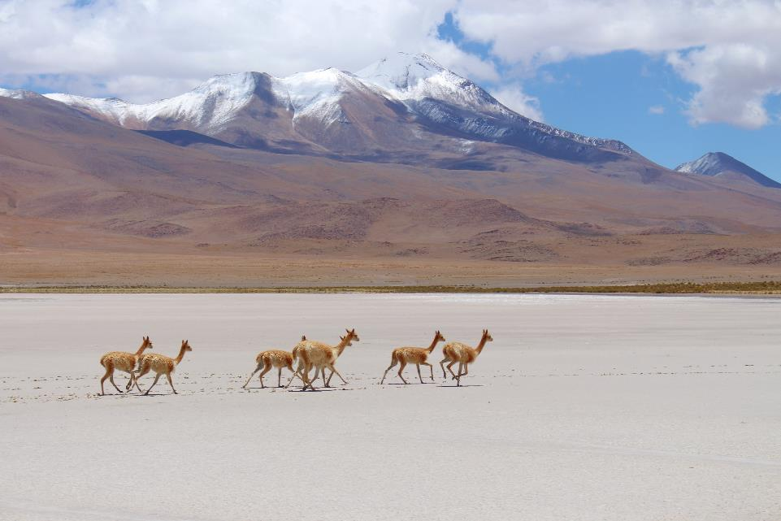
Optional wildlife tours in the Bolivian Amazon and the world famous Salar de Uyuni salt flats

Slide 25


Slide 26
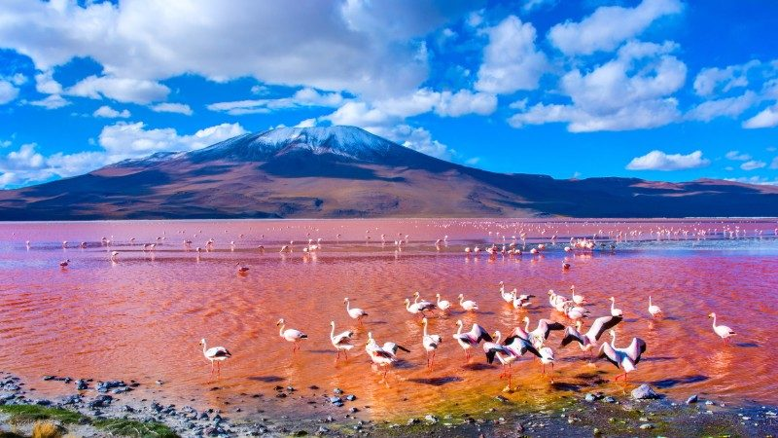
Salar de Uyuni

Slide 27
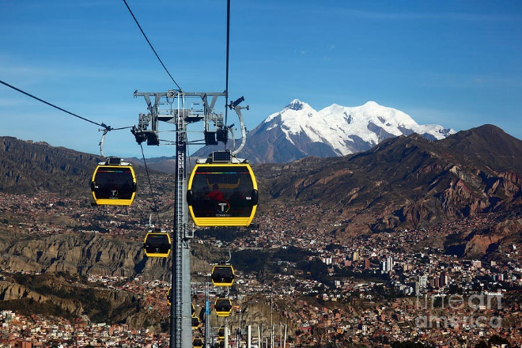
La Paz

Slide 28
List of community projects carried out in 2019: link
Ongoing remote work is being carried out by Students for Indigenous Rights and Environmental Justice in Bolivia (SIREJ, founded by 2019 University of Oregon Bolivia study abroad students)
2 minute clip of Urubicha music school students playing a Pirates of the Caribbean song: link

Slide 29
Seven minute clip on the Chiquitano struggle for autonomy in Lomerío: link
3 minute video clip on Urubicha music, instrument-making and handicrafts: link (you can select “CC” and autotranslate captions from Spanish into English)

