Slide 1
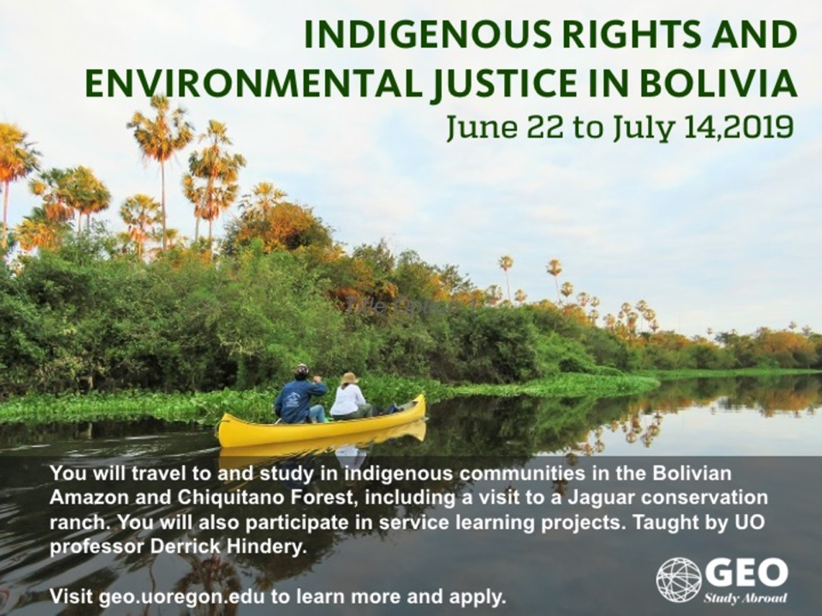

Slide 2
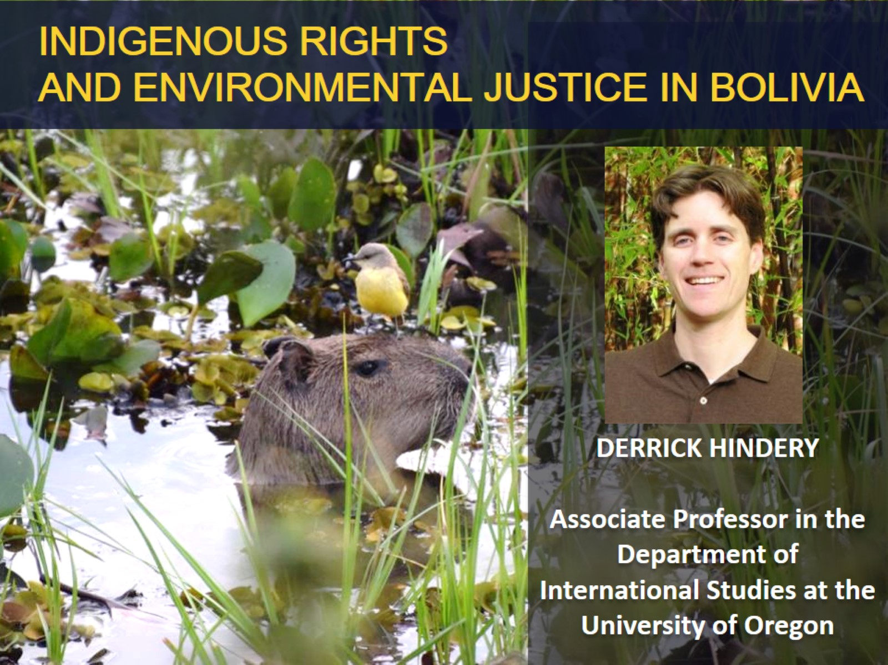
INDIGENOUS RIGHTS AND ENVIRONMENTAL JUSTICE IN BOLIVIA

Slide 3
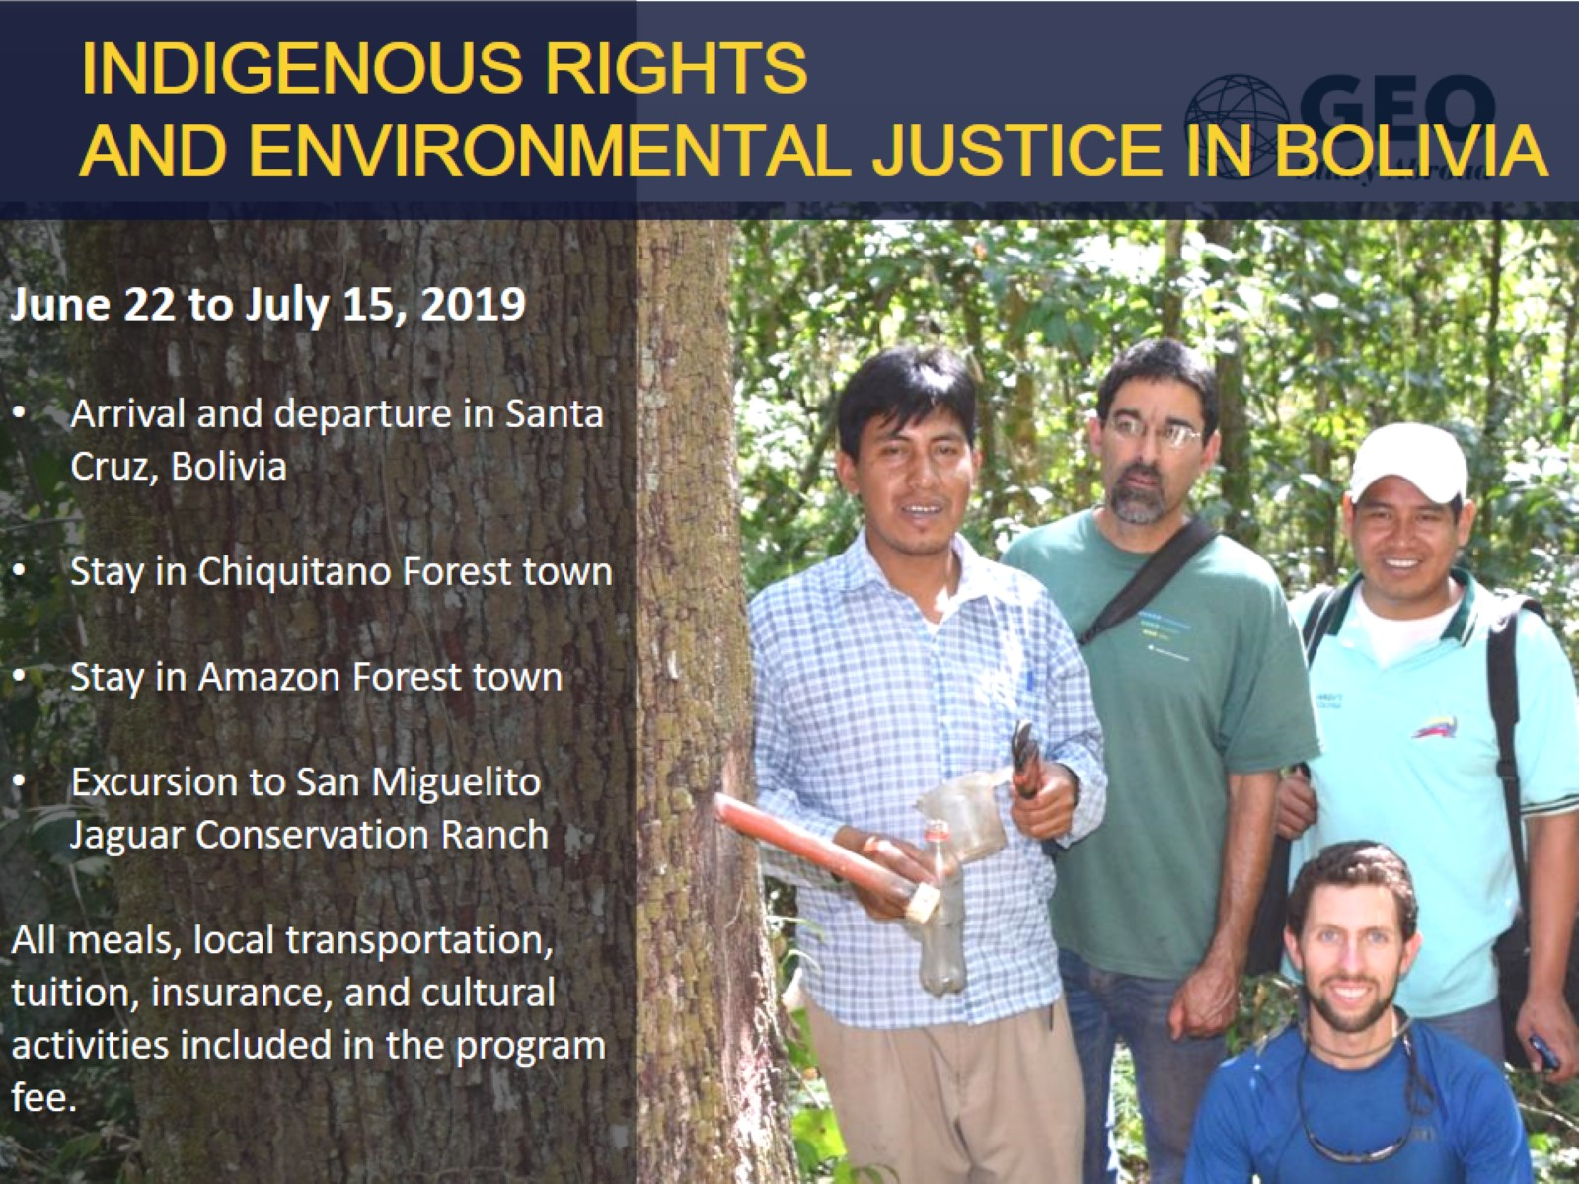
INDIGENOUS RIGHTS AND ENVIRONMENTAL JUSTICE IN BOLIVIA

Slide 4
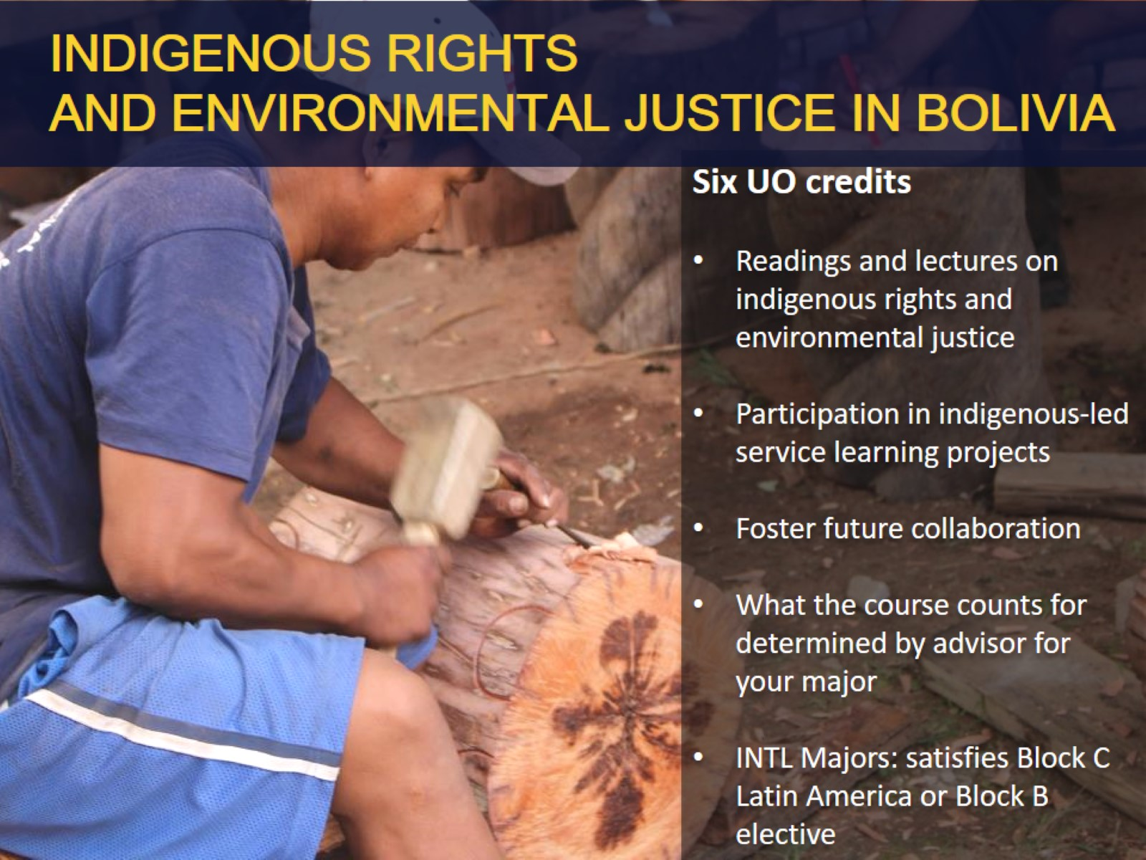
INDIGENOUS RIGHTS AND ENVIRONMENTAL JUSTICE IN BOLIVIA

Slide 5
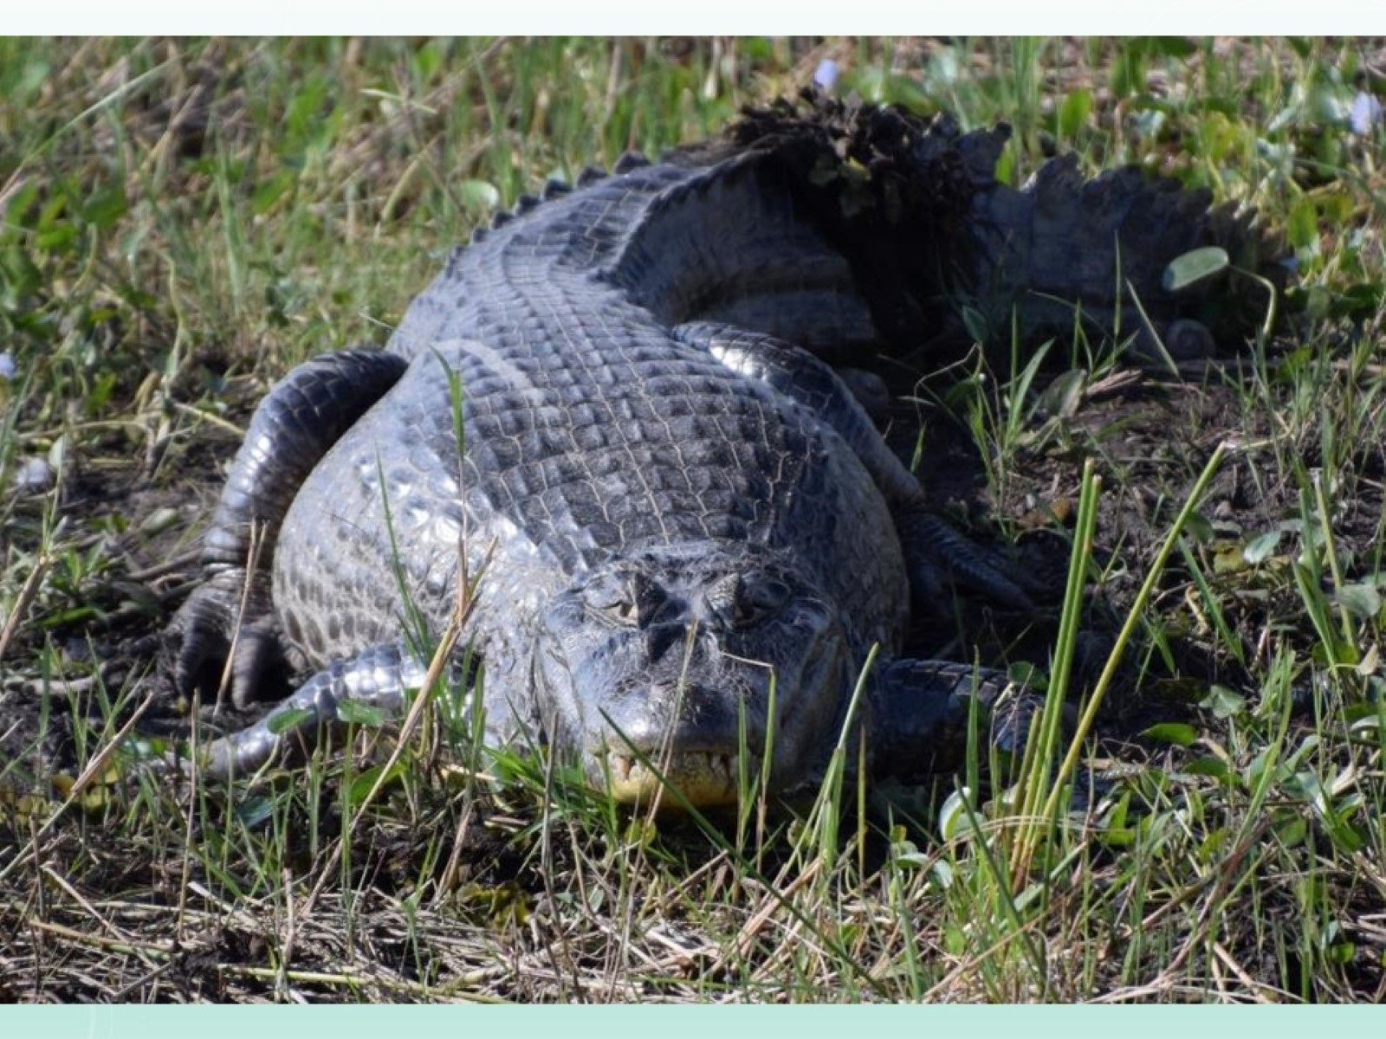

Slide 6
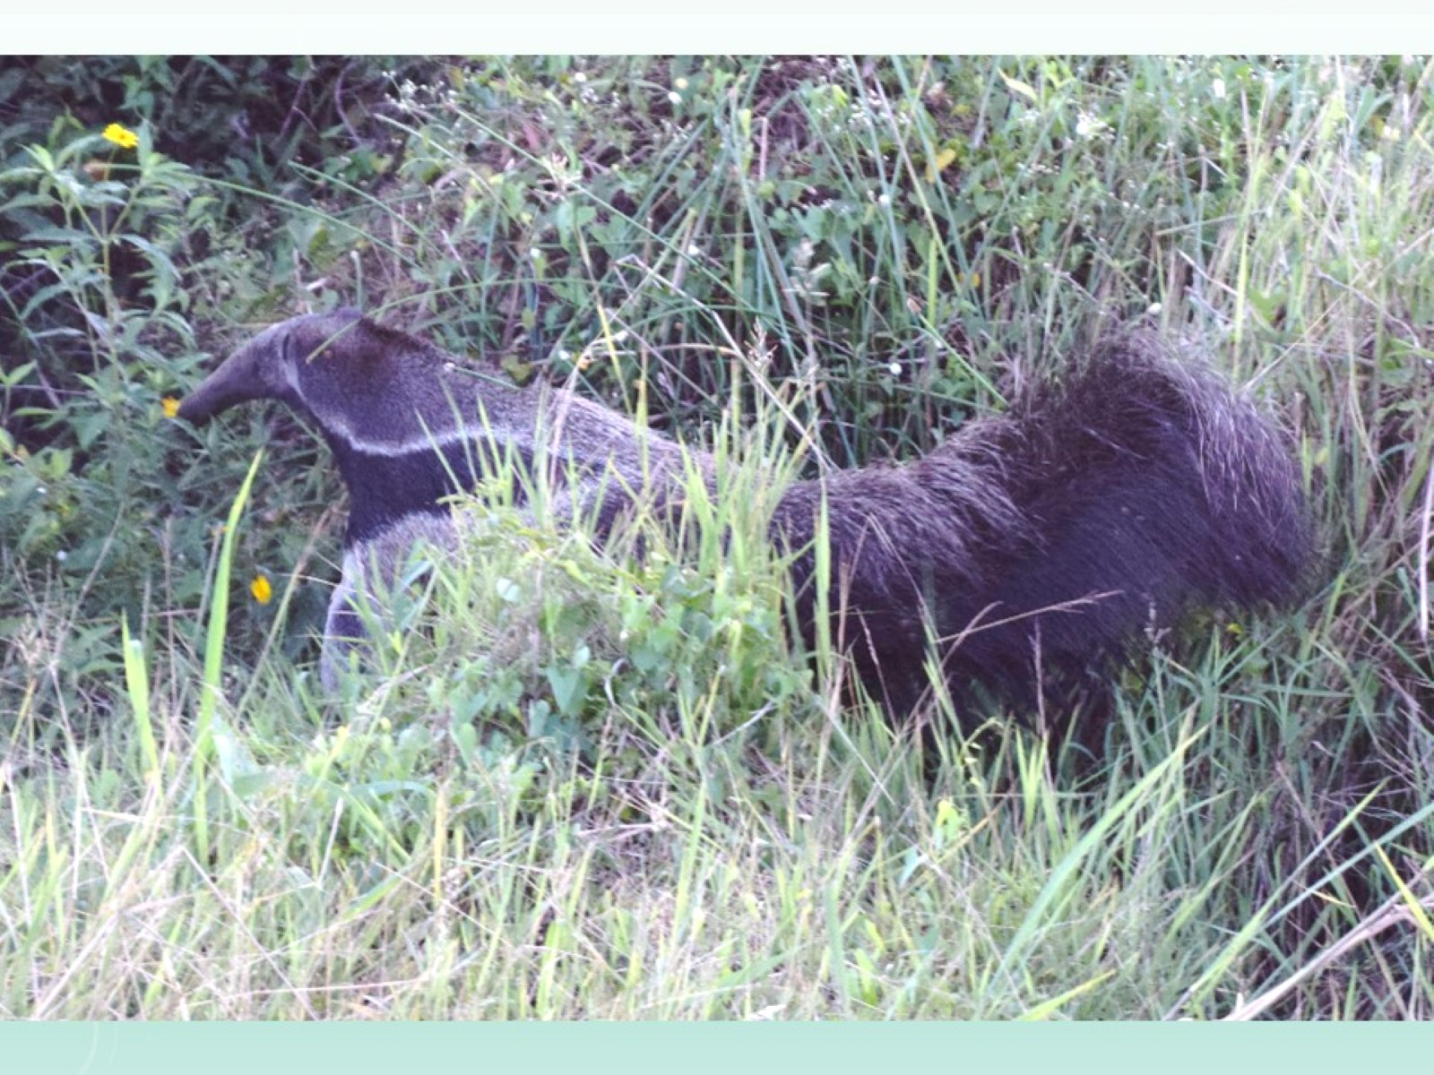

Slide 7
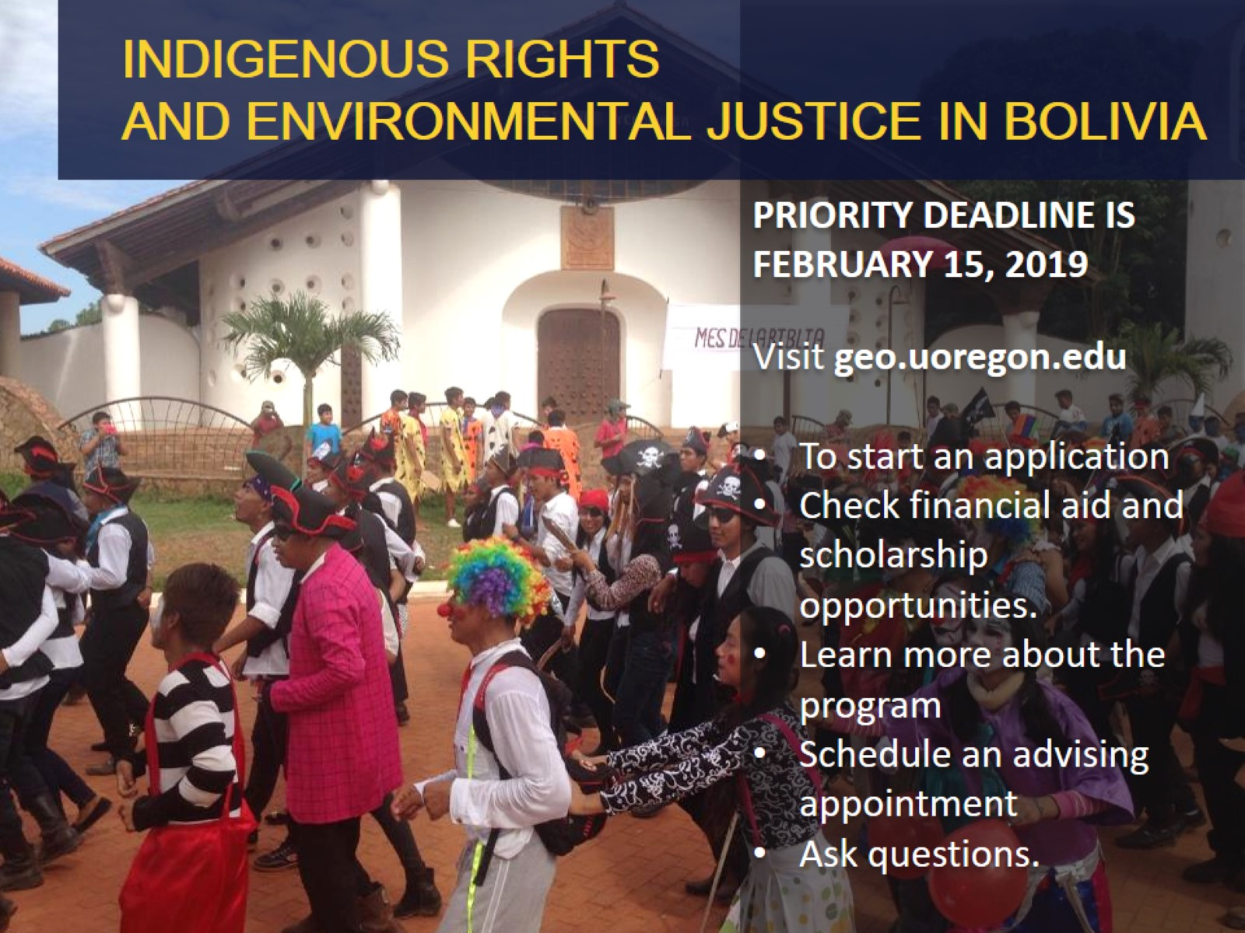
INDIGENOUS RIGHTS AND ENVIRONMENTAL JUSTICE IN BOLIVIA

Slide 8
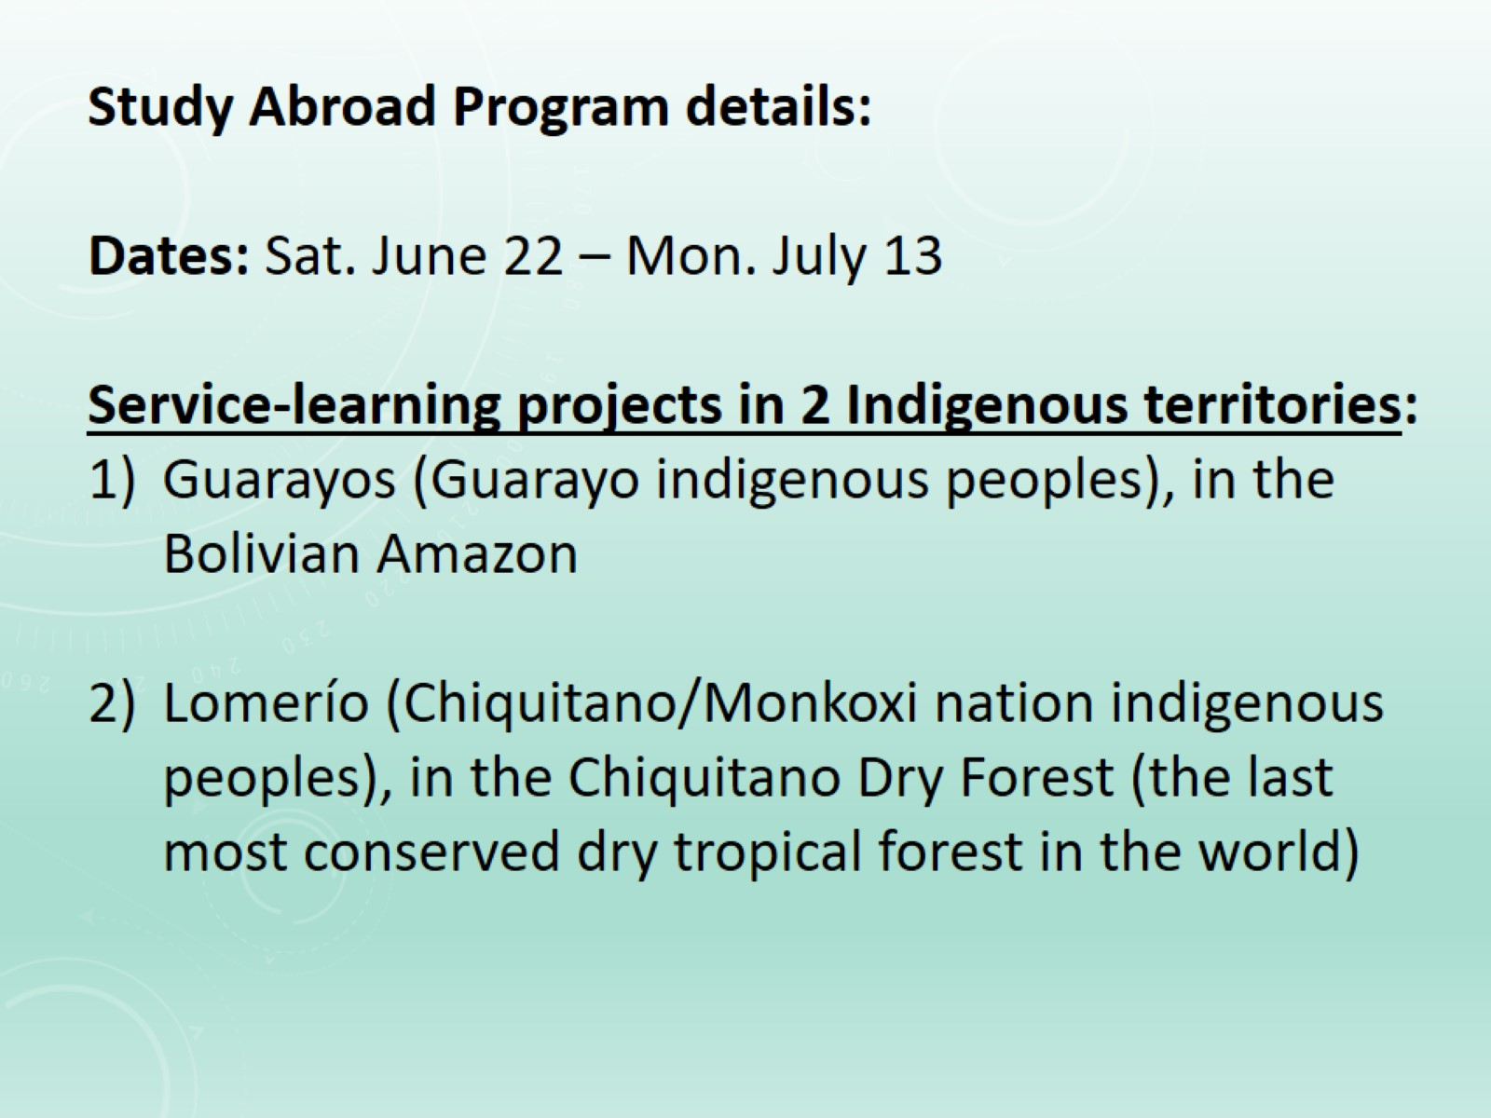

Slide 9
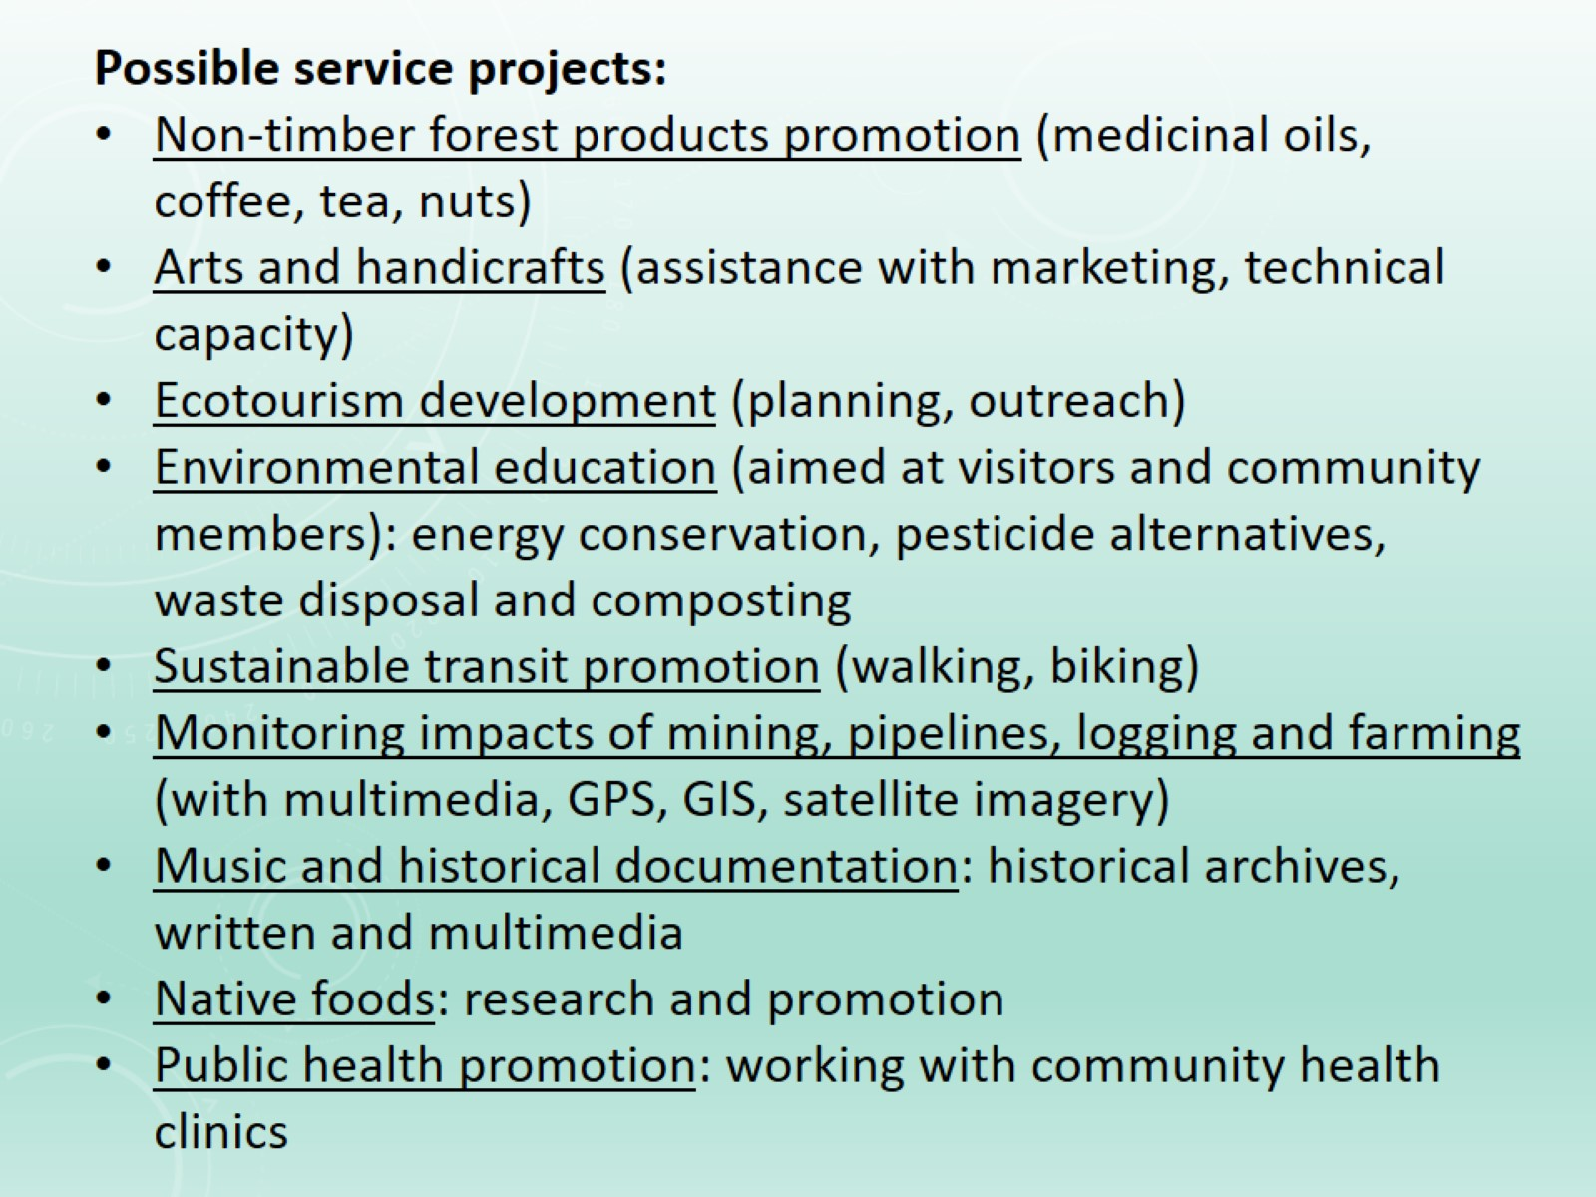

Slide 10
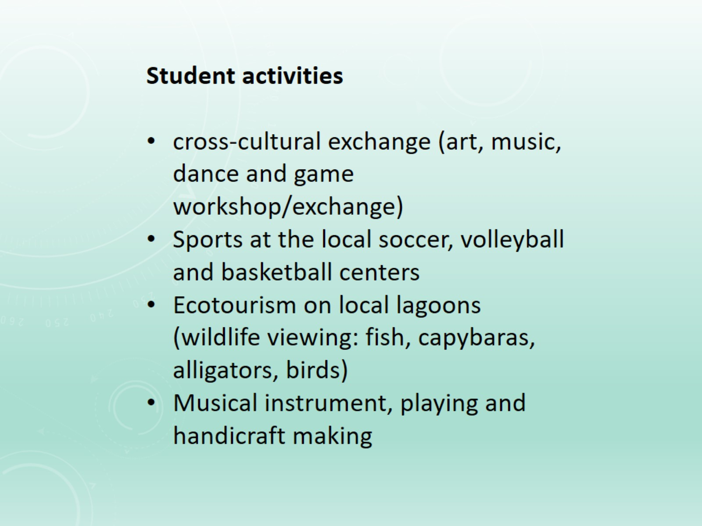

Slide 11
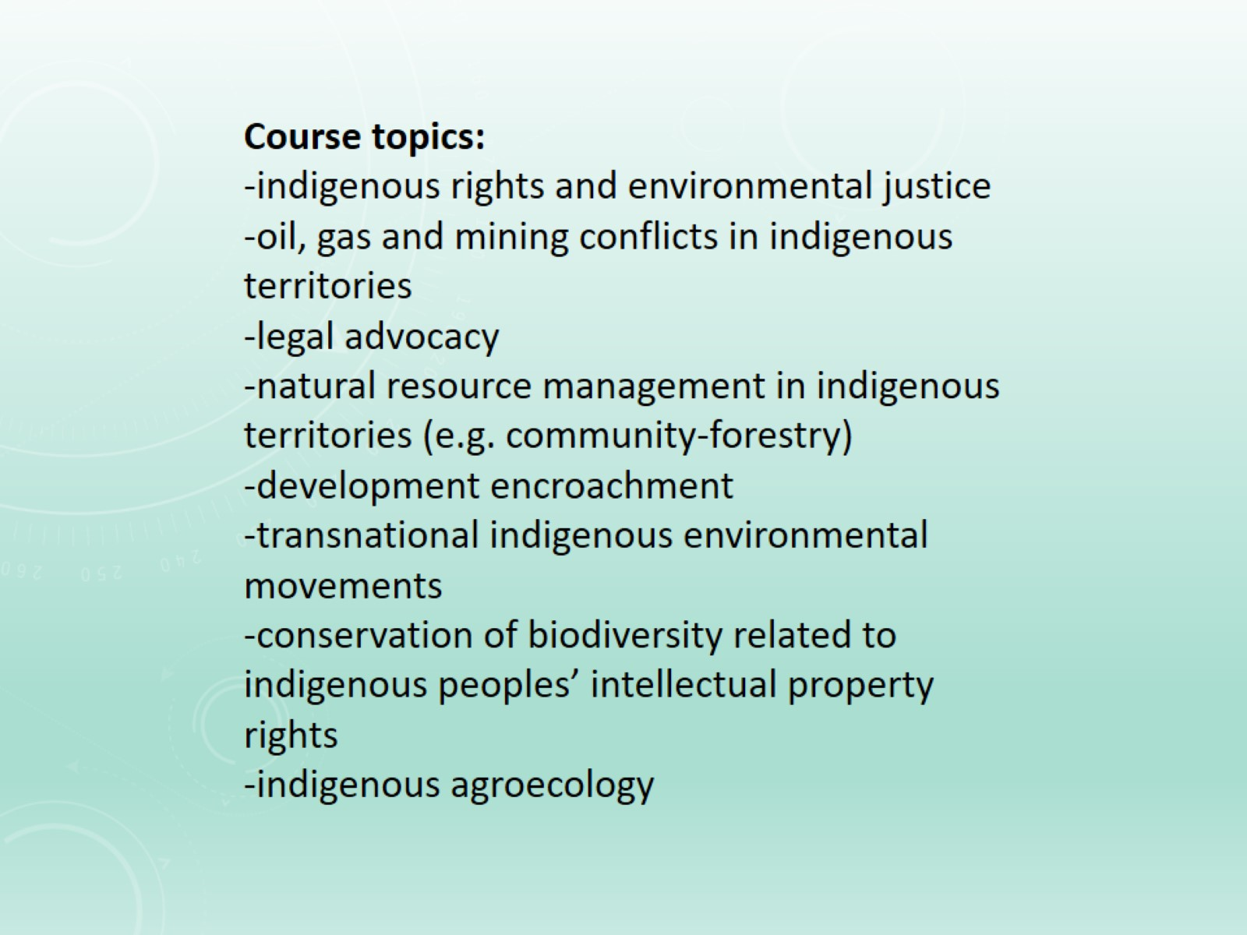

Slide 12
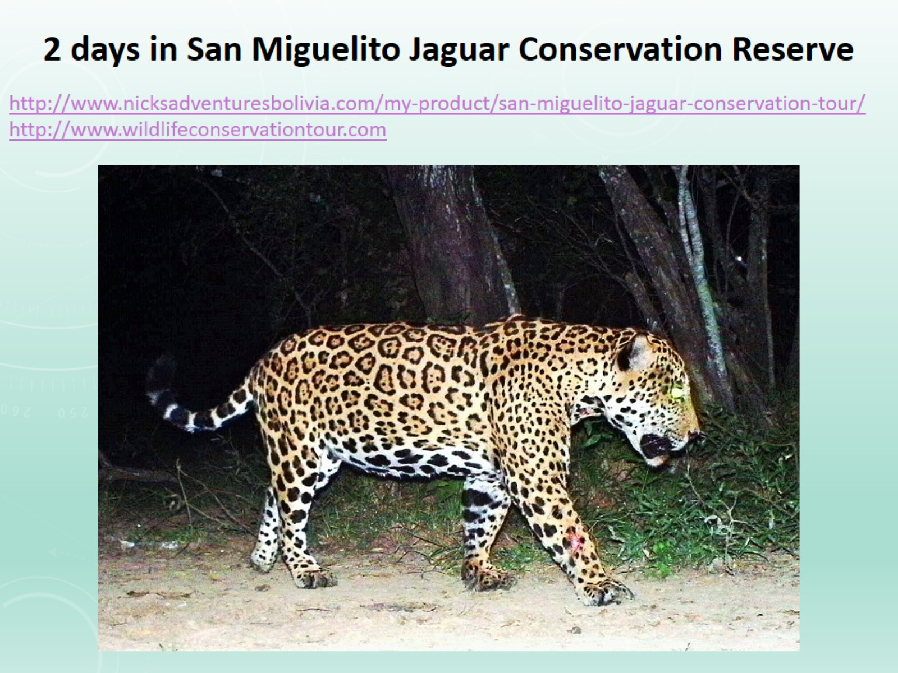

Slide 13
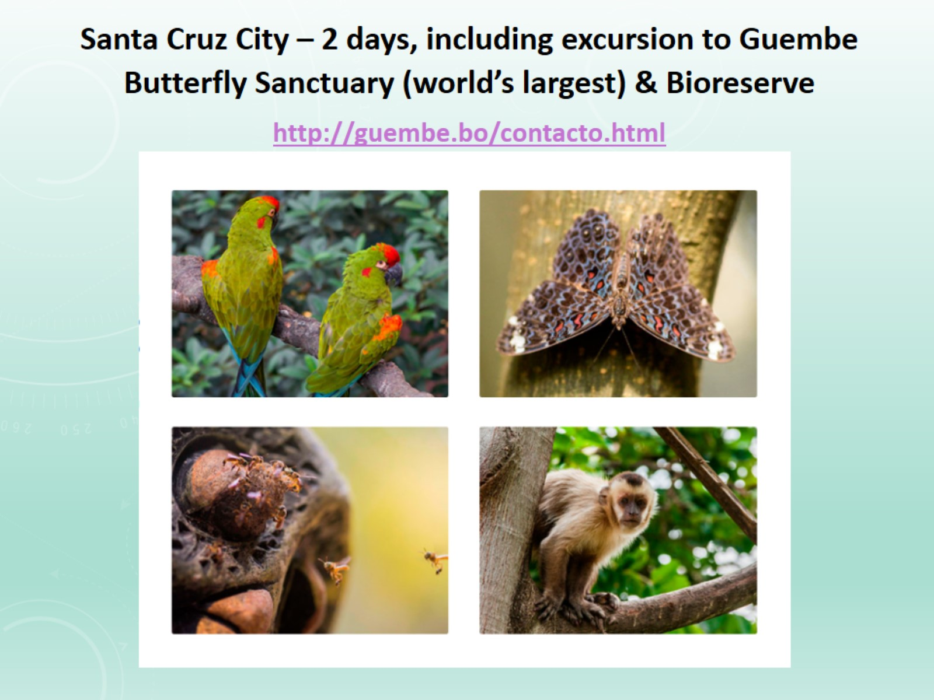

Slide 14
Seven minute clip on the Chiquitano struggle for autonomy in Lomerío: link
3 minute video clip on Urubicha music, instrument-making and handicrafts: link (you can select “CC” and autotranslate captions from Spanish into English)

