Slide 1
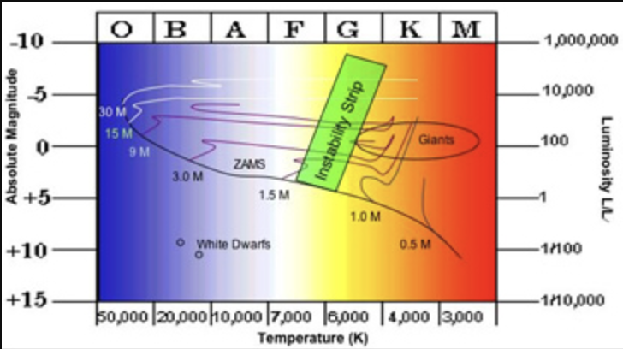
Astronomy 122
Homework 3: Cepheids and M100
Due: by the end of March 1, 2024
It is preferred that you turn the assignment in through course website on CANVAS. However, hardcopy will be accepted
Name and Date:
Below is shown a Hertzprung-Russell (HR) Diagram. The green box marks what is known as the Instability Strip. As stars pass through the Instability Strip they become unstable to pulsations.

Slide 2
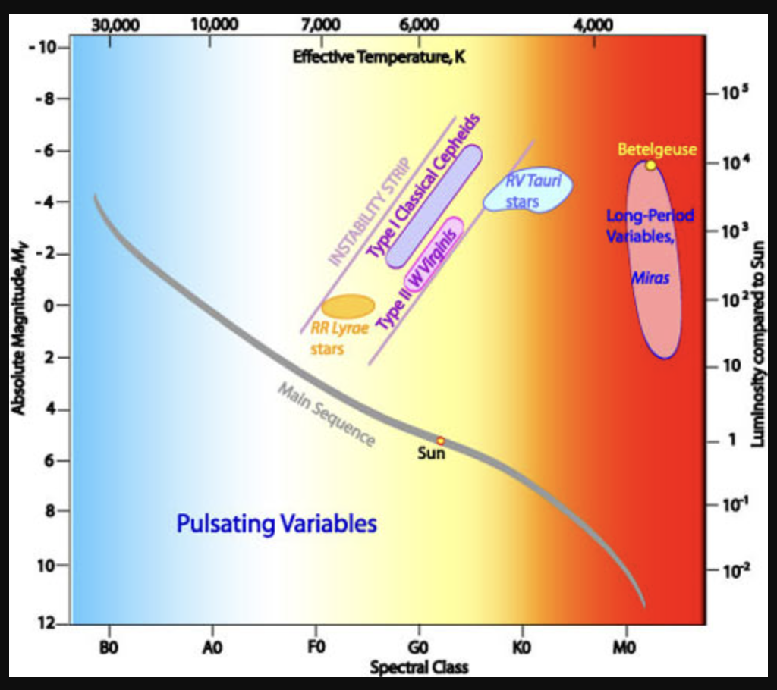
As stars pass through the Instability Strip they become unstable to pulsations. Prominent examples are the Type I Classical Cepheids, Type II Cepheids (W Virginis stars), and RR Lyrae stars.
The remarkable thing about the Cepheids (Type I and Type II) is that there is a well-defined relation between their periods of pulsation (P) and their luminosities (L). This P-L relationship was discovered by Henrietta Leavitt in 1908 through studies of 1,777 stars in the Large and Small Magellanic Clouds.
The P-L relationship means that by measuring how fast a Cepheid variable pulsates, we may infer its intrinsic luminosity. This coupled with its measured brightness allows us to determine its distance. This is an incredibly important result.

Slide 3
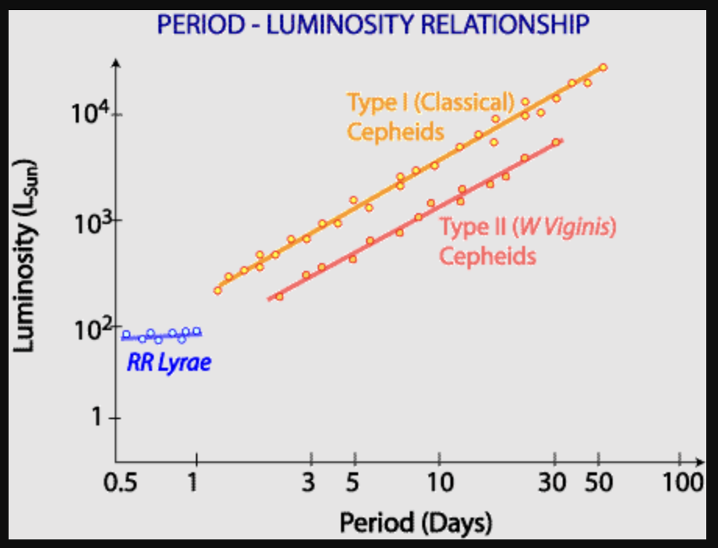
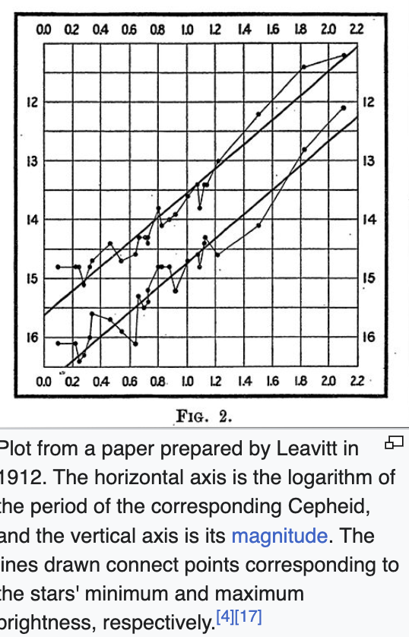
Modern P-L relationship—at the time of Leavitt’s work, it was not known that there were Type I and Type II Cepheids. This was later clarified by Baade in the 1940s.

Slide 4
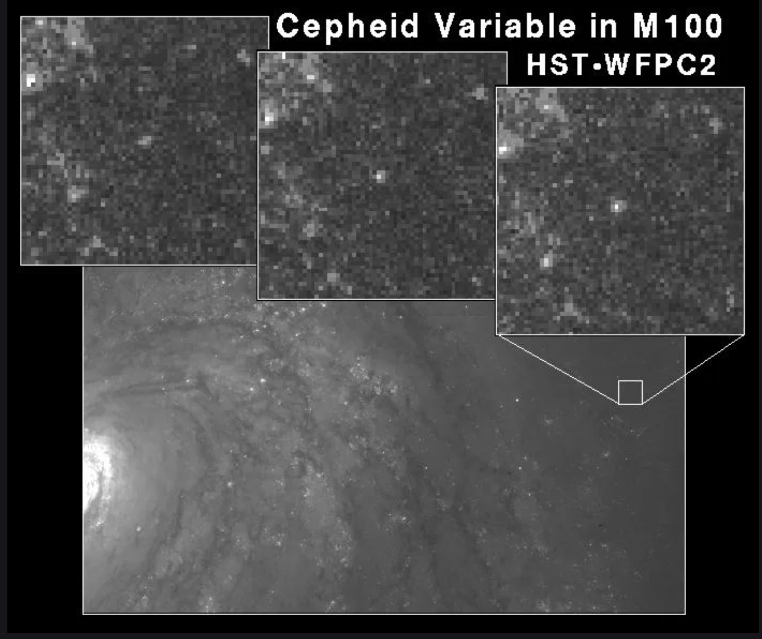
The Hubble Telescope (HST) observed Type I Cepheids in the nearby spiral galaxy, M100. The 3 upper panels show a Cepheid marked at three times. It is clear that the Cepheid in the center of the image is changing in brightness.
Observations of Cepheids allow the distance to M100 to be determined.

Slide 5
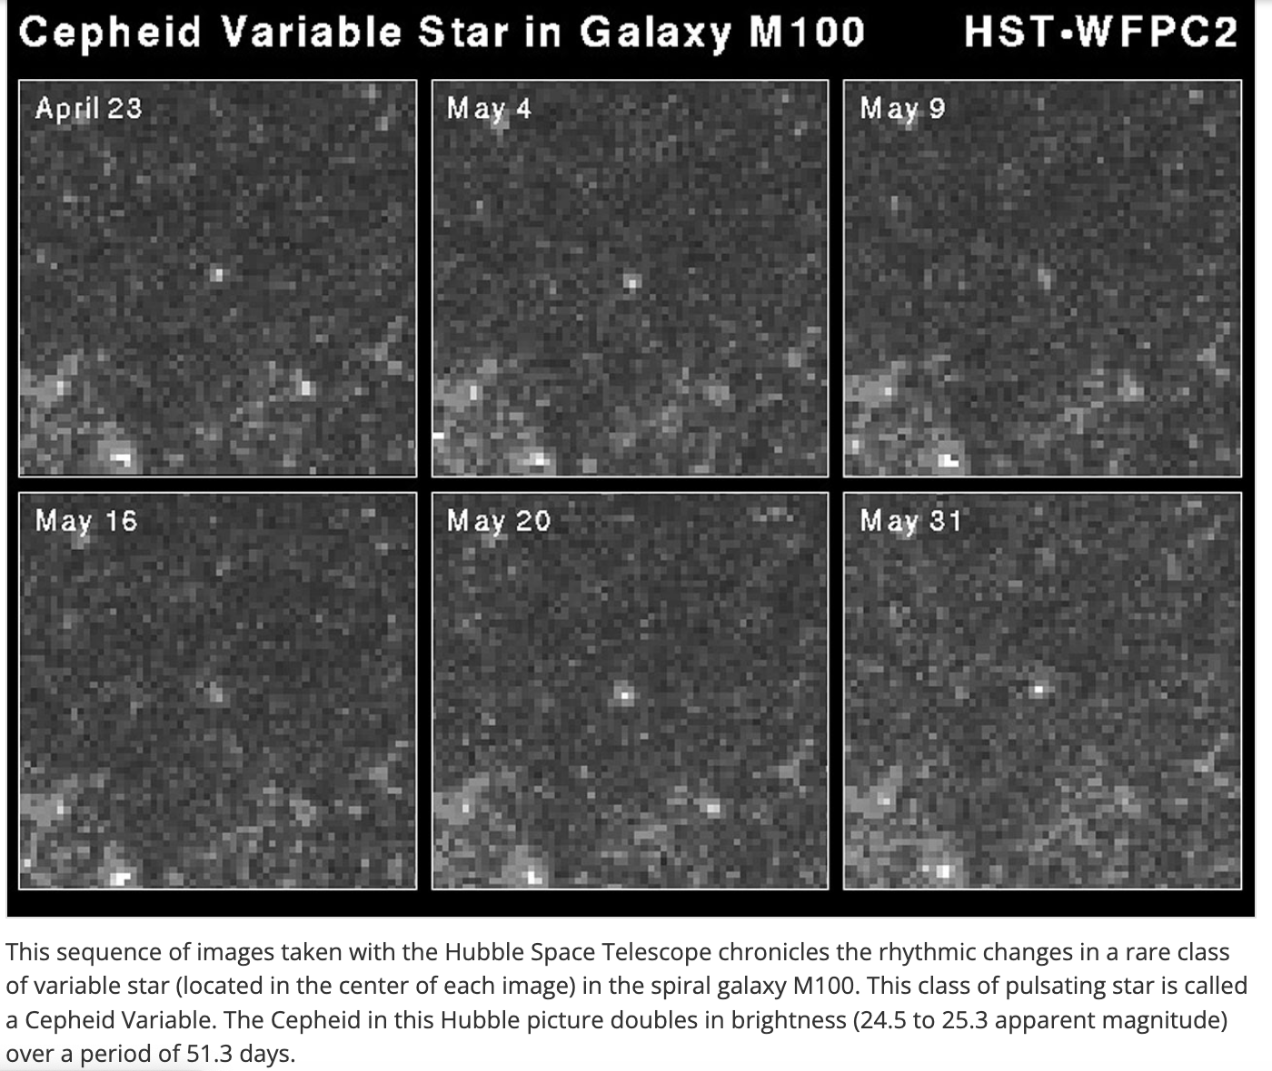
Hubble images of a Type I Cepheid in the nearby spiral galaxy, M100. The 6 panels show the marked star at six times. It is clear that the star in the center of the image is changing in brightness.
Observations of a Cepheid allow the distance to M100 to be determined. As noted in the caption, the Cepheid is changing with a pulsation period of 51.3 days from which we can estimate its luminosity from P-L relation.

Slide 6
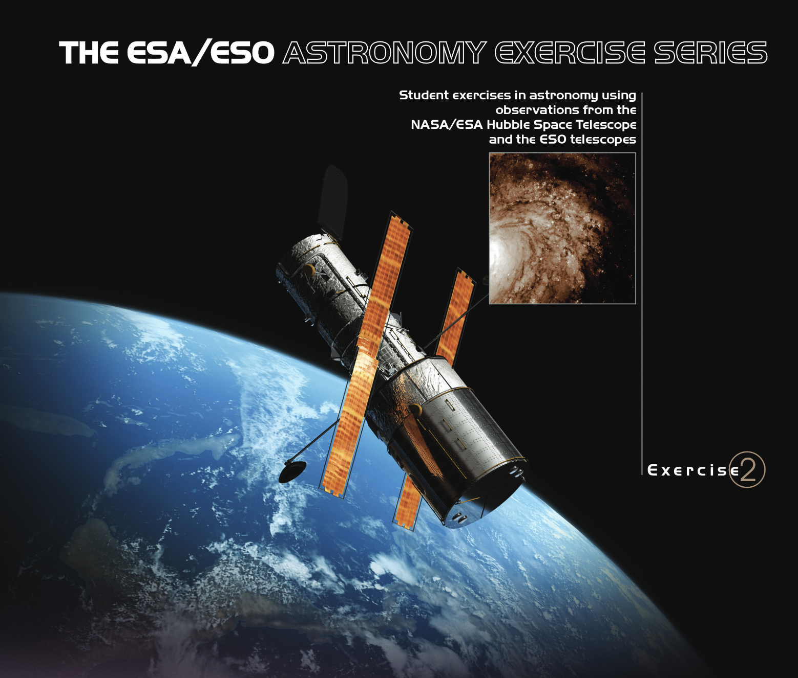
I grabbed light curves for 12 Cepheid variable stars in the spiral galaxy M100 from the ESA/ESO Astronomy Exercise Series (see cover sheet to right).
You will determine the pulsation periods for each Cepheid and then use the Cepheid period-luminosity relation to get the intrinsic brightnesses for each Cepheid. You will then determine an average distance to M100.

Slide 7
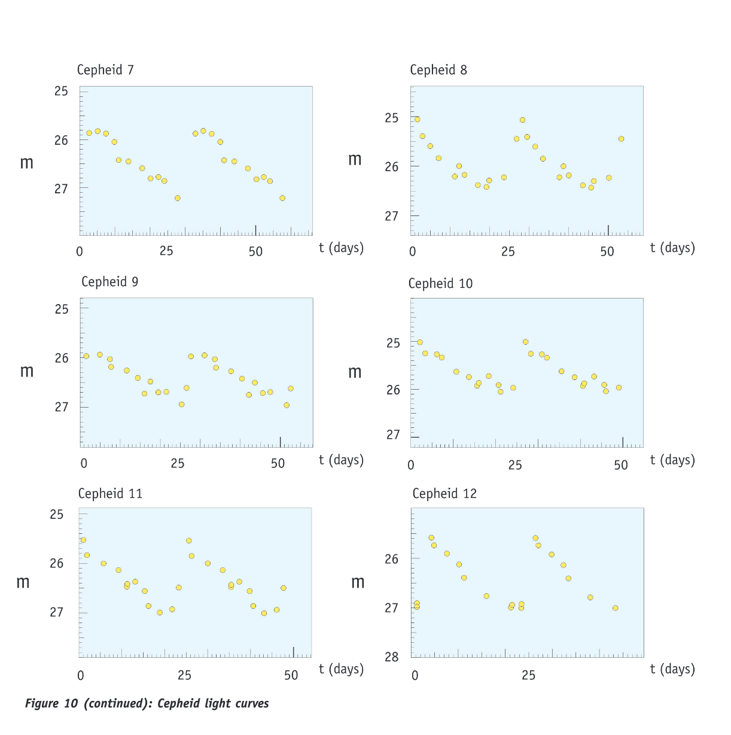
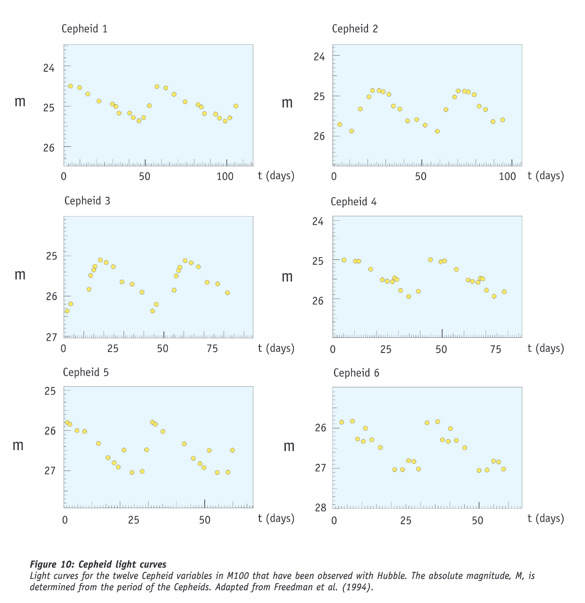

Slide 8
The light curves plot the apparent magnitudes (observed magnitudes) of 12 Cepheids observed in M100 by the Hubble Space Telescope.
From the plotted light curves estimate the pulsation periods (the timescales on which the Cepheids repeat) from the plots. Enter your results in Column 2 of the Table on slide 12.
Using the period-luminosity relationship given on the next slide, Slide 11, estimate the absolute Magnitude, M, for each of the 12 Cepheids. The pictured Cepheids are all Type I (Classical) Cepheids. Enter your results in Column 3 of the Table on slide 12.
The observed average magnitudes, m, for each of the observed Cepheids is given in Column 4 of the Table on slide 12.
I show how to get the period and average Absolute Magnitude, M for for the Cepheid 1 light curve on the next pages.

Slide 9
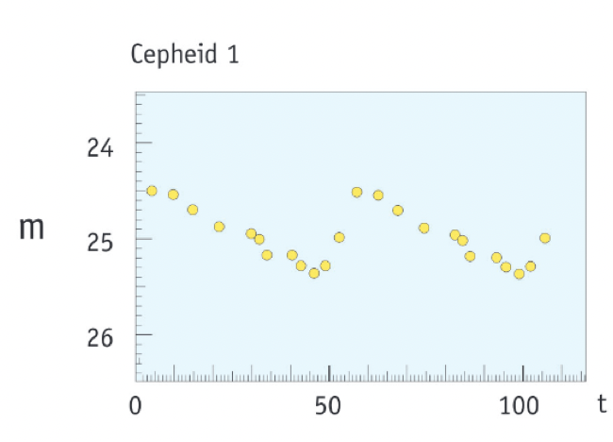
Estimate period, P:
Draw a horizontal line
Find 2 successive times where it strikes the light curve
The cycle runs from 32 days to 84 days or P = 52 days.

Slide 10
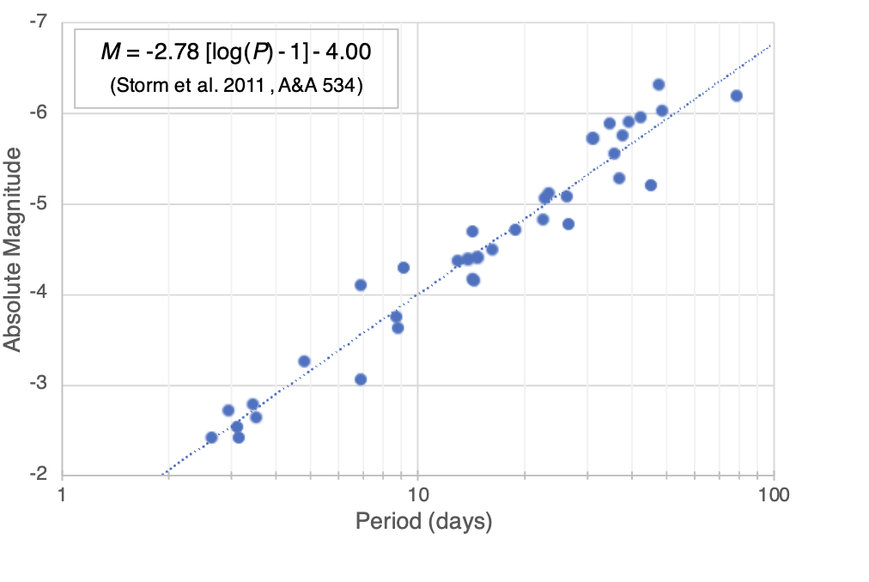
Rather than plotting L, the Absolute Magnitude = -2.5 log (L/4ᴨd²) is plotted.
Using P = 52 days, read M ~ -6 to -6.1
Using M and the observed m, we can infer the distance to M100 from,
D = 5x10^{0.2(m-M)} pc

Slide 11
Using M and the observed m, we can infer the distance to M100,
D = 5x10^{(m-M)/5} pc
= 5x10^{(24.90-[—6.1])/5} pc
= 5x10^{6.2} pc
~ 15,800,000 pc
= 15.8 Mpc (Mega parsec)

Slide 12
Cepheid | Period, P | Absolute M | Apparent m | Distance
1 | 52 days | -6.1 | 24.90 | 15.8 Mpc
2 |  |  | 25.40
3 |  |  | 25.75
4 |  |  | 25.48
5 |  |  | 26.43
6 |  |  | 26.45
7 |  |  | 26.50
8 |  |  | 25.73
9 |  |  | 26.45
10 |  |  | 25.55
11 |  |  | 26.28
12 |  |  | 26.30
Assume that the average of the distances to the Cepheids gives the distance to M100. What is the distance to M100?

Slide 13
Assume that the average of the distances to the Cepheids gives the distance to M100. What is the distance to M100?
What is the distance to the closet Cepheid? What is the distance to the most distant Cepheid? M100 has diameter of about 30,000 pc. Comment on this result as it relates to how accurate is the P-L relation for Cepheids. Estimate about how accurate Cepheid distance measurements are likely to be.
Cepheids offer one of the more powerful methods to set the distance scale of the Universe. They, themselves cannot be seen across the Universe, but are used to calibrate Type I Supernova, the exceedingly bright objects that can be seen across the Universe.

