Slide 1
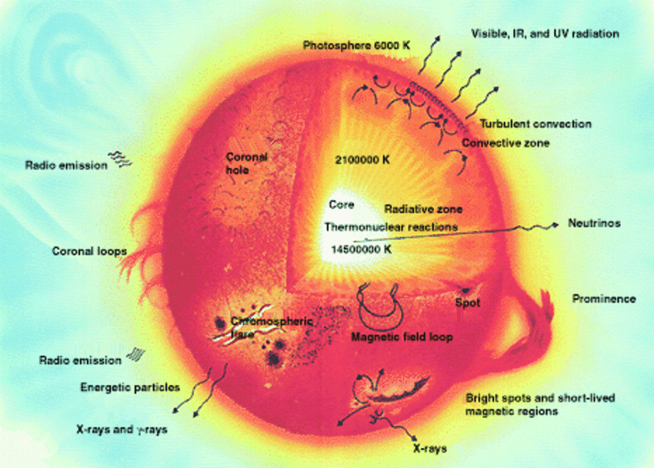
Section 2: Stellar Interiors

Slide 2
What are Some Things about Stars?
Most stars are in thermal and hydrostatic equilibrium, have similar chemical compositions (hydrogen and helium), rotate slowly and have weak magnetic fields which may be ignored. This leads to the Vogt-Russell Theorem*
“The structure of a star, in hydrostatic and thermal equilibrium with all energy derived from nuclear reactions, is uniquely determined by its mass and the distribution of chemical elements throughout its interior.”
Carroll and Ostlie

Slide 3
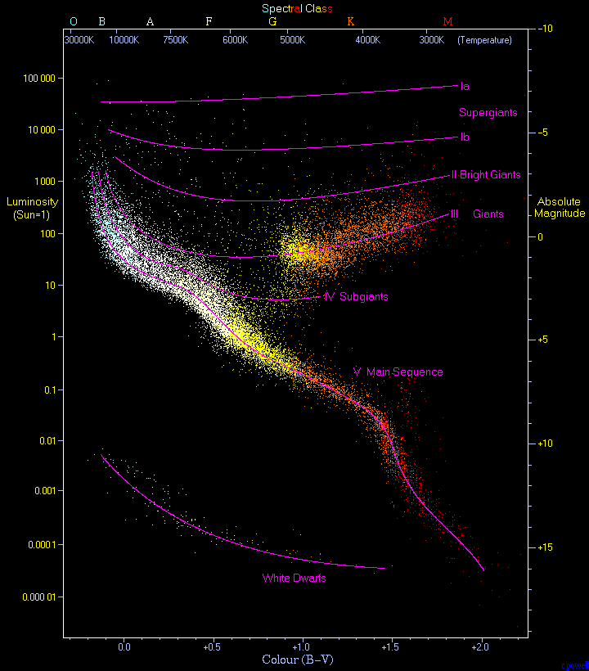
Concentrations where we find stars are where stars are in equilibrium.
Around 90 % of normal stars are found along the Main Sequence.
We first think about Main Sequence stars, but much of our work applies to all “normal” stars.

Slide 4
Equations of Stellar Structure
The equations that govern stellar structure are conservation equations:
Mass Conservation
Momentum Conservation
Energy Conservation
plus relations which describe the microphysics of stars, the equation-of-state, the opacity, nuclear reactions, energy transport processes (radiation, particle, convection, waves, … ), …

Slide 5
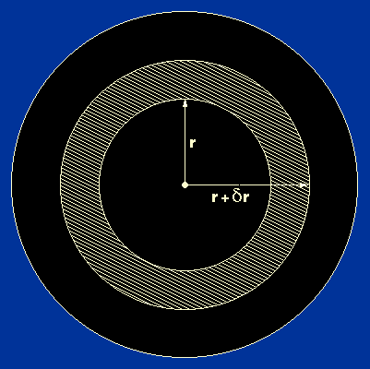
I. Mass Conservation
In the shell between r and r+Δr, an amount of mass Δm = ρ(r)4πr²Δr is contained. In the limit Δr goes to 0, we have that the mass changes with r as
where M(r) is the mass contained within radius r. The differential equation assumes that mass is neither created nor destroyed in the volume. …. .

Slide 6
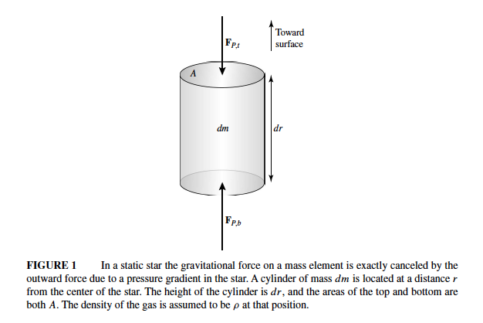
II. Momentum Conservation
In the above equation, we use gravity for a spherically

Slide 7
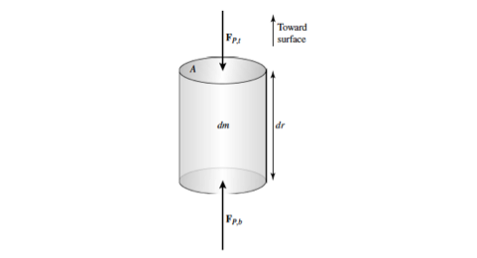
Forces acting on the above cylinder are,

Slide 8
Force balance is then,

Slide 9
Equation-of-State
The equation-of-state (EOS) relates how the pressure P, mass density ρ, internal energy density I, temperature T, entropy S, and composition of the material are related. For stars, the relation depends upon both photons and particles.
For an ideal gas, we have P = nkT, where n is the number density of particles, k is the Boltzmann constant, and T is the temperature.
For photon gases and degenerate gases, the EOS depends upon quantum effects. For a photon gas in equilibrium with matter, P = ⅓aT⁴ where a is the radiation constant. For gases with T = 0 K, the pressure depends only the composition and n of the gas.
For normal stars, we look at classical ideal, photon and degenerate gases.

Slide 10
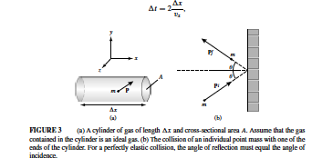
The pressure of a material depends upon the energy stored in its translational degrees-of-freedom. It is independent of the energy stored in its internal degrees-of-freedom.
We set up a simple method through which we can calculate the pressure of any material using kinetic theory.
An incoming particle carrying momentum p_{i} approaches a reflecting surface at angle ϑ_{i} to the normal. The particle reflects at the same angle with the same magnitude of momentum, |p_{i}|. For the collision the particle then delivers an impulse to the wall of
Δp = 2|p_{i}|cos ϑ_{i}

Slide 11
The number of incoming particles for given p is n(p)vAΔt and the total momentum delivered to the wall is n(p)vAΔpΔt = 2n(p)|v|A|p|cos²ϑ_{i}Δt
The pressure, the force per unit area for momentum p is then
For an isotropic particle distribution integrate over dΩ and the pressure is

Slide 12
For a nonrelativistic (NR) gas, p = mv, and we write
where n(v)d³v is the number density of particles with v over the range [v,v+dv].

Slide 13
For a gas that obeys Maxwell-Boltzmann statistics,
we then write
Performing the integral leads to
the ideal Gas Law

Slide 14
For a NR gas when quantum mechanical effects are important, the gas becomes degenerate and no longer follows Maxwell-Boltzmann statistics. The gas obeys the Pauli exclusion principle and so follows the Fermi-Dirac statistics. In this case the pressure integral becomes
The pressure depends only on the matter density ρ, it is independent of the temperature T.

Slide 15
For a strongly relativistic (Rel) gas, v ≈ c, and we write
For Rel gases that obey Fermi-Dirac statistics
or photons governed by the Planck distribution,

Slide 16
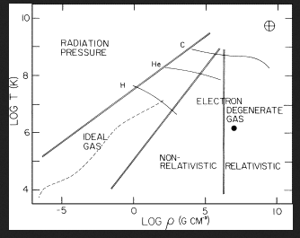

Slide 17
How did we figure out where each form of pressure is dominant?
Radiation pressure vs Gas pressure
Gas pressure vs degenerate pressure
Relatvistic vs nonrelativistic pressure

Slide 18
Radiation pressure vs Gas pressure
Radiation pressure must be taken into account when the temperature is roughly given by

Slide 19
Radiation pressure vs Gas pressure
where we used k = 1.38x10⁻¹⁶ erg K = 0.620, m_{o} = 1.66x10⁻²⁴ g, and a = 7.57x10⁻¹⁵ erg T⁻⁴ cm⁻³.
The Sun has density 150 g cm⁻³ and temperature 14 million K, and radiation pressure is not important in the Sun.

Slide 20
2. Gas pressure vs degenerate pressure
What we really are asking is when do quantum mechanical effects become important?

Slide 21
When do quantum mechanical effects become important?
To get a handle on this, recall the Heisenberg Uncertainty Principle (HUP), ΔxΔp ≥ ½ħ.
For a gas of NR particles, p = mv and E = 0.5(p²/m) and the average particle energy is of order 1.5kT.
Express p in terms of kT,

Slide 22
When do quantum mechanical effects become important?
According to the HUP, the smallest scale on which we can localize the particle is then
For a pure hydrogen gas, this corresponds to

Slide 23
3. Relatvistic vs nonrelativistic pressure

Slide 24
Dimensional Arguments
Let’s start learning an important skill. We estimate the central pressure of stars like the Sun. Rather than solving the equation of hydrostatic equilibrium exactly, we make rough approximations to solve the equation.
Approximate

Slide 25
Dimensional Arguments
Let’s start learning an important skill. We estimate the central pressure of stars like the Sun. Rather than solving the equation of hydrostatic equilibrium exactly, we make rough approximations to solve the equation.
Approximate and

Slide 26
Dimensional Arguments
For the Sun, M* = 1.99x10³³ g and R* = 6.96x10¹⁰ cm, and
P_{c}~ 5.3x10¹⁵ dyne-cm⁻²
Solving
leads to
P_{c}~ 2.7x10¹⁷ dyne-cm⁻²

Slide 27
Dimensional Arguments
For the Sun, the pressure is dominated by ordinary gas pressure which obeys the perfect gas law, P = nkT.
The actual core temperature of the Sun is 15x10⁶ K

Slide 28
Dimensional Arguments
If we are not in hydrostatic equilibrium because of an imbalance between the pressure gradient and gravity, motion will ensue to erase the imbalance.
How quickly will the imbalance be erased?
Let α be a small number, α << 1, and write

Slide 29
Dimensional Arguments
In the spirit of before, write
for ρ = 1 g cm⁻³ and α = 1. Roughly speaking, this says that if the Sun is disturbed from hydrostatic equilibrium it will be punished on a time scale of around 20 minutes.

Slide 30
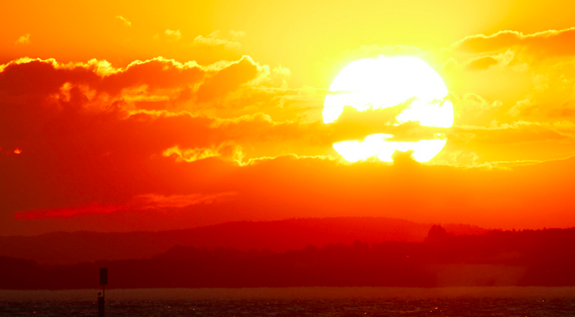
III. Energy Conservation
III. Energy Conservation
Stars continuously lose energy to space. A star radiates energy at the rate given by its luminosity, L. In order to maintain thermal equilibrium, a star must then generate energy at rate L.

Slide 31
What supplies the energy needed to keep the Sun shining?
How much energy is needed?
L = 3.8x10³³ erg s⁻¹
τ = 4.5 billion years (current age)
W = τL = 5x10⁵⁰ erg
Thermal store--1.5kTxN
T_{c}=15x10⁶ K
N=2x10³³ g/(0.62x1.7x10⁻²⁴ g)=1.9x10⁵⁷
W_{th} = 6x10⁴⁸ erg << W ✕

Slide 32
Internal Combustion
Part per unit mass, C—0.3%, O--0.96%
N_{C}=0.03x10⁵⁷ N_{O}=0.1x10⁵⁷, release 10 eV per CO
W_{c} = 5x10⁴⁴ erg << W ✕
Gravitational Energy
W_{g} = -(3/10)(GM²/R)=-1.2x10⁴⁸ erg << |W| ✕
Nuclear Energy
W_{n} = ε(0.1Mc²)=1.3x10⁵¹ erg > W ✔

Slide 33
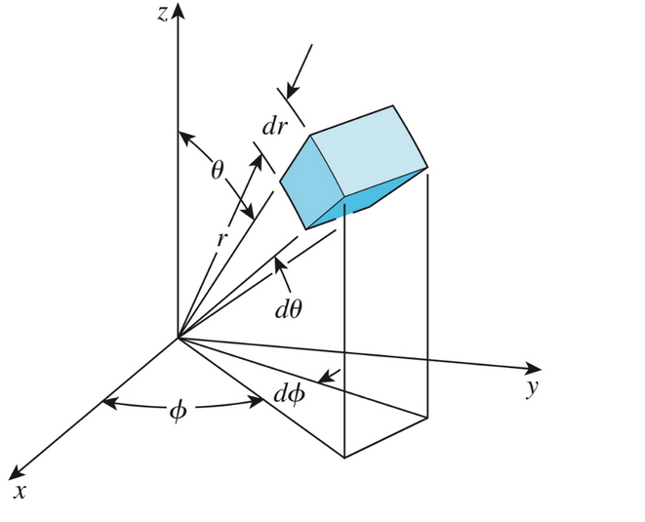
Energy Conservation
a. In the shell, ΔL_{ε} = 4πr²ρεdr
b. To keep the temperature in the shell time-independent, energy must flow out of the box. Energy flows as
c. The numerator is the excess energy in the shell and the denominator is the time it takes for photons to carry (leak) energy out of the shell.

Slide 34
To find Δt, we assume that photons random walk out of the shell.¹ In a random walk, a photon travels a distance Δr given by N^{1/2}λ where N is the number of steps and λ is the average distance traveled between interactions. The average time between interactions is λ/c and so Δt = Nλ/c = (Δr /λ)²(λ/c) = Δr²/(cλ),
and the flux F is
¹In mathematics, a random walk is a random process that describes a path that consists of a succession of random steps on some mathematical space

Slide 35
To see how this flux of energy can empty or fill up a shell, look at
✕ ✕

Slide 36
The total change is then ΔL_{ε}+ΔL_{f}, so that we find,
The above expresses conservation of internal energy. As a simplification which we utilize later, break down solution of this equation into two regions:
The region where nuclear energy generation occurs
The region outside of this where energy transport is dominant.

Slide 37
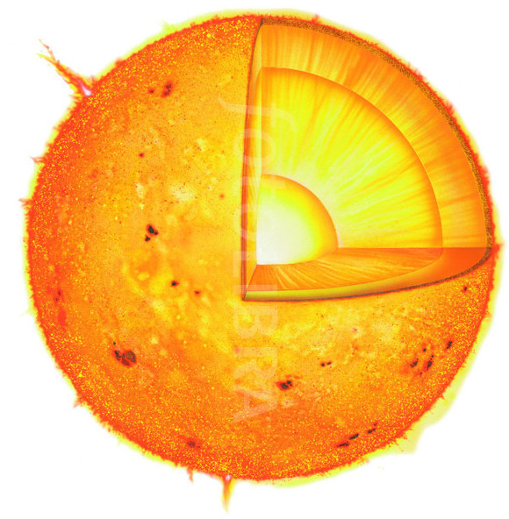
Although it is clear that the simpiification is not accurate, as a first approximation it is okay. Because nuclear reactions require high temperatures and pressures, they occur only in the cores of stars.
The nuclear energy generation region, growing L region,
The energy transport region, constant L region,

Slide 38
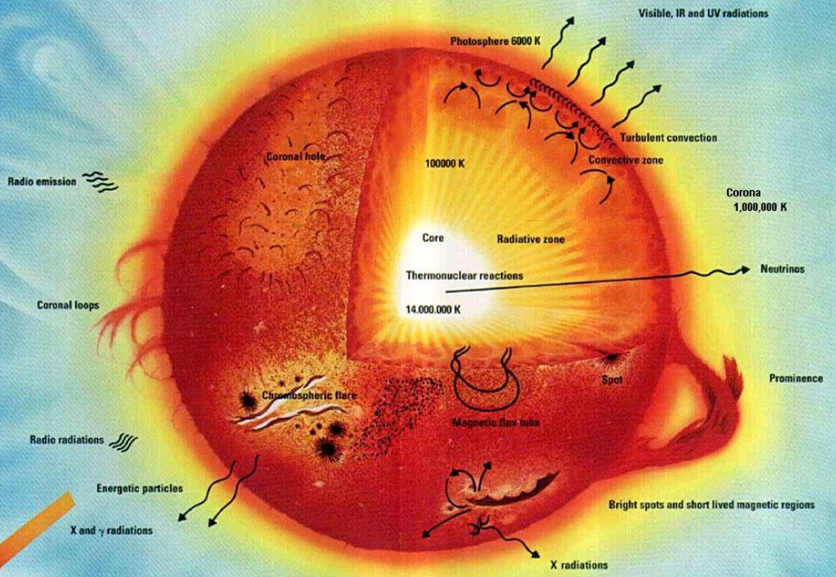
The Sun generates energy in its core through hydrogen burning (proton-proton chain), the energy then flows outward through photon transport giving way to convection and then finally to photon transport in its atmosphere.
In order to solve the energy conservation equation, we need to have forms for the nuclear energy generation rate and the manner in which energy is transported in the interiors of stars. We consider
reaction chains that take us from hydrogen to iron
energy transport mechanisms , convection, photon diffusion, and thermal conduction

Slide 39
Radiative Diffusion
Because the mean free path is λ = 1/(κρ) << Δx, we are in the diffusive approximation and write the radiation energy density appropriate for a blackbody radiator, U = aT⁴,
The above expression is appropriate for gas-photon materials which are in equilibrium as in the interior of a star.
The above formula can be modified to also represent the diffusion of energy by nonrelativistic material particles by using the appropriate forms for the energy density, the signal speed for the particles, and the mean free path for the particles. In this case, we refer to the transfer as thermal conduction.

Slide 40
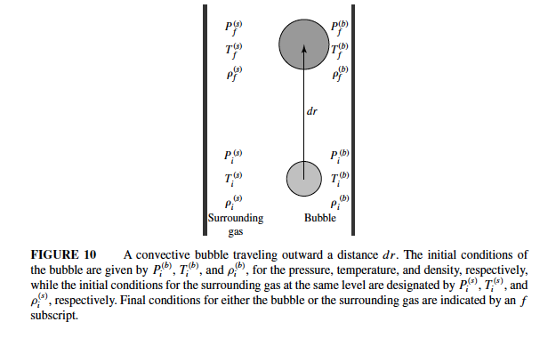
Convection
Convection is the transport of energy by bulk motions of the fluid. Convection in stars is a buoyancy effect where gravity drives the motion. To set-up, see the figure below.

Slide 41
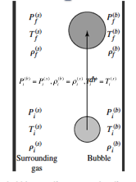
The bubble is, initially, in equilibrium with its surroundings,
As the bubble rises to r+Δr, it maintains pressure equilibrium but not thermal equilibrium,
The bubble’s ρ and T change adiabatically as it rises.

Slide 42
What we want to know is whether the bubble’s density is larger or smaller than the ambient density at r+Δr.

Slide 43
For stability, we want

Slide 44
For instability
In terms of adiabatic T-gradient

Slide 45
We see that if the adiabatic temperature gradient is steeper than the temperature gradient driven by photon diffusion or thermal conduction, then the region is stable to convective motions.

Slide 46
In the interiors of stars, when they are unstable to convection, convection is usually enough to force the material to marginal instability and so drive the temperature gradient to the adiabatic temperature gradient,
and, also, importantly, leads to efficient mixing of material in convective regions.

Slide 47
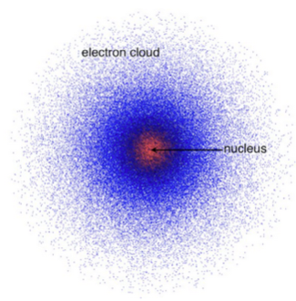
Nuclear Energy Generation
In nuclear reactions, we do not worry about the electrons, the atoms are fully ionized.
For fusion, we worry about the electrical repulsion between the nuclei and the binding due to the strong force.
For nuclear structure, the forces about which we worry are also the electrical repulsion between the protons and the attractive strong force attraction between the protons and neutrons.

Slide 48
Nuclear Structure
The forces of concern are the electrical repulsion between the protons and the attractive strong force attraction between the protons and neutrons.
We cannot make a nucleus composed of only protons, the electrical repulsion would blow it apart.
In the nucleus, neutrons increase the distance between protons and the strong force binding ➔a competition determines the structure of the nucleus.

Slide 49
A nucleus composed of two protons would require a huge external force to hold it together, it is not bound.
If a neutron is added, may not need to add an external force; the added separation and binding due to the neutron may be enough to make the nucleus stable.
If another neutron is added, the added separation and binding can make the nucleus even more stable. The optimal state must be determined by calculation.

Slide 50
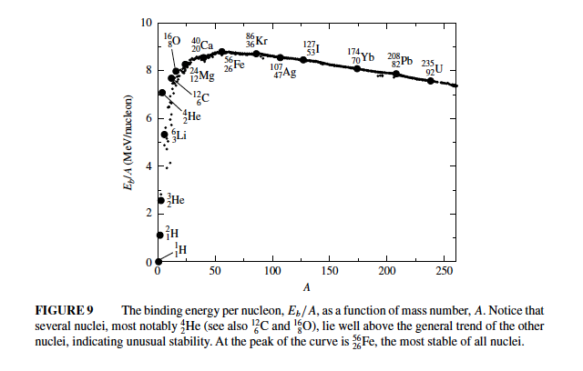
Nuclear Energy Generation and Nucleosynthesis

Slide 51
Fusion fission
Iron is the most tightly bound
Nuclei become easier to bind as A increases. To hold 4 neutrons and protons together is easier than holding two deuterons together (2 nuclei of a n and p together). The un-needed energy is released in a nuclear reaction.

Slide 52
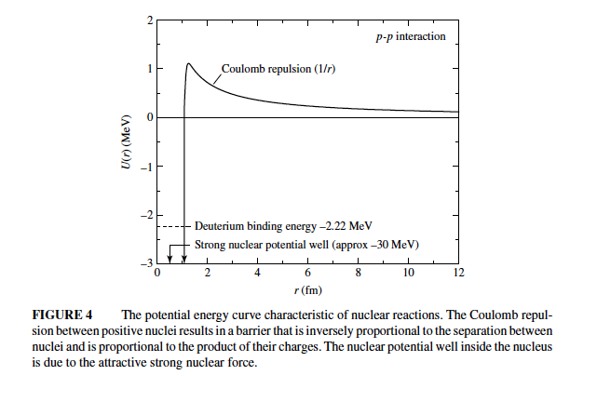
Nuclear Energy Generation

Slide 53
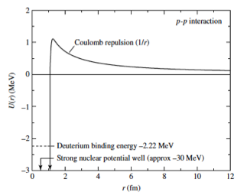
In fusion reactions, the interacting nuclei are bound together by the strong force. The strong force is short range requiring the nuclei to approach to within around a fermi, 10⁻¹³ cm.
The major impediment to fusion is the Coulomb repulsion between the approaching nuclei, the nuclei must approach to within about a fermi, 10⁻¹³ cm. Therefore, in order for fusion to happen, the kinetic energy of the nuclei must be large to overcome the Coulomb repulsion.

Slide 54
We estimate the Coulomb energy using a single particle energy equation. To approach to within a fermi means
The classical temperature needed is nearly 1,000 times larger than the temperature of the Sun’s core. Even for a Boltzmann distribution there are not enough particles with high enough energies to produce the reaction rate needed to power the Sun.
Why does the Sun currently shine at its current rate?

Slide 55
Nuclear Energy Generation
The particle energy is too small to penetrate the barrier (classically).
Quantum mechanically speaking, the nucleus can penetrate the barrier, tunnel.

Slide 56
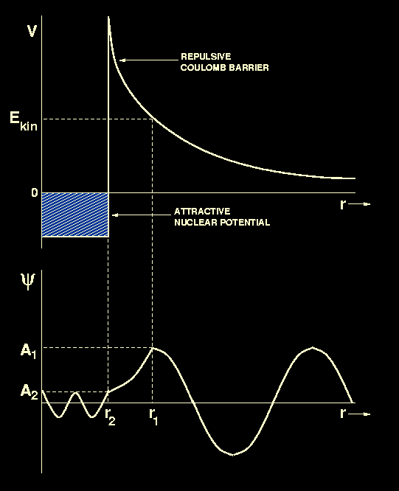
Schroedinger eqn,
Consider stationary states with time-dependence e^{-iωt} and solve in regions where V = 0, V = V_{b}, and V < 0. and match solutions at boundaries and apply conditions at infinity and r = 0.

Slide 57
Roughly, when we do we expect QM to be important?
For L = 10⁻¹³ cm,
This temperature is the average particle energy. Have fair numbers of nuclei at higher E.

Slide 58
Stationary states with time-dependence e^{-iωt} have form
Ψ(r,t)=ψ(r)τ(t)=ψ(r) e^{-iωt} . Insert into Schrodinger equation
Eliminate τ(t) and define E = ħω,
Let α = 2μ(V(r)-E)/ħ² and ψ(r) = Ae^{κr}, then

Slide 59
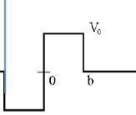
To simplify the calculation, consider a square barrier and a well (see left). Solve for ψ(r) in the three regions, V = 0, V = V_{o}, and V = -V_{o}. Again for α = 2μ(V(r)-E)/ħ² and ψ(r) = Ae^{κr},

Slide 60
To get a rough handle on the tunneling probability, consider only the inward (leftward moving waves and how much the wave attenuates as it moves through the barrier at a given time t.

Slide 61
Estimate b by calculating the classical closest approach for a particle with energy E.
The tunneling probability ncreases with iE because the relative height and width of the barrier gets smaller. However, the # of particles decreases with E,

Slide 62
The prime energy at which fusion takes is shown schematically to the left. The peak falls is referred to as the Gamow peak.

Slide 63
Conservation Laws and Nuclear Energy Generation
Mass and Energy Conservation
Momentum Conservation
Charge Conservation
Baryon Conservation
Lepton Conservation
…
We consider burning chains which occur in normal stars starting with those involving hydrogen up to iron.

Slide 64
Nuclear Energy Generation: Hydrogen Burning
E_{γ} = 0.5(4m_{H}-m_{He}-2m_{e}+-2m_{νe})c² ≈ 26 MeV
4e = 2e + e + 0 + 0
4B = 4B (p + n) + 0 + 0 + 0
0 = 0 + 2 anti-e + 2 neutrino + 0

Slide 65
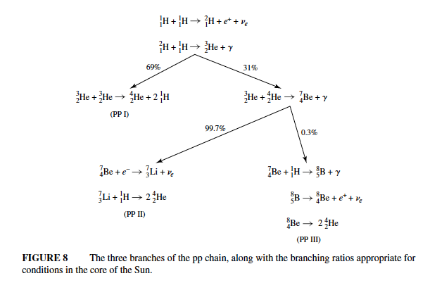
Proton-Proton Chain:

Slide 66
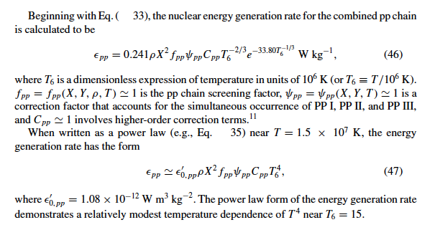
Proton-Proton Chain:

Slide 67
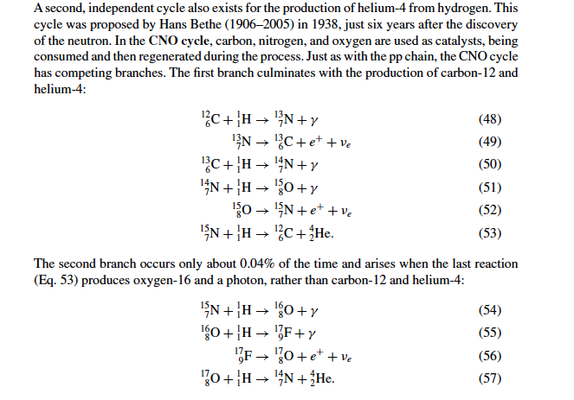
Carbon-Nitrogen-Oxygen Cycle:

Slide 68
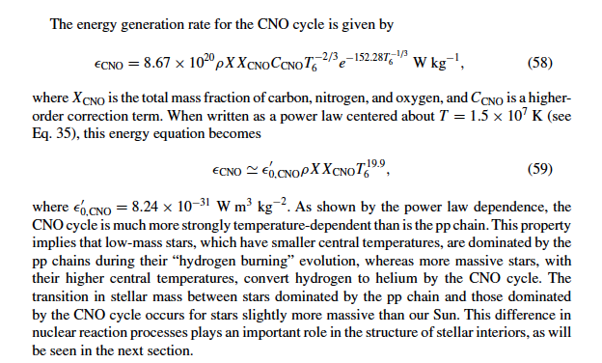
Carbon-Nitrogen-Oxygen Cycle:

Slide 69
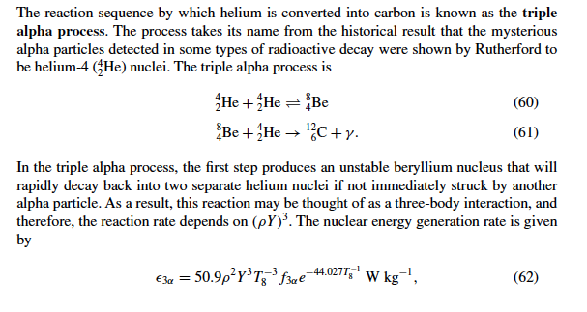
Triple α Cycle:

Slide 70
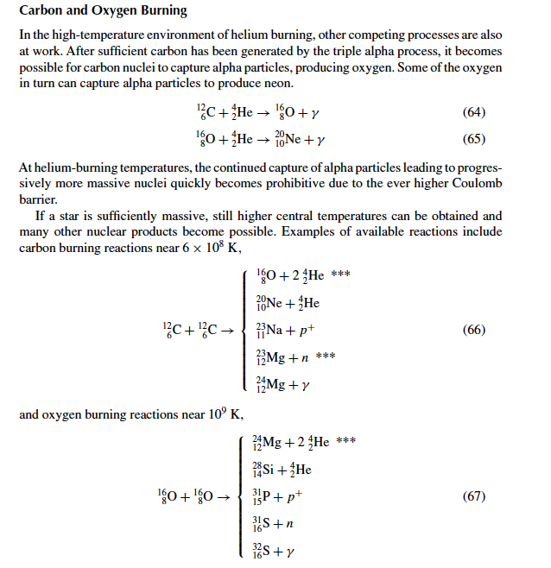

Slide 71
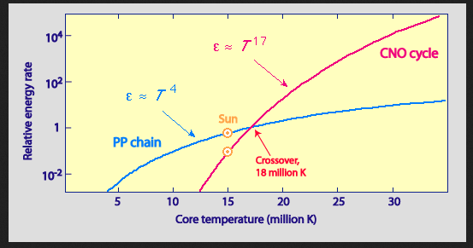

Slide 72
