Slide 1
Section 3: Simple Stellar Structure Models
In this section, we explore simple stellar models. We do not solve the full set of three, coupled differential equations, but, rather, find particular solutions given simplifying assumptions.
We consider two prescriptions for the density, (i) constant density, (ii) linear fall off of density. The solutions allow us to see how well our simple scaling arguments from Section 2 perform.
We consider a prescription for the thermodynamics that allows to solve only the mass and momentum conservation equations, polytropes.

Slide 2
Equations of Stellar Structure
I.
II.
III.

Slide 3
Section 3: Simple Stellar Structure Models
1(i). What does an equilibrium, spherically symmetric, constant density star look like?
I. Mass Distribution

Slide 4
Section 3: Simple Stellar Structure Models
II. Momentum Conservation
Estimate the central pressure. Let r go to R*,

Slide 5
Section 3: Simple Stellar Structure Models
Central Pressure and Temperature
Estimate T_{c}. Use the perfect gas law, P = (ρ/μm_{o})kT, and Solar parameters to find,

Slide 6
Section 3: Simple Stellar Structure Models
III. Energy Conservation
We can’t make further progress unless we know the nuclear energy generation process and the manner in which energy is transported.

Slide 7
Section 3: Simple Stellar Structure Models
1(ii). What does a star with spherically symmetric, density distribution, ρ_{o}(1-r/R*), look like?
I. Mass Distribution

Slide 8
Section 3: Simple Stellar Structure Models
II. Momentum Conservation

Slide 9
Section 3: Simple Stellar Structure Models
Central Pressure and Temperature
Estimate T_{c}. Use the perfect gas law, P = (ρ/μm_{o})kT, and Solar parameters to find,

Slide 10
Section 3: Simple Stellar Structure Models
II. Polytropic Models
Next consider a more realistic but still highly simplified model. Look at what are known as polytropes, objects where the pressure and density are related as
P = Kρ^{γ}
where K is the polytropic constant, and γ is the adiabatic gamma. We usually write γ = 1+1/n, where n is the polytropic index.

Slide 11
Section 3: Simple Stellar Structure Models
Solve the mass and momentum conservation equations
Get rid of M(r)

Slide 12
Section 3: Simple Stellar Structure Models

Slide 13
Section 3: Simple Stellar Structure Models
Cast equation in non-dimensional form. Let,
✕

Slide 14
Section 3: Simple Stellar Structure Models
G and K are physical constants. R_{o} and ρ_{o} may, however, be chosen arbitrarily. Let’s choose them so that
Define a new function and write the famous Lane-Emden equation,

Slide 15
Section 3: Simple Stellar Structure Models
We may model any structure by proper choice of the radius or density normalization. If we choose, R_{o}, then
If we choose ρ _{o} then,

Slide 16
Section 3: Simple Stellar Structure Models
We may model any structure by proper choice of the radius or density normalization. If we choose ρ_{o} or R_{o}, then
and the mass, M, is not free parameter because of the relationship between ρ_{o} and R_{o}.
For a given mass, M, there is only one acceptable pair of ρ_{o} and R_{o} values.

Slide 17
Section 3: Simple Stellar Structure Models
There are analytic solutions for certain values of n.
n = 0
Try a power law solution, D_{o} = aξ^{b}.

Slide 18
Section 3: Simple Stellar Structure Models
As a trial function, try a power law solution, D_{o} = aξ^{b}+c.
To be true for all ξ, the bracketed term must be 0.

Slide 19
Section 3: Simple Stellar Structure Models
To be true for all ξ, the bracketed term must equal to 0,
consequently, we require that b = 2 and a = -2π/3. For n = 0, the solution is then
where c was not determined and is found from the boundary conditions.

Slide 20
Section 3: Simple Stellar Structure Models
What are the appropriate boundary conditions for
At the origin, ξ = 0, D_{n} = 1 and dD_{n}/dξ = 0, there is no cusp in D_{n}. For n = 0, because η = D^{n} , this means that the density is constant and c = 1.
Analytic solutions also exist for n = 1, and 5. Find these solutions.

Slide 21
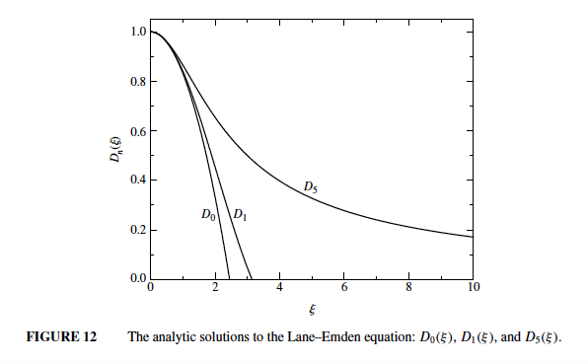
Section 3: Simple Stellar Structure Models

Slide 22
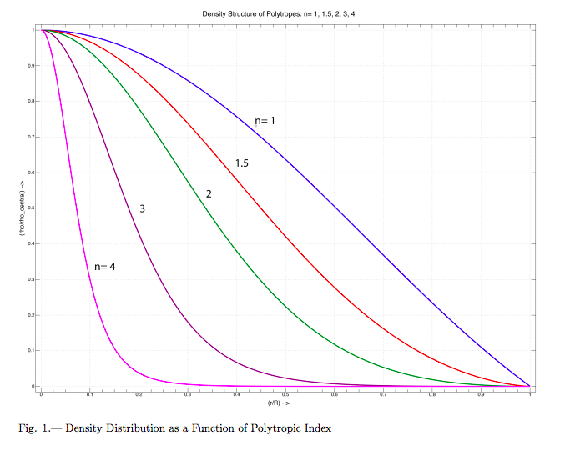
Section 3: Simple Stellar Structure Models

Slide 23
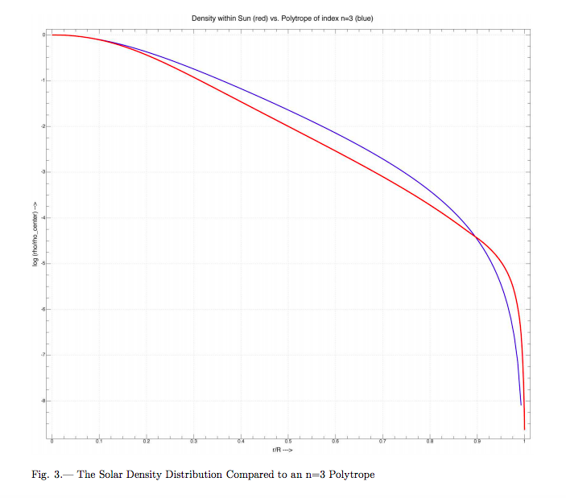
Section 3: Simple Stellar Structure Models

Slide 24
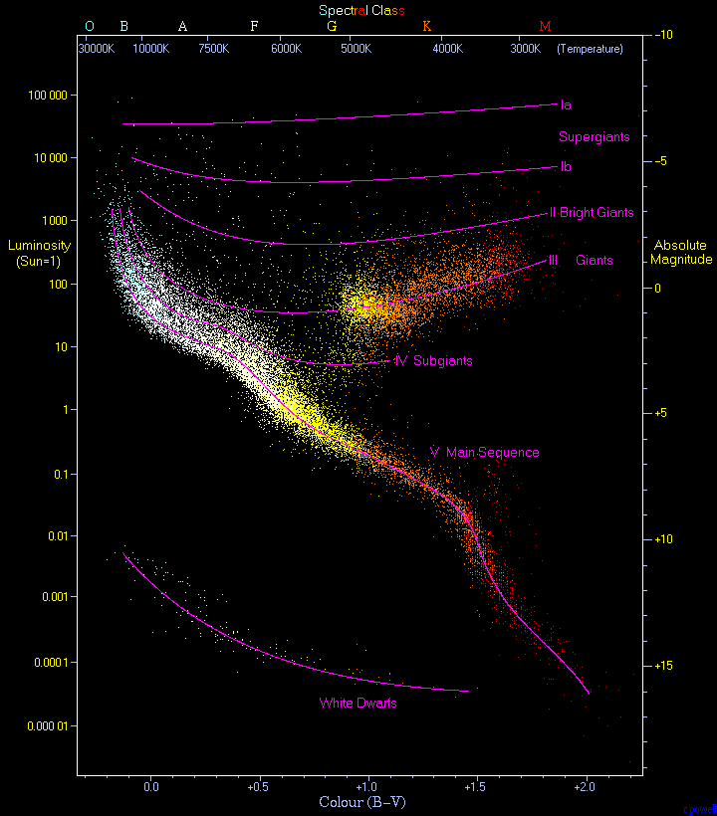

Slide 25
Section 3: Simple Stellar Structure Models
For the next few pages, we will see if we can understand the properties of Main Sequence stars using dimensional analysis. We will look at
Mass-Luminosity relationship
Upper and lower mass limits on Main Sequence stars
Mass-radius relationship

Slide 26
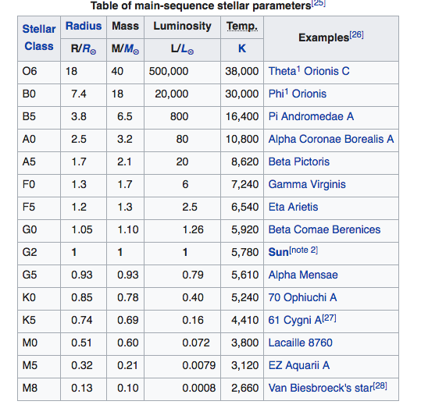

Slide 27
Section 3: Simple Stellar Structure Models
I. Mass-Luminosity relationship
Use dimensional arguments; keep only the non-constant terms,
Scale to the Sun

Slide 28
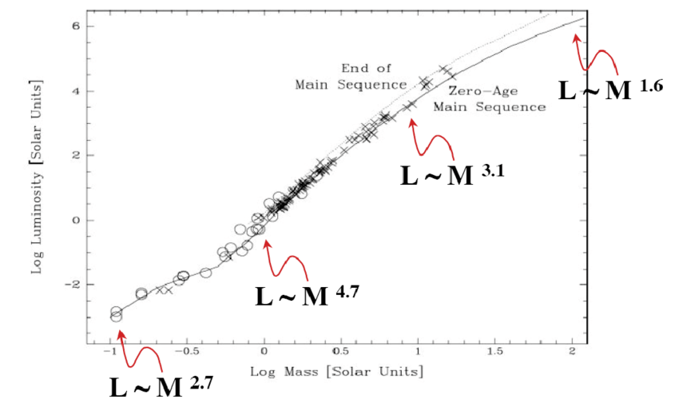

Slide 29
Section 3: Simple Stellar Structure Models
IIa. Main Sequence Upper Mass Limit
Unstable, Eddington Limit

Slide 30
Section 3: Simple Stellar Structure Models
For massive stars,
A little high, but in the right ballpark. If not the direct reason likely the correct reason is a related.

Slide 31
Section 3: Simple Stellar Structure Models
IIb. Main Sequence Lower Mass Limit
A protostar has not yet ignited nuclear fusion so, as it radiates, it cools and contracts compressing and heating. Eventually, it compresses and heats to the point where fusion ignites in its core and it becomes a star. This happens when its core temperature reaches around 10 million K.

Slide 32
Section 3: Simple Stellar Structure Models
As a protostar contracts and heats, a complication may set in. If the protostar becomes compact enough, quantum mechanical effects become important and we must take account of the Pauli exclusion principle, degenerate gas pressure becomes important. This happens when uncertainty principle effects,
are non-negligible. When does this happen?

Slide 33
Section 3: Simple Stellar Structure Models
For a gas with number density n and thermal energy kT, let’s estimate when this happens.
n implies average particle separation of n^{-1/3}
kT implies average momentum of p = (3mkT)^{1/2}
Quantum effects will be important when

Slide 34
Section 3: Simple Stellar Structure Models
Quantum effects will be important when
or ρ ≈ 690 g cm⁻³. The central density of a 0.1 solar mass star is around 500 g cm⁻³. Detailed calculations show that QM effects become important in stars with 0.08 solar masses.

Slide 35
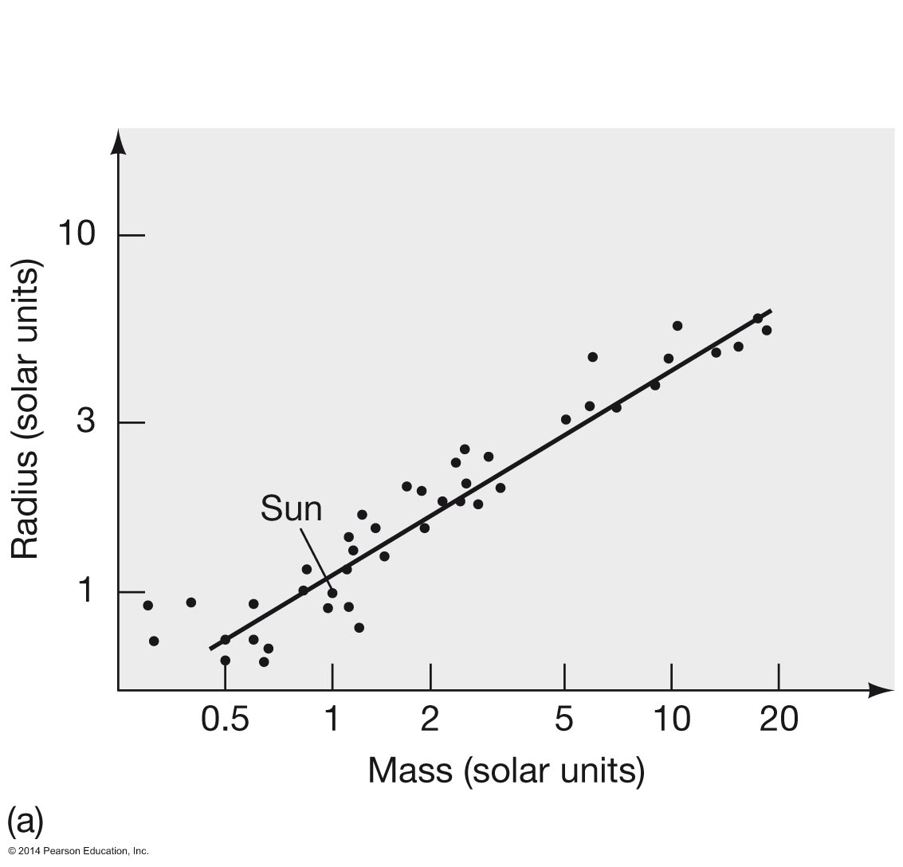
The density increases with decreasing mass
R α M^{0.6}
R α M^{0.9}

