Slide 1
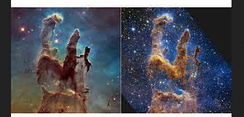
Section 4: Star Formation
Pillars: Hubble vs Webb
Is star formation currently on-going in the Milky Way?
ε = 0.007 and for solar-type stars, α = 3.1. We see O and B stars! Star formation is on-goingl

Slide 2
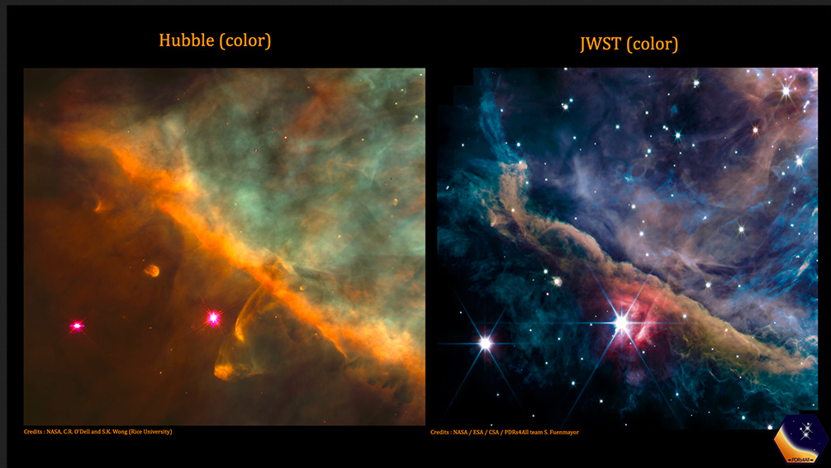
Section 4: Star Formation

Slide 3
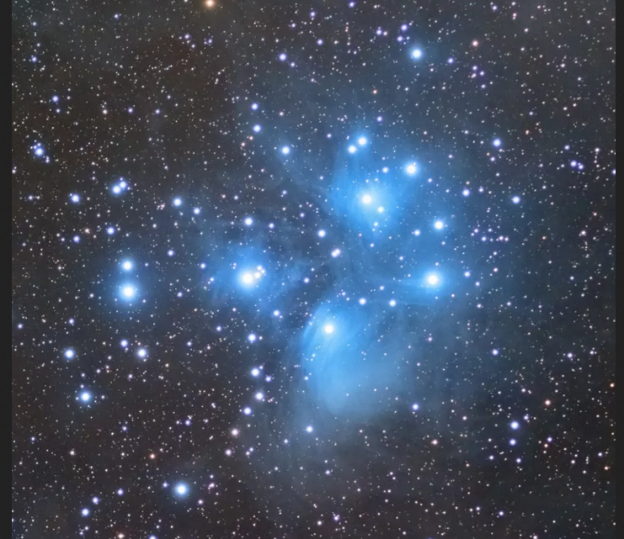
Section 4: Star Formation

Slide 4
Where does star formation take place?
Star Formation takes place in condensed cores in Giant Molecular Clouds (GMC). GMCs are large gas clouds composed primarily of H₂, molecular hydrogen. GMCs do contain some dust, they are about 2 % by mass of dust.
They have masses of 10⁴ to 10⁷ M_{s} and large sizes, a few light years. GMCs are dense 100 to several million molecules per cm³. The density of air in this room is roughly 10¹⁸-10¹⁹ molecules per cm³, and the average density of particles in our Galaxy is around 1 atom per cm³. GMCs are cold, T ~ 10-50 K.

Slide 5
The star formation process is amazing taking the condensed ISM clouds to Main Sequence stars -- objects with central T ~ 10⁷ K, n ~ 10²⁶ particles per cm³, and Radii ~ million or so km (~ 3 light-seconds!)--the whole process driven by gravity.
Star forming clouds are initially in hydrostatic and thermal equilibrium, star formation must be triggered--clouds have low pressures due to their low n and T. Triggers compress the clouds which pushes all particles closer together and so increases the inward pull of gravity on the cloud. Many triggers have been proposed.
Why do the clouds continue to collapse after the trigger?

Slide 6
Although there are only tiny amounts of dust, dust is a emitter of light over a broad range of energy (strong continuous emission) and is an efficient absorber and scatterer of visible light.
This prevents us from seeing star forming regions in the optical; dust; it does not affect IR and microwaves as much as optical, though. IR and microwaves offer the best views of the star forming regions.
Dust strongly cools contracting clouds. Initially, the clouds are optically thin to IR and dust cools the collapsing clouds. Only when the clouds become dense enough is heat trapped and collapse halts.

Slide 7
What is the rate for star formation?
There are ~200 billion stars in the Milky Way. The Milky Way is roughly 10 billion years old. The average mass of a Milky Way star is somewhat less than the mass of the Sun, 0.3 or so M_{s}. The exact value is not important for this argument as any star a little less massive than the Sun has an age longer than the lifetime of the Milky Way. We estimate an average star formation rate of 20 stars per year.

Slide 8
How Long Does Star Formation Persist?
Roughly, 4 M_{s} of material goes into star formation every year (7 stars per year are thought to form in the Milky Way galaxy, based on study of ₁₃Al²⁶ by Integral).
Stars return roughly 1 - 2 M_{s} per year back to the ISM ===> a net loss of gas of roughly 2 or 3 M_{s} per year. Currently, the ISM contains 10-15 % of the visible mass of the Milky Way ===> ten or so billion M_{s} of gas and dust, the materials out of which stars form. Star formation will persist in the Milky Way galaxy for billions or more years. Has the rate been steady?

Slide 9
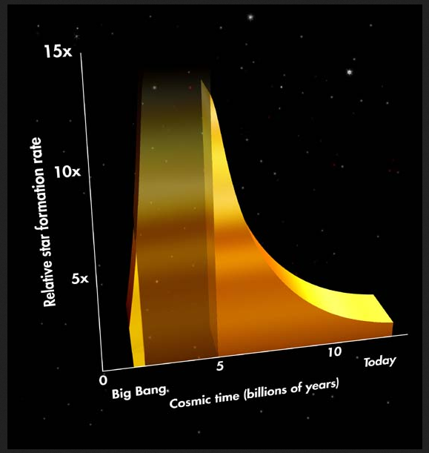
Section 4: Star Formation

Slide 10
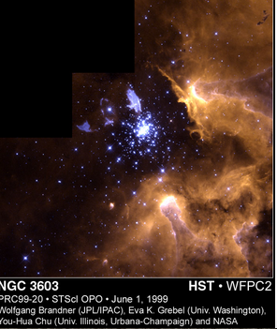
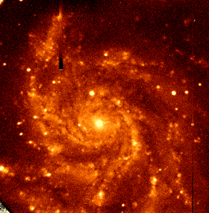
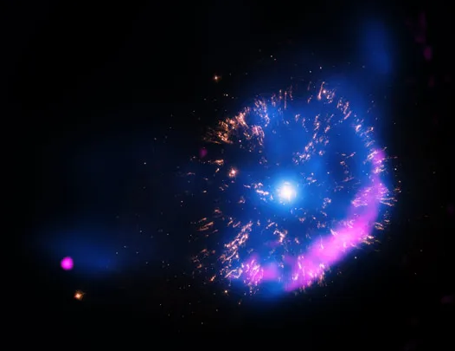
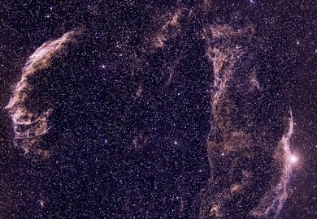
Triggers

Slide 11
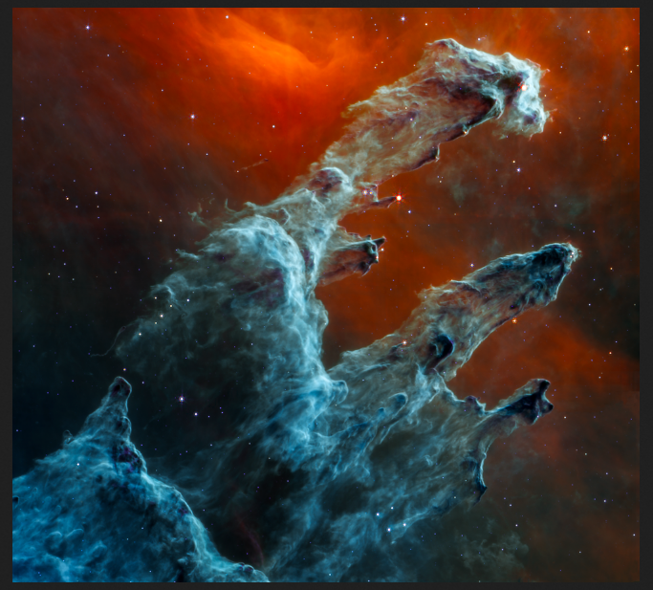
Section 4: Star Formation

Slide 12
What is the Jeans Mass, M_{J}?
I. Virial Theorem

Slide 13
Virial Theorem:

Slide 14
Energy and the Virial Theorem
Monotomic gas
Diatomic molecular gas
Relativistic gas
CASES

Slide 15
II. Jeans Mass
Say we have an uniform ISM cloud with T = 10 K, and n = 1,000 cm⁻³ (3.4x10⁻²¹ g), initially in equilibirum. Then,
<3(γ-1)U> = 3(γ-1)NkT = 3(γ-1)(M/2m_{H})kT
<W_{g}> = -0.6GM²/R = -0.6GM^{5/3}(2m_{H}n)^{1/3}
sum to 0, suggesting a critical mass, the Jeans Mass,

Slide 16
The Jeans Mass,
increases with temperature and decreases with density.
Do these properties seem reasonable to you?

Slide 17
The Jeans Mass,
HI cloud, T = 50 K, n = 500 cm⁻³, M_{J} = 1,500 M_{s}
H2 cloud, T = 10 K, n = 8,000 cm⁻³, M_{J} = 4 M_{s}
For 1 M_{s}, n = 1.2x10⁵ cm⁻³ if T = 10 K
The first clouds to become unstable have M_{J} >> 100 M_{S}, the upper mass limit for Main Sequence stars. Low mass clouds become unstable at high density. Star formation is a top-down process and suggests FRAGMENGTATION occurs.

Slide 18
Fragmentation
HI cloud, T = 50 K, n = 500 cm⁻³, M_{J} = 1,500 M_{s}
H2 cloud, T = 10 K, n = 8,000 cm⁻³, M_{J} = 4 M_{s}
For 1 M_{s}, n = 1.2x10⁵ cm⁻³ if T = 10 K
Initially, ignore pressure because the cloud can cool efficiently and so remains cold

Slide 19
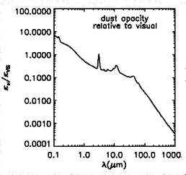
HI cloud, T = 50 K, n = 500 cm⁻³, M_{J} = 1,500 M_{s}
H2 cloud, T = 10 K, n = 8,000 cm⁻³, M_{J} = 4 M_{s}
For 1 M_{s}, n = 1.2x10⁵ cm⁻³ if T = 10 K
6060 Å, kappaV = 2.3 × 104 gr-1

Slide 20
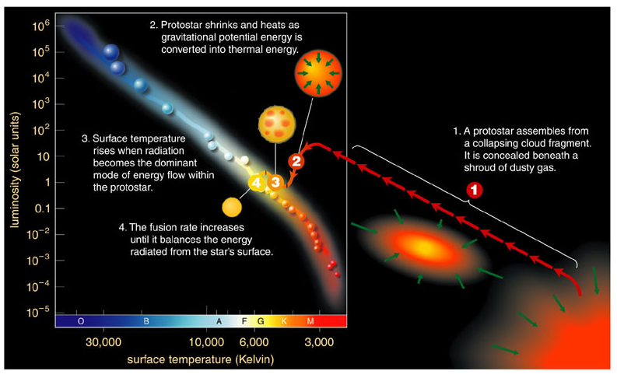
Schematic for Star Formation

Slide 21
Timeline for Star Formation
Can We Make Sense of the General Tracks?
The initial phase is a pressureless collapse, the collapsing cloud is optically thin to infrared radiation (IR)
The pressureless collapse halts when the cloud becomes optically thick to IR
Slow contraction ensues:
Hayashi track
slow contraction to hydrogen ignition, Zero Age Main Sequence

Slide 22
Timeline for Star Formation
Estimate Timescales
Homologous, pressure-free collapse:

Slide 23
Homologous Collapse

Slide 25
Timeline for Star Formation
2. Slow Contraction Phases
Assume contraction is slow enough to use a quasi-static approximation. Start with energy equation
Rewrite using Virial Theorem

Slide 26
Timeline for Star Formation
Slow contraction phases
Use γ=5/3, assume uniform sphere, and take time derivative of energy equation
For Hayashi track, use constant T_{eff} so that L = 4πσR²σT_{eff}⁴ so that

Slide 27
Timeline for Star Formation

Slide 28
Timeline for Star Formation
For slow radiative track, assume constant L

Slide 29
SUN: ISM, n=10³ cm⁻³, Hayashi, T_{eff}=4000 K,R=0.5[10⁸-10⁷], radiative, L=0.4-0.7,R=1.4-0.8

Slide 30
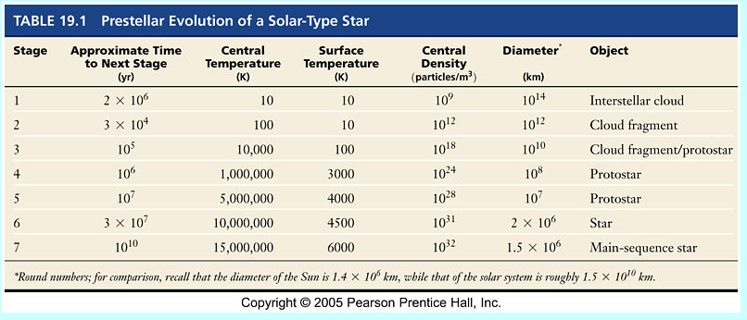
Timeline for Star Formation

Slide 31
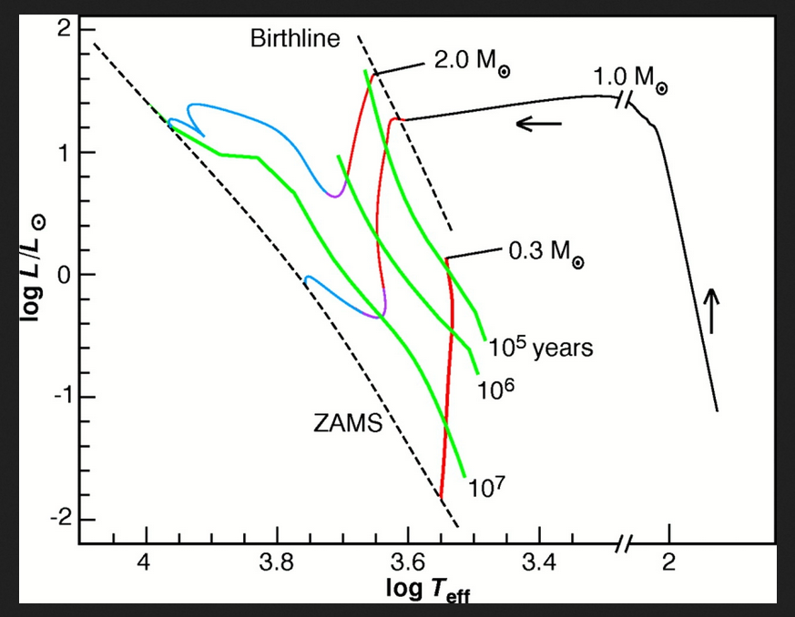
Schematic for Star Formation

Slide 32
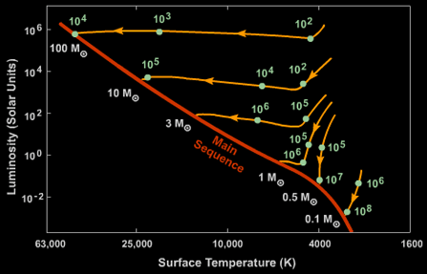

Slide 33
Multiple Star Systems
The preceding discussion concerned the formation of single stars. However, more than half (and perhaps up to 85 %) of all stars are in mulitple (double star, triple star, quadruple star, ... ) star systems. In addition, over 1,000 extra-Solar planetary systems are known. Thus an important point to try and understand is how do we form multiple star systems and planetary systems.
Do binary star systems form by captures of random stars or do the stars in the systems form at the same time from the same cloud?
P(orbital) > 100 years, M₁/M₂ is roughly the same as for indiviual stars observed in the Galaxy ===> stars probably form as individual stars, either because the binary system is so large that they form essentially as individual stars or because they formed in different regions and simply were captured into the binary system.
P(orbital) < 100 years, years, M₁/M₂ ~ 1 ➔ stars in short orbital period binary star systems (and in the extreme, planetary systems) probably form as units.
The theory of how individual stars form is in fairly good shape. The details of how binary stars form is much less secure.

Slide 35
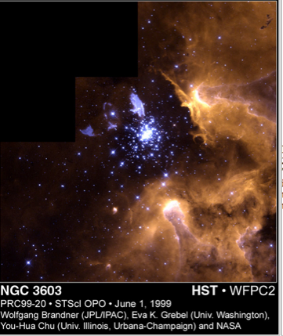
HUBBLE SNAPSHOT CAPTURES LIFE CYCLE OF STARS
In this stunning picture of the giant galactic nebula NGC 3603, the crisp resolution of NASA's Hubble Space Telescope captures various stages of the life cycle of stars in one single view and highlights how astronomers study the evolution of objects whose lifetimes are much longer than human lifetimes (and, in fact, humanity's lifetime).

Slide 36
To the upper right of center is the evolved blue supergiant called Sher 25. The star has a unique circumstellar ring of glowing gas that is a galactic twin to the famous ring around the supernova 1987A. The grayish-bluish color of the ring and the bipolar outflows (blobs to the upper right and lower left of the star) indicates the presence of processed (chemically enriched) material

Slide 37
Near the center of the view is a so-called starburst cluster dominated by young, hot Wolf-Rayet stars and early O-type stars . A torrent of ionizing radiation and fast stellar winds from these massive stars has blown a large cavity around the cluster.

Slide 38
The most spectacular evidence for the interaction of ionizing radiation with cold molecular-hydrogen cloud material are the giant gaseous pillars to the right and lower left of the cluster. These pillars are sculptured by the same physical processes as the famous pillars Hubble photographed in the M16 Eagle Nebula.

Slide 39
Dark clouds at the upper right are so-called Bok globules , which are probably in an earlier stage of star formation.
To the lower left of the cluster are two compact, tadpole-shaped emission nebulae. Similar structures were found by Hubble in Orion, and have been interpreted as gas and dust evaporation from possibly protoplanetary disks (proplyds). The "proplyds" in NGC 3603 are 5 to 10 times larger in size and correspondingly also more massive

Slide 40
This single view nicely illustrates the entire stellar life cycle of stars, starting with the Bok globules and giant gaseous pillars, followed by circumstellar disks, and progressing to evolved massive stars in the young starburst cluster. The blue supergiant with its ring and bipolar outflow marks the end of the life cycle.

