Slide 1
Section 3: Simple Stellar Structure Models
We explore simple stellar models and some properties of Main Sequence stars. We do not solve the full set of coupled differential equations, rather, we find particular solutions for simplifying assumptions.
We make further dimensional arguments to see if we can understand more properties of Main Sequence stars.
We consider two prescriptions for the density, (i) constant density, (ii) linear fall off of density. The solutions allow us to see how well our simple scaling arguments perform.

Slide 2
Equations of Stellar Structure
I.
II.
III.

Slide 3
Dimensional Analysis
We first see if we can understand further properties of Main Sequence stars using dimensional analysis. We look at
Mass-Luminosity relationship
Upper and lower mass limits on Main Sequence stars
Mass-radius relationship

Slide 4
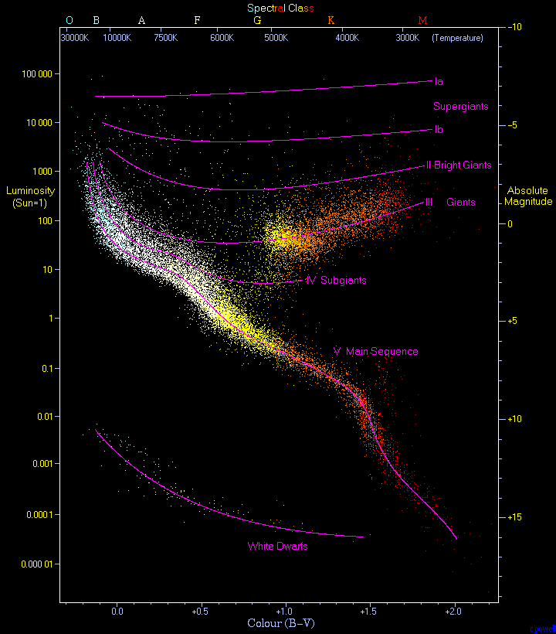

Slide 5
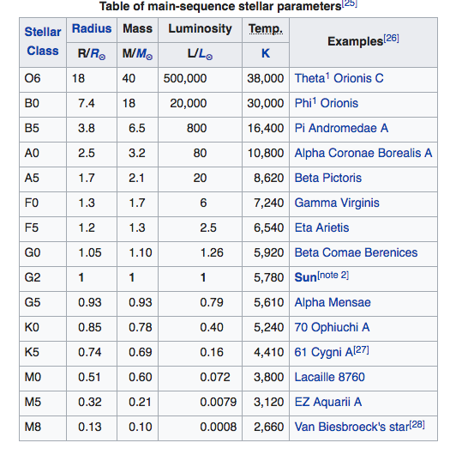

Slide 6
I. Mass-Luminosity relationship
Use dimensional arguments; keep only the non-constant terms,
Scale to the Sun

Slide 7
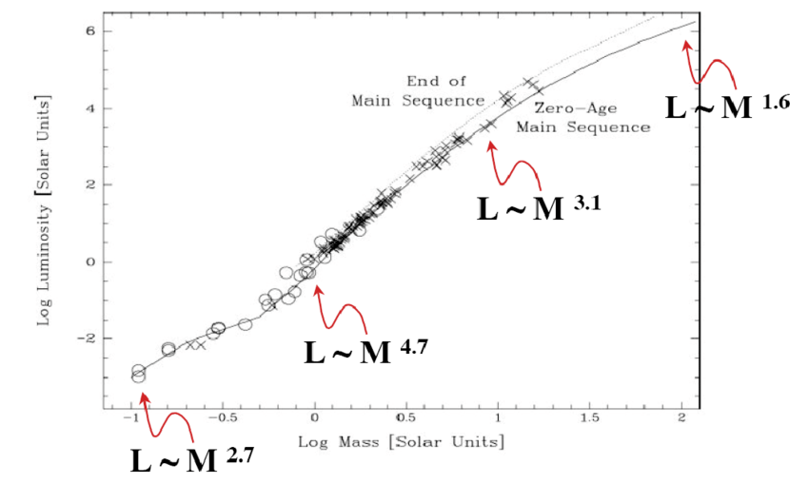

Slide 8
IIa. Main Sequence Upper Mass Limit
Unstable, Eddington Limit

Slide 9
A little high, but in the right ballpark. If not the direct reason likely the correct reason is related.

Slide 10
IIb. Main Sequence Lower Mass Limit
A protostar has not yet ignited nuclear fusion so, as it radiates, it cools and contracts compressing and heating. Eventually, it compresses and heats to the point where fusion ignites in its core and it becomes a star. This happens when its core temperature reaches around 10 million K.

Slide 11
As a protostar contracts and heats, a complication may set in. If the protostar becomes compact enough, quantum mechanical effects become important and we must take account of the Pauli exclusion principle, degenerate gas pressure becomes important. This happens when uncertainty principle effects,
are non-negligible. When does this happen?

Slide 12
For a gas with number density n and thermal energy kT, estimate when this happens.
n implies average particle separation of n^{-1/3}
kT implies average momentum of p = (3m_{e}kT)^{1/2}
Quantum effects will be important when

Slide 13
Quantum effects will be important when
The central ρ of a 0.1 M star is ~ 500 g cm⁻³. (i) For smaller M, ρ is larger and, (ii) Brown dwarfs, failed stars, have T ~ 10⁶ K. Detailed modeling finds that QM effects are important in stars below 0.08 M.

Slide 14
Section 3: Simple Stellar Structure Models
We explore simple stellar models and some properties of Main Sequence stars. We do not solve the full set of coupled differential equations, rather, we find particular solutions for simplifying assumptions.
We consider two prescriptions for the density, (i) constant density, (ii) linear fall off of density. The solutions allow us to see how well our simple scaling arguments from Section 2 perform.
We make dimensional arguments to see if we can understand some properties of Main Sequence stars.

Slide 15
Equations of Stellar Structure
I.
II.
III.

Slide 16
1(i). What does an equilibrium, spherically symmetric, constant density star look like?
I. Mass Distribution

Slide 17
II. Momentum Conservation
Estimate the central pressure. Let r go to R*,

Slide 18
Central Pressure and Temperature
Estimate T_{c}. Use the perfect gas law, P = (ρ/μm_{o})kT, and Solar parameters to find,

Slide 19
III. Energy Conservation
We can’t make further progress unless we know the nuclear energy generation process.

Slide 20
1(ii). What does a star with spherically symmetric, density distribution, ρ_{o}(1-r/R*), look like?
I. Mass Distribution

Slide 21
II. Momentum Conservation

Slide 22
Central Pressure and Temperature
Estimate T_{c}. Use the perfect gas law, P = (ρ/μm_{o})kT, and Solar parameters to find,

