Slide 1
Physics 421M Course CRN: 15532 Class: 09:30-10:30, MWF, 00 REMOTE Text: Mathematical Methods in the Physical Sciences, 3rd Ed., Mary L. Boas https://pages.uoregon.edu/imamura/421/physics.421.html
Instructor: James Imamura
Office: 457 Willamette Hall E-mail: imamura@uoregon.edu Phone: 541-346-5212 Office Hours: by appointment

Slide 2
Grading:
Homework: 50 pts Tests will be take-home exams Test 1: 50 pts Test 2: 50 pts Final: 70 pts Total: 220 pts
Tests:
Test 1: Wednesday, October 28, 2020 Test 2: Wednesday, November 25, 2020 Final: Thursday, December 10, 2020 @ 10:15

Slide 3
Material:
Vector Algebra. Chapters 3.4,3.5,6.1-6.3: vector analysis and vector operations, addition, subtraction, multiplication (scalar, dot product, cross product), multiplication involving 3 or more vectors (Triple Scalar Product, Triple Vector Product, Laplace's Identity, and applications); vector functions. rotations (Chapter 3.7) and vectors as first rank tensors (and scalars as zero rank tenors) (Chapter 10.2). For additional enrichment and enjoyment on other transformations needed for Cartesian vectors, see 10.6. 10.6 not to be tested.
Vector Calculus. Chapter 6.4-6.12, parts of Chapter 4 (Partial Differentiation), Chapter 5 (Multipole Integrals, Applications of Integration), and Chapter 10 curvlinear coordinate systems and some Tensor Analysis.
Chapter 7 (Fourier Series and Transforms), Chapter 8 (Ordinary Differential Equations), Chapter 12 (Series solutions of differential equation, Legendre, Bessel, Hermite, and Laguerre functions), Chapter 13 (Partial Differential Equations)

Slide 4
VECTOR CALCULUS
Physical quantities, positions, velocities, accelerations, … , may be represented geometrically, by directed line segments,
algebraically (in some coordinate system),
v v
a
y
x
A = (A_{x},A_{y})

Slide 5
Vector formulas, such as F = ma, p = mv, l = rxp, …, do not depend upon coordinate system, consequently, we like express relations in vector forms.
We briefly review some notation, and simple operations, addition, subtraction, and multiplication of vectors before moving on to vector calculus.

Slide 6
Vector Length:
|A|²=A_{x}²+A_{y}²
In n-dimensions
|A|² = Σ A_{i}A_{i}
n
i=1

Slide 7
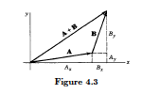
Vector Addition:
A+B
A+B=(A_{x}+B_{x},A_{y}+B_{y},A_{z}+B_{z})
Commets:
A+B=B+A, commutative
A+B+C =(A+B)+C=A+(B+C), associative

Slide 8
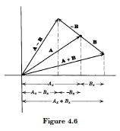
Vector Subtraction:
A-B
A-B=(A_{x}-B_{x},A_{y}-B_{y},A_{z}-B_{z})
Comments:
A-B=A+(-B)=(-B)+A
-A-B-C=(-A-B)-C=-A+(-B-C)

Slide 9
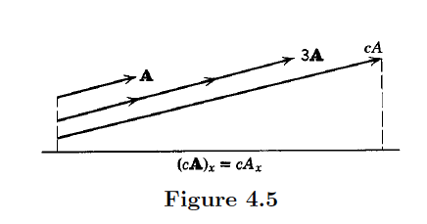
Vector Multiplication by a constant:

Slide 10
Problem 3.4: Show that the diagonals of a parallelogram bisect each other.
I
B
A

Slide 11
Problem 3.4: Show that the diagonals of a parallelogram bisect each other.
I
B
A
I

Slide 12
Problem 3.4: Show that the diagonals of a parallelogram bisect each other.
I
A+B
B
A
I

Slide 13
Problem 3.4: Show that the diagonals of a parallelogram bisect each other.
I
A+B
A-B
B
A
I

Slide 14
Write two vectors, one approaching
from the left and one from the right,
I_{L} = B+α(A-B) and I_{R} = (A+B)-β(A+B)
where α > 0 and β > 0. Note that I_{L} = I_{R} and solve for α and β. This leads to α = β = ½. Could also do this problem algebraically.

Slide 15
Vector Multiplication:
Consider two vector multiplication forms:
Scalar product (dot product)
Cross product (outer product)

Slide 16
Scalar Product
Comments:
A•B=B•A, commutative
A•(B+C)=A•B+A•C, distributive

Slide 17
Scalar Product
Comments:
A•B=B•A, commutative
A•(B+C)=A•B+A•C, distributive

Slide 18
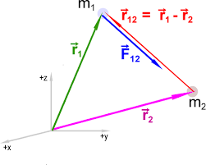
Gravitational interaction:

Slide 19
Gravitational interaction:
|r₁-r₂|² = (r₁-r₂) • (r₁-r₂)
= r₂²+r₁²-2r₁r₂ cos θ
and the expression for the field Is
F = -Gm₁m₂(r₁-r₂)/(r₂²+r₁²-2r₁r₂ cos θ)^{3/2}
Law of Cosines

Slide 20
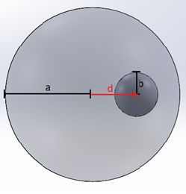
Electrostatic interaction:
In a uniformly charged sphere of radius a, a spherical cavity of radius b is excised. What is the electric field in the cavity?

Slide 21
What is the electric field in the cavity?
We know (can show) that the electric field in an uniformly charged sphere is radial and given by
E = Q(r)r/r³
= (4πr³ρ/3) r/r³
= (4πρ/3)r
Field is radial and increases with r

Slide 22
r r_{c}
Find field at this point in the cavity

Slide 23
r r_{c}
Add fields
Total = (4πρ/3)r – (4πρ/3)r_{c}
= (4πρ/3){r-(r-d)} = (4πρ/3)d
Field
Is uniform

Slide 24
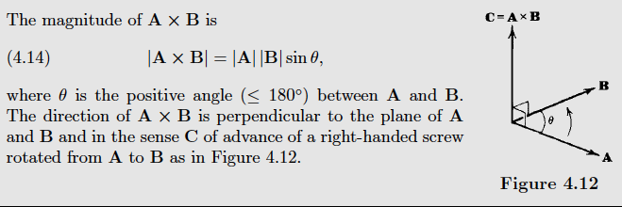
Vector Multiplication:
Cross Product

Slide 25
Cross Product
Comments:
AxB=-BxA, not commutative
Ax(B+C)=AxB+AxC, distributive

Slide 26
Cross Product
cross product in component form (Cartesian coordinates—consider other coordinate systems later),

Slide 27
Cross Product: Physical Examples
Angular momentum, J = r x p, r = position vector, p = linear momentum
Torque, τ = r x F, τ = torque, r = position vector, F = force
Lorentz Force, F = v x B, v = velocity, B = magnetic field
…

Slide 28
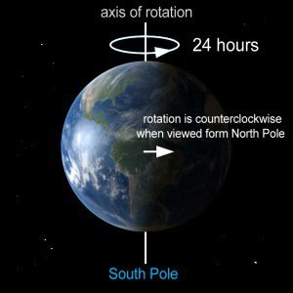
Consider a rotating object:
The Earth spins on its axis with rotation period P= 23h56.091s.
What is the speed of an object fixed to the Earth at latitude λ = (½π- θ)? θ is the polar angle.
The object moves a distance
D = 2πr sin θ per rotation of the Earth.
Its speed is then |v| = D/P = 2πr sin θ x (|Ω|/2π)
= r|Ω|sin θ ➔ v = Ω x r

Slide 29
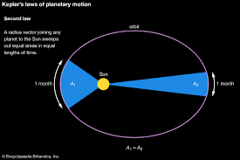
Geometrically, the 2nd Law says that

Slide 30
we construct
|v|dt
r
Sun
◉ •
Planet

Slide 31
Area, A
θ
Form the parallelogram and find the area A, First find the area of the rectangle,
(r+|v|dt cosθ) |v|dt sinθ

Slide 32
Area, A
θ
Form the parallelogram and find the area A, Next, subtract the triangles to find 2A,
2A = (r+|v|dt cosθ) |v|dt sinθ - |v|²dt² (cosθ sinθ)

Slide 33
Area, A
θ
Form the parallelogram and find the area A, Next, subtract the triangles to find 2A,
2A = (r+|v|dt cosθ) |v|dt sinθ - |v|dt (cosθ sinθ)
This yields,
2A = r|v|dt sinθ ➔ 2A/dt = r|v|sinθ

Slide 34
Area, A
θ
If the planet has mass m, then
2mA/dt = r|mv|sinθ = |r x mv| = |r x p| = |J|
Kepler’s 2nd says that that the area, A, swept out for any time interval dt is constant so that,
|J| = constant

Slide 35
B
A
θ
In general, the area of the triangle, sides A and B where A and B form angle θ, is given by
Area = ½|A x B |

Slide 36
A
B
In general, the area of a parallelogram, sides A and B, has area given by
Area = |A x B |

Slide 37
Find the distance from point P = (3,2,5) to the line paasing through r_{o} = (4,-1,3) parallel to vector A = (1,0,-2)
P = (3,2,5)
r_{o} = (4,-1,3)
•
D(t)
Equation of line is r(t)-r_{o} = A t, where t is a parameter

Slide 38
Find the distance from point P = (3,2,5) to the line paasing through r_{o} = (4,-1,3) parallel to vector A = (1,0,-2)
The vector between P and r(t) is D = P – r and we want the minimum value for this length, that is, we want to find |D| when D and A are perpendicular, that is, when
D • A = 0
Notes:
=

Slide 39
Find the distance from point P = (3,2,5) to the line passing through r_{o} = (4,-1,3) parallel to vector A = (1,0,-2)
D • A = ( P – r ) • A = (P – r_{o}-A t) • A = 0
when
(P-r_{o})•A–A•A t = 0
so
t = (-5)/(5) = -1
and
|D_{min}| = 3
Notes:
=

Slide 40
Triple Vector Products
Given three vectors, A, B, and C, form products:
(A•B)C, A•(BxC), Ax(BxC) , …
Other forms that are not valid

Slide 41
Triple Vector Products
(A•B) C = C( A•B), commutative
Ax(BxC) = -(BxC)xA, not commutative
A•(BxC) = (BxC)•A, commutative
Switching order only affects Ax(BxC).
What are some identities associated with these forms?

Slide 42
Triple Vector Products
Is Ax(BxC) = (AxB)xC? No, not commutative. imagine A,B,C are in the x,x,y directions
(BxC) is then in z-direction and Ax(BxC) in –y direction
(AxB) is then 0 and (AxB)xC = 0

Slide 43
identity associated with this form
Ax(BxC) = B(A•C)-C(A•B)
(BAC-CAB rule). Easily shown (but tedious) using Cartesian coordinates.

Slide 44
Ax(BxC) = B(A•C)-C(A•B)
(BxC) =(B_{x},B_{y},B_{z})x(C_{x},C_{y},C_{z}) = (B_{y}C_{z}-B_{z}-C_{y},B_{z}C_{x}-B_{x}C_{z},B_{x}C_{y}-B_{y}C_{x}) = (f_{x},f_{y},f_{z})
Ax(BxC) = (A_{y}f_{z}-A_{z}f_{y},A_{z}f_{x}-A_{x}f_{z},A_{x}f_{y}-A_{y}f_{x})

Slide 45
Ax(BxC) = B(A•C)-C(A•B)
(BxC) =(B_{x},B_{y},B_{z})x(C_{x},C_{y},C_{z}) = (B_{y}C_{z}-B_{z}-C_{y},B_{z}C_{x}-B_{x}C_{z},B_{x}C_{y}-B_{y}C_{x}) = (f_{x},f_{y},f_{z})
Ax(BxC) = (A_{y}f_{z}-A_{z}f_{y},A_{z}f_{x}-A_{x}f_{z},A_{x}f_{y}-A_{y}f_{x})
= (A_{y}[B_{x}C_{y}-B_{y}C_{x}]-A_{z}[B_{z}C_{x}-B_{x}C_{z}],...,…)

Slide 46
Ax(BxC) = B(A•C)-C(A•B)
(BxC) =(B_{x},B_{y},B_{z})x(C_{x},C_{y},C_{z}) = (B_{y}C_{z}-B_{z}-C_{y},B_{z}C_{x}-B_{x}C_{z},B_{x}C_{y}-B_{y}C_{x}) = (f_{x},f_{y},f_{z})
Ax(BxC) = (A_{y}f_{z}-A_{z}f_{y},A_{z}f_{x}-A_{x}f_{z},A_{x}f_{y}-A_{y}f_{x})
= (A_{y}[B_{x}C_{y}-B_{y}C_{x}]-A_{z}[B_{z}C_{x}-B_{x}C_{z}],...,…)
= (B_{x}[A_{x}C_{x}+A_{y}C_{y}+A_{z}C_{z}]-C_{x}[A_{x}Bx+A_{Y}B_{Y}
+A_{Z}B_{Z}]-A_{X}B_{X}C_{X}+A_{X}B_{X}C_{X},...,…)

Slide 47
Ax(BxC) = B(A•C)-C(A•B)
Ax(BxC) = (A_{y}f_{z}-A_{z}f_{y},A_{z}f_{x}-A_{x}f_{z},A_{x}f_{y}-A_{y}f_{x})
= (A_{y}[B_{x}C_{y}-B_{y}C_{x}]-A_{z}[B_{z}C_{x}-B_{x}C_{z}],...,…)
= (B_{x}[A_{x}C_{x}+A_{y}C_{y}+A_{z}C_{z}]-C_{x}[A_{x}B_{x}+A_{Y}B_{Y}
+A_{Z}B_{Z}]-A_{X}B_{X}C_{X}+A_{X}B_{X}C_{X},...,…)
Generalize to
B(A•C) – C(A•B)

Slide 48
identity associated with this form
(AxB)xC = -Cx(AxB) = -A(C•B)+B(C•A)

Slide 49
identity associated with this form
A•(BxC) = [ABC]
A•(BxC) = (AxB)•C, can be shown expanding in Cartesian coordinates. Exchange dot and cross in this form.

Slide 50
identity associated with this form
A•(BxC)
A•(BxC) = (A_{x},A_{y},A_{z})(f_{x},f_{y},f_{z})
= A_{x}(B_{y}C_{z}-B_{z}C_{y})+A_{y}(B_{z}C_{x}-B_{x}C_{z})
+A_{z}(B_{x}C_{y}-B_{y}C_{x})
A•(BxC) = C_{x}(A_{y}B_{z}-A_{z}B_{y})+C_{y}(A_{z}B_{x}-A_{x}B_{z})
+C_{z}(A_{x}B_{y}-A_{y}B_{x})
= (AxB)•C = C•(AxB)

Slide 51
identity associated with this for
A•(BxC) = C•(AxB)
B•(CxA) = A•(BxC)
C•(AxB) = B•(CxA)
A•(CxB) = B•(AxC)
C•(BxA) = A•(CxB)
B•(AxC) = C•(BxA)
B
C A
Same magnitudes and signs for CW or CCW permutations

Slide 52
Consider vectors, A,B,C; A,B,C are not all parallel to the same plane,
[ABC] ≠ 0
Show that any vector can be written as a linear combination of A,B, & C.

Slide 53
Let some vector V, be expressed as
V = aA + bB +cC
Cross V into B,
VxB = aAxB + cCxB

Slide 54
Let some vector V, be expressed as
V = aA + bB +cC
Cross V into B,
VxB = aAxB + cCxB
Dot C into the result,
(VxB)•C = aC•(AxB)

Slide 55
Solve for a
a = (VxB)•C / C•(AxB)

Slide 56
Solve for a
a = (VxB)•C / C•(AxB)
Put this into a form (prettier form)
a = V•(BxC) /{-C•(BxA)}

Slide 57
Solve for a
a = (VxB)•C / C•(AxB)
Put this into a form (prettier form)
a = V•(BxC) /{-C•(BxA)}
Change to “[]” notation
a = [VBC] / [ABC]

Slide 58
Similarly for b and c leads to
a = [VBC] / [ABC]
b = [AVC] / [ABC]
c = [ABV] / [ABC]

