Slide 1
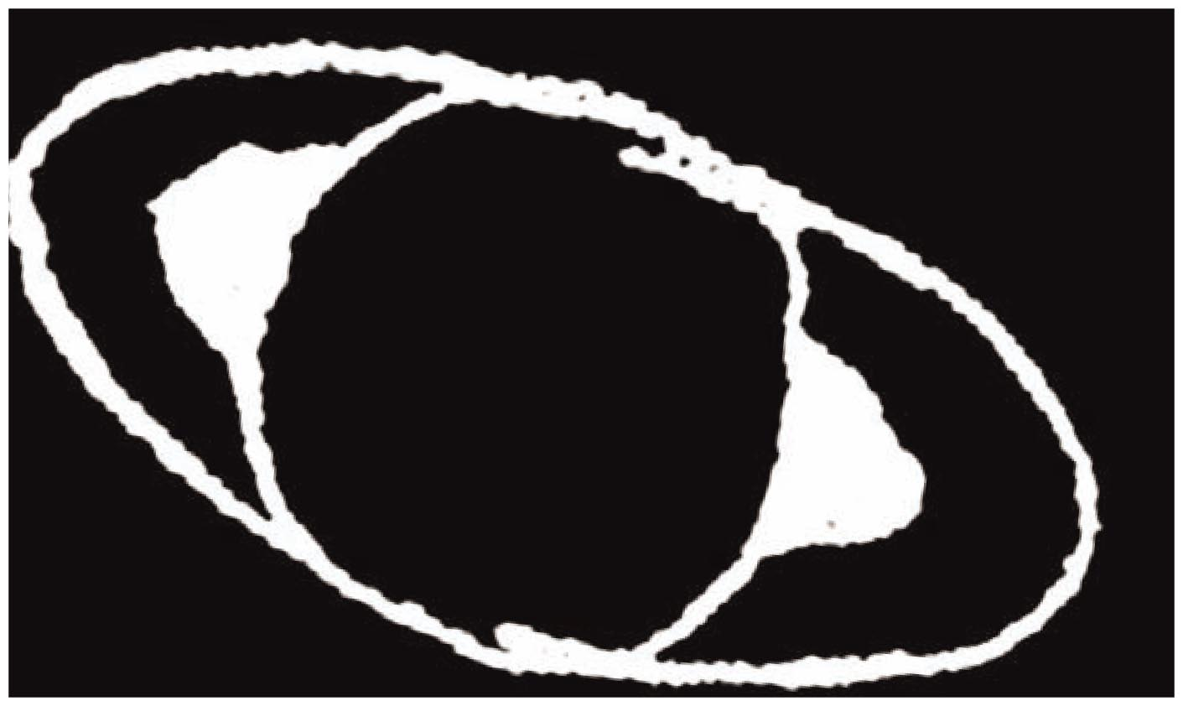
Chapter 1 Part 1 Opener 1

Slide 2
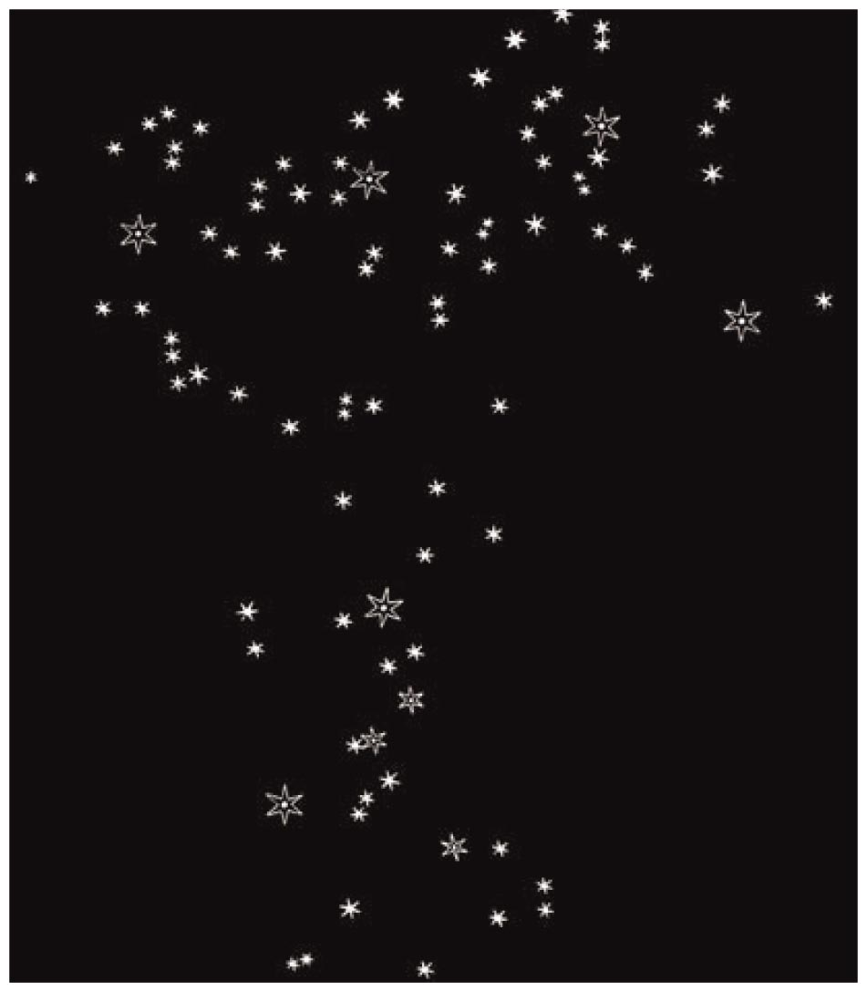
Chapter 1 Part 1 Opener 2

Slide 3
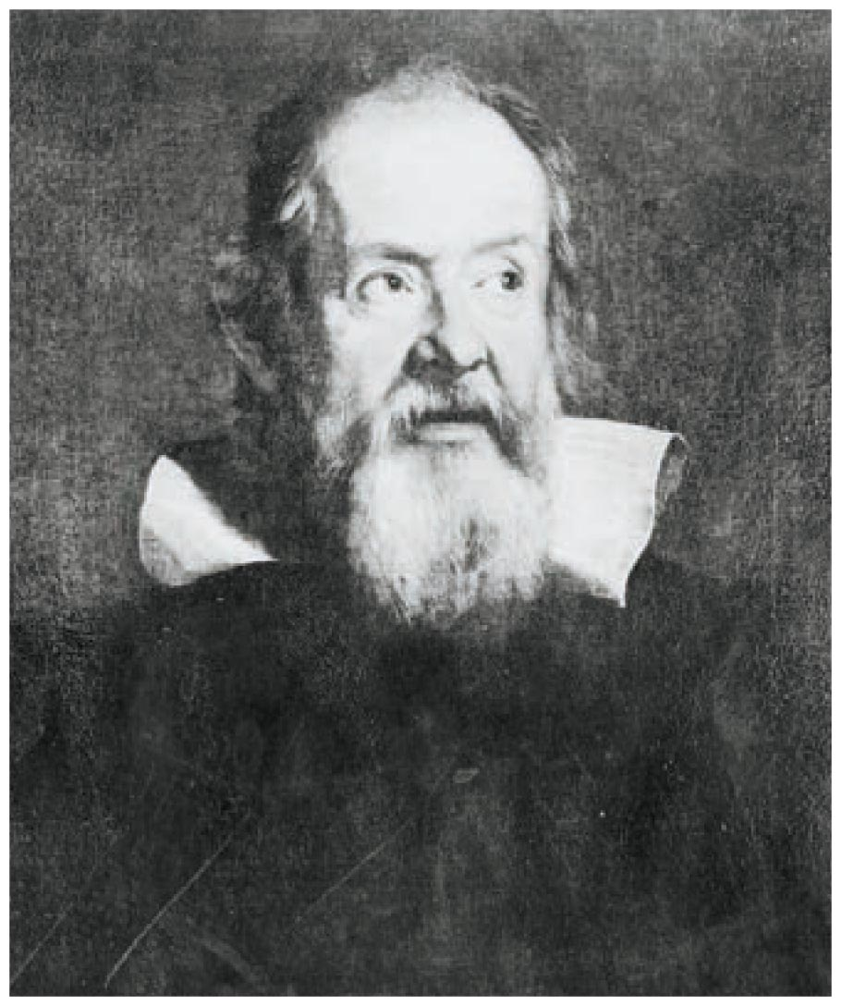
Chapter 1 Part 1 Opener 3

Slide 4
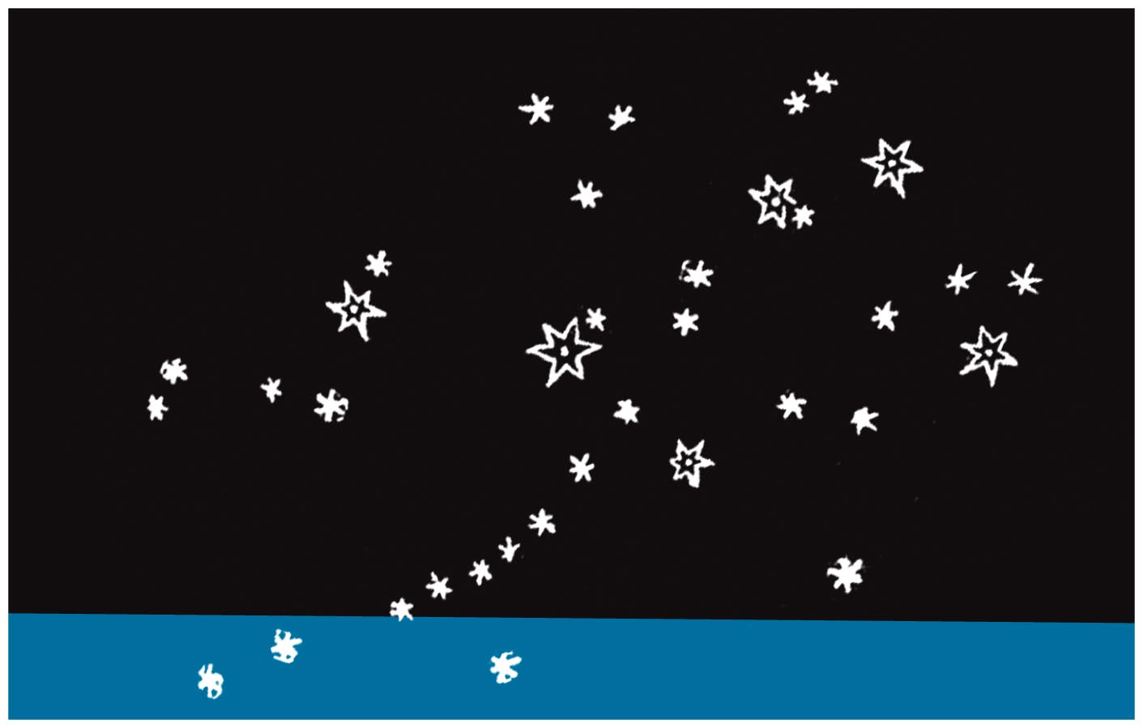
Chapter 1 Part 1 Opener 4

Slide 5
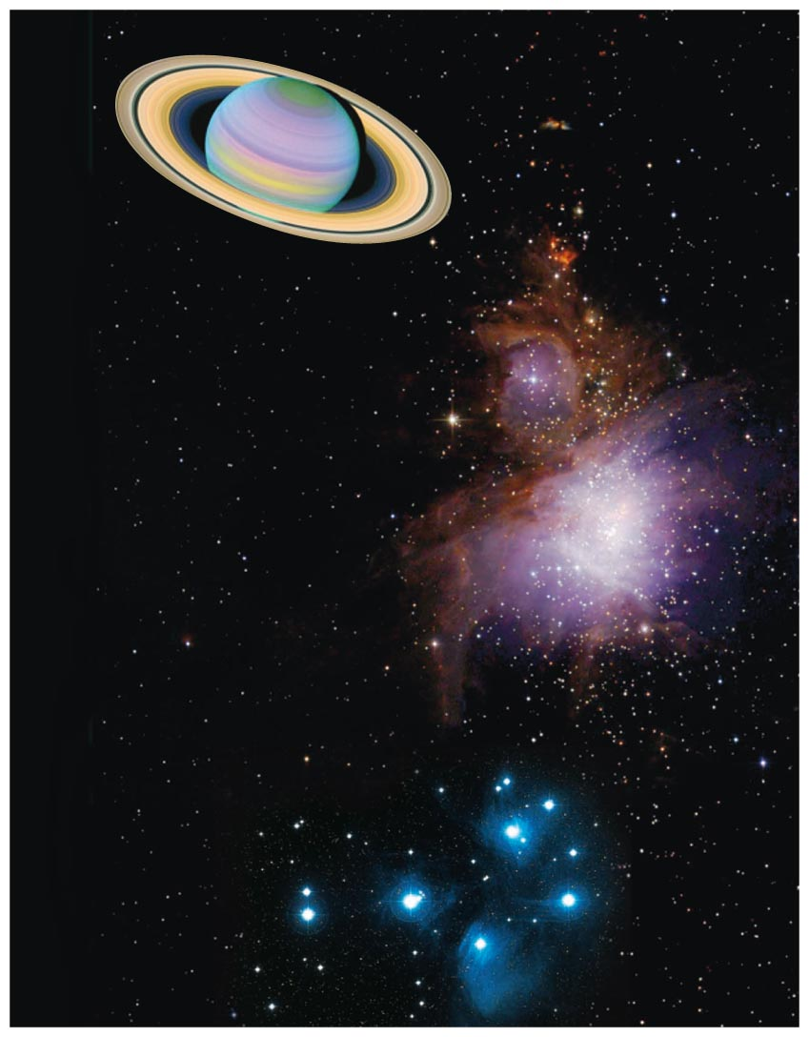
Chapter 1 Part 1 Opener 5

Slide 6
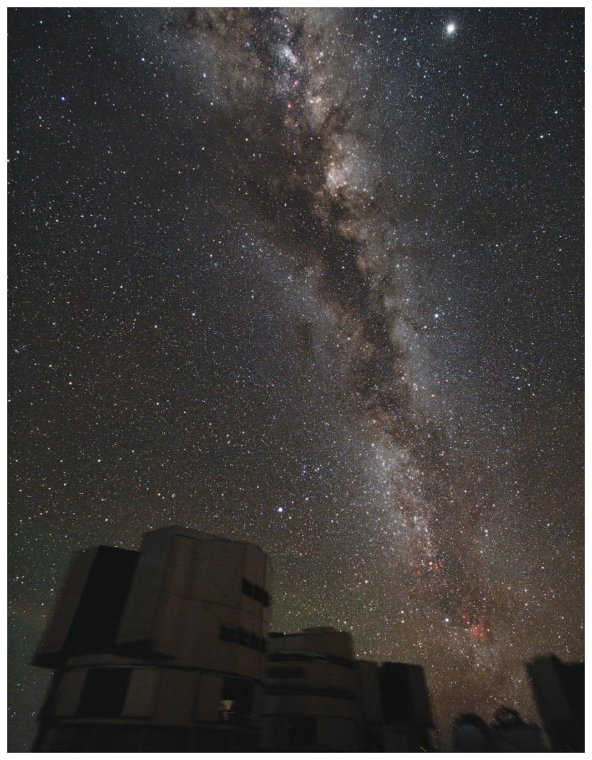
Chapter 1 Opener

Slide 7
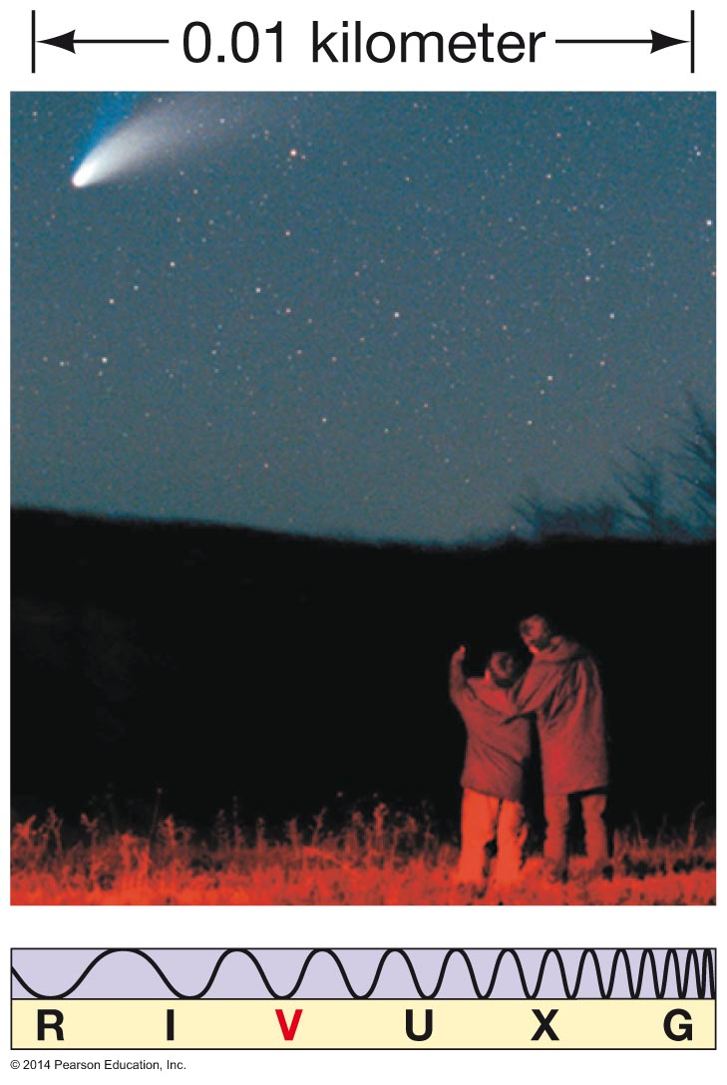
Figure 1.1

Slide 8
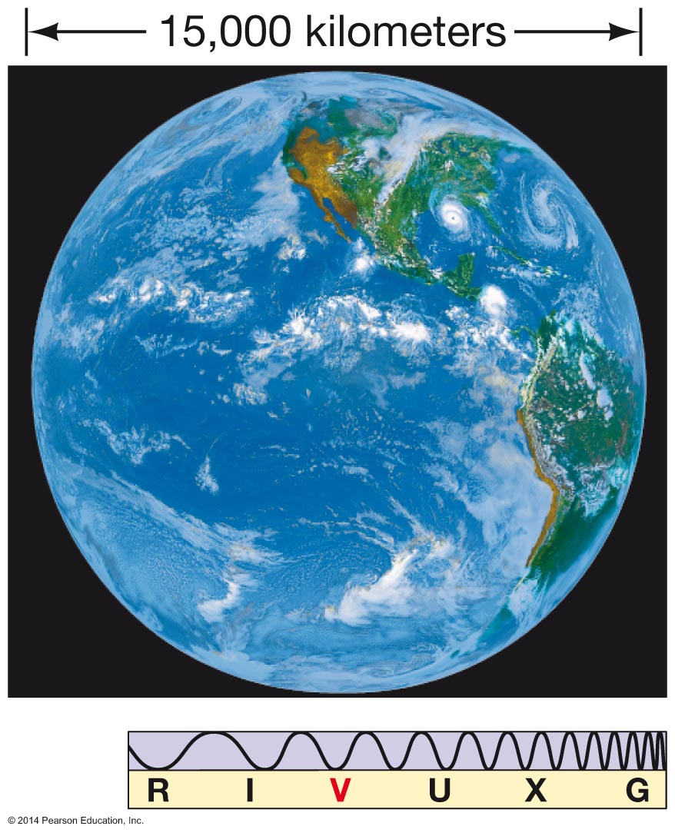
Figure 1.2

Slide 9
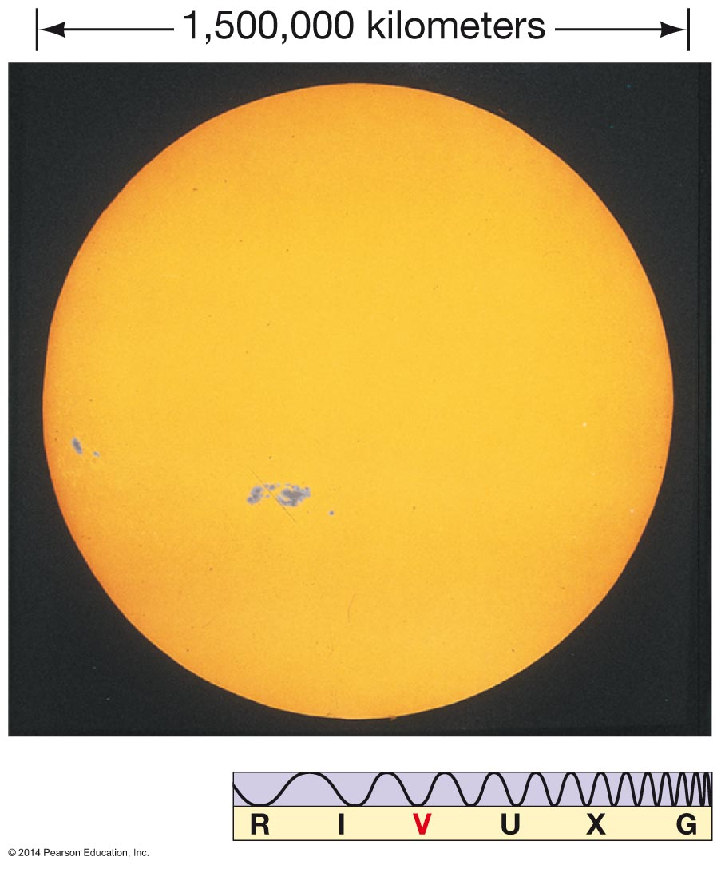
Figure 1.3

Slide 10
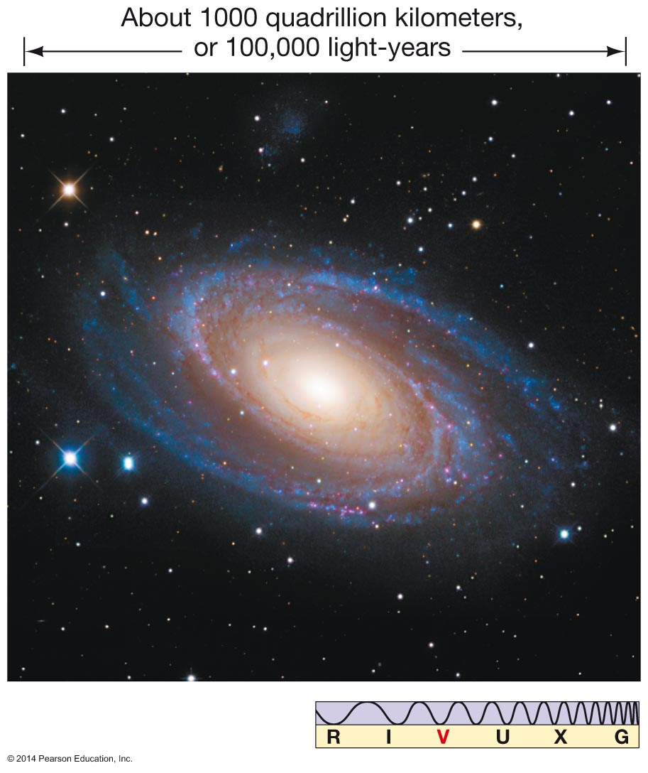
Figure 1.4

Slide 11
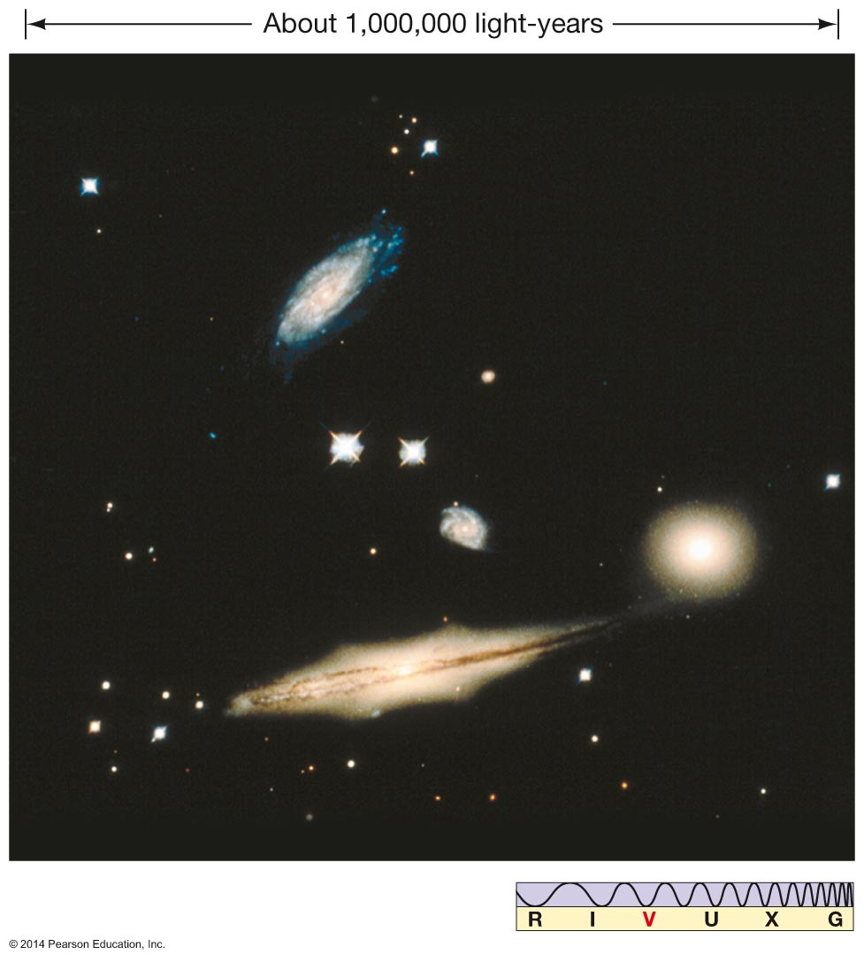
Figure 1.5

Slide 12
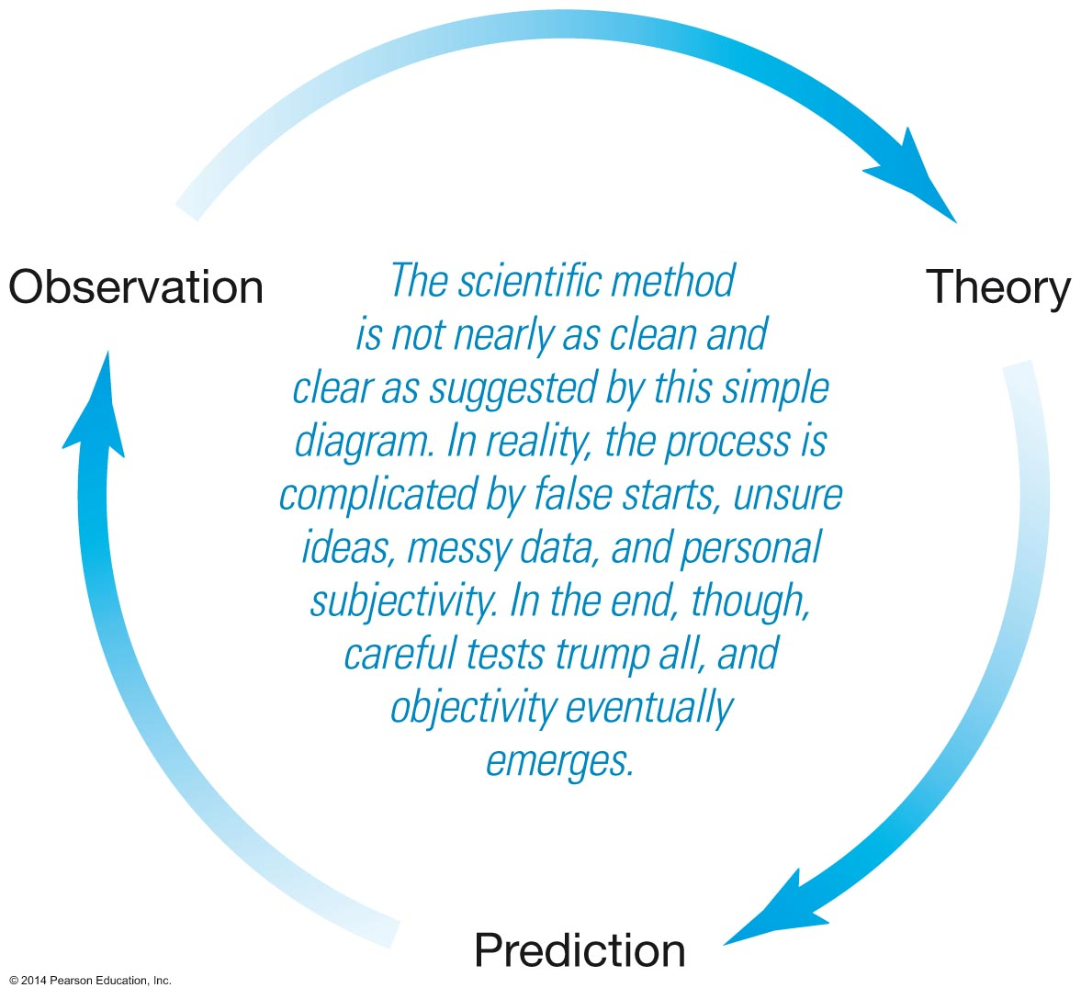
Figure 1.6

Slide 13
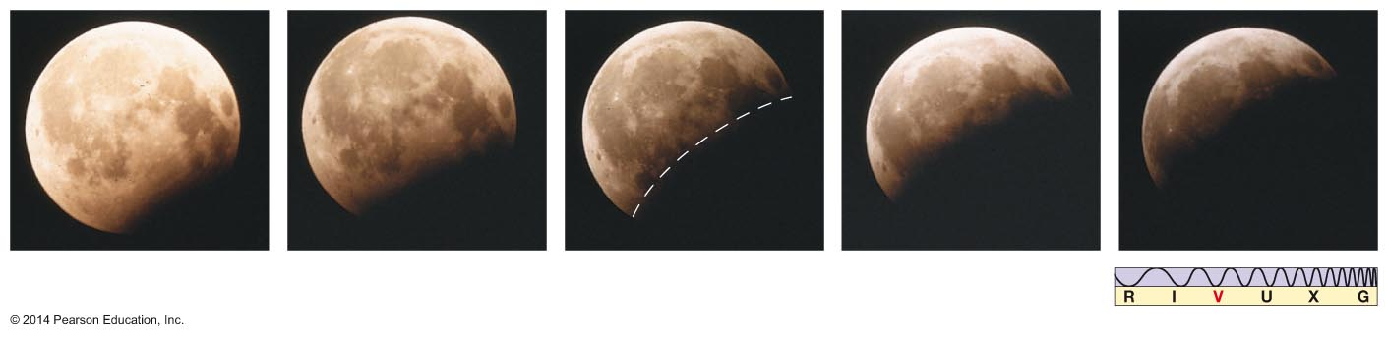
Figure 1.7

Slide 14
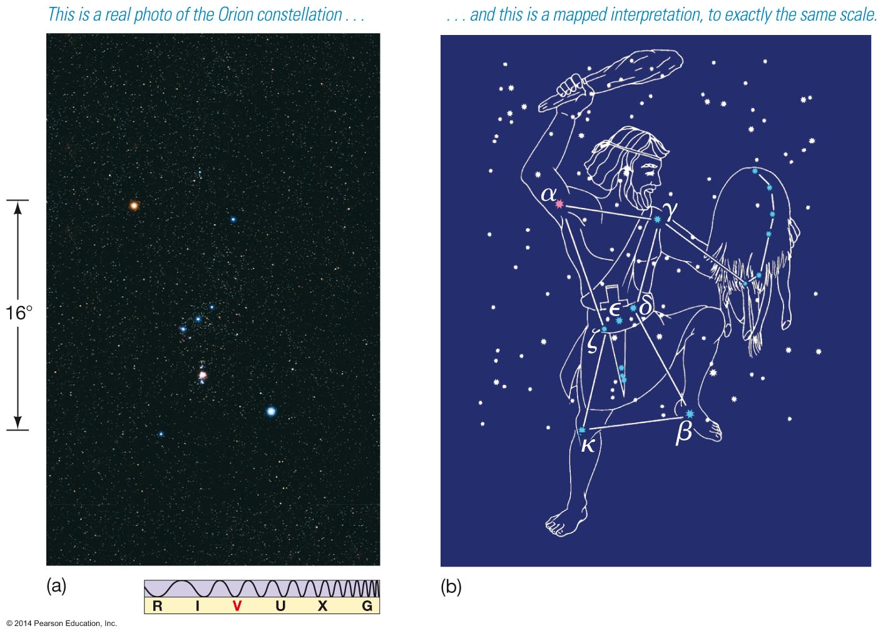
Figure 1.8

Slide 15
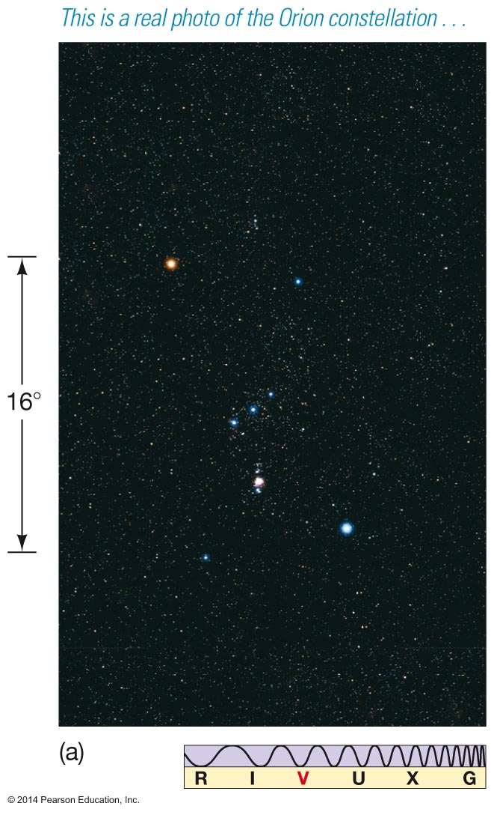
Figure 1.8a

Slide 16
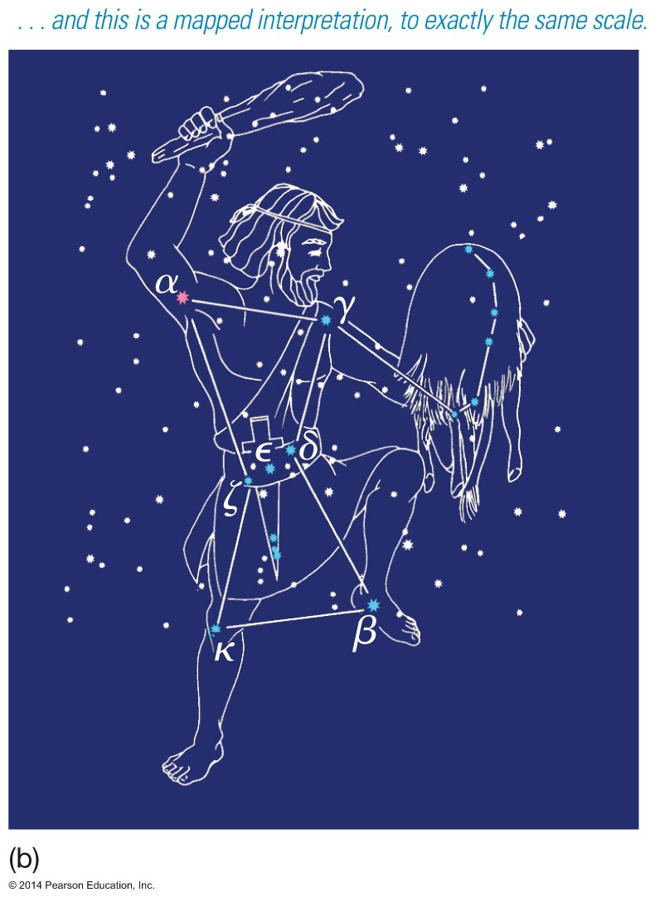
Figure 1.8b

Slide 17
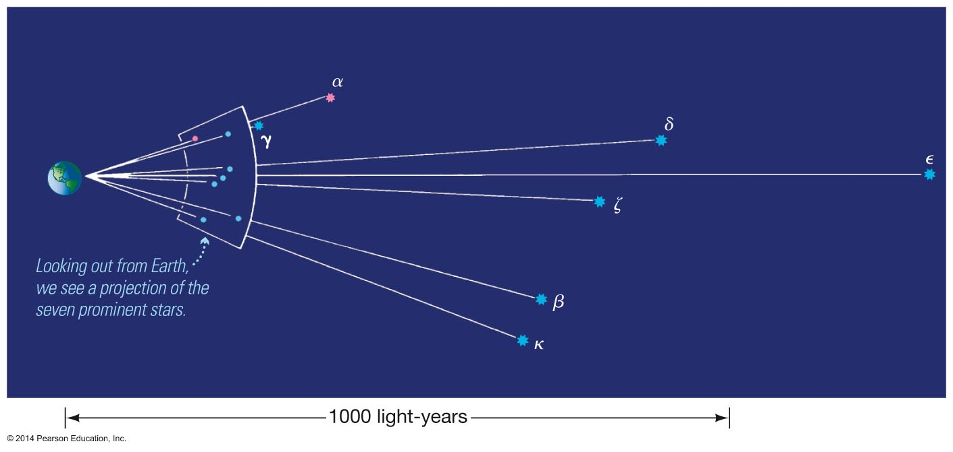
Figure 1.9

Slide 18
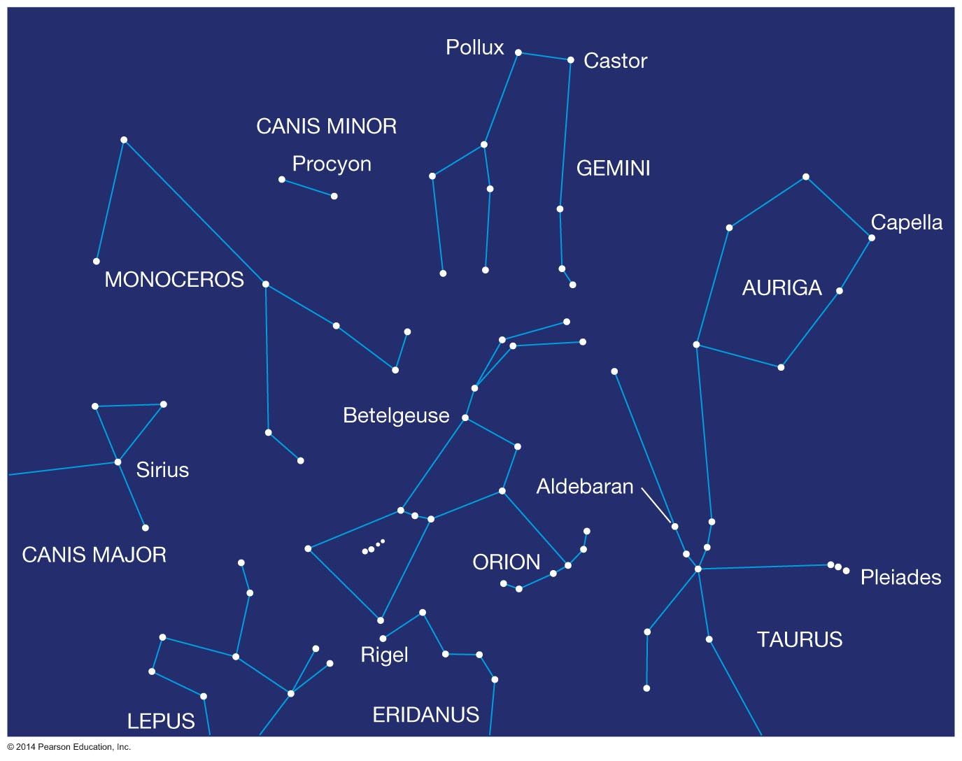
Figure 1.10

Slide 19
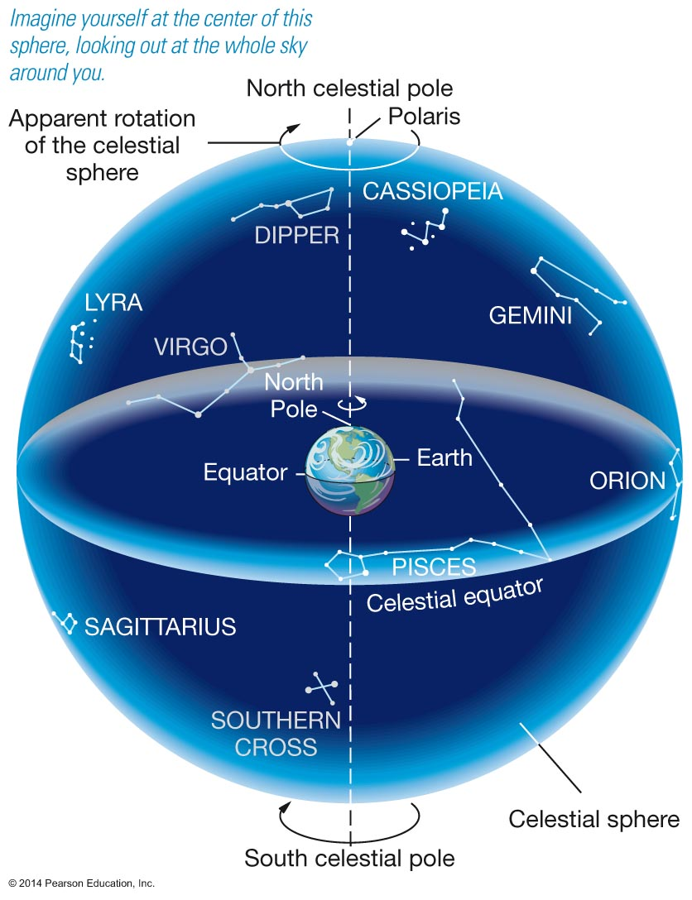
Figure 1.11

Slide 20
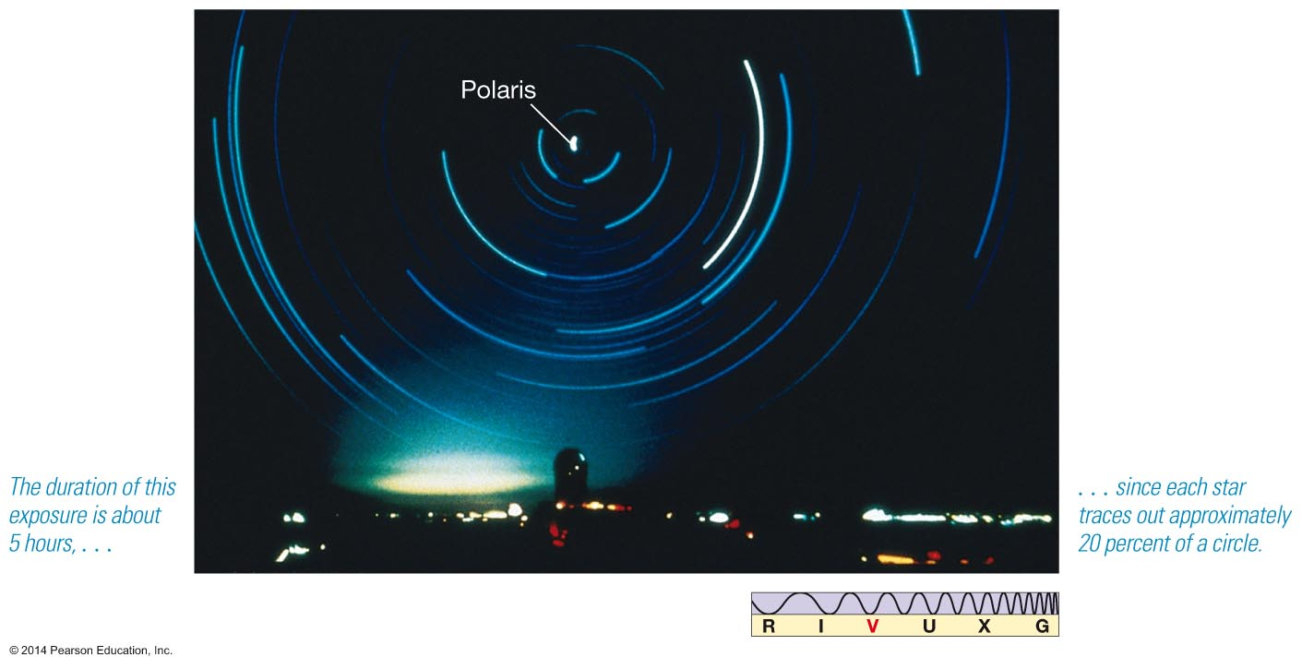
Figure 1.12

Slide 21
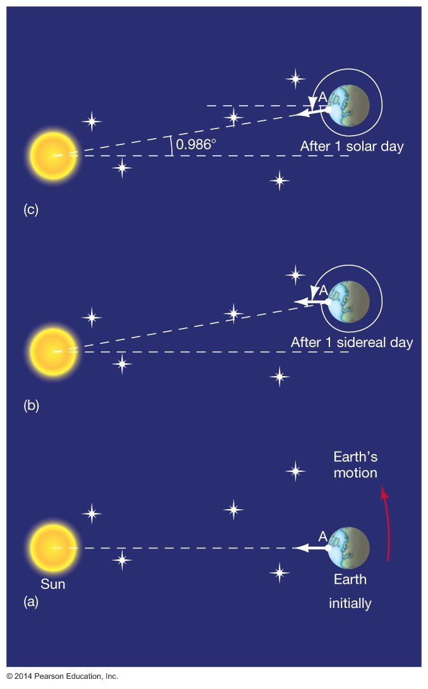
Figure 1.13

Slide 22
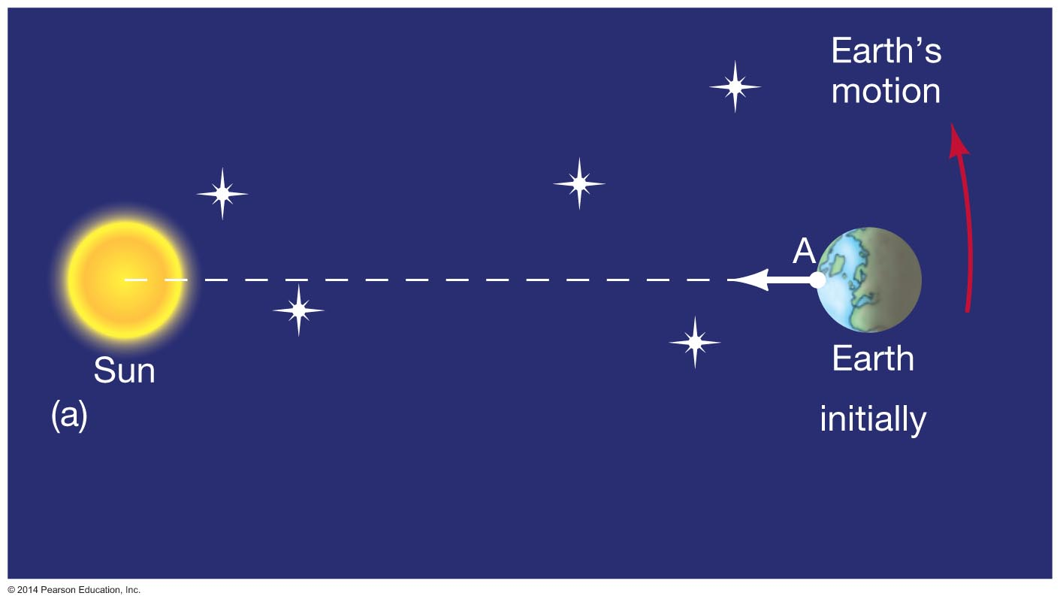
Figure 1.13a

Slide 23
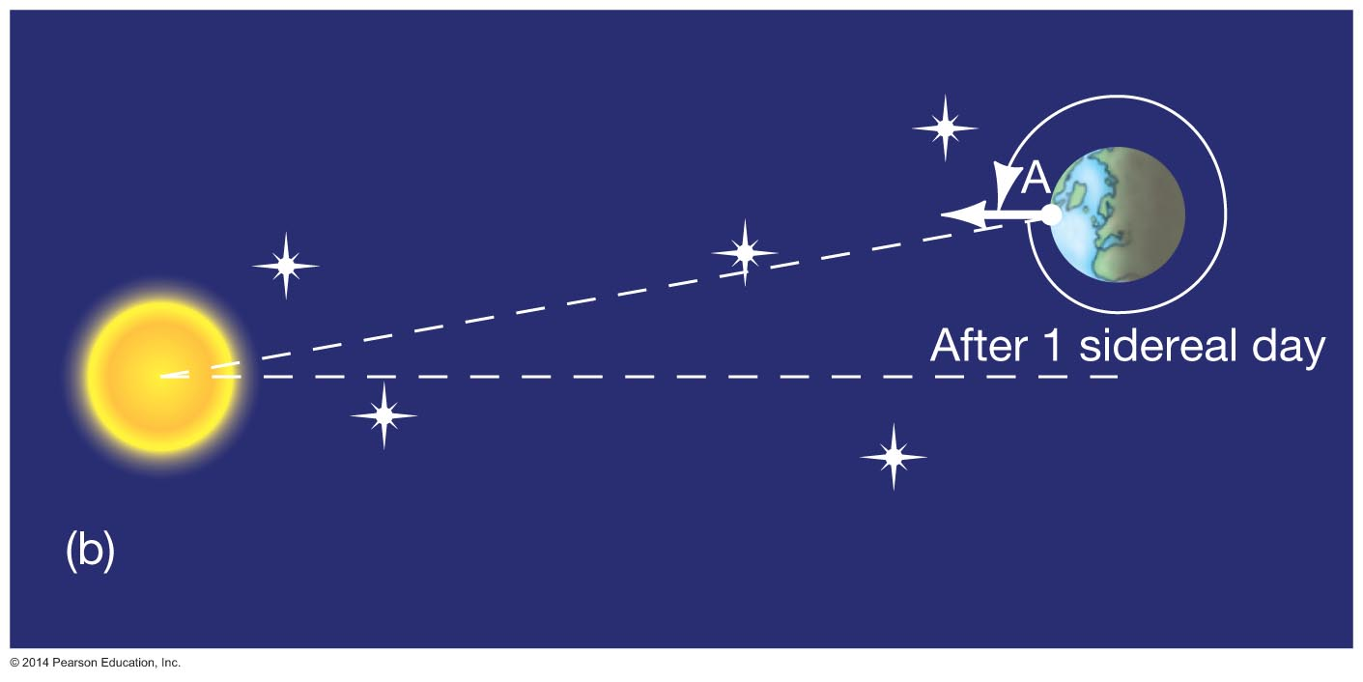
Figure 1.13b

Slide 24
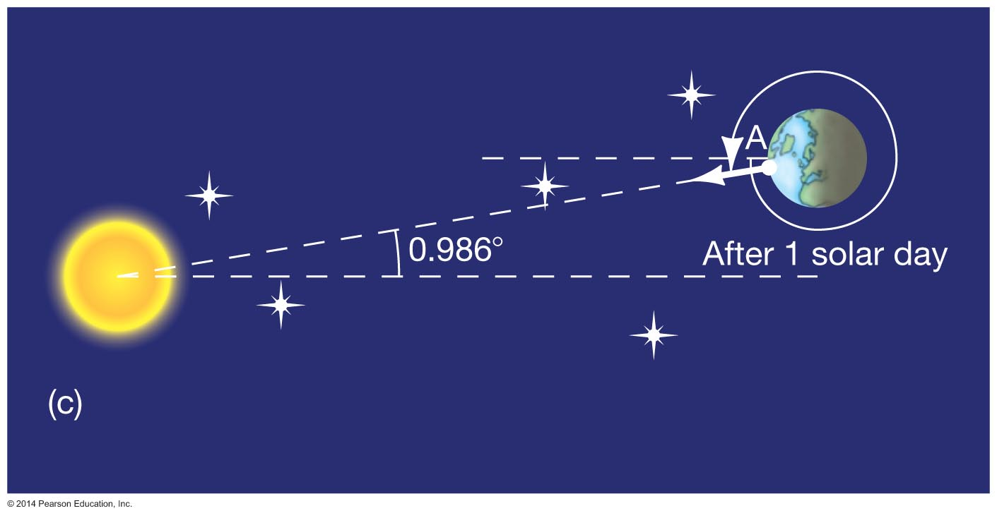
Figure 1.13c

Slide 25
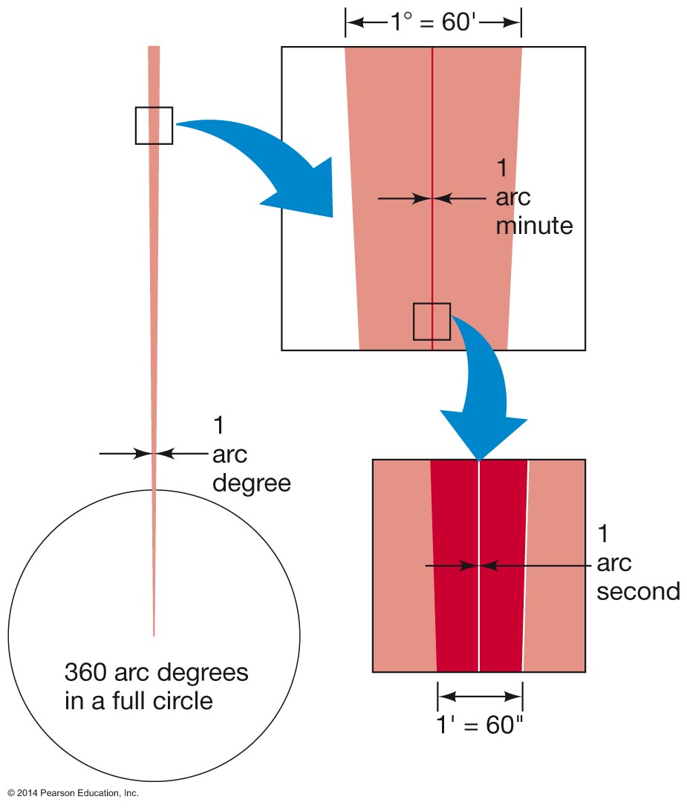
Unnumbered Figure Page 14

Slide 26
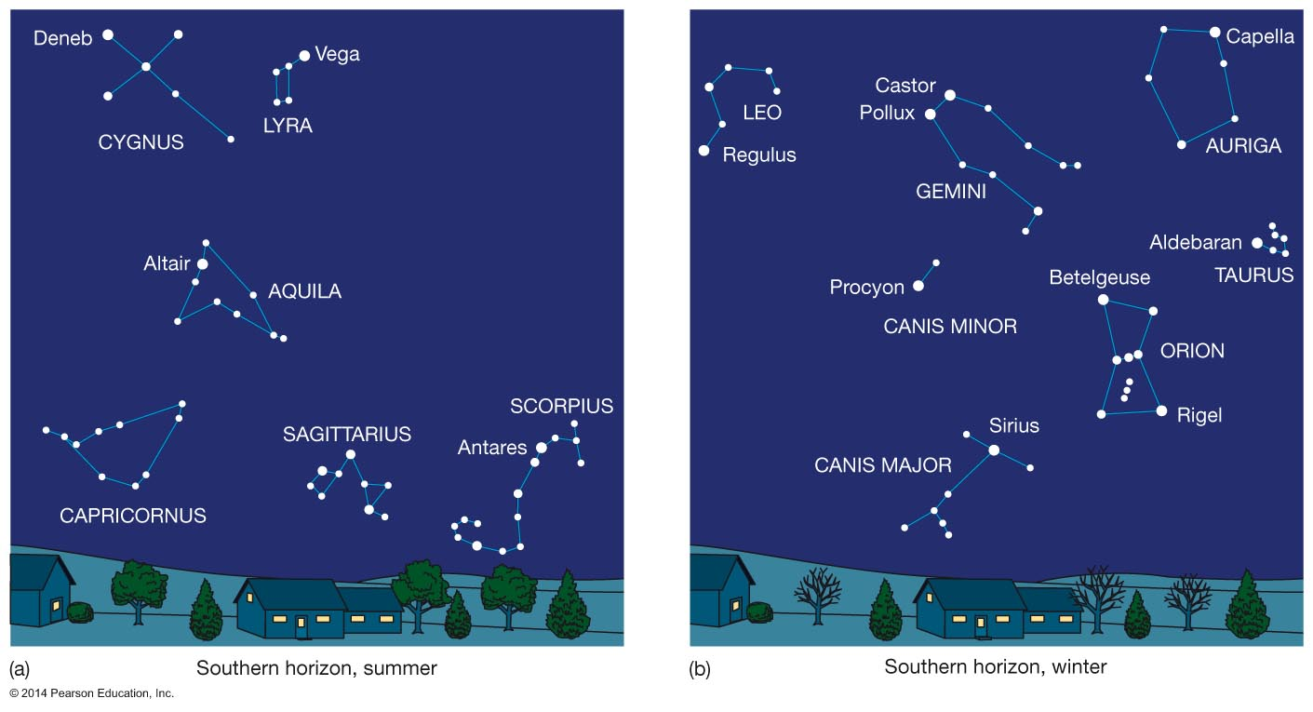
Figure 1.14

Slide 27
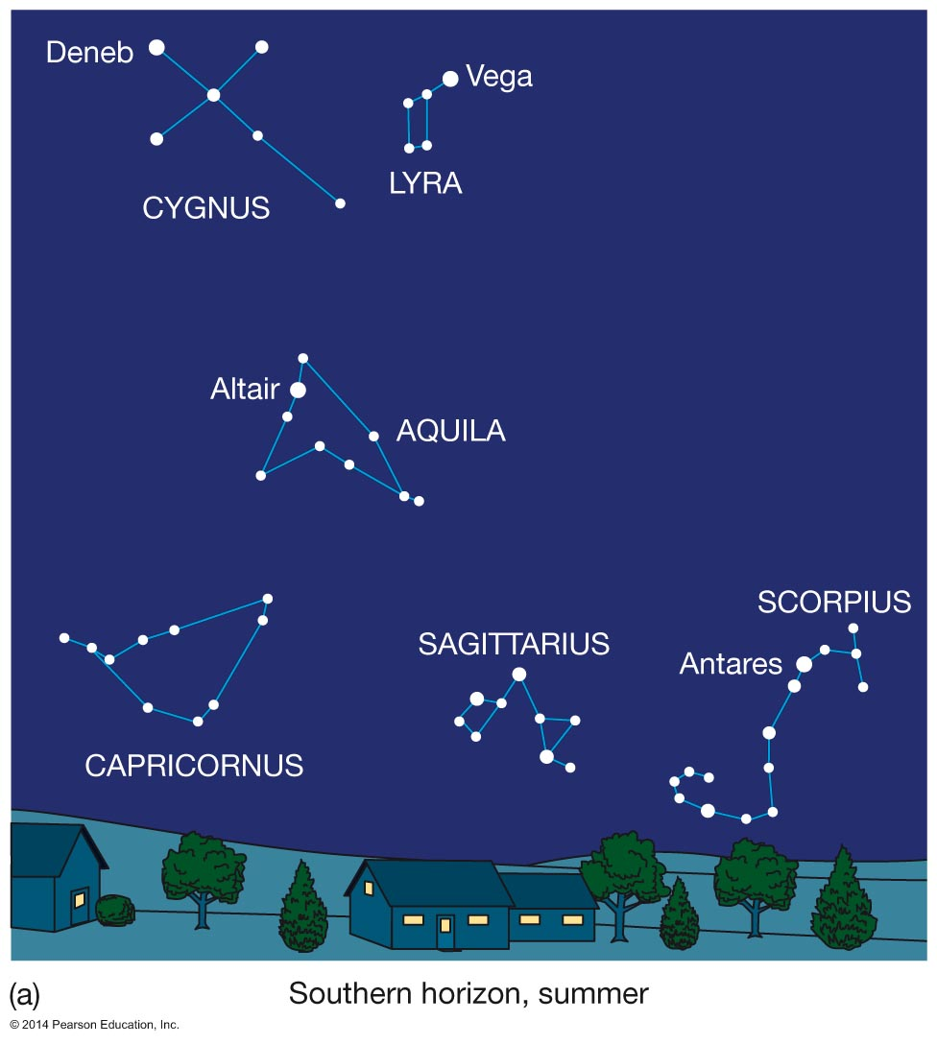
Figure 1.14a

Slide 28
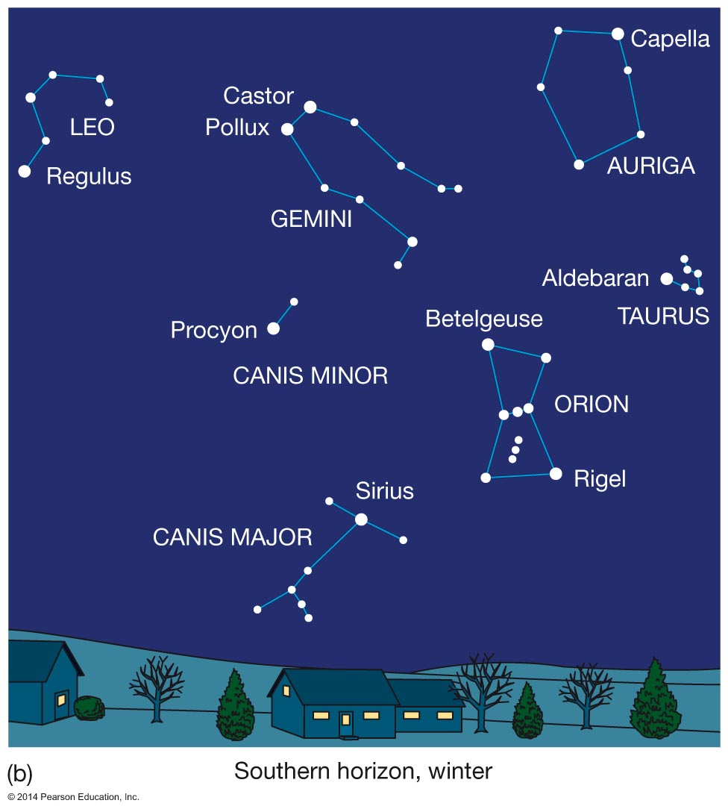
Figure 1.14b

Slide 29
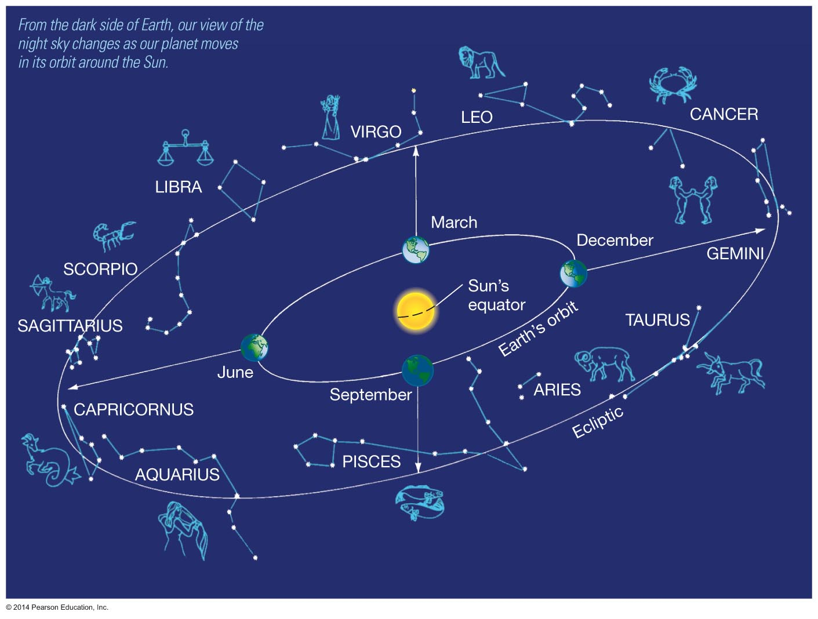
Figure 1.15

Slide 30
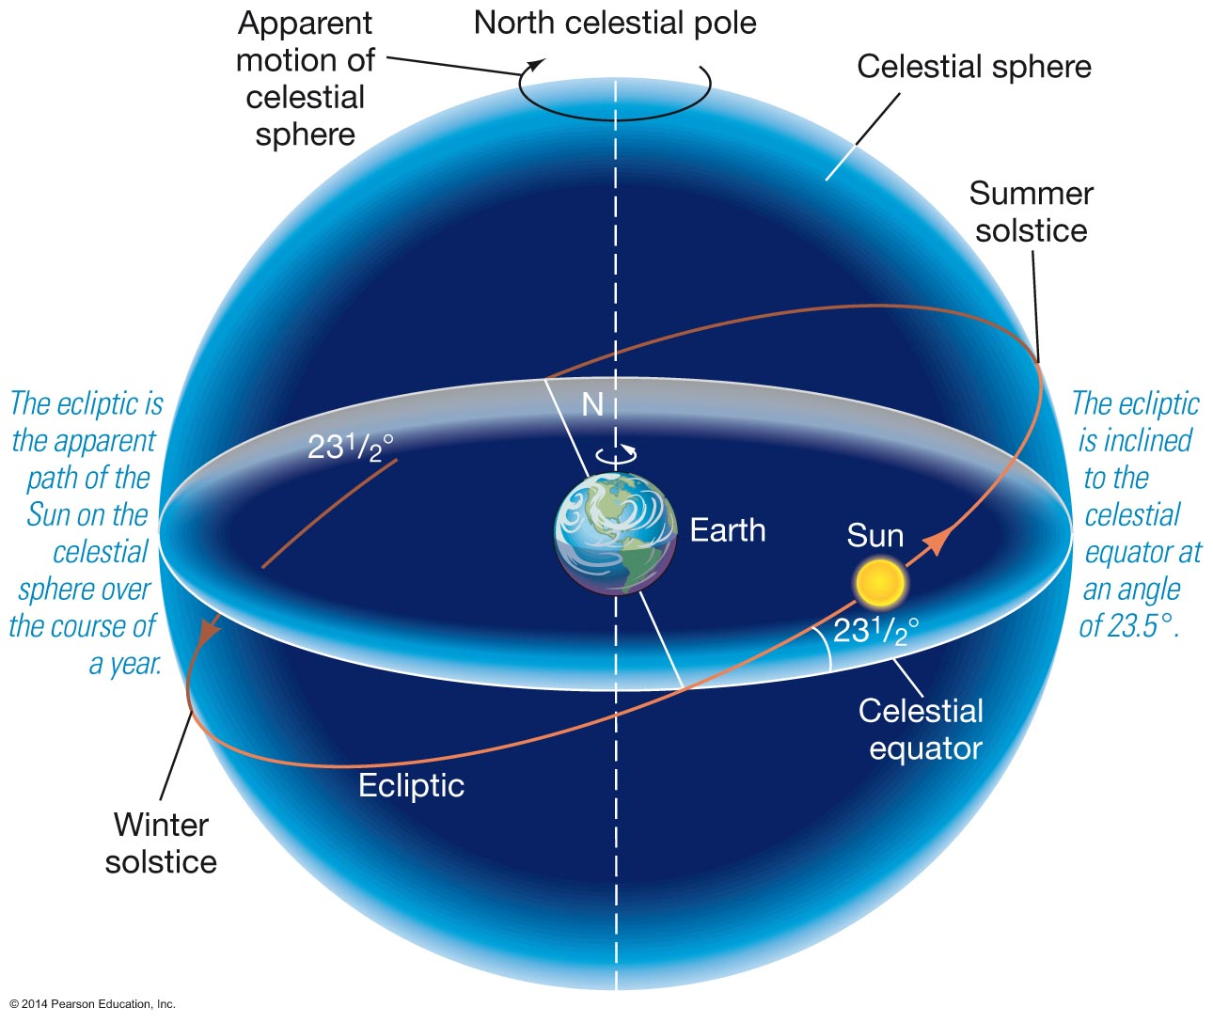
Figure 1.16

Slide 31
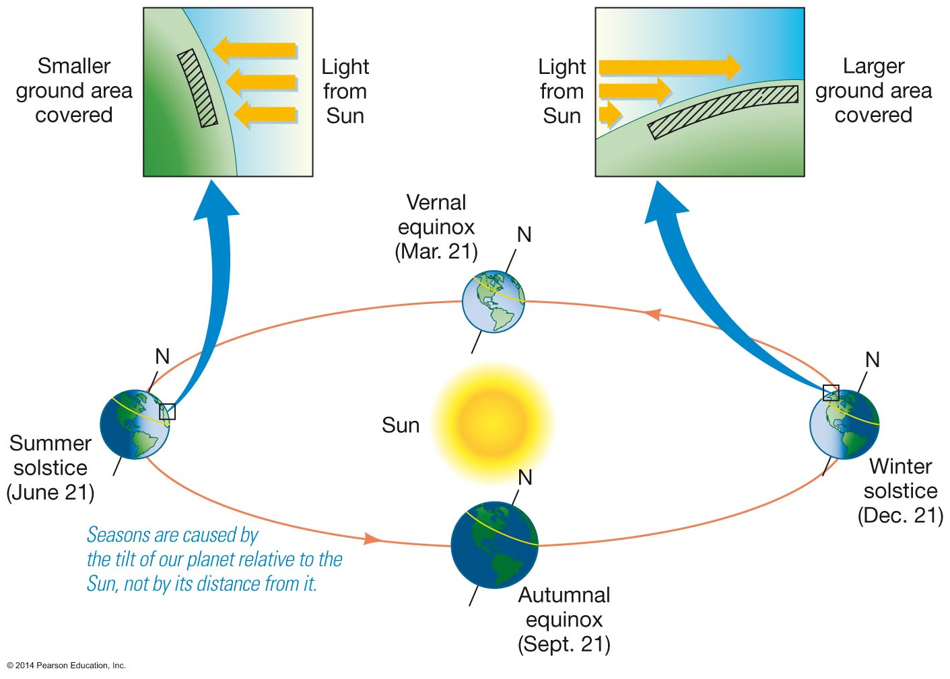
Figure 1.17

Slide 32
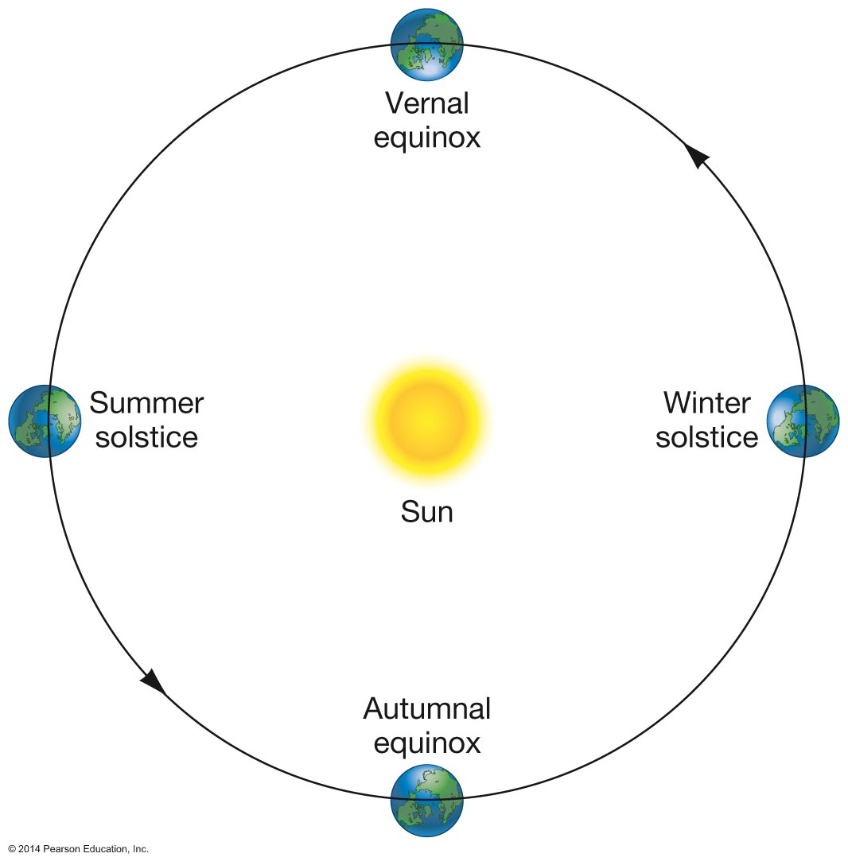
Figure 1.18

Slide 33
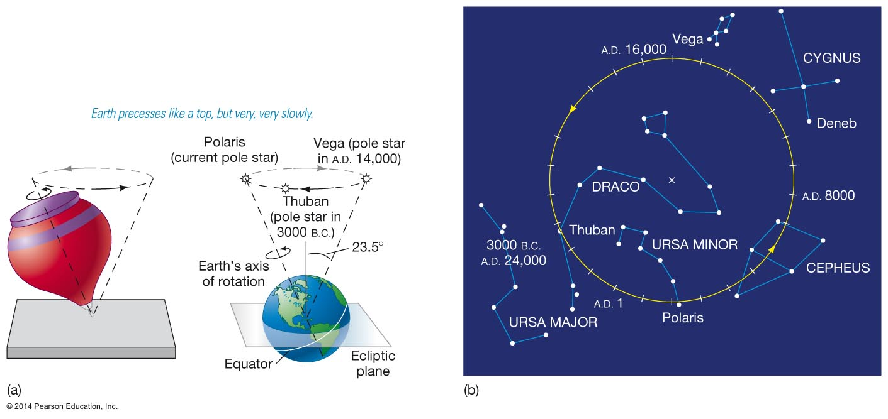
Figure 1.19

Slide 34
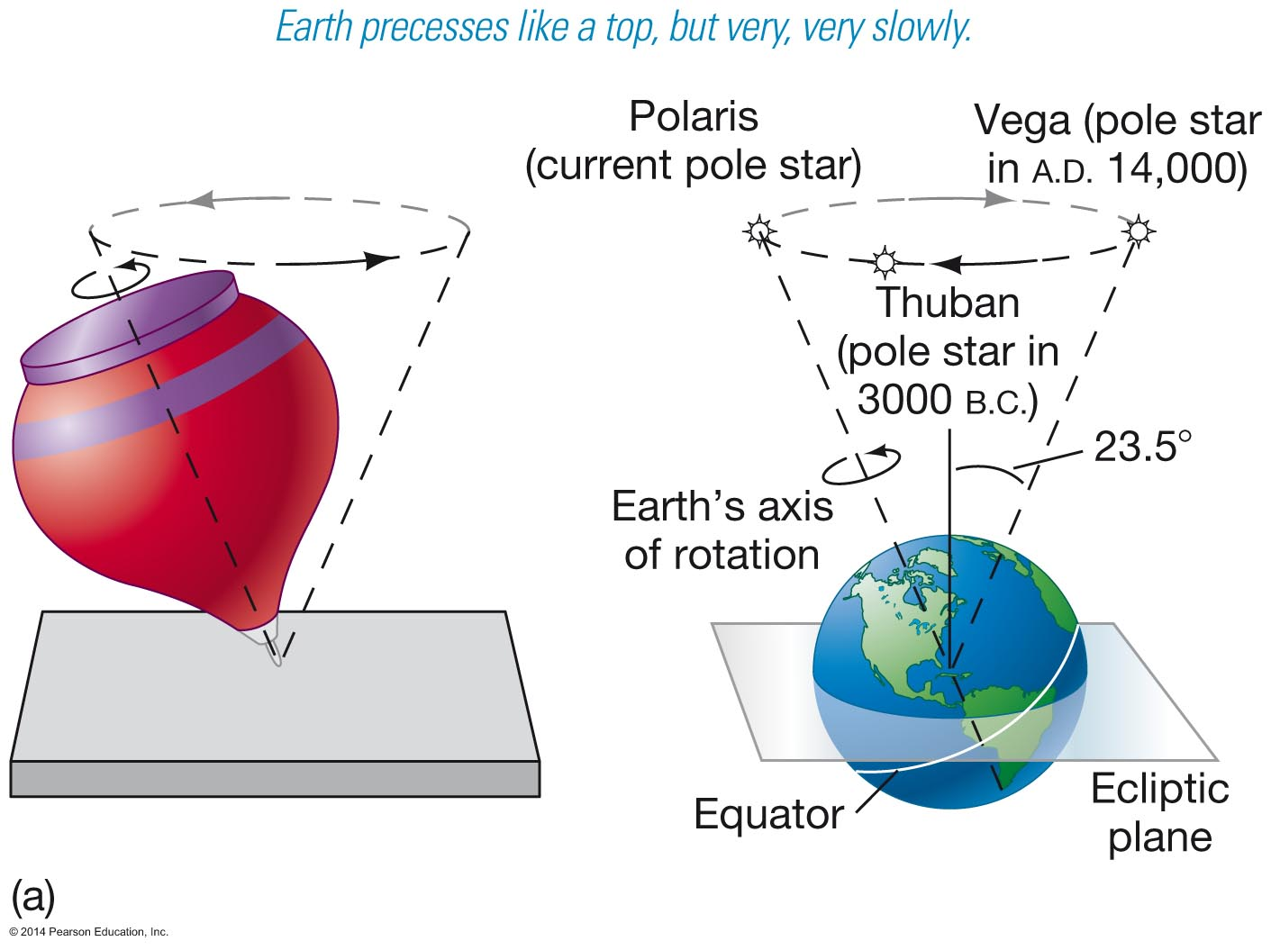
Figure 1.19a

Slide 35
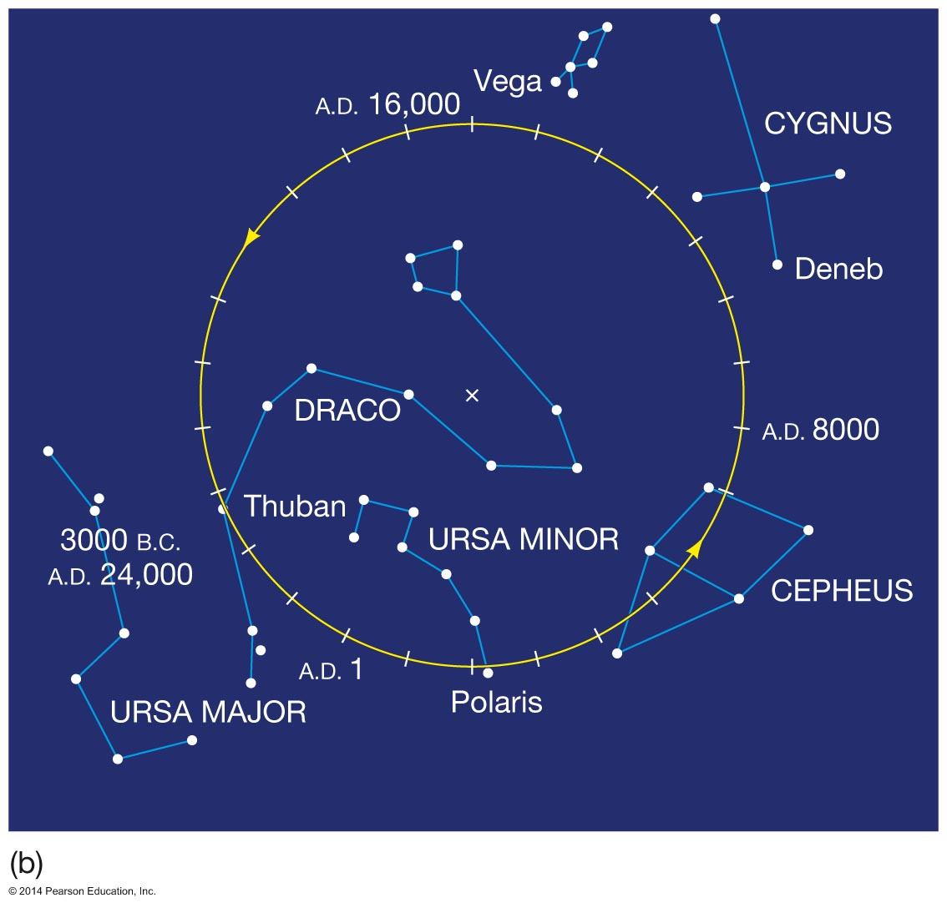
Figure 1.19b

Slide 36
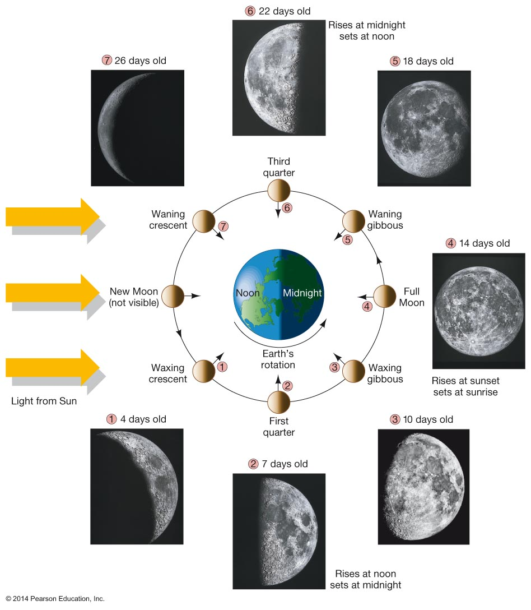
Figure 1.20

Slide 37
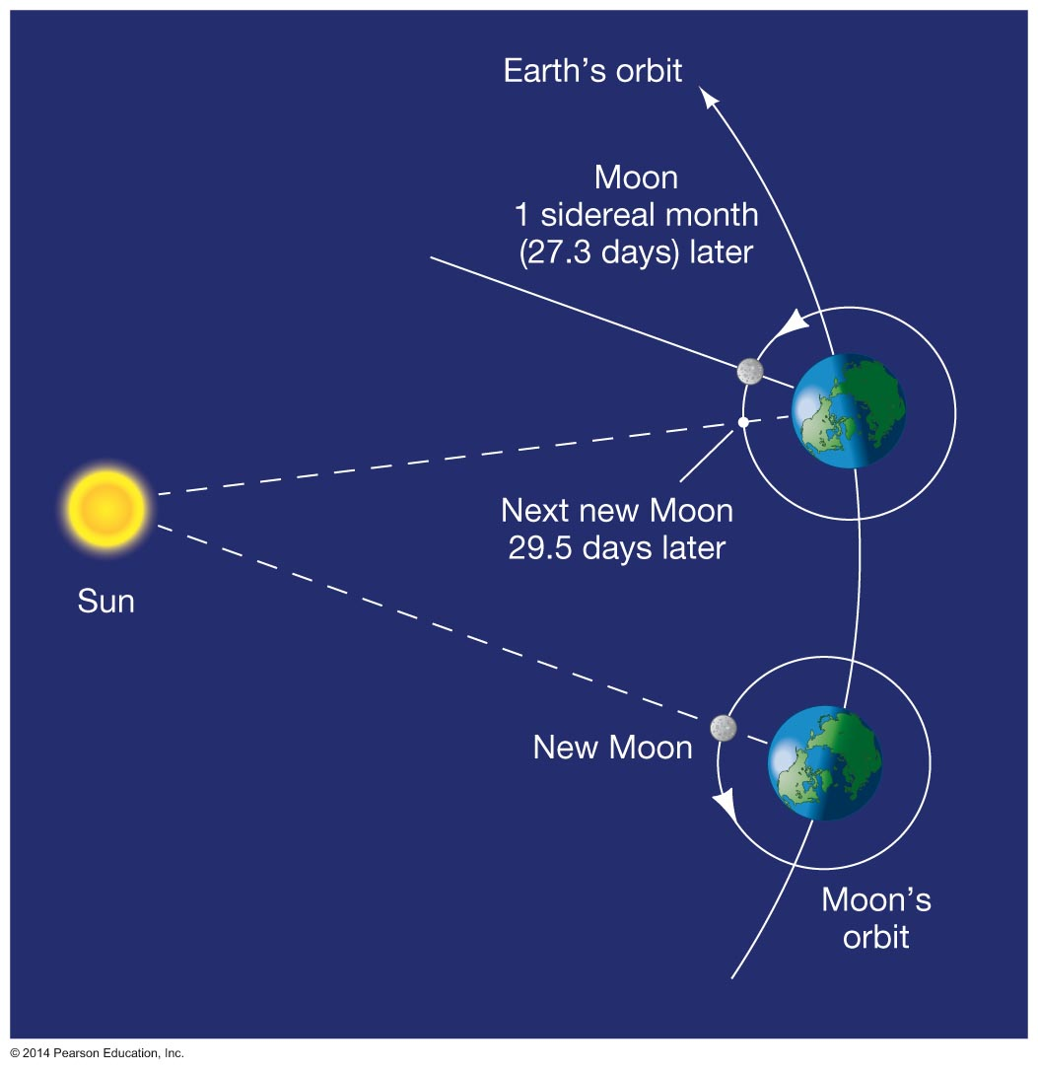
Figure 1.21

Slide 38
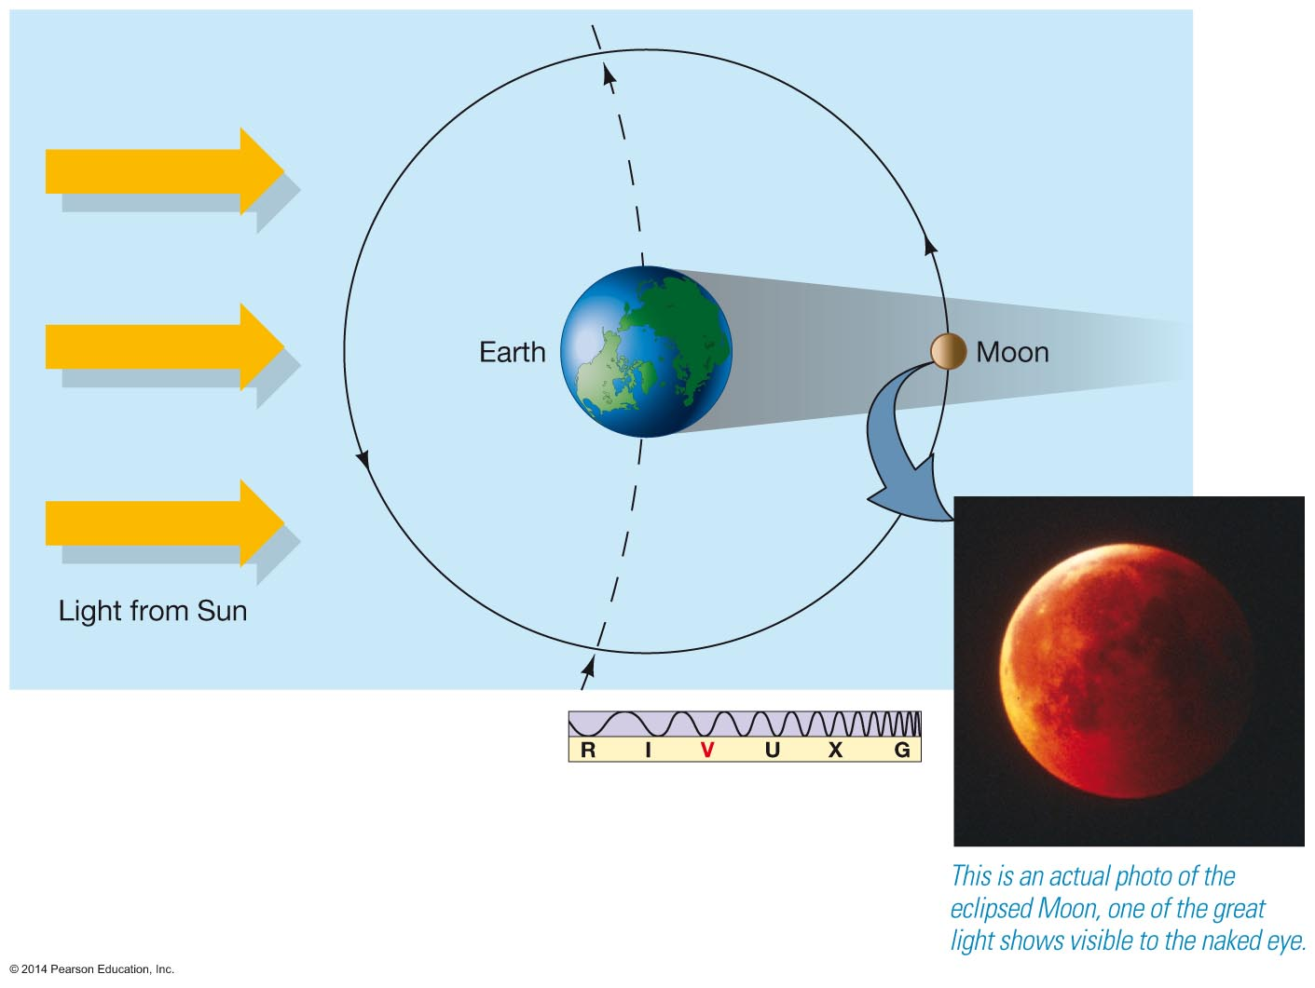
Figure 1.22

Slide 39
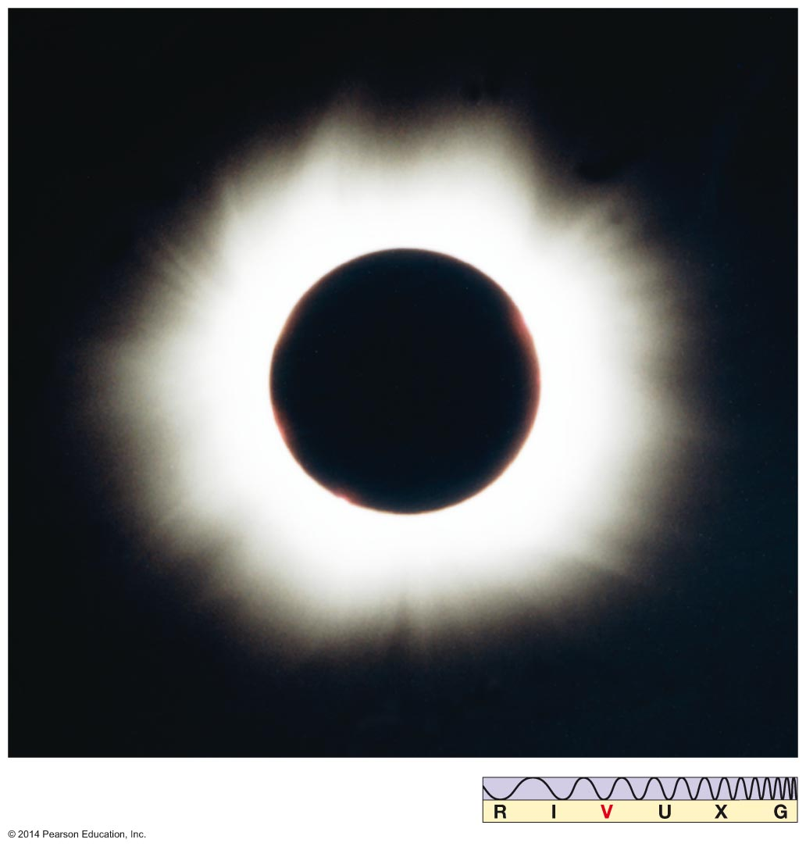
Figure 1.23

Slide 40
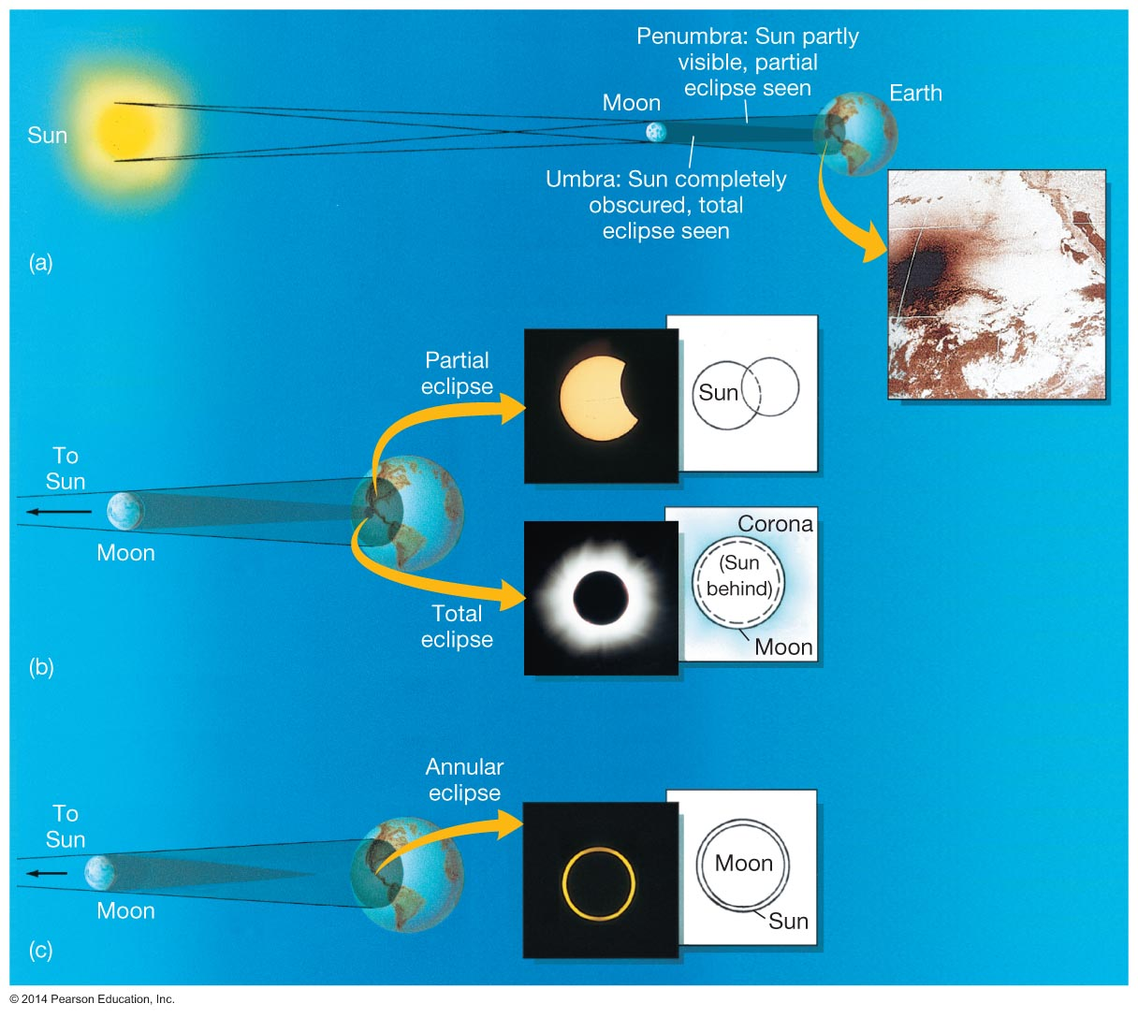
Figure 1.24

Slide 41
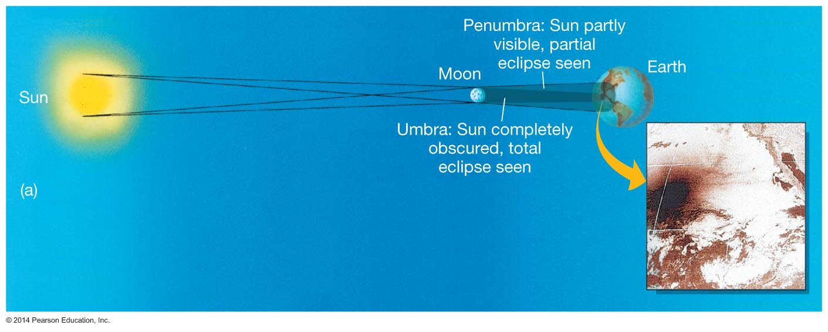
Figure 1.24a

Slide 42
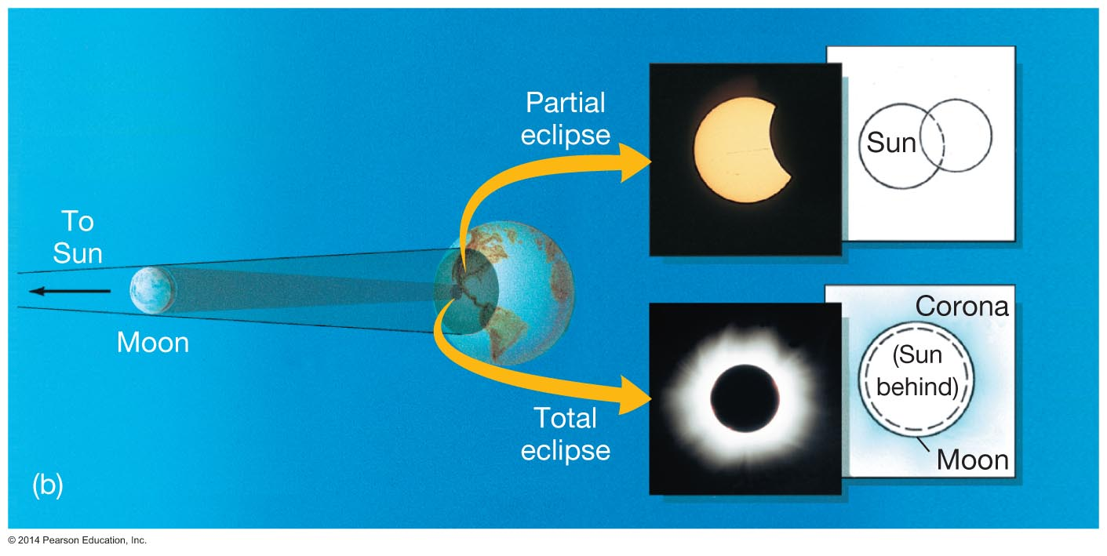
Figure 1.24b

Slide 43
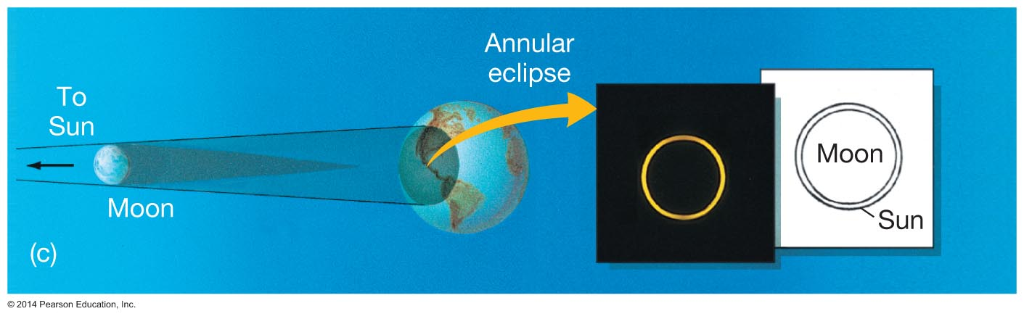
Figure 1.24c

Slide 44
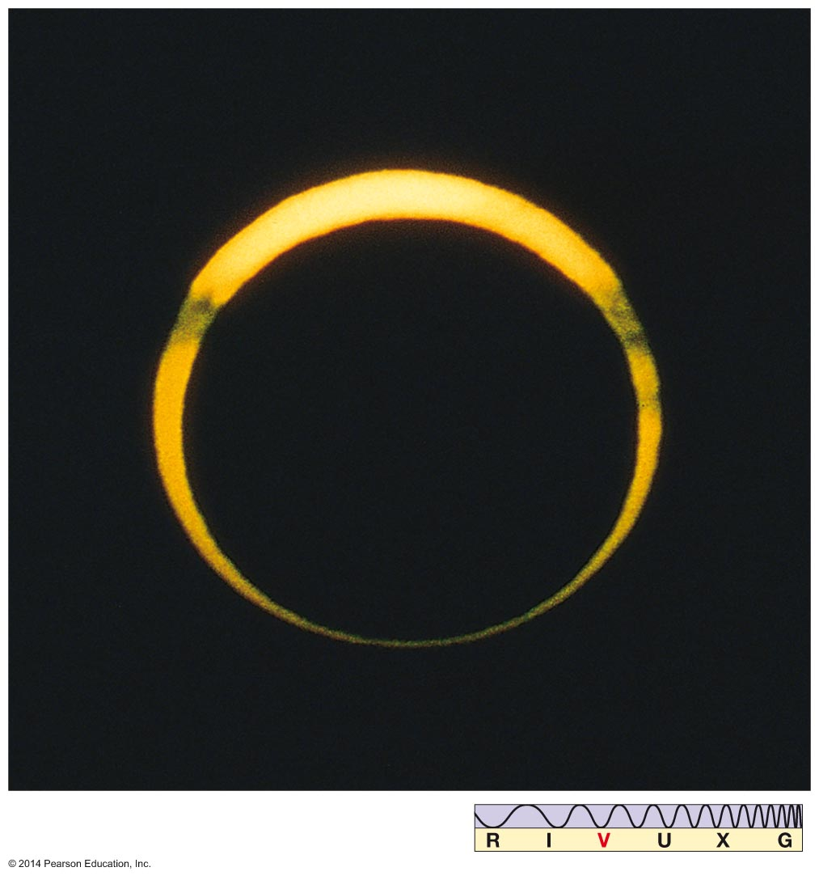
Figure 1.25

Slide 45
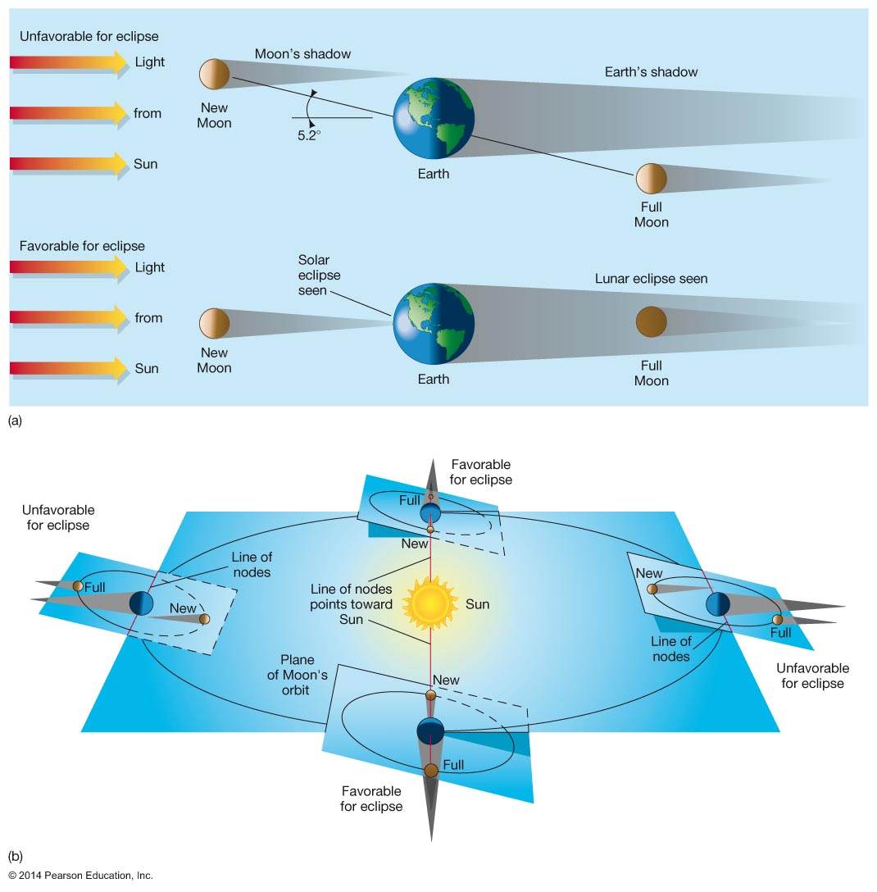
Figure 1.26

Slide 46
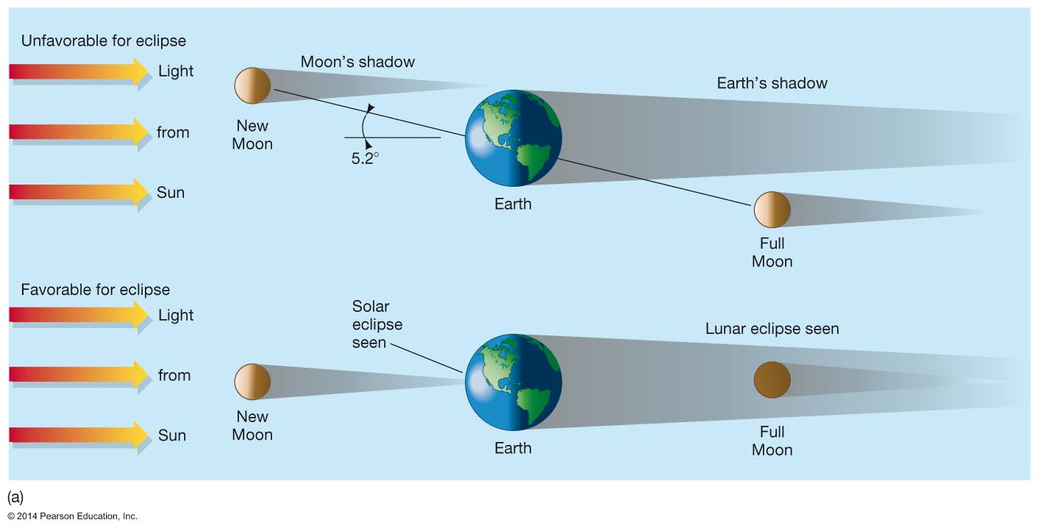
Figure 1.26a

Slide 47
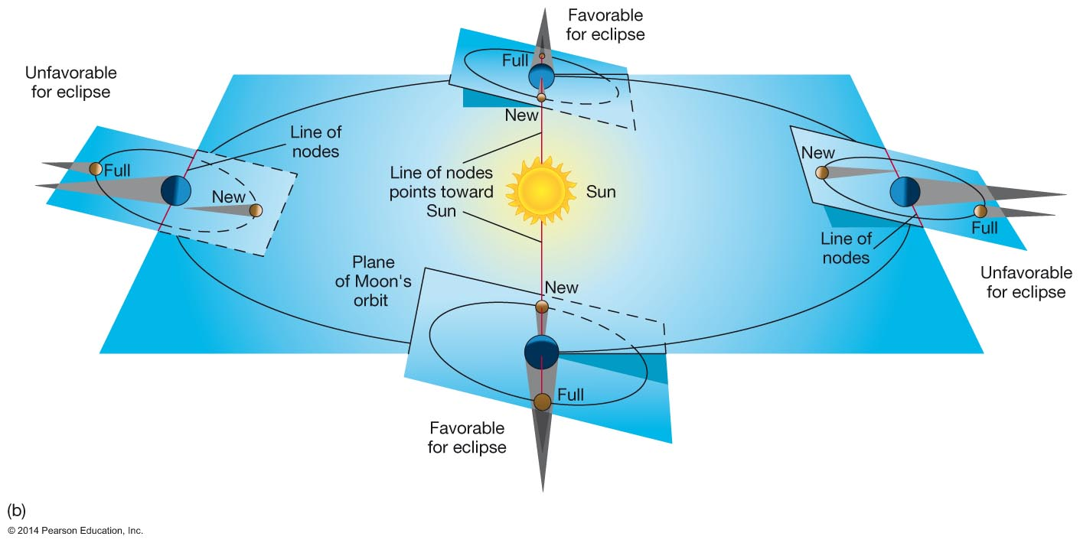
Figure 1.26b

Slide 48
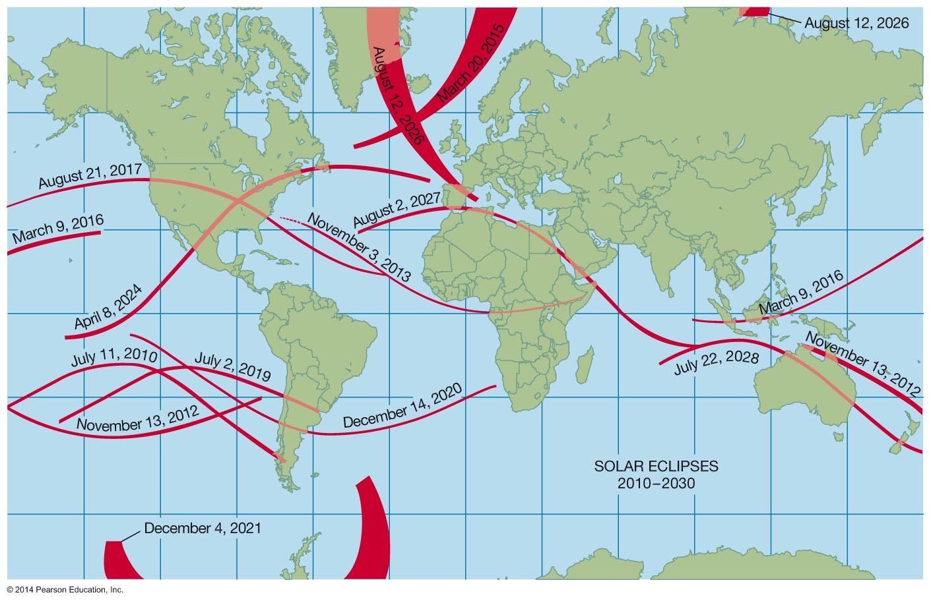
Figure 1.27

Slide 49
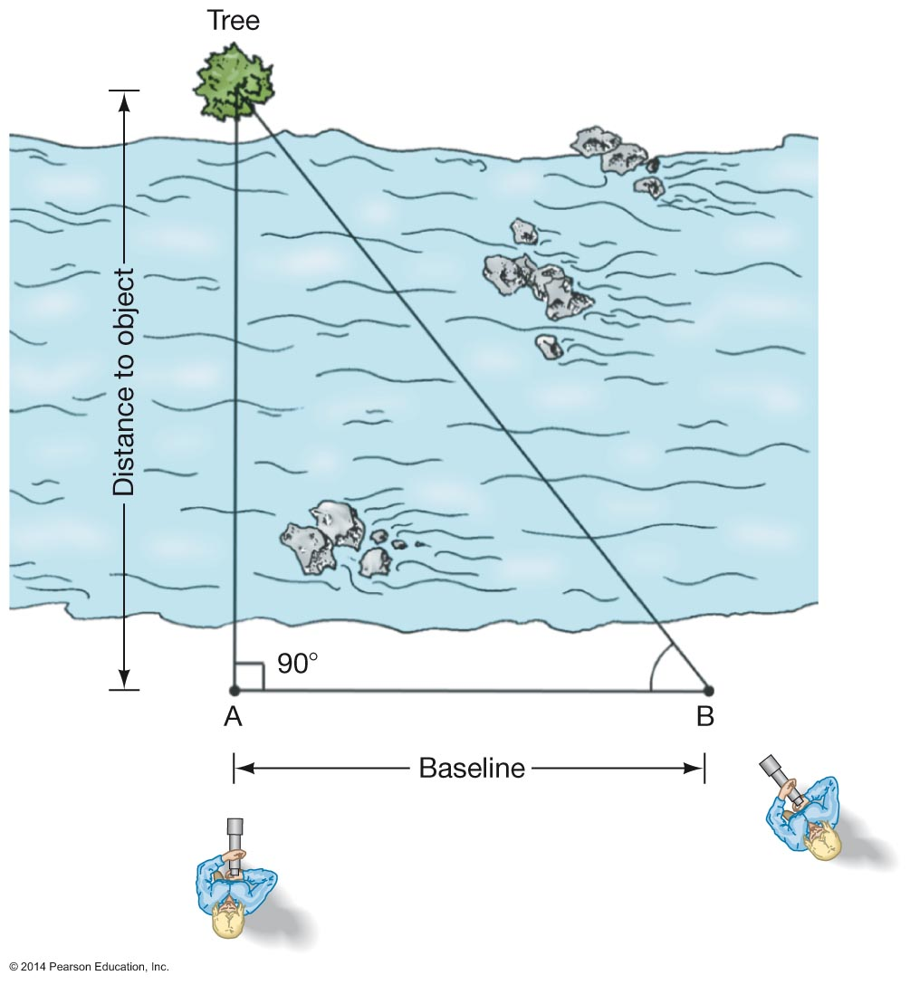
Figure 1.28

Slide 50
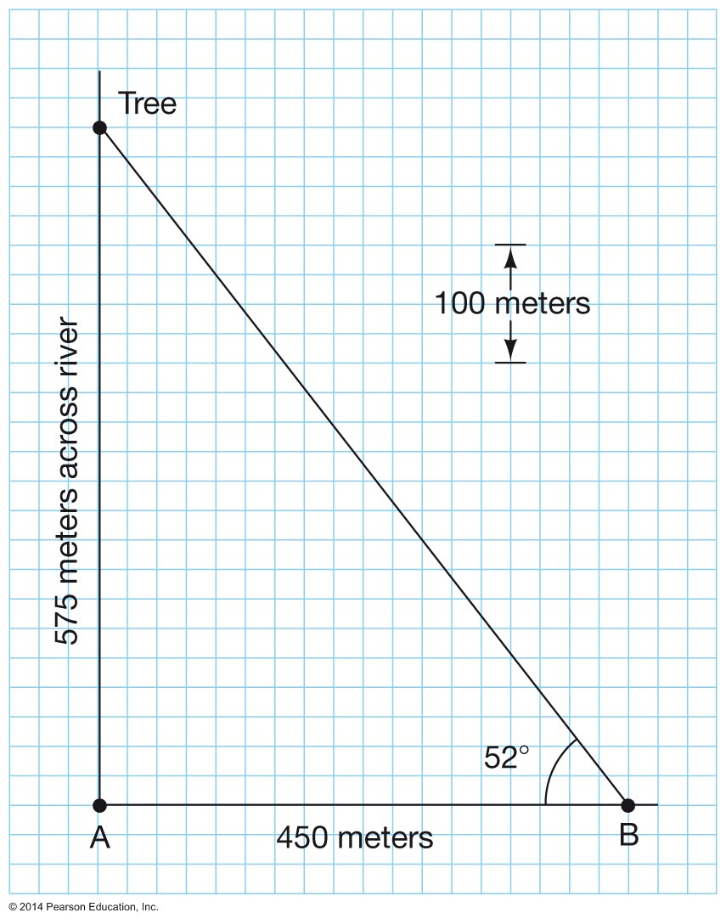
Figure 1.29

Slide 51

Figure 1.30

Slide 52

Figure 1.31

Slide 53

Figure 1.32

Slide 54

Unnumbered Figure 1 Page 28

Slide 55

Unnumbered Figure 2 Page 28

