Slide 1
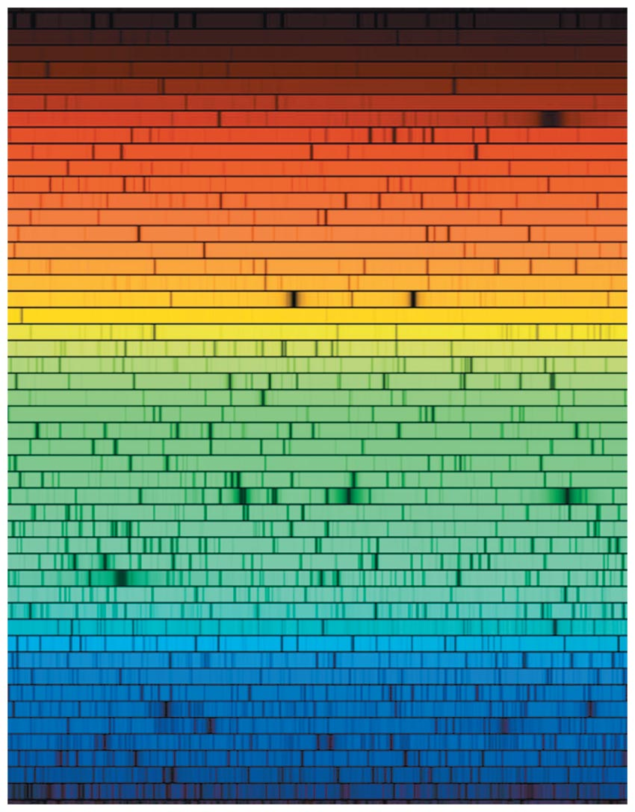
Chapter 4 Opener

Slide 2
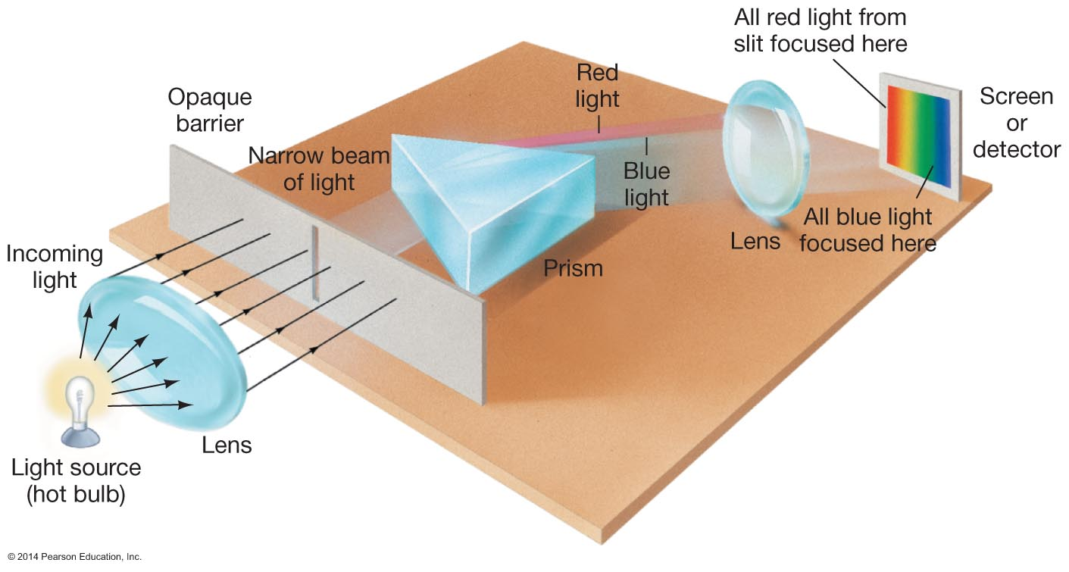
Figure 4.1

Slide 3
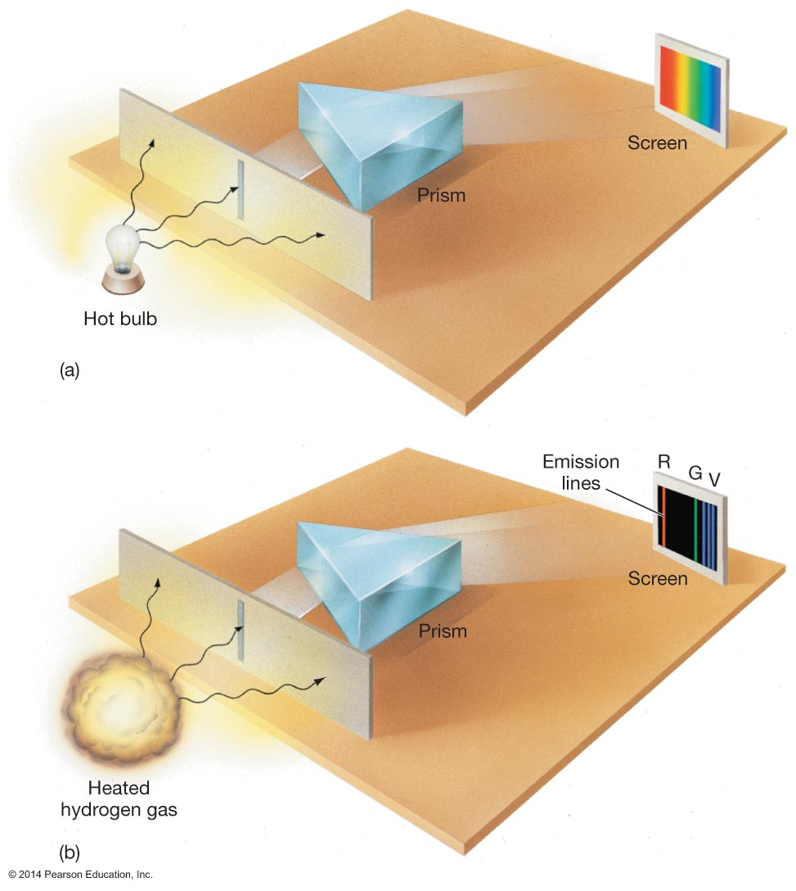
Figure 4.2

Slide 4
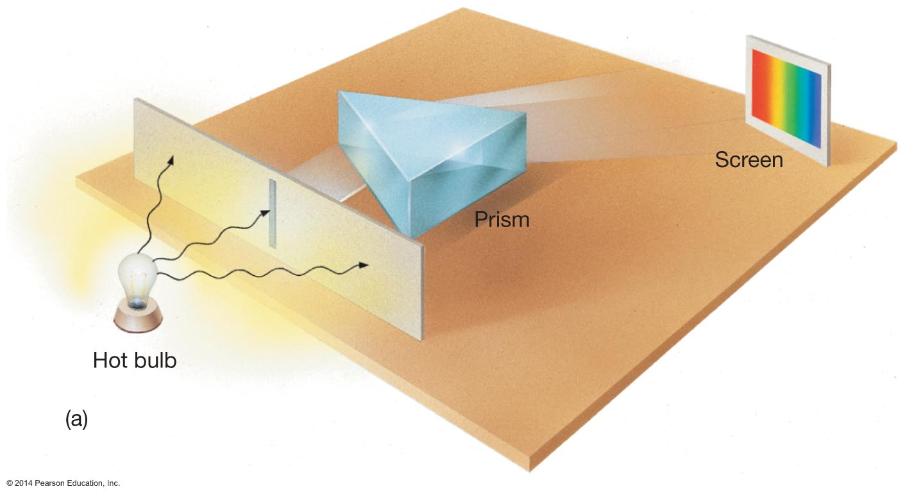
Figure 4.2a

Slide 5
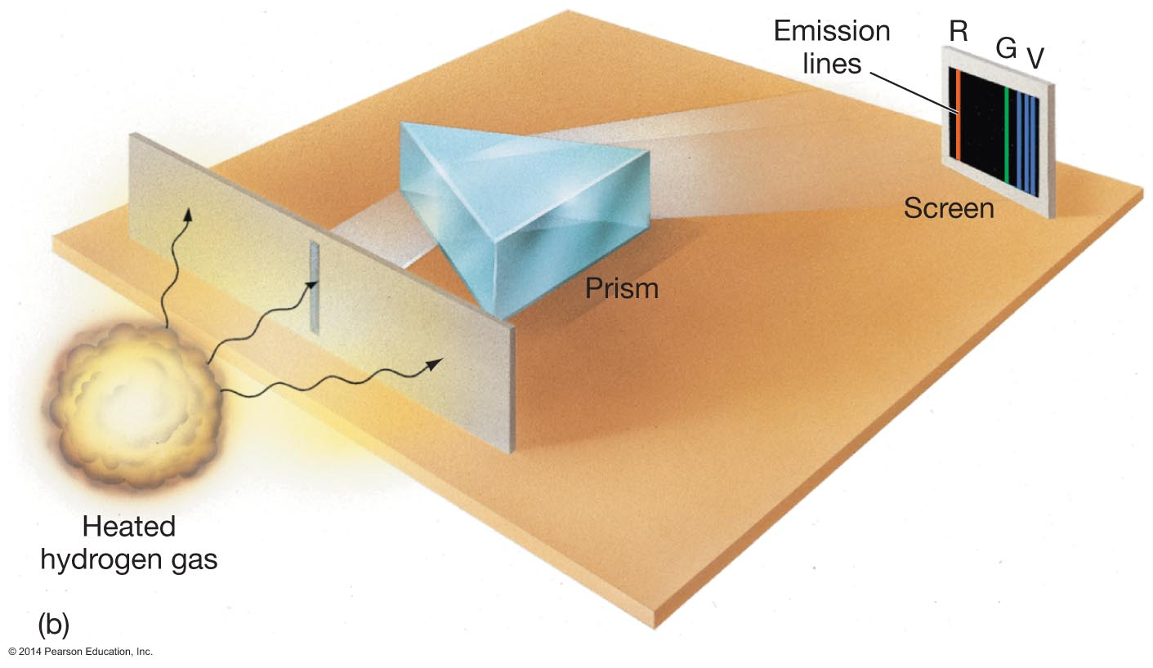
Figure 4.2b

Slide 6
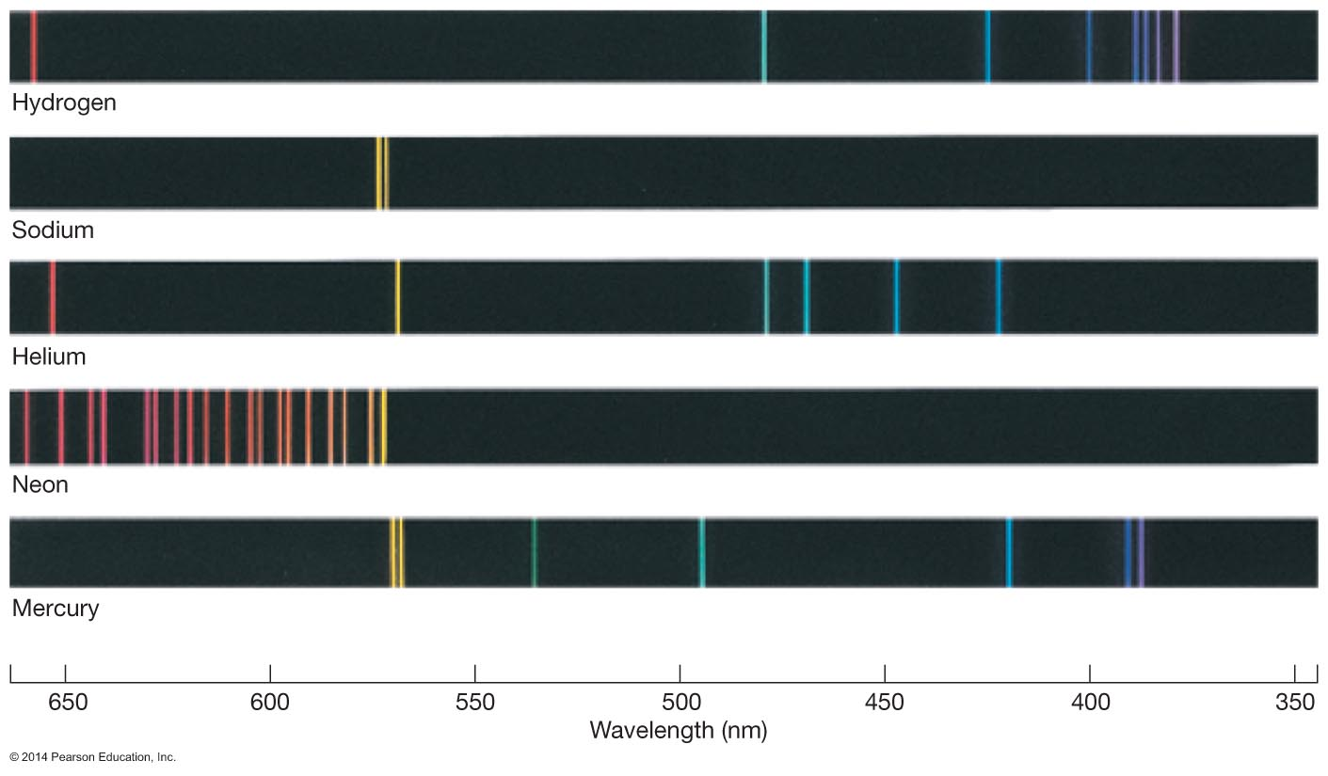
Figure 4.3

Slide 7
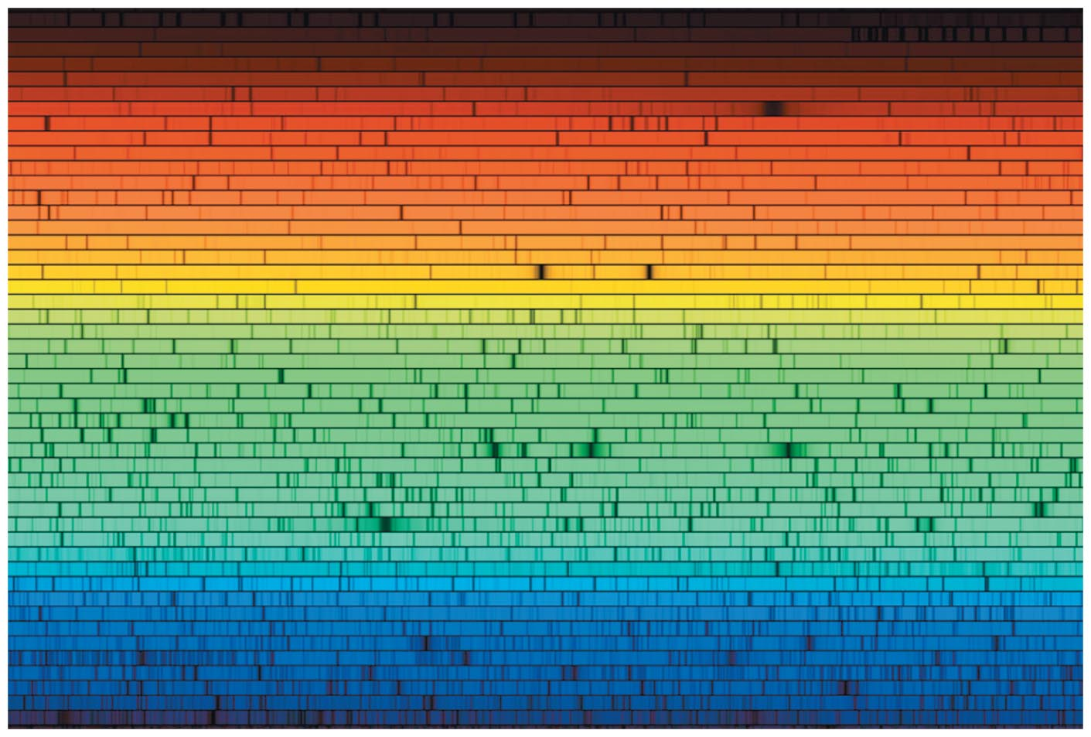
Figure 4.4

Slide 8
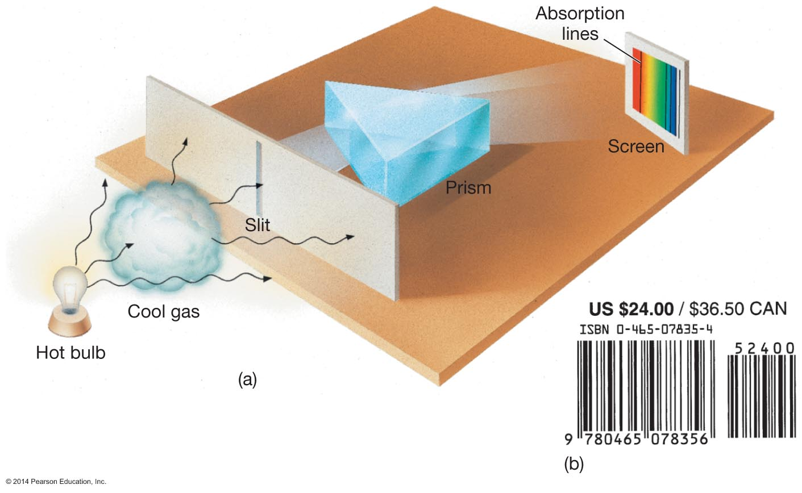
Figure 4.5

Slide 9
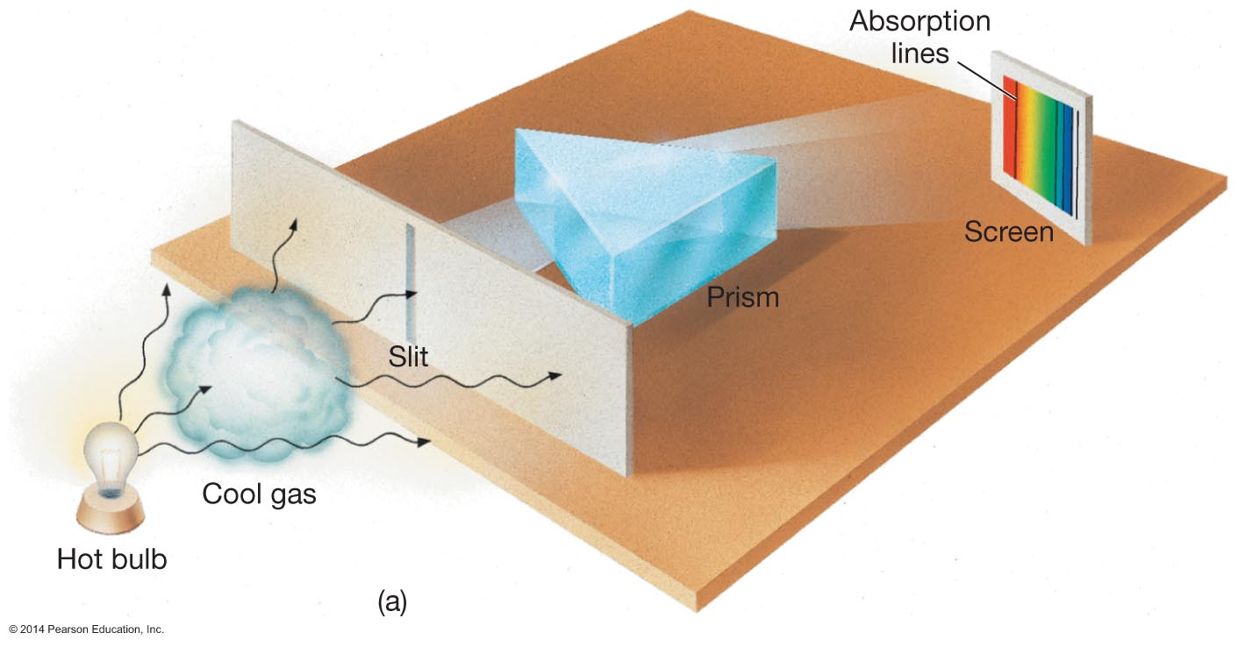
Figure 4.5a

Slide 10
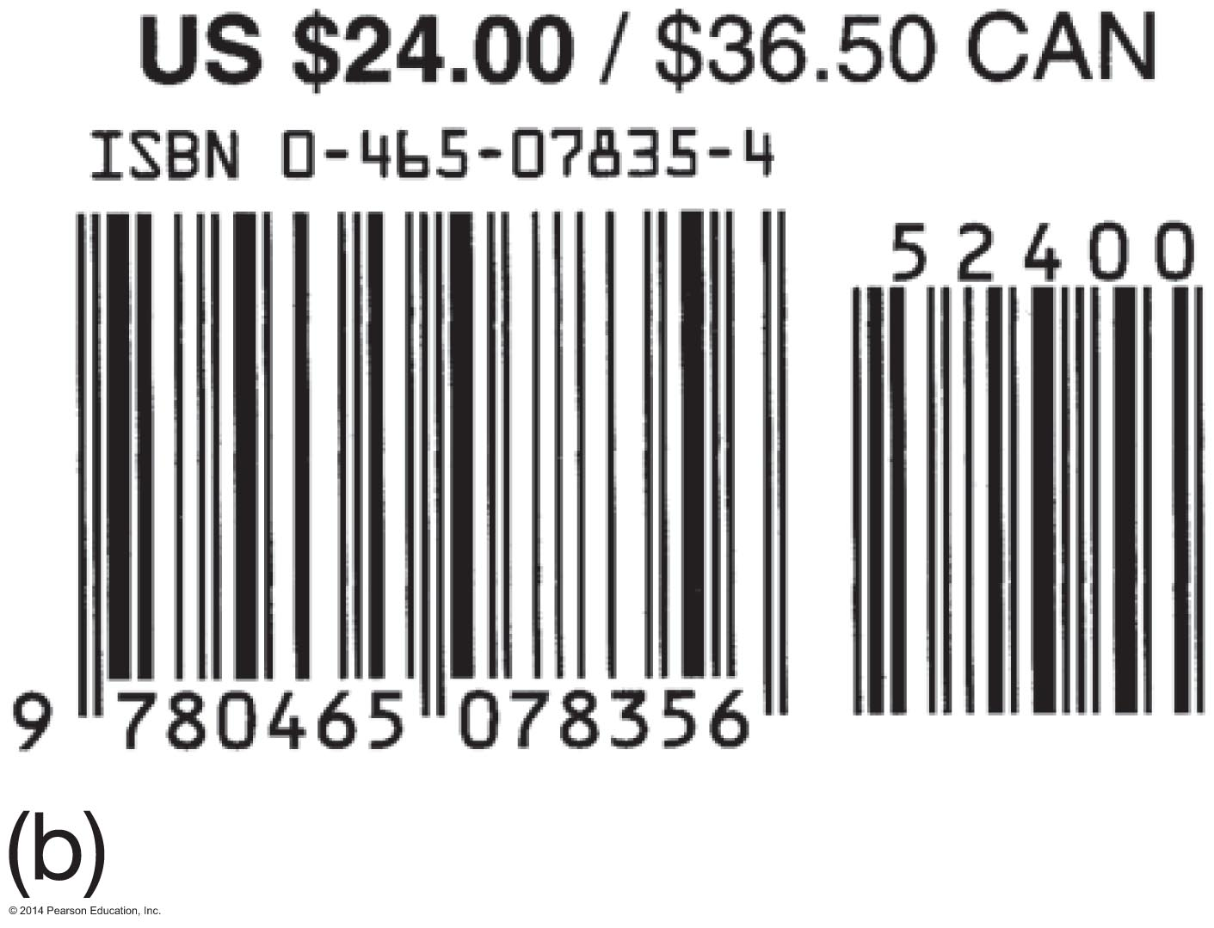
Figure 4.5b

Slide 11
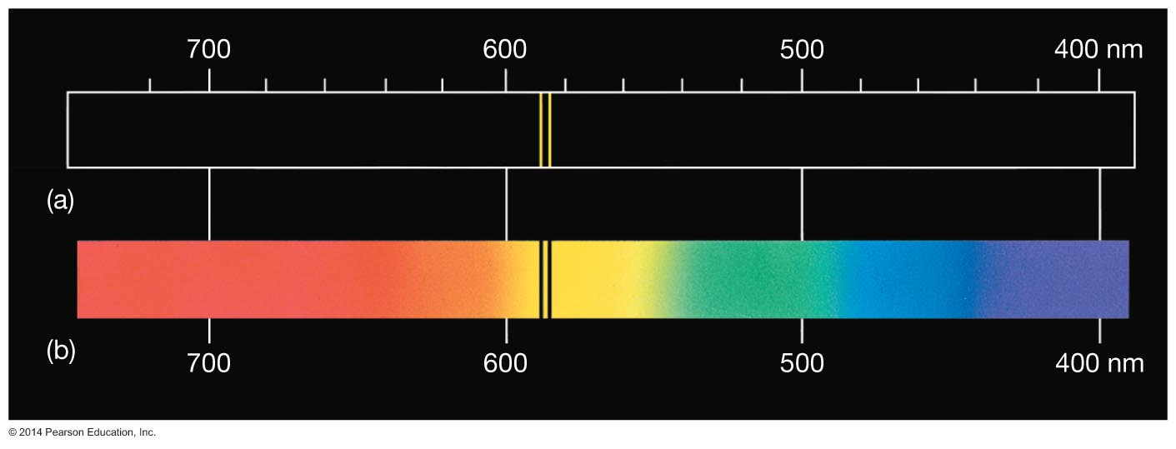
Figure 4.6

Slide 12
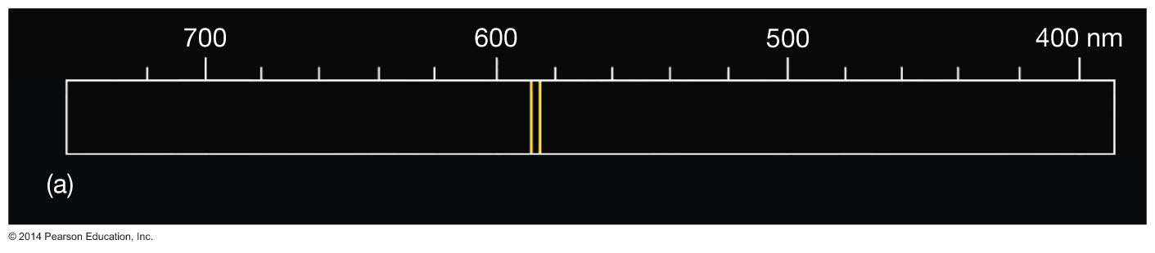
Figure 4.6a

Slide 13
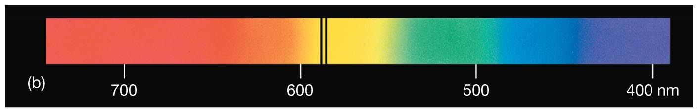
Figure 4.6b

Slide 14
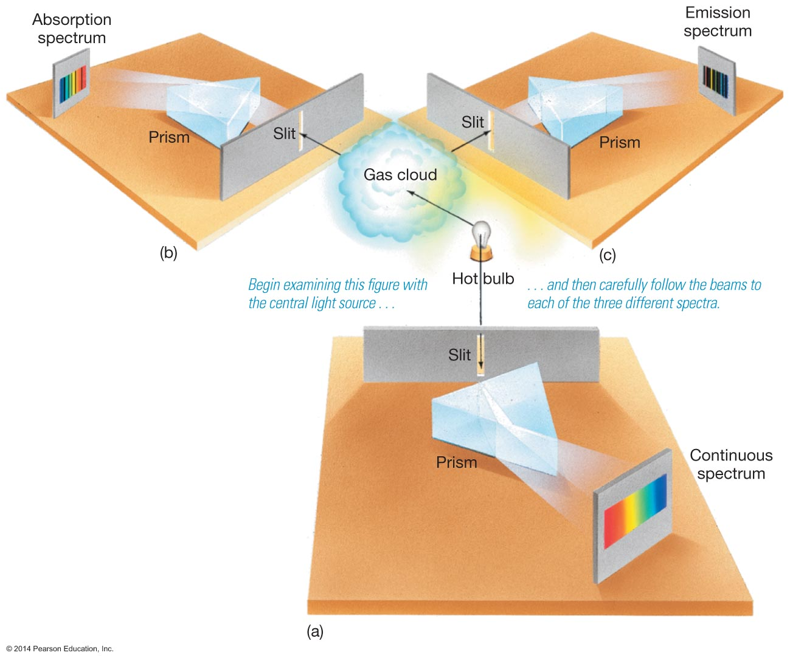
Figure 4.7

Slide 15
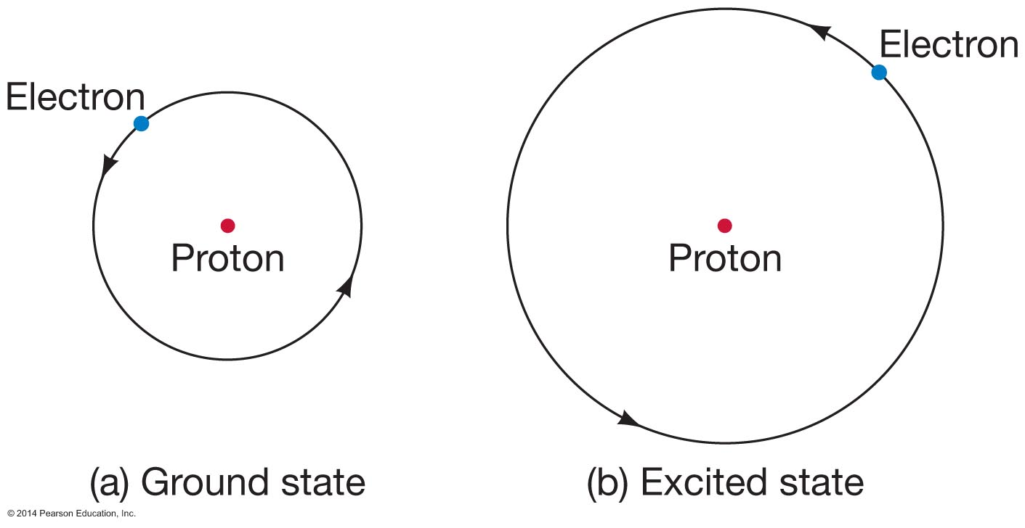
Figure 4.8

Slide 16
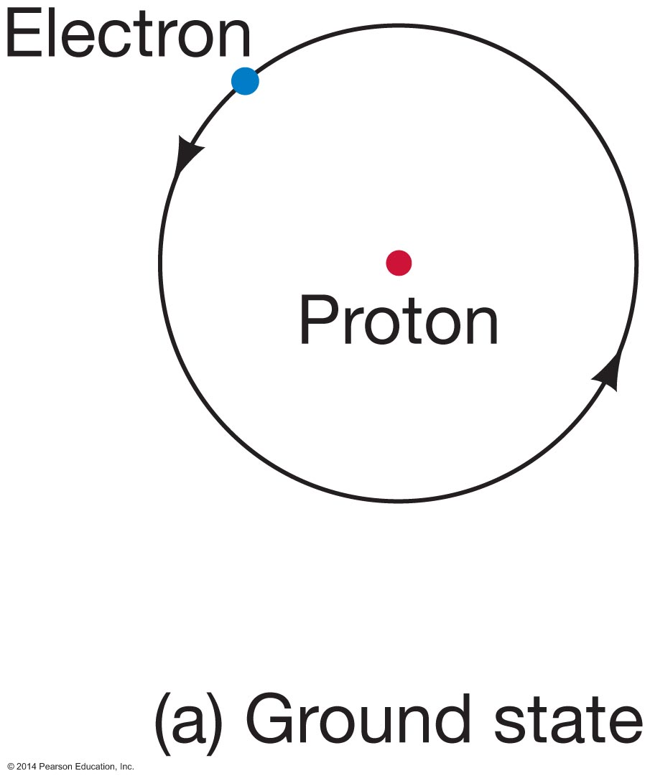
Figure 4.8a

Slide 17
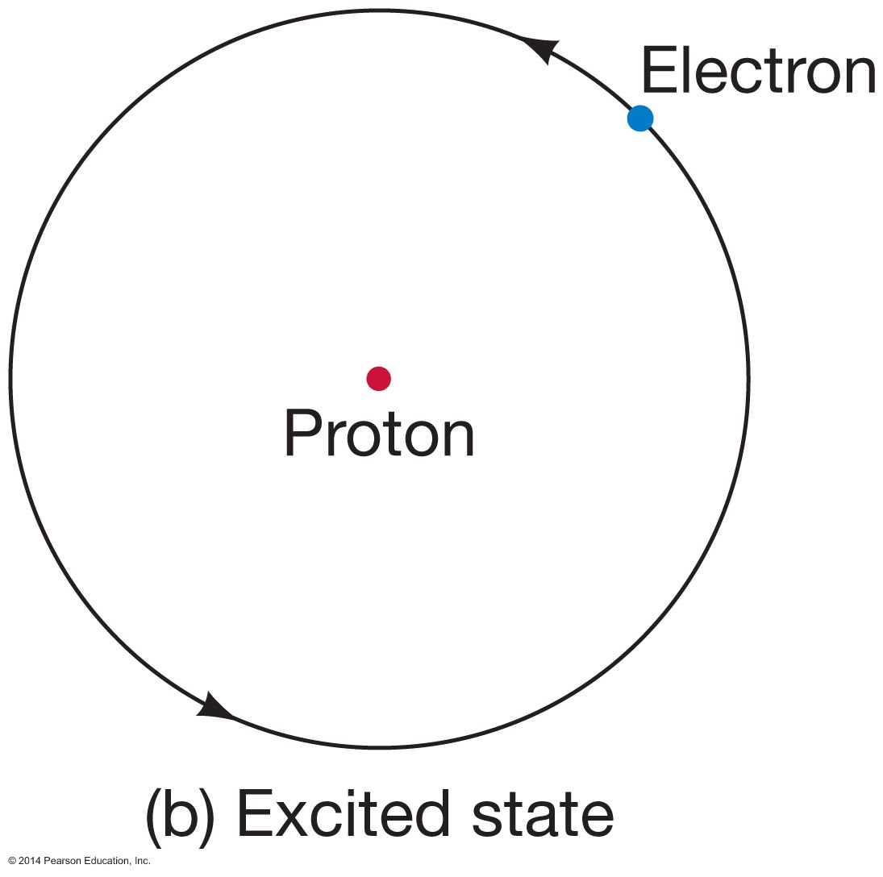
Figure 4.8b

Slide 18
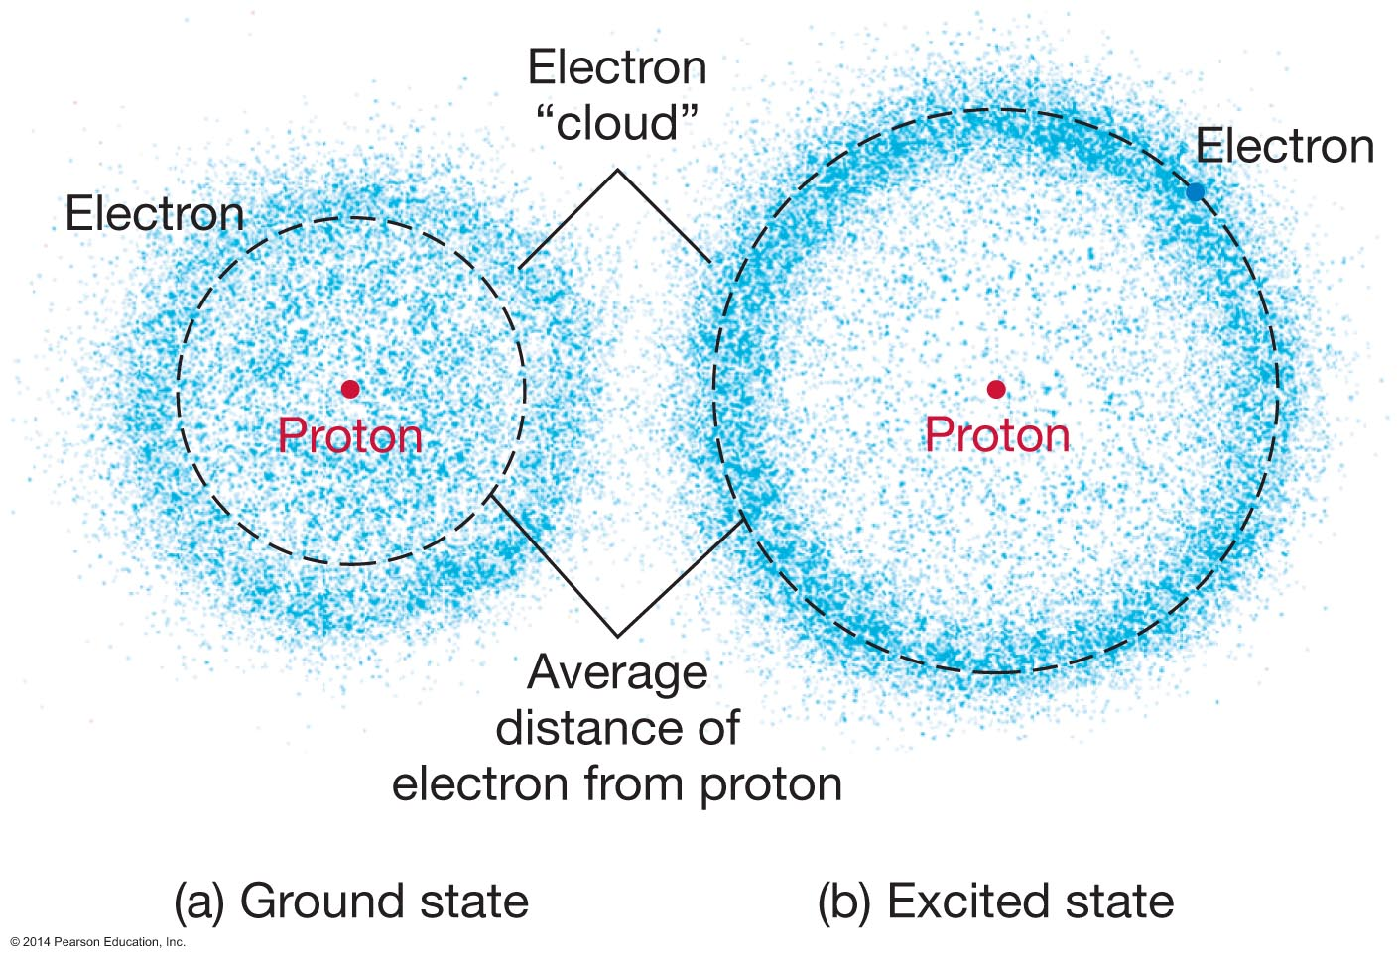
Figure 4.9

Slide 19
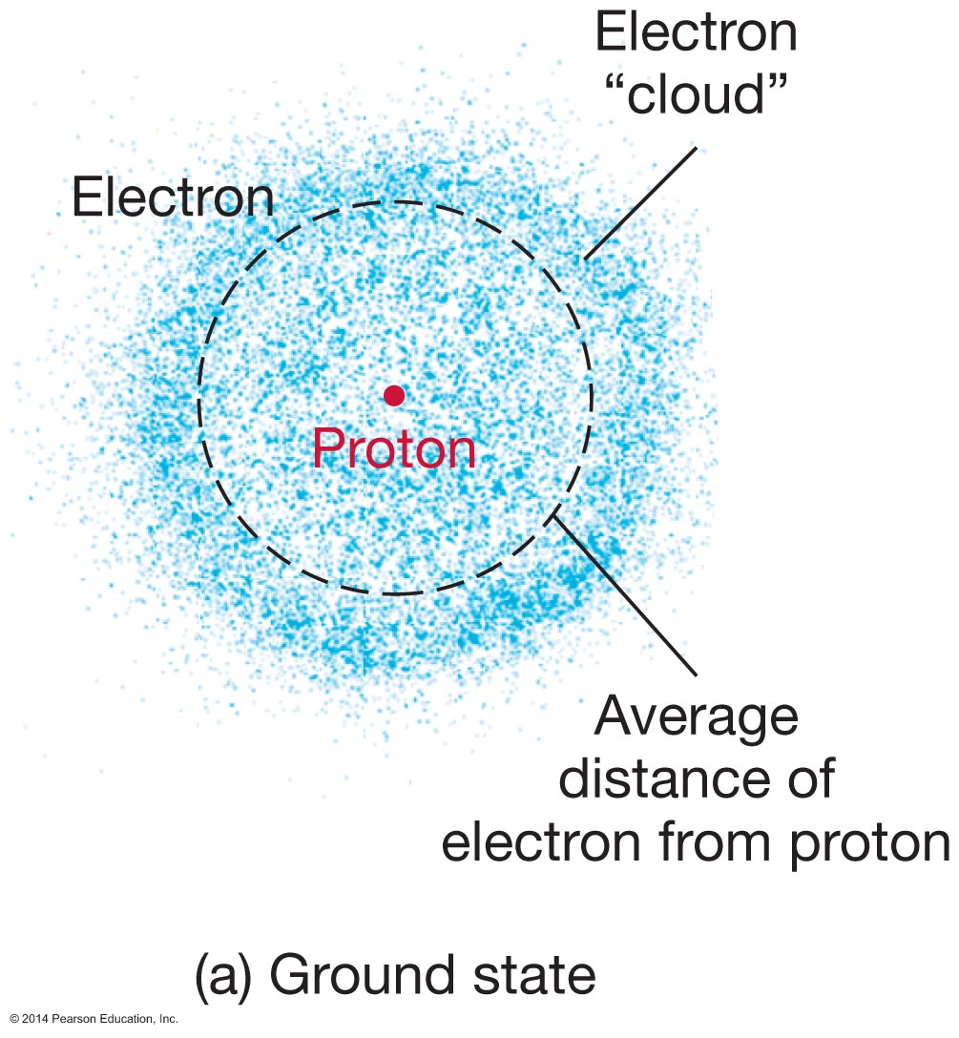
Figure 4.9a

Slide 20
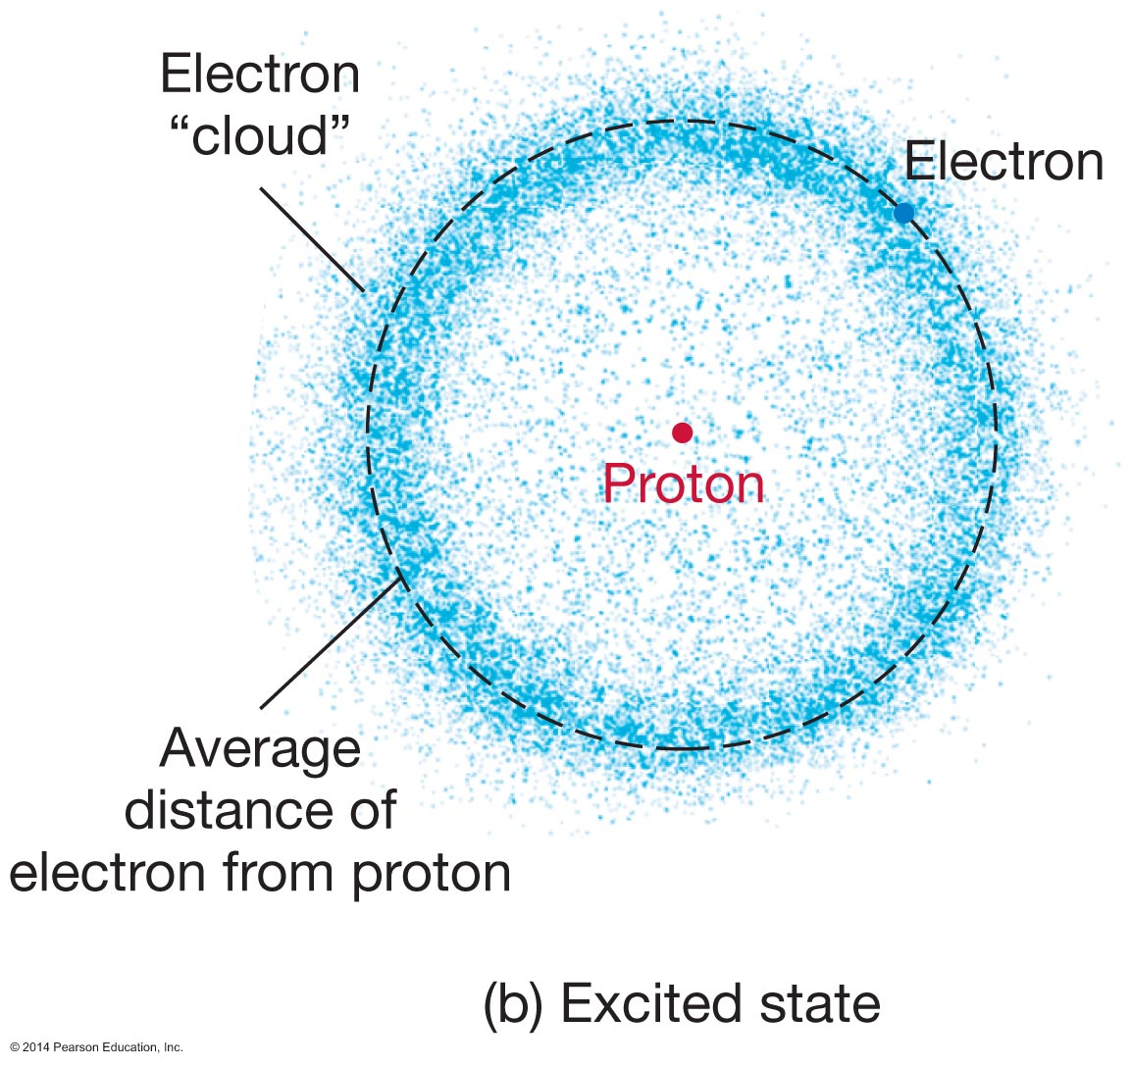
Figure 4.9b

Slide 21
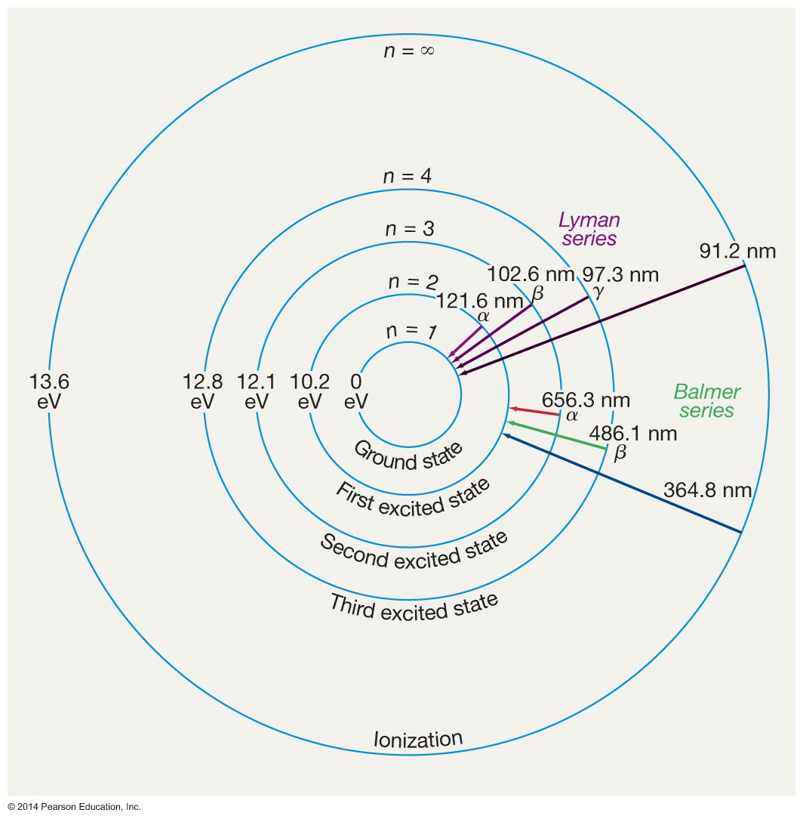
Unnumbered Figure Page 86

Slide 22
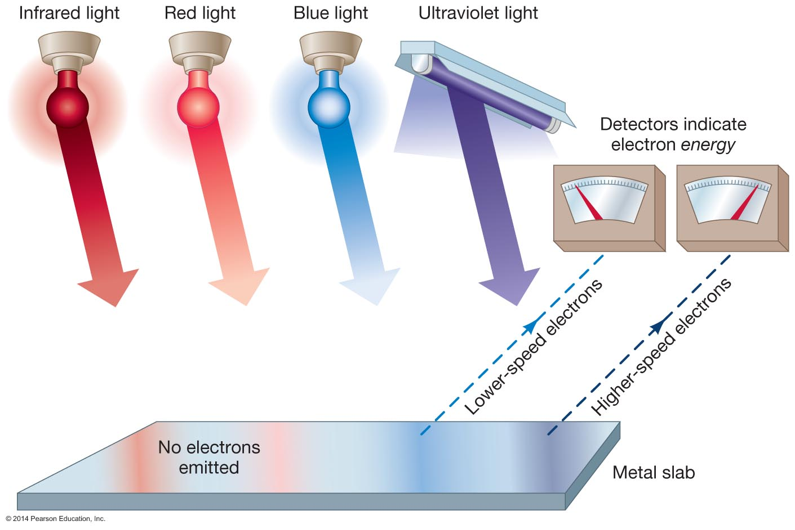
Unnumbered Figure Page 88

Slide 23
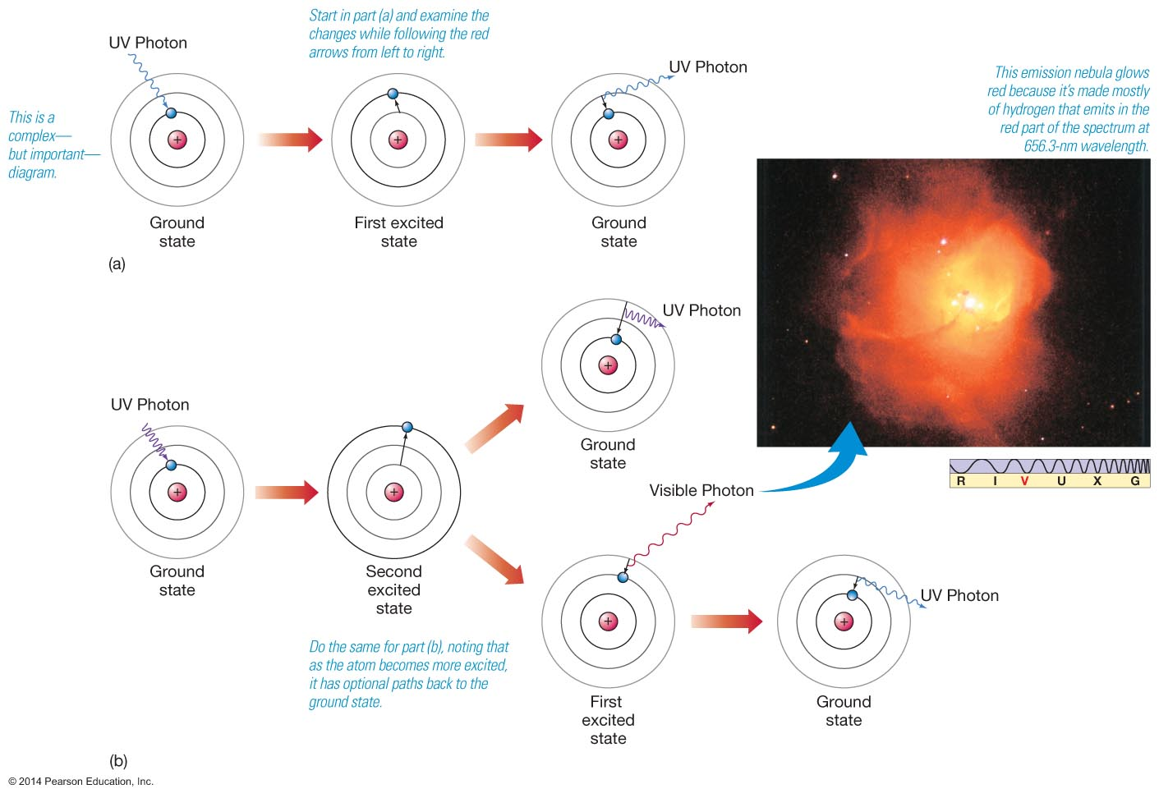
Figure 4.10

Slide 24
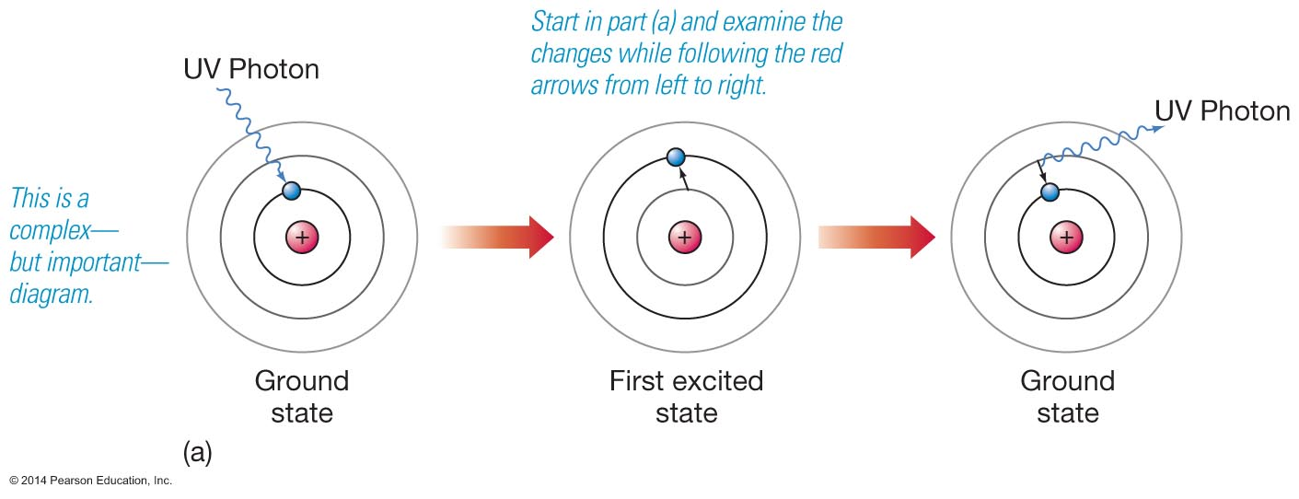
Figure 4.10a

Slide 25
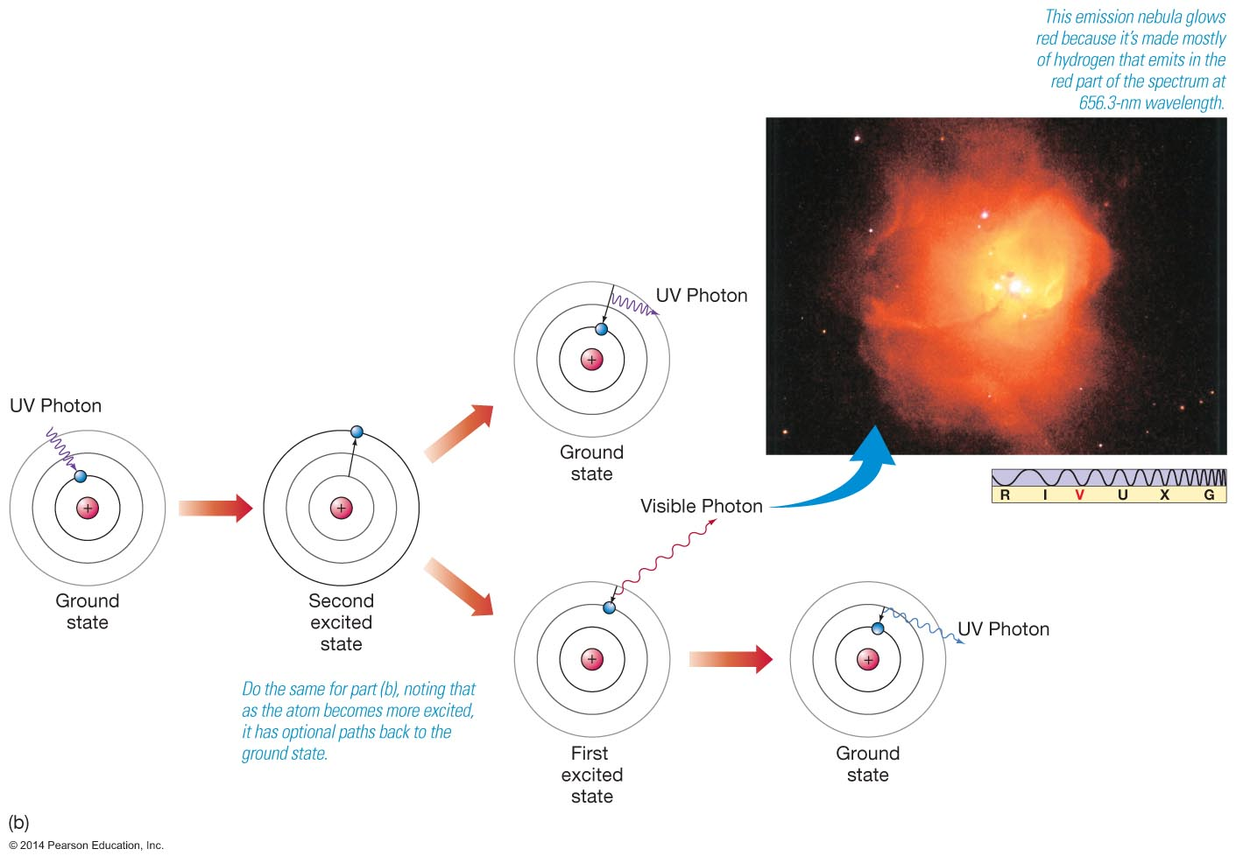
Figure 4.10b

Slide 26
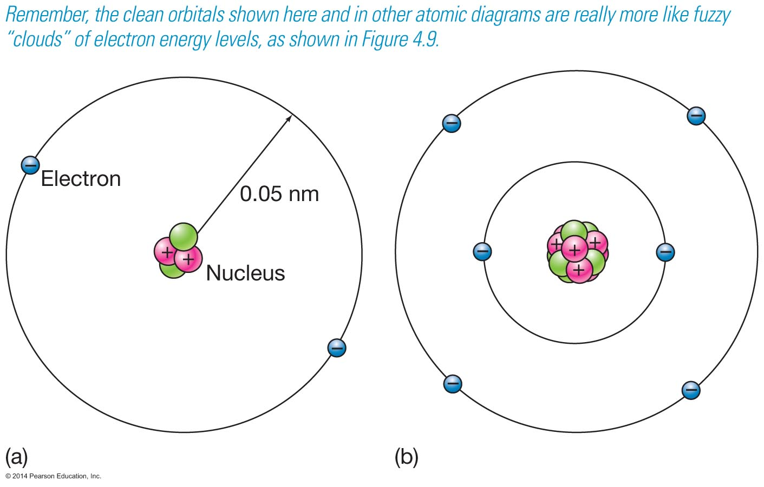
Figure 4.11

Slide 27
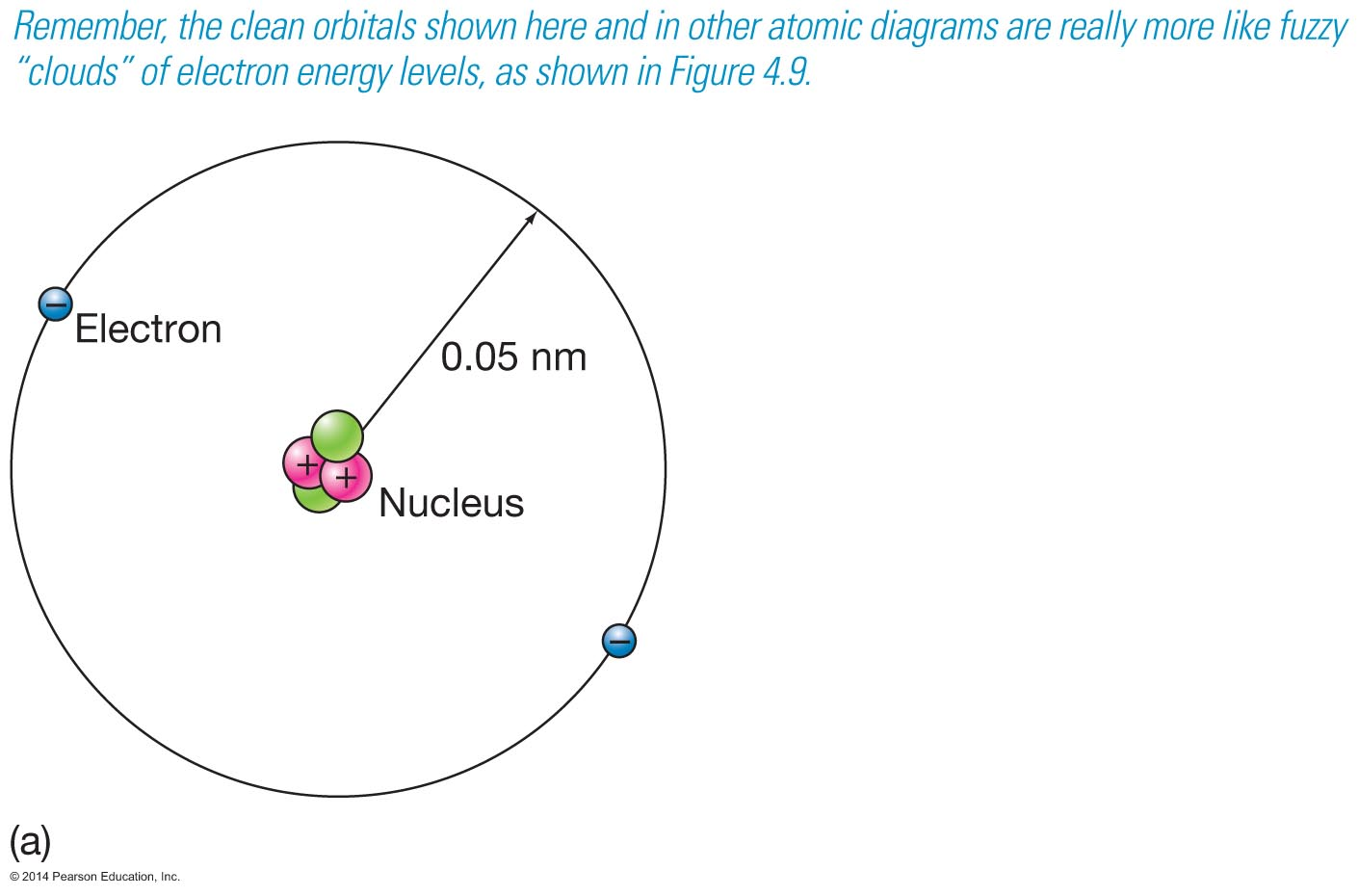
Figure 4.11a

Slide 28
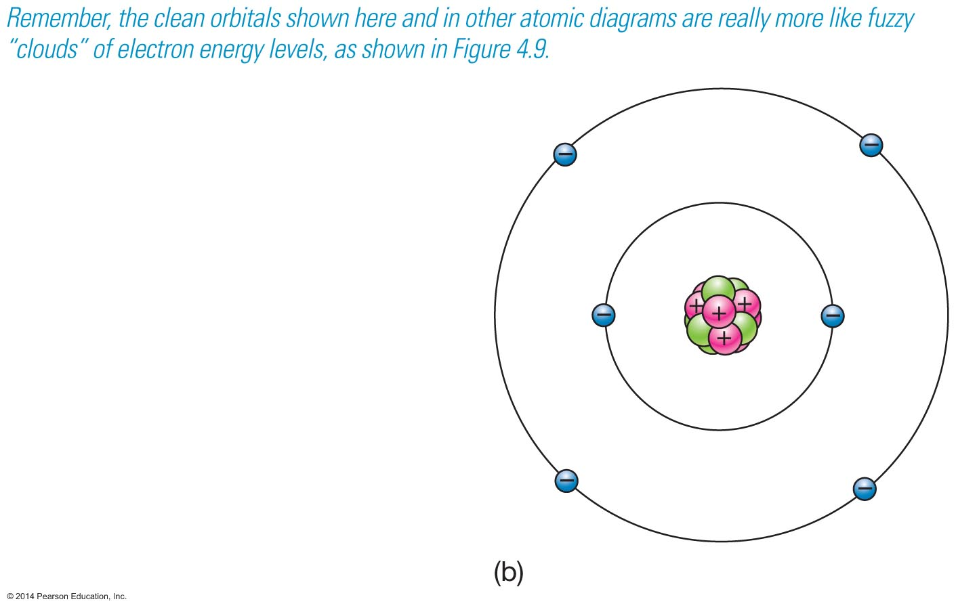
Figure 4.11b

Slide 29
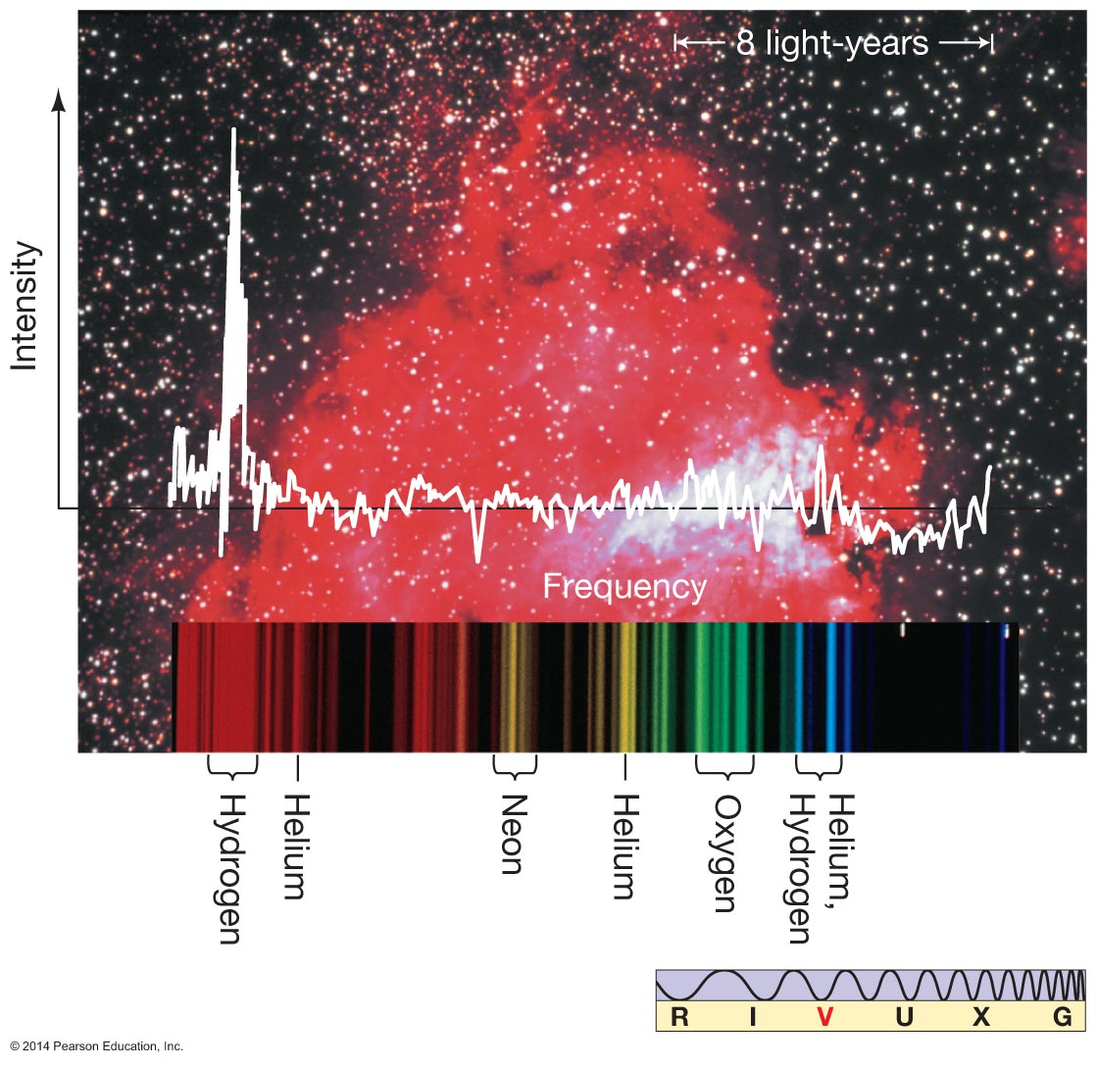
Figure 4.12

Slide 30
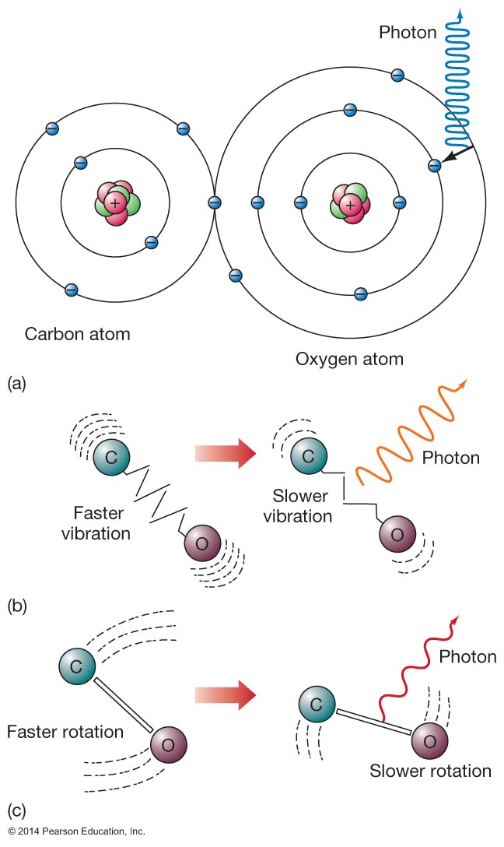
Figure 4.13

Slide 31
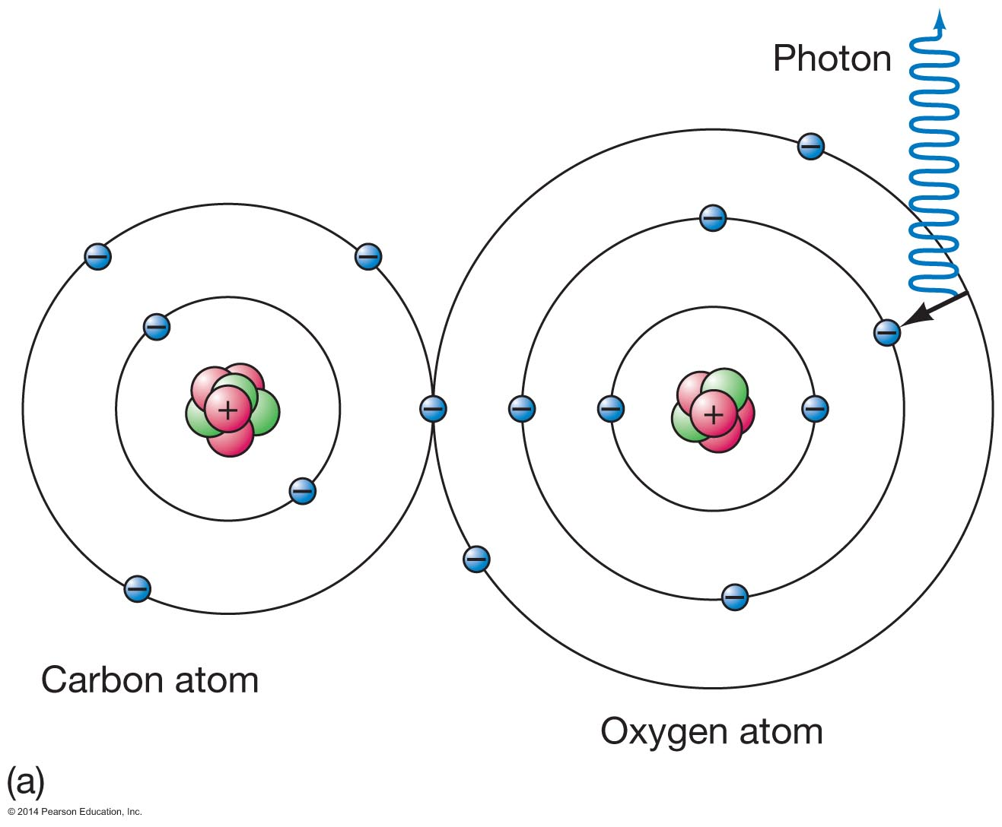
Figure 4.13a

Slide 32
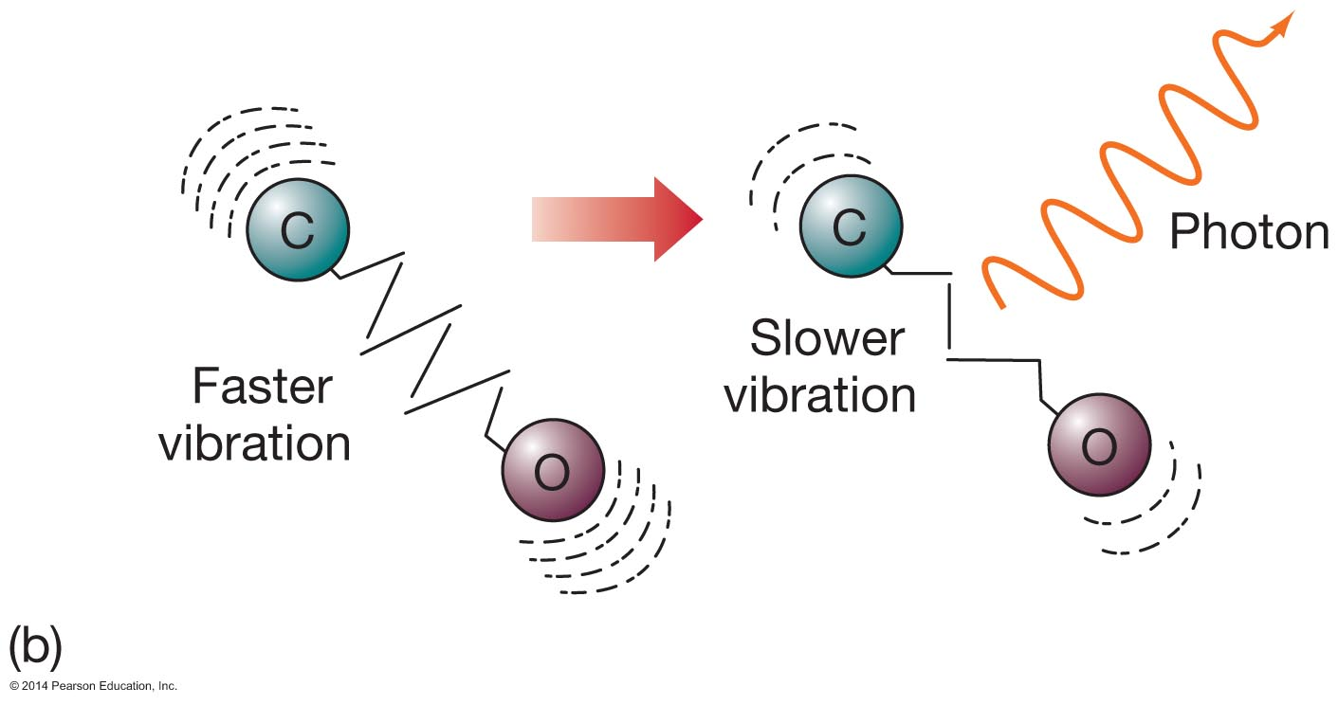
Figure 4.13b

Slide 33
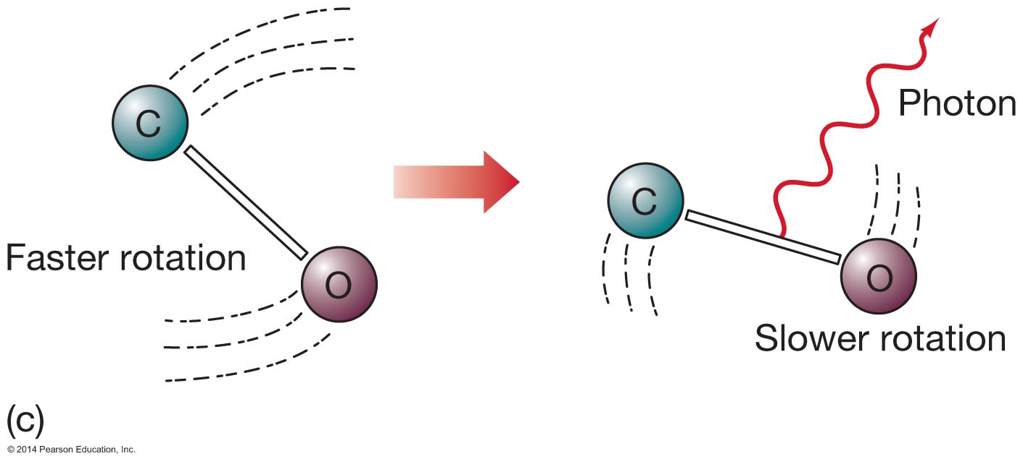
Figure 4.13c

Slide 34
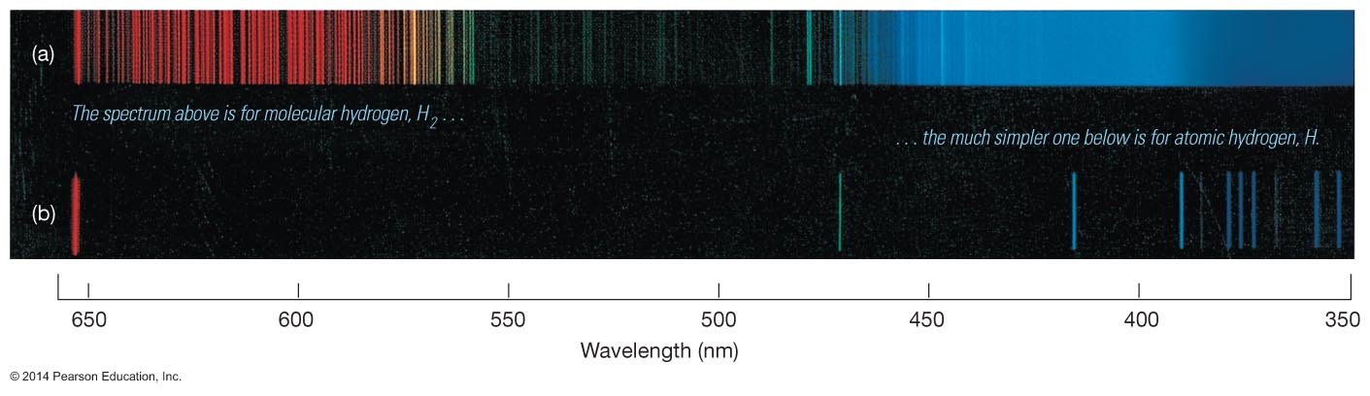
Figure 4.14

Slide 35
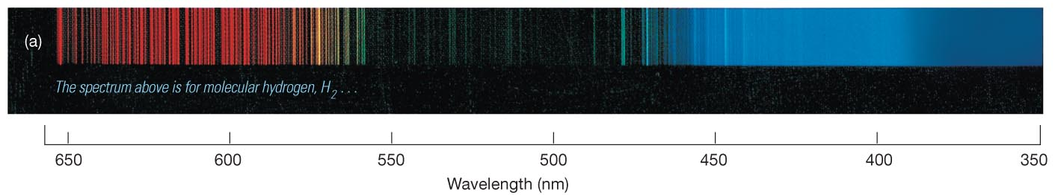
Figure 4.14a

Slide 36
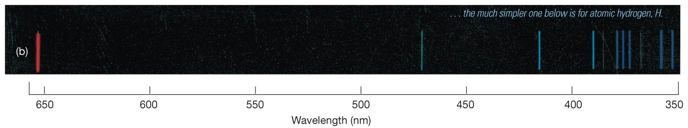
Figure 4.14b

Slide 37
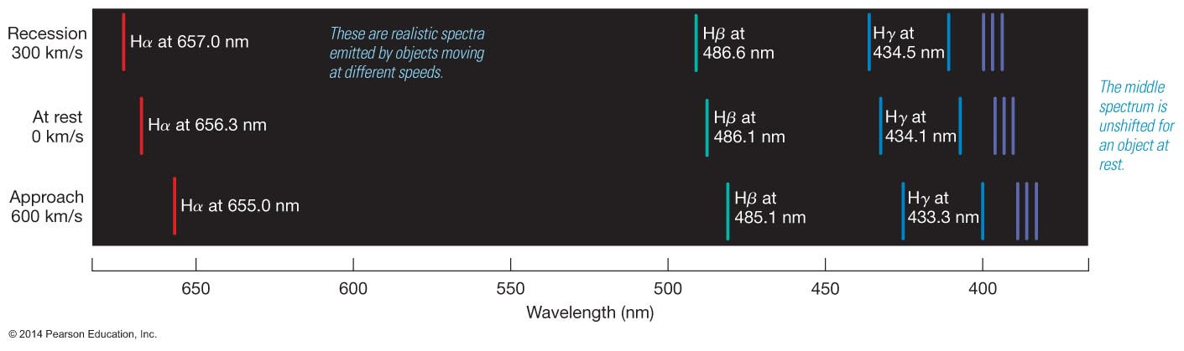
Figure 4.15

Slide 38
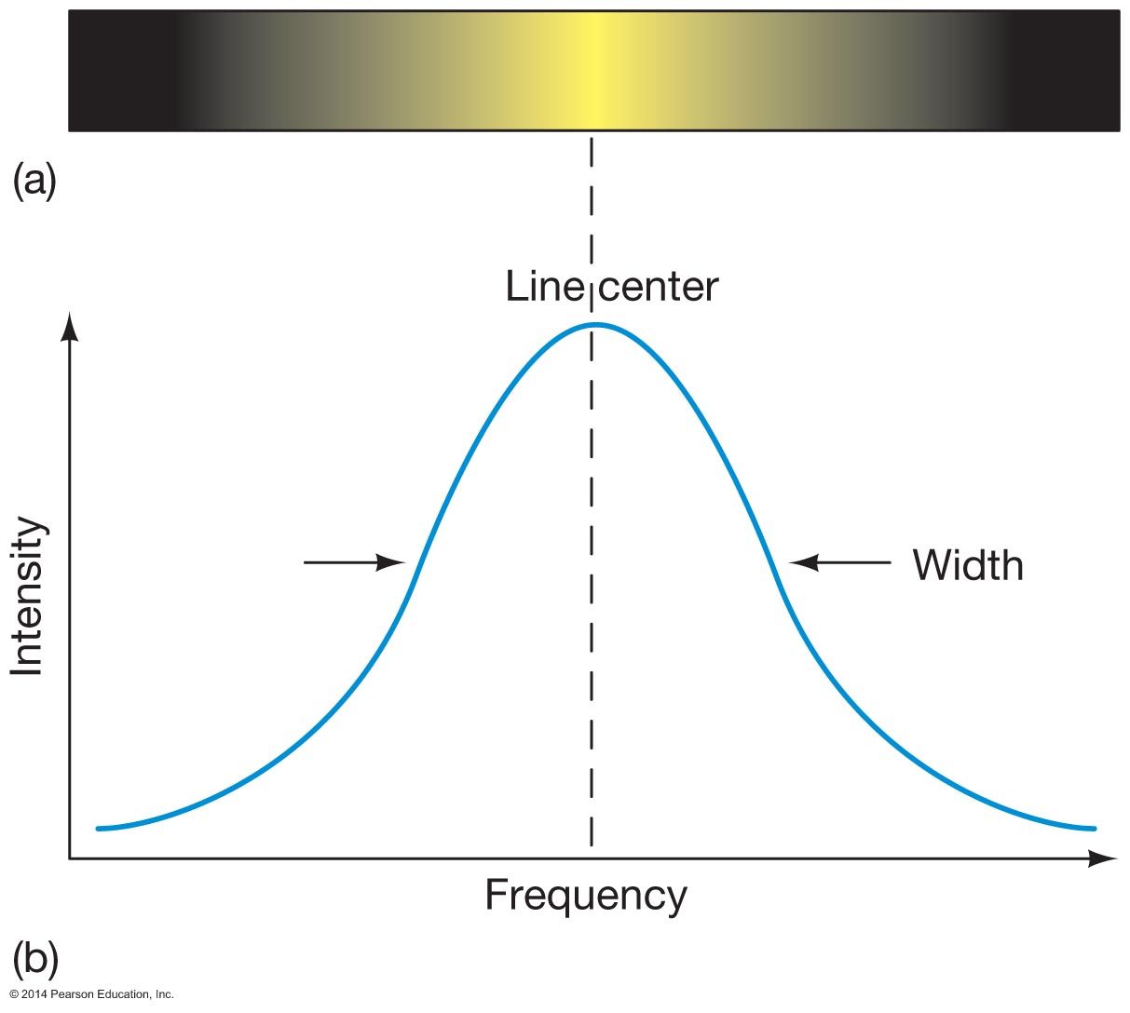
Figure 4.16

Slide 39

Figure 4.16a

Slide 40
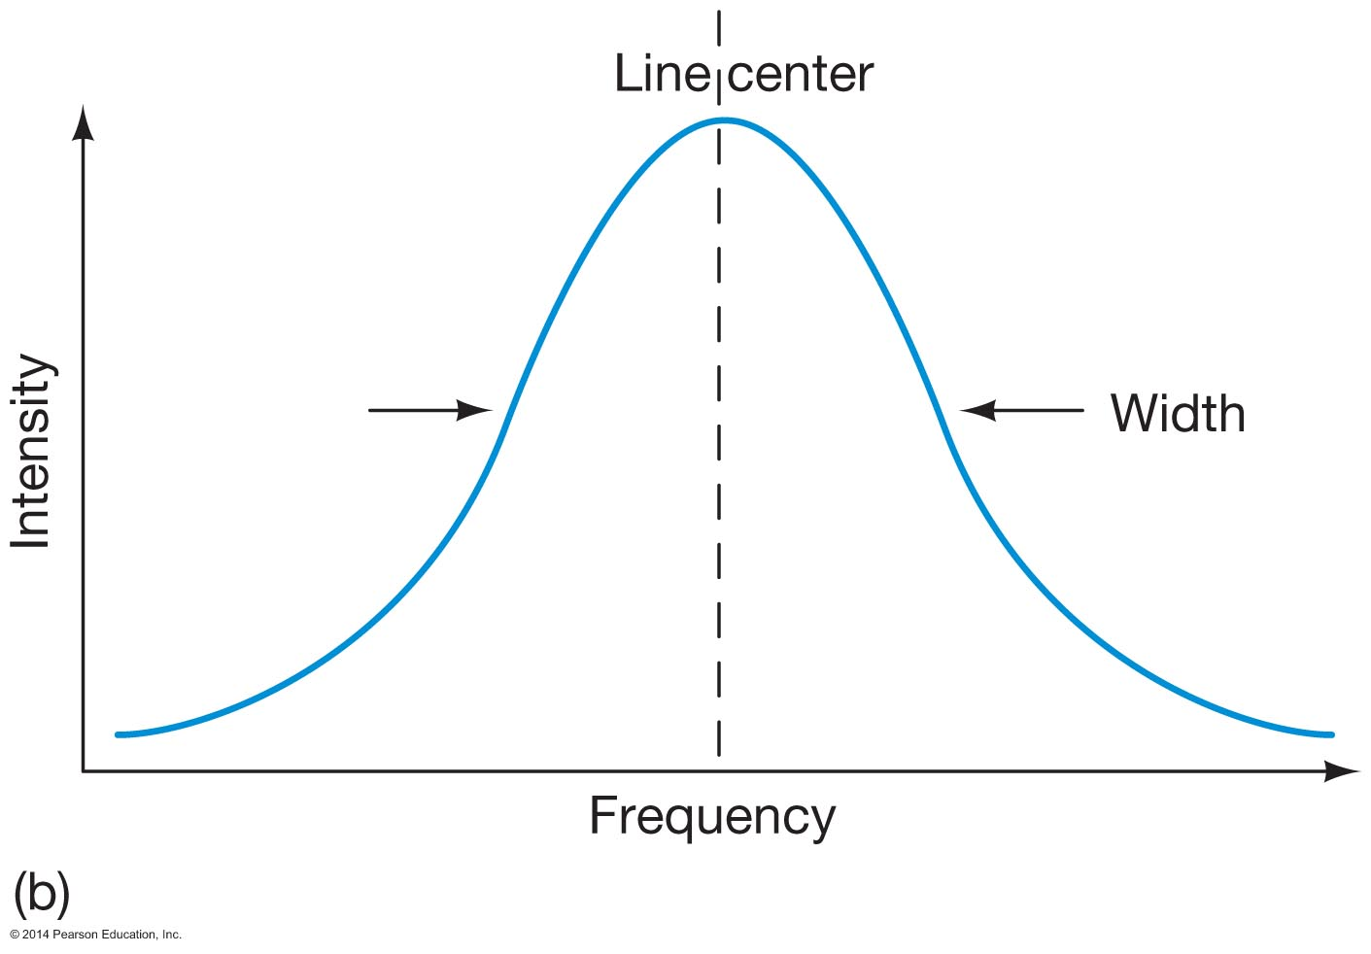
Figure 4.16b

Slide 41
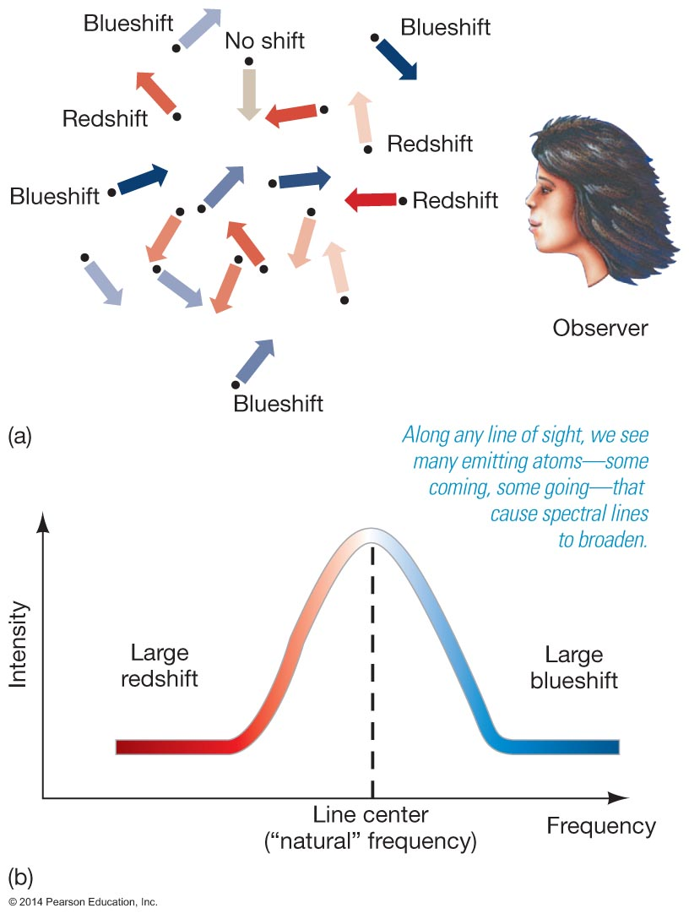
Figure 4.17

Slide 42
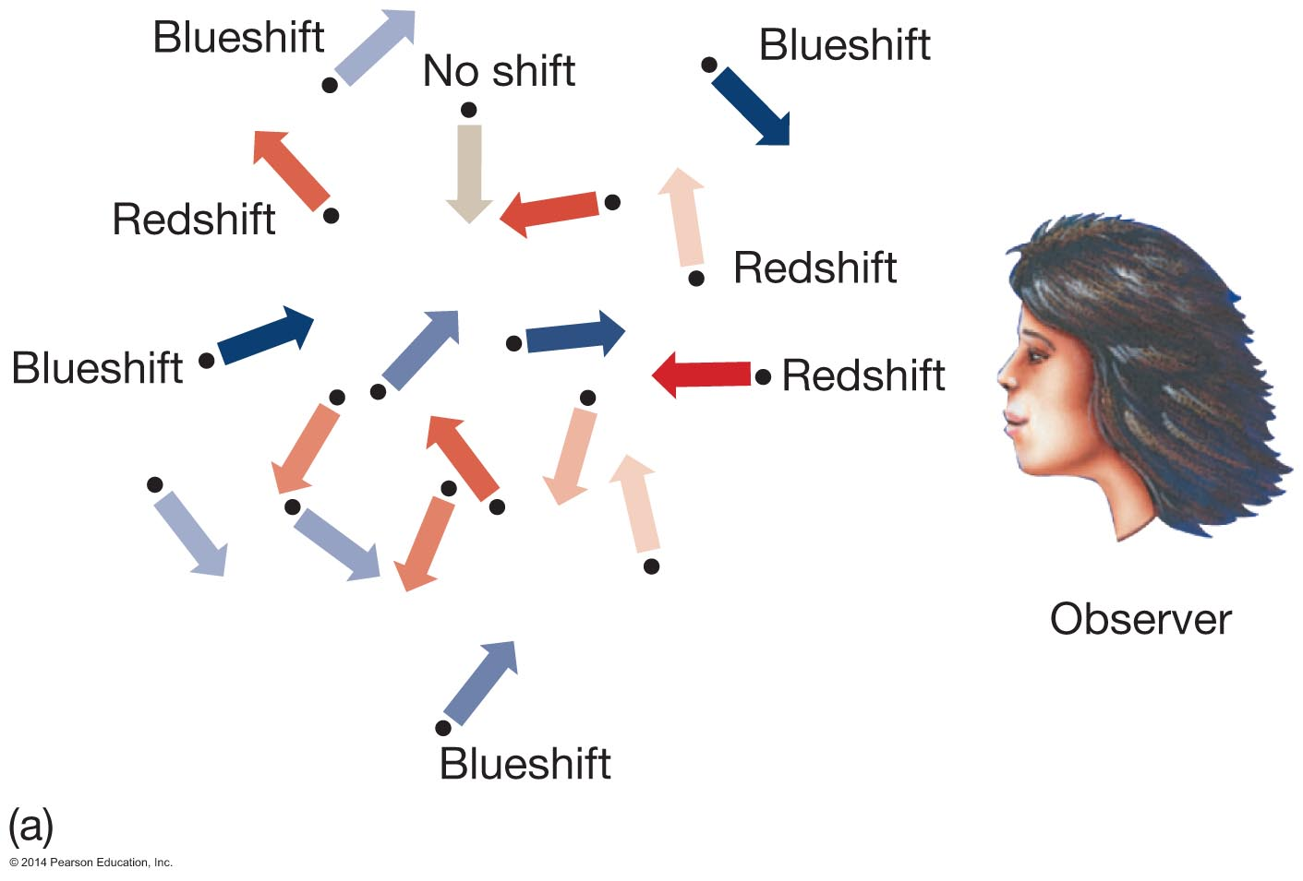
Figure 4.17a

Slide 43
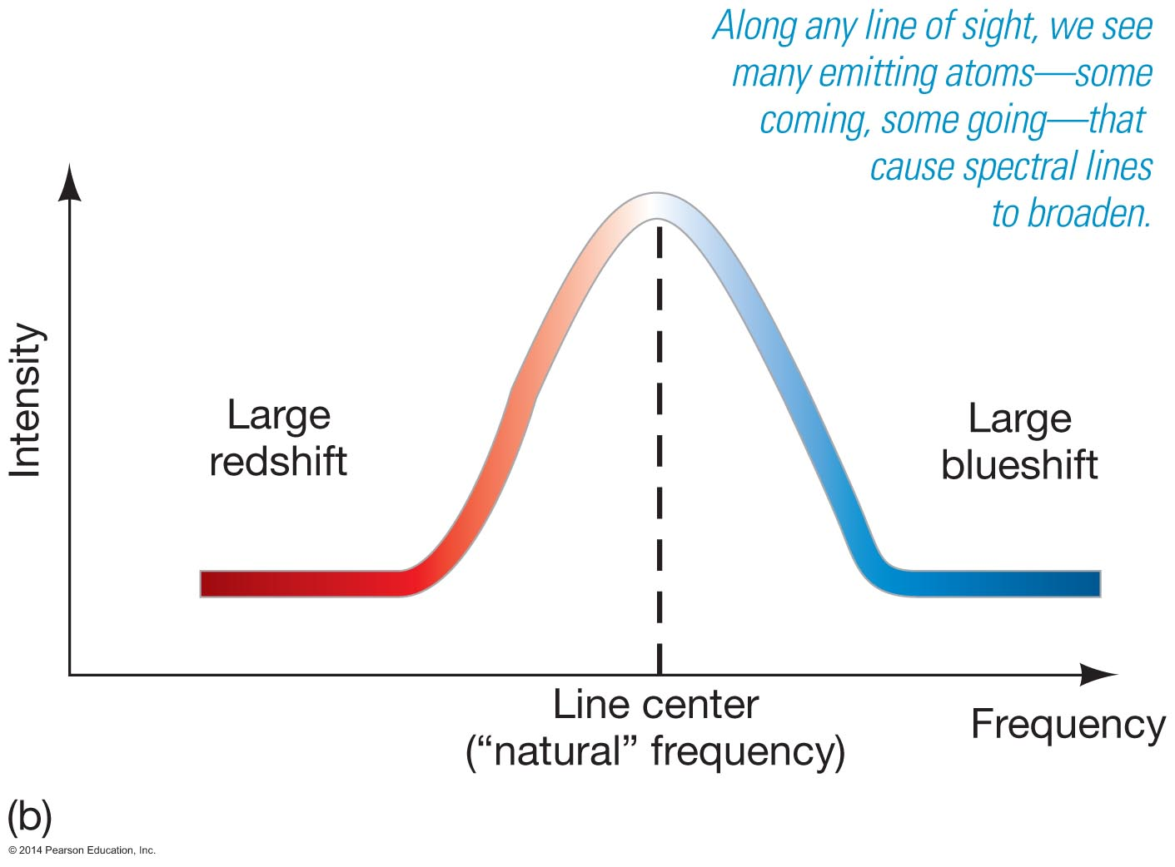
Figure 4.17b

Slide 44
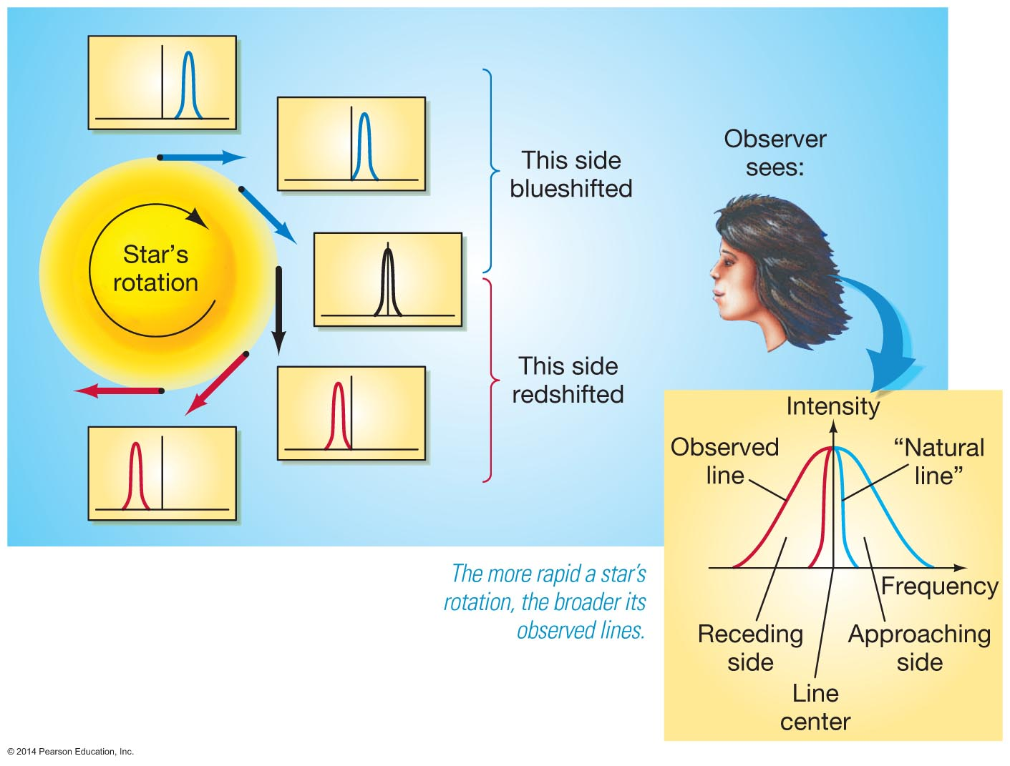
Figure 4.18

Slide 45
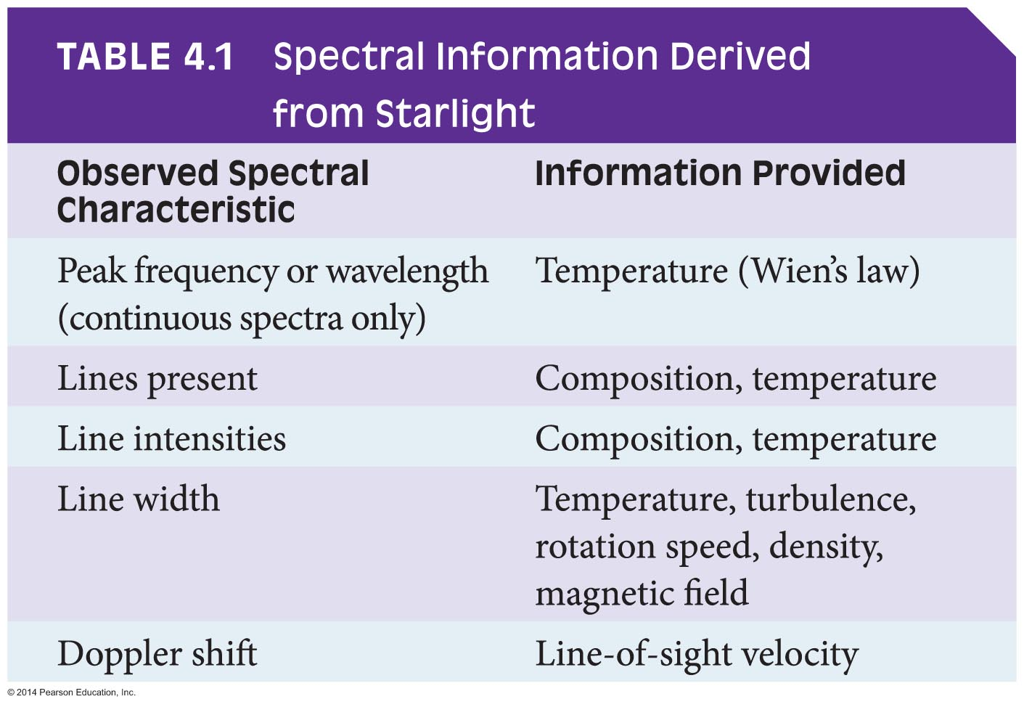
Table 4.1

