Slide 1
Cataloging Video Resources with RDA Part 1: Technological Aspects
ALA Editions Workshop
May 10, 2018
Kelley McGrath
University of Oregon

Slide 2
OLAC
http://olacinc.org/
Founded in 1980, OLAC is an organization for catalogers concerned with all types of nonprint materials, including a wide range of digital resources as well as more “traditional” formats: video and sound recordings, websites, maps, multimedia, graphic materials, and realia. Through conferences, workshops, publications, and the electronic discussion list, catalogers exchange information and enjoy expert and practical advice on cataloging audiovisual resources.
Notes:
List, newsletter, best practices

Slide 3
Caveat
The views and interpretations expressed in this presentation are my own and do not necessarily reflect the opinions of anyone else.

Slide 4
Definitions: Content Type
Two-Dimensional Moving Image
Content expressed through images intended to be perceived to be moving, and in two dimensions. Includes motion pictures (using live action and/or animation), film and video recordings of performances, events, etc., other than those intended to be perceived in three dimensions.
Includes video games
Notes:
May be accompanied by sound or not

Slide 5
Definitions: Content Type
Three-Dimensional Moving Image
Content expressed through images intended to be perceived to be moving, and in three dimensions. Includes 3-D motion pictures (using live action and/or animation), stereoscopic (S-3D) video games, etc.
For video games that utilize three-dimensional graphics instead of stereoscopic techniques, use two-dimensional moving image
Notes:
may or may not be accompanied by sound

Slide 6
Content Type
A 3D video game may refer to:
any video game with 3D game graphics, that are computed in 3 dimensions
→ Two-dimensional moving image
any stereoscopic video game, with a stereoscopic depth effect (including virtual reality (VR)
Three-dimensional
moving image
(definitions from Wikipedia)
Notes:
https://en.wikipedia.org/wiki/Stereoscopy
Separate image to each eye
Most stereoscopic methods present two offset images separately to the left and right eye of the viewer. These two-dimensional images are then combined in the brain to give the perception of 3D depth. This technique is distinguished from 3D displays that display an image in three full dimensions, allowing the observer to increase information about the 3-dimensional objects being displayed by head and eye movements.
.a realistic and immersive simulation of a three-dimensional environment, created using interactive software and hardware, and experienced or controlled by movement of the body

Slide 7
Content Type
Cartographic Moving Image
Cartographic content expressed through images intended to be perceived as moving, in two dimensions. Includes satellite images of the Earth or other celestial bodies in motion.
[not discussed in this presentation]

Slide 8
Media and Carrier Type
Media Type: A categorization reflecting the general type of intermediation device...
Carrier Type: A categorization reflecting the format of the storage medium and housing of a carrier in combination with the type of intermediation device...
...required to view, play, run, etc., the content of a resource.

Slide 9
Media Type
Projected: stores images for use with a projection device
Video: stores analog or digitally-encoded images designed for use with playback devices such as a VCR or DVD player
Computer: stores electronic files, designed for use with a computer (either on tangible media or accessed remotely)
Notes:
Post-GMD supposed to get clean separation of content and carrier, but didn’t quite happen; these things aren’t all the same—audio and video types mix in content; no principled distinction between video and computer for digital video; might be better to split between digital and analog (magnetic, etc.) intermediation. The dividing line between a stand-alone playback device and a computer is blurry. MP3 files originally required a computer, but then someone started manufacturing stand-alone CD players that will play MP3 CDs. In the other direction, my stand-alone DVD player at home will play Youtube videos and other online video content, which has traditionally been considered computer content.

Slide 10
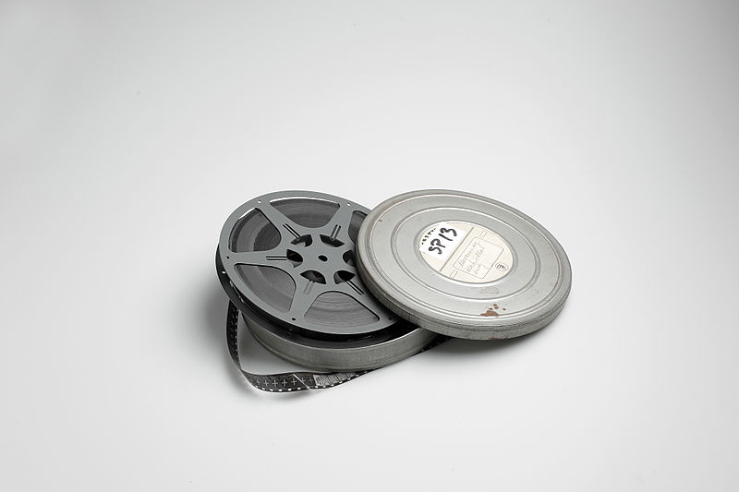
Content, Carrier, Media
16 mm. film
336 ǂa two-dimensional moving image ǂb tdi ǂ2 rdacontent
337 ǂa projected ǂb g ǂ2 rdamedia
338 ǂa film reel ǂb mr ǂ2 rdacarrier

Slide 11
Content, Carrier, Media
VHS Video
336 ǂa two-dimensional moving image ǂb tdi ǂ2 rdacontent
337 ǂa video ǂb v ǂ2 rdamedia
338 ǂa videocassette ǂb vf ǂ2 rdacarrier

Slide 12
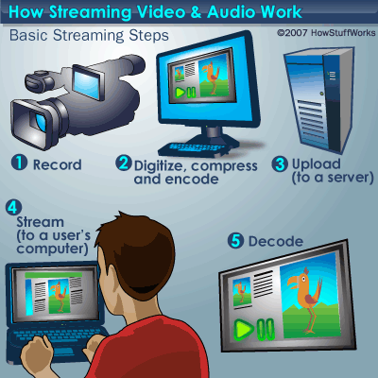
Content, Carrier, Media
Streaming Video
336 ǂa two-dimensional moving image ǂb tdi ǂ2 rdacontent
337 ǂa computer ǂb c ǂ2 rdamedia
338 ǂa online resource ǂb cr ǂ2 rdacarrier
Notes:
Media type is related to carrier not content; no appropriate carrier type under video intermediation; adding video media type is not appropriate
A media type used to store moving or still images, designed for use with a playback device such as a videocassette player or DVD player. Media used to store digitally encoded as well as analog images are included.

Slide 13
Content, Carrier, Media
Database of streaming videos
336 ǂa two-dimensional moving image ǂb tdi ǂ2 rdacontent
337 ǂa computer ǂb c ǂ2 rdamedia
338 ǂa online resource ǂb cr ǂ2 rdacarrier
* In MARC, use type g record for content with 006 to reflect integrating resource aspect
Notes:
or portal to collection of streaming videos; don’t use type a record; correct way to bring out continuing resource aspects for non-textual resources is to use 006

Slide 14
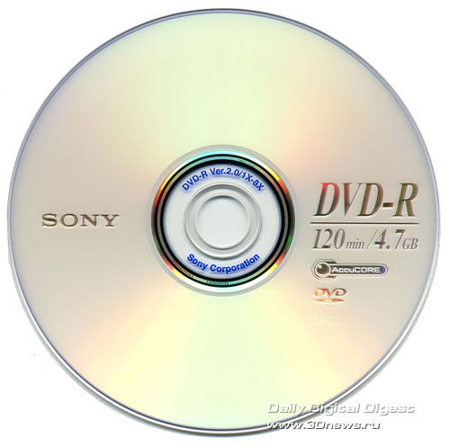
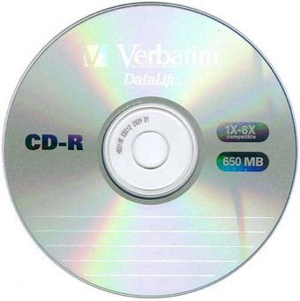
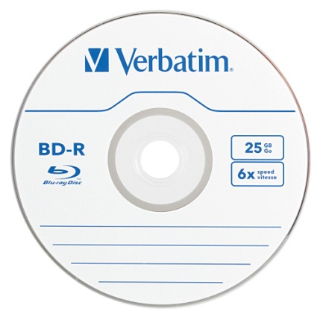
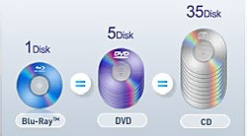
Optical discs
Notes:
The way RDA treats optical discs exemplifies the conflation of content with the strictly physical characteristics of a carrier. The three types of optical discs shown here are usually same size and look similar. However, there are physical differences in the construction and materials used which are important to the user because the user needs a device with the right kind of drive to play a given disc.

Slide 15
Optical discs
What is the correct media and carrier type for this disc?
audio/audio disc
computer/computer disc
video/video disc
I don’t know

Slide 16
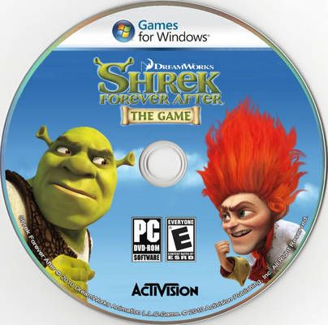
Optical discs
Notes:
These are all same physical disc in terms of system requirements, but not same RDA media and carrier type

Slide 17
Optical discs
video
videodisc
audio
audio disc
computer
computer disc

Slide 18
Optical discs
video
videodisc
audio
audio disc
computer
computer disc
computer
computer disc

Slide 19
Optical discs
video
videodisc
audio
audio disc
depends
on content
computer
computer disc
computer
computer disc

Slide 20
3.19 Digital Characteristic
3.19.3 Encoding Format (347 ǂb)
A schema, standard, etc., used to encode the digital content of a manifestation.
Formerly-listed video encoding formats:
Blu-ray
DVD video
HD-DVD
MPEG-4
Quicktime
RealVideo
SVCD
VCD
Windows media
* Associated with dedicated playback devices
* Not used with provider-neutral records
Notes:
From Kathy Glennan, ALA representative to the RDA Steering Committee, on OLAC-L:
The RSC has found this vocabulary problematic for some time. The problems included: long-standing issues such as overlap in category groupings, the ad hoc mix of terms based on file formats, abbreviations, and trademarks, the complete lack of definitions, and issues in the maintenance of currency. This is potentially a huge list, with many synonyms. The RSC determined that there was no easy way to determine and maintain a “most useful” list.
The fast track plus proposal noted: "The lack of definitions [in the RDA Glossary] does not appear to have impaired the utility of the RDA instructions for this element, and we think examples are sufficient to maintain such utility."
I think that there is no reason not to use the previous "standard" terminology if it is applicable. However, encoding such terms as $2 rda in a 347 would now be inappropriate.

Slide 21
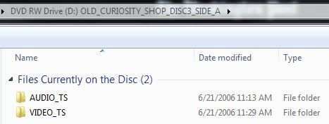
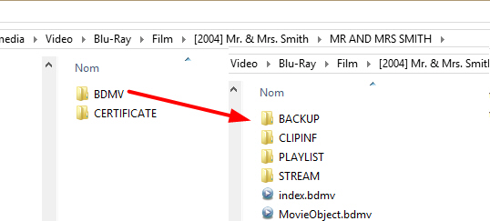
3.19 Digital Characteristic
3.19.3 Encoding Format (347ǂb & 538)
DVD video
Blu-ray (video)
Notes:
What does it mean for a resource to use DVD video or Blu-ray video as an encoding format? Has to do with structure of files that are arranged in a way that is expected by a DVD or Blu-ray player.
http://www.slideshare.net/Schoonts/blurayfinal2
http://www.slideshare.net/achalsingh143/blu-ray-disc-5077091

Slide 22
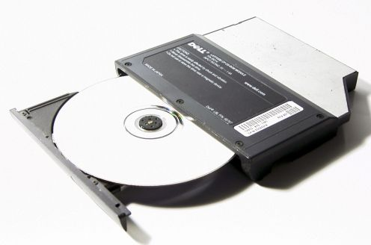
3.9.1 Production Method (340ǂd ǂ2 rdapm)
A process used to produce a manifestation
burning (burned discs, such as DVD-R and DVD+R)
A production method consisting of the application of heat to mark the surface of a material.

Slide 23
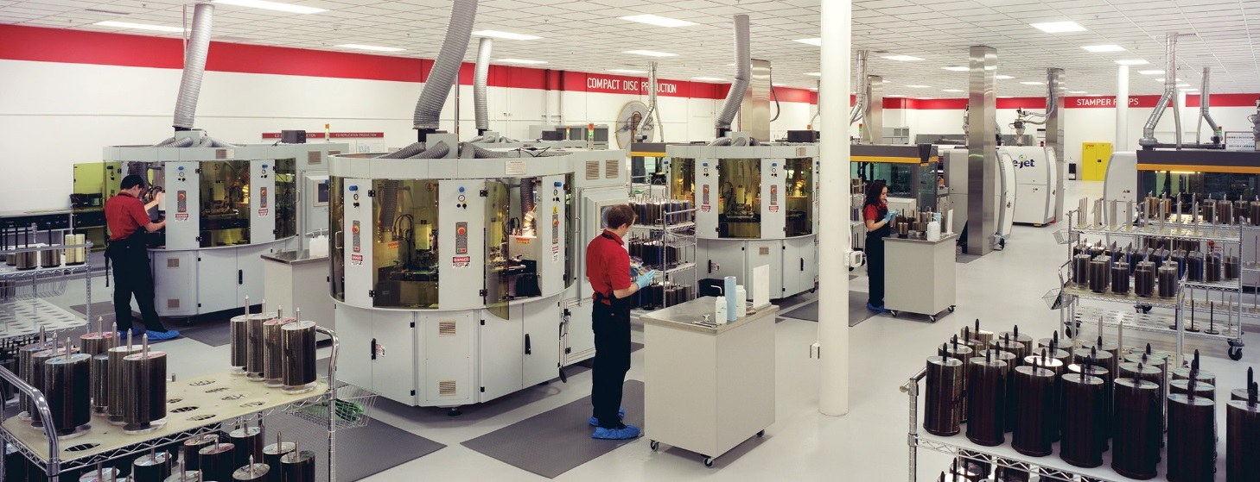
3.9.1 Production Method (340ǂd ǂ2 rdapm)
A process used to produce a manifestation
stamping (commercially-pressed discs)
A production method consisting of the application of pressure to make an impression on the surface of a material.
Notes:
OLAC BP says to generally omit

Slide 24
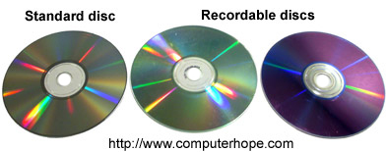
3.9.1 Production Method (340ǂd ǂ2 rdapm)
Identifying stamped and burned discs
https://en.wikipedia.org/wiki/DVD
Notes:
Green or purple tint; can see are where data was written

Slide 25
3.9.1 Production Method (340ǂd)
3.9.1.4 Details of Production Method (538)
Record specific types of burned discs in a note:
340 ǂa burning ǂ2 rdapm*
538 ǂa DVD-R.**
538 ǂa DVD+R.
538 ǂa BD-RE.
* https://www.loc.gov/marc/relators/tn170310src.html
**Often found on disc hub

Slide 26
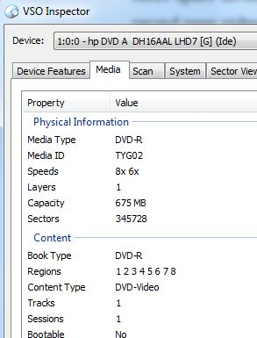
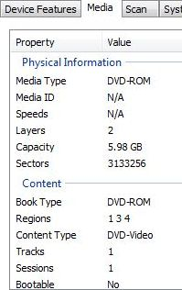
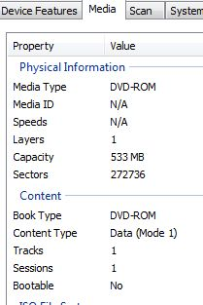
Optical Disc Info
burned videodisc, DVD-video
stamped videodisc,
DVD-video
stamped computer disc, computer program
Notes:
There is software that you can use to identify the characteristics of an optical disc and its contents if necessary

Slide 27
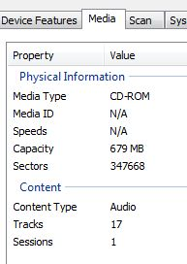
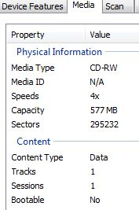
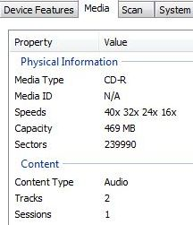
Optical Disc Info
stamped audio disc, CD audio
burned computer disc, data
burned computer disc, data
burned audio disc, CD audio

Slide 28
Software to Identify Optical Disc Info
IfoEdit
http://www.videohelp.com/software/IfoEdit
(described at http://pc.blog.zemows.org/2012/07/15/region-code/)
K-probe
http://www.k-probe.com/
VSO Inspector
http://www.vso-software.fr/products/inspector/inspector.php
Notes:
Examples of free software programs that identify disc characteristics

Slide 29
Content, Carrier, Media
DVD or Blu-ray Video
336 ǂa two-dimensional moving image ǂb tdi ǂ2 rdacontent
337 ǂa video ǂb v ǂ2 rdamedia
338 ǂa videodisc ǂb vd ǂ2 rdacarrier

Slide 30
Content, Carrier, Media
QuickTime Video Instruction on DVD-ROM
336 ǂa two-dimensional moving image ǂb tdi ǂ2 rdacontent
337 ǂa computer ǂb c ǂ2 rdamedia
338 ǂa computer disc ǂb cd ǂ2 rdacarrier
Notes:
Data disc; need computer with software not stand-alone playback device

Slide 31
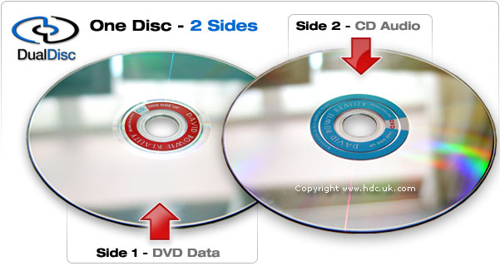
Content, Carrier, Media
DualDisc (DVD video on one side;
DVD audio with music on the other)
336 ǂa two-dimensional moving image ǂb tdi
ǂ2 rdacontent
336 ǂa performed music ǂb prm
ǂ2 rdacontent
337 ǂa video ǂa audio ǂb v ǂb s ǂ2 rdamedia
338 ǂa videodisc ǂa audio disc ǂb vd ǂb sd
ǂ2 rdacarrier

Slide 32
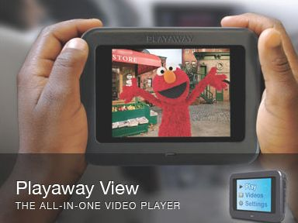
Content, Carrier, Media
Playaway View
336 ǂa two-dimensional moving image ǂb tdi ǂ2 rdacontent
337 ǂa ?? ǂ2 rdamedia
338 ǂa ?? ǂ2 rdacarrier

Slide 33
Content, Carrier, Media
Playaway View
336 ǂa two-dimensional moving image ǂb tdi ǂ2 rdacontent
337 ǂa video ǂb v ǂ2 rdamedia
338 ǂa other ǂb vz ǂ2 rdacarrier

Slide 34
Content, Carrier, Media
Online Video Game
336 ǂa two-dimensional moving image ǂb tdi ǂ2 rdacontent
336 ǂa computer program ǂb cop ǂ2 rdacontent
337 ǂa computer ǂb c ǂ2 rdamedia
338 ǂa online resource ǂb cr ǂ2 rdacarrier
* OLAC game best practices: use both moving image and computer program
* In MARC, video games should be coded as leader/06 (record type) = m (computer file) with 008/26 (file type) = g (game)

Slide 35
Content, Carrier, Media
Video Game on Cartridge
336 ǂa two-dimensional moving image ǂb tdi ǂ2 rdacontent
336 ǂa computer program ǂb cop ǂ2 rdacontent
337 ǂa computer ǂb c ǂ2 rdamedia
338 ǂa computer disc cartridge ǂb ce ǂ2 rdacarrier
* OLAC game best practices: use both moving image and computer program content types

Slide 36
3.4 Extent (300ǂa)
Number + Type of Unit (Carrier Type)
300 ǂa 1 online resource (1 video file)
300 ǂa 2 videodiscs
300 ǂa 3 videocassettes
300 ǂa 1 computer disc
[or] 300 ǂa 1 CD-ROM
300 ǂa 1 videodisc (456 frames) [3.4.1.7.8]

Slide 37
3.5 Dimensions (300ǂc & 340ǂb)
Use centimeters
300 ǂa 2 videodiscs ; ǂc 12 cm
300 ǂa 3 videocassettes ; ǂc 13 mm
300 ǂa 1 film reel ; ǂc 16 mm
LC-PCC PS uses alternative for discs, most cassettes
300 ǂa 2 videodiscs ; ǂc 4 3/4 in.
300 ǂa 1 videocassette ; ǂc 1/2 in.
but
300 ǂa 1 videocassette ; ǂc 8 mm

Slide 38
3.18 Video Characteristic
3.18.2 Video Format (346ǂa ǂ2 rdavf)
A standard, etc., used to encode the analog video content of a manifestation
Beta
Laser optical*
U-matic
VHS
* Used for LaserDiscs not digital videodiscs, such as Blu-ray or DVD

Slide 39
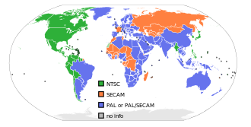
3.18 Video Characteristic
3.18.3 Broadcast Standard (346ǂb ǂ2 rdabs)
A system used to format a manifestation of a video for television broadcast
HDTV
NTSC
PAL
SECAM
Broadcast standards differ in the way color is encoded and the picture size and frame rate they use

Slide 40
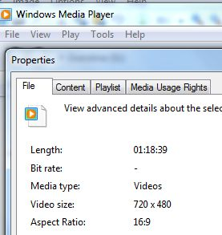
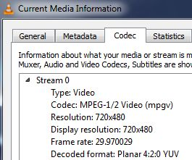
3.18 Video Characteristic
3.18.3 Broadcast Standard (346ǂb)
Only matters if viewing on a television; computer monitors will display any broadcast standard
Identify on computer using picture size
 | NTSC | PAL
DVD | 720x480 | 720x576
DVD/VCD | 352x240 | 352x288
Notes:
VLC media player: select tools, codec information
Windows media player: Display menu bar (go to library, organize (dropdown list), layout, check “show menu bar”; go to library and select file, properties

Slide 41
3.19 Digital Characteristic
3.19.2 Digital file type (347ǂa ǂ2 rdaft)
A general type of data content encoded in a computer file
347 ǂa video file ǂ2 rdaft
Use for computer media type and for video media type with digital carriers

Slide 42
3.19 Digital Characteristic
3.19.4 File Size (347ǂc)
Number of bytes in a digital file
347 ǂc 550 MB
347 ǂc 1.5 GB
* Not used with provider-neutral records

Slide 43
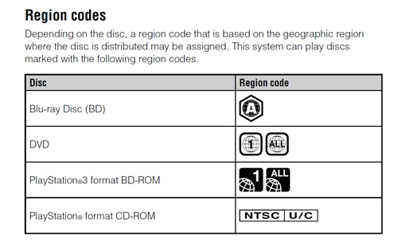
3.19 Digital Characteristic
3.19.6 Regional Encoding (347ǂe ǂ2 rdare)
A designation for one or more regions of the world for which a videodisc or video game carrier has been encoded, restricting playback to a device configured to decode it
347 ǂe region 4 ǂ2 rdare
347 ǂe region A ǂ2 rdare
Notes:
see disc info programs
to view DVDs from other regions, purchase region-free player or use region-free software player (VLC is free: http://www.videolan.org/)

Slide 44
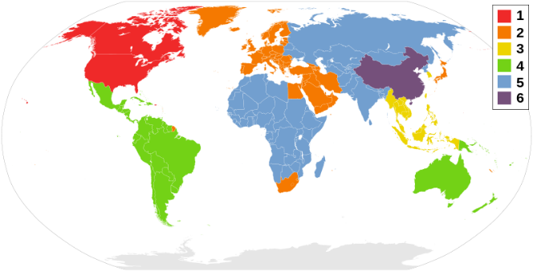
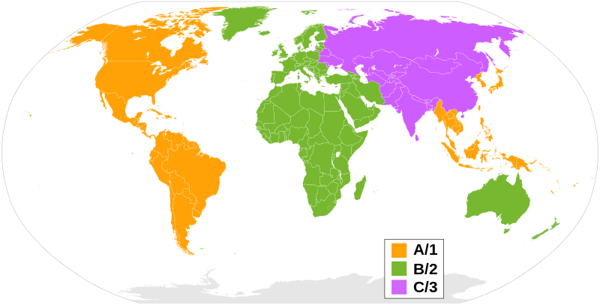
3.19 Digital Characteristic
3.19.6 Regional Encoding (347 ǂe ǂ2 rdare)
all regions
region 1
region 2
region 3
region 4
region 5
region 6
region 7
region 8
region A
region B
region C (Blu-ray)
region C (video game)
region J
region U/C
Notes:
Vocabulary will be added in April 2017 Toolkit update
Use all regions for variations, such as region 0, region free

Slide 45
3.19 Digital Characteristic
3.19.7 Encoded Bitrate (347ǂf)
A speed at which streaming audio, video, etc., is designed to play
347 ǂf 800 kbps
* Not used with provider-neutral records
Notes:
probably don’t know this unless you are provider

Slide 46
3.20 Equipment or System Requirement (538)
DVD or Blu-ray Video
538 ǂa PDF requires computer with DVD-ROM drive for viewing.
538 ǂa System requirements for DVD-ROM features: IBM-compatible computer, 166 MHz Pentium processor; 32 MB RAM, 5-20 MB available hard disk space; Microsoft Windows 95 or higher; DVD-ROM drive.
538 ǂa DVD; NTSC; region 1; stereo. [can repeat in 538]
Notes:
in MARC can repeat elements that have their own fields in 538; some catalogs only display 538

Slide 47
3.20 Equipment or System Requirement (538)
Streaming video
538 ǂa System requirements: Adobe Flash Player 8 or higher
* Not used with provider-neutral records except for details of digital preservation projects

Slide 48
3.20 Equipment or System Requirement (538 & 753)
Video Games
Platform, operating system, broadcast standard, hardware (processor speed, memory, video card, drive type) internet connection, online account
538 ǂa System requirements: XBox 360 with the NTSC designation.
753 ǂa Microsoft Xbox 360 (NTSC-U/C) ǂ2 gcipplatform*
* Consider using GAMECIP vocabulary for 753: http://metadataregistry.org/vocabulary/show/id/354.html

Slide 49
3.20 Equipment or System Requirement (538 & 753)
Video Games
538 ǂa System requirements for PC: Windows XP, (SP2), Windows Vista (SP1) or Windows 7; 2.0 GHz P4 processor or equivalent for XP/2.4 HGz P4 processor or equivalent for Vista and Windows 7; At least 1 GB RAM for XP/1.5 GB for Vista/2DB for NVIDIA ION computers; at least 3.5 GB free hard drive space; DirectX 9.0c compatible video card with 128 MB video RAM and support for PixelShader 2.0. See packaging for supported video cards.
538 ǂa System requirements for Macintosh: Mac OS X 10.5.7 Leopard or higher; Intel Core Duo processor (game will not run on a PowerPC Macintosh); at least 2 GB RAM; at least 3.5 GB free hard drive space; ATU X1600 or NVIDIA 7300 GT with 128 MB of video RAM. See packaging for supported video cards.
538 ǂa Disc characteristics: DVD-ROM.
538 or 500 ǂa Requires The Sims 3 to play.
753 ǂc Microsoft Windows XP ǂ2 gcipplatform
753 ǂc Microsoft Windows Vista ǂ2 gcipplatform
753 ǂc Microsoft Windows 7 ǂ2 gcipplatform
753 ǂc Apple Mac OS X 10.5 ǂ2 gcipplatform

Slide 50
7.18 Sound Content (300ǂb & 007/05)
sound*
silent
* Use sound for silent films where the expression being described has a soundtrack

Slide 51
3.16 Sound Characteristics (344)
3.16.2 Type of recording (344ǂa ǂ2 rdatr)
analog [videocassette, LaserDisc]
digital [CD, DVD, Blu-ray, online]
3.16.3 Recording medium (344ǂb ǂ2 rdarm)
magnetic [videocassette]
magneto-optical
optical [CD, DVD, Blu-ray, LaserDisc]

Slide 52
3.16 Sound Characteristics (344)
3.16.8 Configuration of playback channels (344ǂg ǂ2 rdacpc)
A number of sound channels used to make a recording
mono
stereo
quadraphonic [rare]
surround [more than two channels]
3.0, 4.0, 5.1, 6.1, 7.1, etc. *
*Include number of surround channels somewhere in record

Slide 53
3.16 Sound Characteristics (344)
3.16.8 Configuration of playback channels (344ǂg ǂ2 rdacpc)
Dolby Digital 2.0 mono
Dolby Digital 2.0 stereo
Dolby Digital 2.0 surround
What is correct value for “Dolby Digital 2.0 surround?”
stereo
surround
both stereo and surround
not in RDA vocabulary
Notes:
2.0 mono = mono; same mono info is sent to two channels

Slide 54
3.16 Sound Characteristics (344)
3.16.8 Configuration of playback channels (344ǂg ǂ2 rdacpc)
Dolby Digital stereo surround
Dolby Digital 2.0 surround
Encoded from 3-4 channels. Contains only two channels of information. During playback, the receiver takes those two channels and processes them into a front right, a center, a front left, and a mono rear channel.

Slide 55
3.16 Sound Characteristics (344)
3.16.8 Configuration of playback channels (344ǂg ǂ2 rdacpc)
Mono 1.0 = mono
Mono 2.0 = stereo
Stereo 2.0 = stereo
Stereo surround/2.0 surround = surround
(from July 2017 OLAC-L discussion)
Notes:
2.0 mono = mono; same mono info is sent to two channels

Slide 56
3.16 Sound Characteristics (344)
3.16.9 Special playback characteristics (344ǂh ǂ2 rdaspc)
An equalization system, noise reduction system, etc. used in making an audio recording
*Dolby is for analog tapes
for digital optical discs (audio codec, compression method):
Dolby Digital
DTS
PCM (pulse-code modulation)
LPCM (linear pulse-code modulation)
Notes:
Only LPCM in RDA vocab

Slide 57
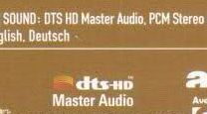
3.16 Sound Characteristics (344)
3.16.9 Special playback characteristics (344ǂh)

Slide 58
3.16 Sound Characteristics (344)
3.16.9 Special playback characteristics (344ǂh ǂ2 rdaspc)
Dolby Digital 5.1
Dolby Digital surround 5.1
Dolby Digital 2.0
Dolby TrueHD 5.1
DTS 5.1
DTS-HD Master Audio 7.1
PCM stereo

Slide 59
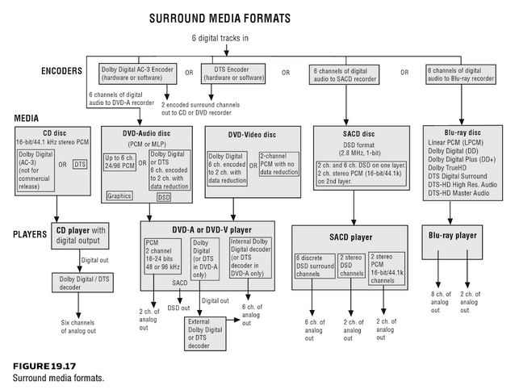
3.16 Sound Characteristics (344)
Bartlett, Bruce, and Jenny Bartlett. Practical Recording Techniques: The Step-by-Step Approach to Professional Audio Recording. Burlington, MA: Focal Press, 2009.

Slide 60
3.17 Projection Characteristic of Motion Picture Film (345)
3.17.2 Presentation Format (345ǂa ǂ2 rdapf)
A format used in the production of a projected image, such as Cinerama, IMAX, standard silent aperture
3.17.3 Projection Speed (345ǂb)
A speed at which a projected carrier must be operated to produce the moving image intended
*Only used for film carriers
*Make note for video carriers if details of original film are considered important

Slide 61
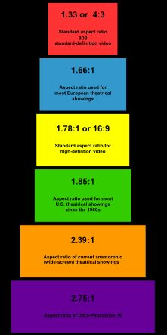
7.19 Aspect Ratio (500)
7.19 Aspect Ratio (500)
Ratio of the width to the height of a moving image (numerical & designation)
full screen (less than 1.5:1)
wide screen (1.5:1 or greater)
mixed (multiple aspect ratios in same work)*
*OLAC recommends using “Mixed aspect ratios”
https://en.wikipedia.org/wiki/Aspect_ratio_%28image%29
Notes:
designations

Slide 62
7.19 Aspect Ratio (500)
7.19 Aspect Ratio (500)
Record an aspect ratio of the expression as a numerical ratio in standard format with a denominator of 1.
wide screen (2.35:1)
full screen (1.33:1)*
wide screen (1.85:1)
full screen (1.33:1) [resource includes both]
* often seen as 4:3

Slide 63
7.19 Aspect Ratio (500)
7.19 Aspect Ratio (500)
16:9 on DVD packaging usually refers to “anamorphic widescreen” and not the actual aspect ratio of the film
https://en.wikipedia.org/wiki/Anamorphic_widescreen#DVD_Video
http://www.wisegeek.org/what-is-anamorphic-widescreen.htm
http://www.tvshowsondvd.com/n/3997
Notes:
16:9 almost never aspect ratio of file; for widescreen, look for denominator of 1
picture adjust to differently-sized screens better
wikipedia link lists various ways that this appears on packaging

Slide 64
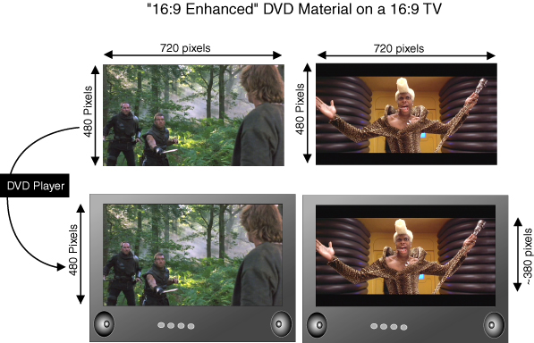
Anamorphic Widescreen on DVDs
Enhanced for widescreen televisions
Enhanced for 16:9
http://hometheaterhifi.com/volume_6_4/feature-article-enhanced-widescreen-november-99.html
http://arstechnica.com/civis/viewtopic.php?f=2&t=1243481&start=40
Notes:
http://hometheaterhifi.com/volume_6_4/feature-article-enhanced-widescreen-november-99.html
http://arstechnica.com/civis/viewtopic.php?f=2&t=1243481&start=40

Slide 65
7.19 Aspect Ratio (500)
7.19.1.4 Details of Aspect Ratio (500)
If a video has been modified from its original aspect ratio, if possible, note original ratio
full screen (1.33:1); original aspect ratio: 1.85:1
* change less common in the era of widescreen TVs
* theatrical widescreen films began in 1950s

Slide 66
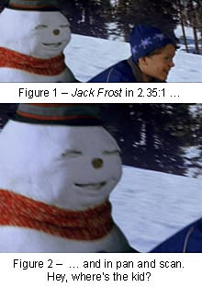
Letterboxed vs. Full Screen
Full frame
4:3/1.33:1
Modified to fit your TV
Pan and scan
* Make note if aspect ratio has been changed from the original
* Pillarbox is opposite of letterbox (black lines on side)
http://www.hifi-writer.com/he/panscan/panscan.htm
Notes:
http://www.hifi-writer.com/he/panscan/panscan.htm

Slide 67
7.17 Color Content (300ǂb, 340ǂg & 007/03)
presence of color, tone, etc. in the content of a resource
Black, white, single color shades of black, single color tints of white and single color tones of gray are considered to be single colors
monochrome
polychrome
Notes:
Monochrome = A colour content consisting of tones of one colour, or black and white, or black or white and another colour.
Polychrome = A colour content consisting of two colours, neither of which is black or white, or more than two colours.

Slide 68
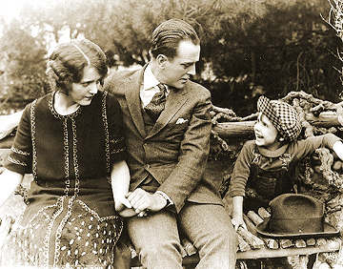
7.17 Color Content (300ǂb , 340ǂg & 007/03)
presence of color, tone, etc. in the content of a resource
Alternative: use terms from a substitute vocabulary
black and white [for monochrome]
sepia [for monochrome]
color [for polychrome]
Notes:
Sepia is example of toning (see slide 69)

Slide 69
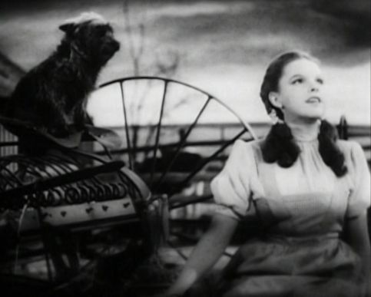
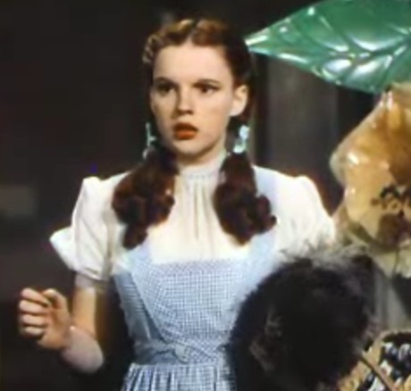
7.17 Color Content (300ǂb , 340ǂg & 007/03)
color
black and white
black and white and color
color with black and white sequences
color with black and white introductory sequence

Slide 70
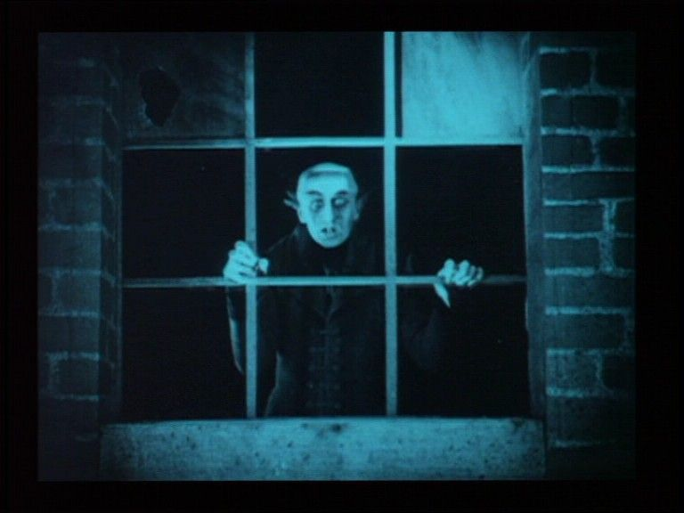
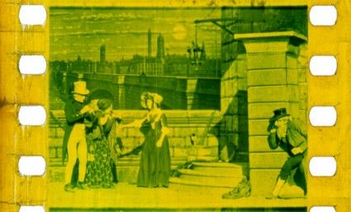
7.17 Color Content (300ǂb , 340ǂg & 007/03)
black and white (tinted)*
black and white (toned)*
black and white (tinted and toned)*
sepia
* Tinting and toning are techniques that were used to add color to early film
Notes:
https://en.wikipedia.org/wiki/Film_tinting
Film tinting is the process of adding color to black-and-white film, usually by means of soaking the film in dye and staining the film emulsion. The effect is that all of the light shining through is filtered, so that what would be white light becomes light of some color.
Film toning is the process of replacing the silver particles in the emulsion with colored, silver salts, by means of chemicals. Unlike tinting, toning colored the darkest areas, leaving the white areas largely untouched.

Slide 71
7.22 Duration (300 ǂa, 008/18-20 & 306)
Running time of the content
Exact time if easy to determine
96 min.*
Approximate time (stated or estimated)
approximately 3 hr.*
Omit duration
*Use abbreviations for time units from App. B.5.3
Notes:
Watch out for black frames at end of film

Slide 72
DVD video
300 ǂa 1 videodisc (120 min.) : ǂb sound,
color ; ǂc 4 3/4 in. [or 12 cm]
340 ǂd burning ǂ2 rdapm
340 ǂb 4 3/4 in. ǂg color
344 ǂa digital ǂ2 rdatr
344 ǂb optical ǂ2 rdarm
344 ǂg stereo ǂ2 rdacpc
344 ǂh Dolby Digital
346 ǂb NTSC ǂ2 rdabs
347 ǂa video file ǂ2 rdaft
347 ǂb DVD video
347 ǂe region 1 ǂ2 rdare
538 ǂa Disc characteristics: DVD-R.
500 ǂa Wide screen (1.78:1).
Notes:
Mocked-up example for demonstration

Slide 73
DVD video
300 ǂa 1 videodisc* (120 min.) : ǂb sound,
color ; ǂc 4 3/4 in. [or 12 cm] **
538 ǂa DVD-R; NTSC; Dolby Digital stereo; region 1.
500 ǂa Wide screen (1.78:1).
*OLAC recommends using the controlled list of carriers for shared cataloging
**Use inches if following LC-PCC PS
Notes:
alternate way of recording same data as previous slide

Slide 74
Streaming Video
300 ǂa 1 online resource (1 video file (17 min.)) : ǂb sound, color.
347 ǂa video file ǂ2 rdaft
347 ǂb RealVideo *
* Not used with provider-neutral records

Slide 75
Blu-ray
300 ǂa 1 videodisc (75 min.) : ǂb sound, color ; ǂc 4 3/4 in.
340 ǂd stamping ǂ2 rdapm
340 ǂg color
344 ǂa digital ǂ2 rdatr
344 ǂb optical ǂ2 rdarm
344 ǂg mono ǂ2 rdacpc
346 ǂb PAL ǂ2 rdabs
347 ǂa video file ǂ2 rdaft
347 ǂb Blu-ray
347 ǂe region B ǂ2 rdare

Slide 76
Videocassette
300 ǂa 1 videocassette (120 min.) : ǂb sound, black and white (tinted) ; ǂc 1/2 in. [or 13 mm*]
346 ǂg black and white (tinted)
346 ǂa VHS ǂ2 rdavf
346 ǂb NTSC ǂ2 rdabs
538 ǂa VHS; NTSC.
* See 3.5.1.4.3 dimensions of cassettes

Slide 77
Video Instruction on Computer Discs
300 ǂa 1 computer disc (5 video files, 30 min.) : ǂb sound, color ; ǂc 4 3/4 in. [or 12 cm]
340 ǂg color
347 ǂa video file ǂ2 rdaft
347 ǂb RealVideo
538 ǂa System requirements: Macintosh or Windows operating system; Real Player; sound card; CD-ROM drive.

Slide 78
Video Instruction on Computer Discs
300 ǂa 1 DVD-ROM (120 min.) : ǂb QuickTime, sound, color with black and white sequences ; ǂc 4 3/4 in.
340 ǂd stamping ǂ2 rda
340 ǂg color ǂg black and white
347 ǂa video file ǂ2 rdaft
347 ǂb QuickTime
538 ǂa System requirements: Macintosh or Windows operating system; QuickTime software; sound card; DVD-ROM drive.

Slide 79
Video Game
300 ǂa 1 computer disc : ǂb sound, color ; ǂc 4 3/4 in. + ǂe 1 booklet.
340 ǂd stamping ǂ2 rda
340 ǂg color
347 ǂb Blu-ray
538 ǂa System requirements: PlayStation 3; 143 MB hard disk space
753 ǂa Sony PlayStation 3 ǂ2 gcipplatform
Notes:
add 753?

Slide 80
Video Game
300 ǂa 1 DVD-ROM : ǂb sound, color ; ǂc 4 3/4 in.
340 ǂd stamping ǂ2 rda
340 ǂg color
346 ǂb NTSC ǂ2 rdabs
347 ǂe U/C ǂ2 rdare
538 ǂa System requirements: Xbox 360 with NTSC designation; 4 MB memory; HDTV 720p/1080i/1080p
753 ǂa Microsoft Xbox 360 (NTSC-U/C) ǂ2 gcipplatform

Slide 81
7.7 Intended Audience (521, 008/22 & 385)
521 8_ ǂa MPAA rating: G. ǂa CHV rating: G.
521 8_ ǂa MPAA rating: PG for sensuality and language.
521 8_ ǂa ESRB rating: E for everyone (Mild cartoon violence, comic mischief)
385 __ ǂa First grade students ǂa Second grade students ǂ2 lcdgt
521 2_ ǂa Grades 1-2.
521 3_ ǂa Speech therapists, dental students and professionals.
500 __ ǂa 1-2 players, simultaneous.
Notes:
Give number of players for video games
385 is newer field for audience characteristics that uses controlled vocabulary: http://www.loc.gov/marc/bibliographic/bd385.html

Slide 82
7.10 Summarization of the Content (520)
Important for resources that aren’t easily browsed, such as moving images
concise
objective
specific terms to aid keyword searching
OLAC recommendations on summary notes:
http://olacinc.org/sites/capc_files/summnotes.pdf
Notes:
See OLAC recommendations for more details
may wish to edit publishers’ blurbs or use ellipses to make more neutral

Slide 83
7.11 Place and Date of Capture (518 & 033)
518 ǂa Filmed May-July 1967 in the red deserts of Morocco.
518 ǂo Recorded ǂd 1976 September 14 ǂp Santa Barbara, California.
518 ǂa Recorded in performance at the Royal Albert Hall, London, May 2-6, 2005.
[or] 518 ǂo Recorded in performance ǂd 2005 May 2-6 ǂp Royal Albert Hall, London. *
* 033 and subfielded 518 are preferable for better machine processing

Slide 84
7.28 Award (586)
586 ǂa Academy Award (1967): Best Director
586 ǂa Best Documentary Short, Atlanta Film and Video Festival, 2002
Notes:
No period at end of MARC field

Slide 85
7.14 Accessibility Content (546)
Provides alternative sensory modes to perceive the primary content of an expression
Includes accessible labels, audio description, captioning, image description, sign language, and subtitles. Does not include subtitles in a language different from the spoken content*
* This can be true, but is not always true
Notes:
For videos: because connected to language info, usually recorded in 546

Slide 86
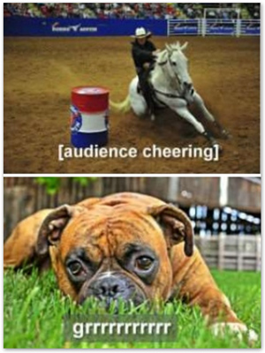
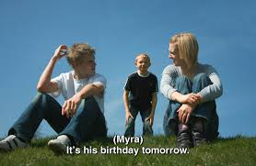
7.14 Accessibility Content (546)
Captions or subtitles for accessibility | Subtitles for videos in a different language
All spoken content | Spoken content in a language different from the language of the subtitles
Sound effects and music
Speaker identification
Other contextual information

Slide 87
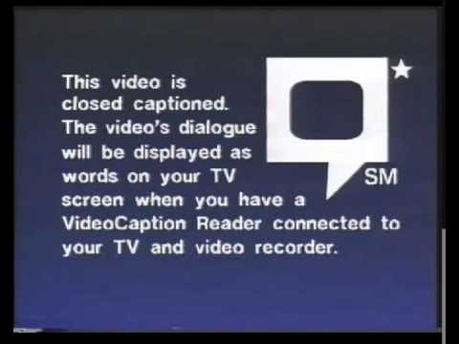
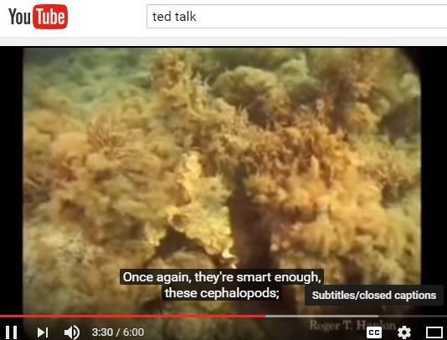
7.14 Accessibility Content (546)
Subtitles for the deaf and hard of hearing (SDH)
Closed captions
Captions for online videos
Open captions
Notes:
Different technologies
Subtitles based only on spoken words
Captions include contextual info that people who can’t hear need, such as sound effects and indications of who is speaking if it’s ambiguous

Slide 88
7.14 Accessibility Content (546)
546 ǂa Audio-described.

Slide 89
7.14 Accessibility Content (546)
7.14 Accessibility Content (546)
546 ǂa Closed-captioned.
546 ǂa English or Spanish soundtracks; optional English subtitles for the deaf or hard of hearing (SDH); optional audio-described soundtrack for the visually impaired.
546 ǂa Optional captions for the deaf and hearing impaired in English.*
*Closed captions and SDH are specific technologies; I prefer the more generic “captions” for online videos

Slide 90
7.12 Language of the Content (546/041)
Spoken or sung
Sign language
Intertitles
Subtitles
Captions
Notes:
Language for moving images is complex

Slide 91
7.12 Language of the Content (546/041)
546 ǂa Spanish or English soundtracks; optional subtitles in English or French.
008/35 [lang] spa
041 1 ǂa spa ǂa eng ǂj eng ǂj fre ǂh spa
Notes:
Can use 041$h for original language even when no translation is involved.
https://www.loc.gov/marc/bibliographic/bd041.html see $h - Language code of original (R)
https://www.oclc.org/bibformats/en/0xx/041.html

Slide 92
7.12 Language of the Content (546/041)
546 ǂa Silent film with English intertitles.
008/35 [lang] zxx
041 0 ǂa zxx ǂj eng ǂh eng
[English soundtrack]
008/35 [lang] eng
041 0 ǂa eng ǂh eng
Notes:
041$h definition has been expanded to include original language whether or not a translation is involved.

Slide 93
Questions?
???

