Slide 1
Cataloging Video Resources with RDA Part 2: Content & Publication
ALA Editions Workshop
May 17, 2018
Kelley McGrath
University of Oregon

Slide 2
What are You Describing? What’s the Title?
2.1.2 Basis for Identification of the Manifestation
Comprehensive Description
2.1.2.2 Single Unit
2.1.2.3 Issued in More Than One Part
+
2.2.2 Preferred Source of Information
2.2.2.3 Resources Consisting of Moving Images
Notes:
don’t always think about this; need to be consistent in what you’re describing
Focus on most common situation: comprehensive description of single unit; some of this can be extrapolated for multi-part resources

Slide 3
What are You Describing?
2.1.2.2 Basis for Identification of the Manifestation
Single Work on Single Unit:
Prefer source of info that identifies whole
Documentary film on a single disc; no extras
Use title frames or other sources as prescribed by 2.2.2.3 Preferred Sources
Notes:
Rental versions

Slide 4
What are You Describing?
2.1.2.2 Basis for Identification of the Manifestation
Multiple Works on Single Unit:
Prefer source of info that identifies whole with collective title
Ten animated shorts on a single disc with a collective title
Use disc label, container or menu with collective title

Slide 5
What are You Describing?
2.1.2.2 Basis for Identification of the Manifestation
Multiple Works on Single Unit:
No source of info that identifies whole;
Prefer source with title identifying a main or predominant work or content
Feature film with making-of featurette, game and still photos
Use source identifying main or predominant work to identify the resource as a whole
Notes:
Duration reflects predominant work

Slide 6
What are You Describing?
2.1.2.2 Basis for Identification of the Manifestation
Multiple Works on Single Unit:
No source of info that identifies whole;
No source with title identifying a main or predominant work or content
Combine sources with titles identifying individual works
2.1.2.2 Two feature films on a single disc with no collective title
Use sources of information identifying the individual contents as collective source of information for the whole
Notes:
Non-collective title

Slide 7
What are You Describing?
2.1.2.3 Basis for Identification of the Manifestation
Multiple Units
Five options
No order of preference
Generally, prefer a source with a collective title
Notes:
OLAC best practices has some guidance here; use similar principles as for single-part resource

Slide 8
What are You Describing?
Notes:
Often multiplicity of possible levels of granularity: complete TV series, single season, single disc, single episode

Slide 9
Preferred Source of Info
2.2.2.3 Moving Images
Title frame(s) or screen(s)
Generally, don’t consider
logo screens part of the
title frames
Notes:
These are often added or updated at the time of release and the form of name often is associated with the time of publication. Since the form of name on the title frames usually reflects the form at the time of original release, conflating these can mess up your authority control.
Sometimes (e.g., Films for the Humanities and Sciences), the entities named on these screens are only related to the manifestation and bear no responsibility for the content
However, sometimes there is no other information (e.g., some small educational publishers) in which case it may be appropriate to use the logo screen

Slide 10
Preferred Source of Info
2.2.2.3.1 Moving Images
Tangible Carrier; No Title Frames or Screens
Label permanently affixed to manifestation itself
Container or accompanying material (for comprehensive description)
Internal source, such as a disc menu
Another source forming part of the resource; prefer formally-presented titles
Notes:
Title frames title is important for accurate identification
Occasionally, same film may be distributed by more then one company under different titles (e.g., by both Films for the Humanities and Sciences and Insight Media, both of which often rename the content they distribute)

Slide 11
Preferred Source of Info
2.2.2.3.2 Moving Images
Online; No Title Frames or Screens
Textual content (Web page)
Embedded metadata in textual form
Another source forming part of the resource; prefer formally-presented titles

Slide 12
Preferred Source of Info
2.2.2.3 Moving Images: Alternative
Use a label with a title permanently printed on or affixed to resource (not container or accompanying material)
Example: a label on a videodisc

Slide 13
2.17.2.3 Note on Source of Title
Make a note on the source from which the title proper is taken if not using the title frame or title screen
500 Title from cassette label.
500 Title from container.
500 Title from disc menu.
*Use 500 for this note, based on Toolkit mapping, except when following PN guidelines and combining with “description based on” note (see next slide)

Slide 14
Note on Source of Title
2.17.2.3 Note on Source of Title Proper
2.17.13.5 Date of Viewing of an Online Resource
500 Title from publisher’s website.
500 Viewed on January 25, 2016.
588 Description based on online resource; title from Steam resource page viewed October 3, 2014. *
588 Description based on videodisc version record. *
588 0_ Description based on online resource; title from title screen (Alexander Street Press, viewed November 26, 2012). *
*Provider-neutral record

Slide 15
2.3.1.6 Introductory Words, Etc.
Do not transcribe words that serve as an introduction and are not intended to be part of a title
Disney presents Sleeping Beauty
245 ǂa Sleeping Beauty / ǂc Disney presents
but
245 ǂa Alfred Hitchcock's Notorious
The Incredibles
Disney presents a Pixar film
245 ǂa The Incredibles / ǂc Disney presents a Pixar film

Slide 16
2.3.3 Parallel Title Proper
Source: any source within resource if title proper is from resource
Could include optional subtitles on DVDs

Slide 17
2.3.6 Variant Titles
Source: any source
Include any variants that are likely to help someone find or identify the resource
245 00 ǂa Alex Cox's Highway patrolman = ǂb El patrullero
246 31 ǂa Patrullero
246 30 ǂa Highway patrolman

Slide 18
2.3.6 Variant Titles
245 00 ǂa Fast fitness
246 1_ ǂi Title on disc label: ǂa Ben Salz’s Fast fitness
246 1_ ǂi Title on container: ǂa Fast fitness : ǂb 30-minute fitness regimen for women on the go!

Slide 19
Statements of Responsibility
2.4.1.1 Scope
a statement relating to the identification or function of any agents responsible for the creation of, or contributing to the realization of, the intellectual or artistic content of a manifestation

Slide 20
Statements of Responsibility
2.4.2.3 Recording Statements of
Responsibility Relating to Title Proper
If not all statements of responsibility appearing on the source or sources of information are being recorded, give preference to those identifying creators of the intellectual or artistic content.
Notes:
Moving images often have a *lot* of SORs, but no creators per RDA

Slide 21
Statements of Responsibility
2.4.2.3 Recording Statements of
Responsibility Relating to Title Proper
In case of doubt, record the first statement.
RDA small print under 2.4.2: If more than one statement of responsibility relating to title proper appears on the source of information, only the first recorded is required.

Slide 22
Statements of Responsibility
2.4.2.3 Recording Statements of
Responsibility Relating to Title Proper
Doesn’t mean you have to record the first statement that appears
Have to record at least one statement; preferring one that identifies creators of the intellectual or artistic content
Notes:
My interpretation

Slide 23
Statements of Responsibility
2.17.3.5 Other Information Relating to a Statement of Responsibility
Note
Includes information not recorded in SOR if considered important
Include a word or short phrase to clarify the role if necessary
Notes:
Used to be special rules in chapter 7 under expression characteristics; this proved problematic and there was no principled reason for separate rules; just carried over from aacr2

Slide 24
Responsibility
245 ǂc an RKO Radio picture ; a Mercury production ; original screen play, Herman J. Mankiewicz, Orson Welles ; direction-production, Orson Welles.
511 1_ Joseph Cotton, Dorothy Comingore, Agnes Moorehead… [cast]
508 Photography, Gregg Toland ; editor, Robert Wise ; music, Bernard Herrmann

Slide 25
Responsibility Notes
245 ǂc an RKO Radio picture ; a Mercury production
511 1_ Joseph Cotton, Dorothy Comingore, Agnes Moorehead… [cast]
508 Director, Orson Welles ; producer, Orson Welles ; screenplay, Herman J. Mankiewicz, Orson Welles ; photography, Gregg Toland ; editor, Robert Wise ; music, Bernard Herrmann

Slide 26
2.5 Edition
250 Director’s cut.
250 Unrated.
250 Widescreen edition.
Notes:
Widescreen, full screen are edition statements when called version, edition, or when prominently displayed.

Slide 27
2.7 Production Statement
NOT film/television/video production
Production of an unpublished resource

Slide 28
2.7 Production Statement
Use for locally-produced videos that aren’t commercially distributed
OCLC guidelines on: Locally Made Videorecordings
https://www.oclc.org/bibformats/en/specialcataloging.html#CHDICIBG

Slide 29
2.8 Publication Statement
Who is the publisher of this video?
A&E Television Networks
The History Channel
New Video
none of the above
Notes:
Come back to the answer later

Slide 30
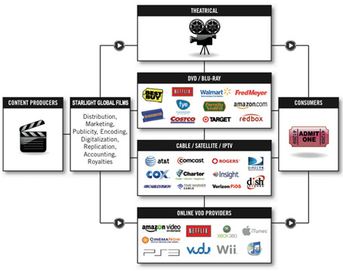
2.8 Publication Statement
Why are video publication statements so hard?
There is no entity called “publisher” in the commercial dissemination of moving images
http://starlightglobalfilms.com/marketing-distribution/

Slide 31
2.8 Publication Statement
Production companies
Financing companies (studio, other investors)*
Distributors
Theatrical distributors*
Home video distributors
* Not related to video manifestations; these may appear in credits, but it’s often not easy to distinguish without additional knowledge; okay to just consider them production companies

Slide 32
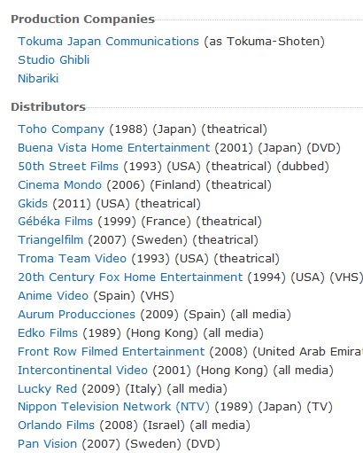
2.8 Publication Statement
Wikipedia →
← IMDb
Notes:
Different category called media companies by medium where film, video, tv appears

Slide 33
2.8 Publication Statement
AMIM 4. Distribution, Release, Broadcast Area
Moving image materials are made available to the public through methods of distribution, releasing, or broadcasting. Distributors or releasing companies perform the function of making moving image materials available. Television networks or stations broadcast television programs.

Slide 34
2.8 Publication Statement
Production Company
Acquires content
Organizes and manages production
Final editorial review
Financing Company
Provides funding
Notes:
Examples of functions that these entities may perform

Slide 35
2.8 Publication Statement
Home Video Distributor
Acquires content (major studios have their own distribution arms, but independent films have to find a distributor)
Licenses content (usually exclusive to a region or format and time-limited—one reason it’s hard to get perpetual streaming rights)
Designs physical object (designs container; develops, outsources or selects special features)
Notes:
Not going to talk about theatrical distributors; not usually relevant to manifestations outside of archives

Slide 36
2.8 Publication Statement
Home Video Distributor
Produces physical object (pressing or burning)
Markets video
Arranges for video to be available online
Sells and distributes video to: chains (Walmart, Barnes & Noble), online stores (Amazon), suppliers for independent bookstores and libraries (like Midwest Tape or Ingram)

Slide 37
2.8 Publication Statement
RDA Definitions
Publisher: An agent responsible for publishing, releasing, or issuing a manifestation
Distributor: An agent responsible for distributing a manifestation
Notes:
OED on publication: The issuing of a book, newspaper, magazine, or other printed matter for public sale or distribution; the action of making material publicly accessible or available in electronic form; an instance of this.
RDA’s definition for distributor is circular

Slide 38
2.8 Publication Statement
Publisher vs. Distributor
In case of doubt, consider the entity to be a publisher
Even when there is a “distributed by” statement, could be considered a publisher
New York, NY : A & E Television Networks : Distributed by New Video, [2007] *
* Is A&E Television Networks really a publisher?
Notes:
Often see this, but is A&E Television Networks really the publisher here?
They own the History Channel, but what else are they doing?
https://en.wikipedia.org/wiki/History_(U.S._TV_channel)
https://en.wikipedia.org/wiki/A%26E_Networks#Arts_and_Entertainment
https://en.wikipedia.org/wiki/New_Video

Slide 39
2.8 Publication Statement
2.8.4.2 Source of info. for publisher’s name
same source as the title proper
another source within the manifestation itself (disc label if using title frames, container, guide)
another source from 2.2.4 (external source)
For video, source other than the title frames (container, disc label) are more likely to have been intended to convey publication info.

Slide 40
How do you identify a publisher?

Slide 41
How do you identify a publisher?

Slide 42
How do you identify a publisher?

Slide 43
How do you identify a publisher?

Slide 44
How do you identify a publisher?

Slide 45
2.8.6 Date of Publication
Rarely have a date of publication
2012 DVD release
First printing 2006
Usually have to infer from a copyright date

Slide 46
2.8.6 Date of Publication
Be careful not to use the copyright date for the original content inappropriately.
Beta cassettes: 1975
Blu-ray disc: 2006
CAV (Constant Angular Velocity) standard play laser optical discs: 1978
CLV (Constant Linear Velocity) standard play laser optical discs: 1978
CED (Capacitance Electronic Disc) video discs: 1981
DVD-Video: 1996 (Japan); 1997 (USA)
Streaming video: 1999
U-matic/U-standard cassettes: 1971
VHS cassettes: 1976
*Thanks to Jay Weitz for the dates

Slide 47
2.11 Copyright Date
If there are multiple copyright dates for a single aspect:
record only the latest copyright date

Slide 48
2.11 Copyright Date
Multiple copyright dates for various aspects (e.g., program, bonus features, packaging): record any considered important. *
Optionally, put other copyright dates in note
PCC: If a full transcription of the copyright statement is desired, record it in a note.
* I don’t think this is particularly useful without additional context. The original copyright date and holder on the title frames (or other dates) would be more useful in 542 note on copyright

Slide 49
2.11 Copyright Date
Packaging date is often the date of release
However, sometimes videos are re-released with no change except in the packaging date; if this is known, don’t use the packaging date
Some publishers (such as Films for the Humanities and Sciences) use a new date every year (essentially print on demand)

Slide 50
2.11 Copyright Date
008 Fixed Field Dates in MARC
008/06 (DtSt) priority: r, p, t
s 2015 = date of film and date of video are same
s 2015 = date of film is earlier, but video version includes changes (any changes)
p 2015 1935 = date of film is earlier and video version is exactly the same (no feature, no languages, etc.)
use r when earlier and later version are same format (e.g., both are videos)
Notes:
Don’t agonize over this. IMO only date1 records something useful. It’s more useful in the long run to put the original date in 046ǂk.

Slide 51
Publication & Copyright
The most important things to remember:
The formatting of publication info on videos is not standardized
Different catalogers interpret the same packaging differently
Be flexible when selecting matches in databases like WorldCat

Slide 52
Relationships with Agents (chapters 18-22)
identifier
and/or
authorized access point
700 1_ ǂa Atkinson, Rowan, ǂe actor.
or
700 1_ ǂa Atkinson, Rowan. ǂ4 act
Notes:
Agents will replace the phrase “persons, families or corporate bodies” in RDA. This is part of the upcoming reconciliation of RDA with FRBR-LRM (library reference model)
Don’t currently use option a for identifiers, but many libraries are already adding identifiers in $0 in anticipation of the transition to linked data

Slide 53
Relationships with Agents
Creators
screenwriter An author of a screenplay, script, or scene. [subcategory under author]
* The screenwriter is never a creator of the moving image, only of the written text. The positioning of screenwriter in the section for creator relationship designators is a known problem.
* See the EURIG proposal at http://www.rda-rsc.org/RSC/Europe/2 for more background on the issue. The problem was referred to the Relationship Designators Working Group

Slide 54
Relationships with Agents
Creators
filmmaker responsible for creating an independent or personal film. A filmmaker is individually responsible for the conception and execution of all aspects of the film.
* “a film by” and “a … film” statements do not necessarily map to the filmmaker relationship designator; usually there is another statement that gives a specific role, most commonly director; in case of doubt, prefer director

Slide 55
Relationships with Agents
Associated with a Work
director responsible for the general management and supervision of a filmed performance, a radio or television program, etc.
film director television director
Roles vary not only by medium, but by genre within medium, e.g., television drama series, sitcom, talk show, reality show, TV news
Notes:
Useful to identify original distribution method in record, but split into film and television isn’t useful way to divvy up roles;
http://getinmedia.com/careers/television-director
http://www.slate.com/articles/arts/television/2010/04/what_do_tv_directors_do.html
http://www.mediacollege.com/employment/television/director.html
https://en.wikipedia.org/wiki/Television_producer

Slide 56
Relationships with Agents
Associated with a Work
producer responsible for most of the business aspects of a production for screen, sound recording, television, webcast, etc. …
film producer television producer
Notes:
TV news producer

Slide 57
Relationships with Agents
Associated with a Work
director of photography captures images, either electronically or on film or video stock, and often selects and arranges the lighting. Also used for chief cinematographer

Slide 58
Relationships with Agents
Associated with a Work
Production company corporate body that is responsible for financial, technical, and organizational management of a production for stage, screen, audio recording, television, webcast, etc.
Consultant, researcher, commissioning or sponsoring body

Slide 59
Relationships with Agents
Associated with an Expression (selected)
animator
art director
costume designer
editor of moving image work
lighting designer
make-up artist
musical director
production designer
recording engineer
special effects provider
stage director
visual effects provider
Notes:
RDA’s division of roles doesn’t really work for moving images
RDA seems to consider these similar to writer of introduction, etc.
What would it mean to have another expression of Gone with the Wind with a different costume designer?
Can talk about the costumes as a work separate from the moving image work, but there is no work without the costume designer

Slide 60
Relationships with Agents
Choreography: Twyla Tharp
What is the correct relationship designator to use?
choreographer
choreographer (expression)
A & B
neither A or B

Slide 61
Relationships with Agents
Associated with an Expression (selected)
choreographer (expression)
composer (expression)
interviewee/interviewer (expression)
restorationist (expression)
Notes:
Another hidden gotcha in RDA; never explains purpose of roles with expression qualifier
For moving images, always choose expression variant

Slide 62
Relationships with Agents
Associated with an Expression (selected)
on-screen participant (non-fiction only)
on-screen presenter (non-specific; contextual or background info.)
commentator, host, moderator, narrator, panelist, speaker, storyteller, teacher
presenter (Miramax Films presents)
Notes:
Note difference between on-screen presenter and presenter

Slide 63
Relationships with Agents
Associated with an Expression (selected)
performer
actor
conductor (choral or instrumental)
dancer
instrumentalist
puppeteer

Slide 64
Relationships with Agents
Corporate Bodies Associated with a
Manifestation
Publishers
Broadcaster involved in broadcasting a manifestation to an audience via radio, TV, webcast, etc.
* This is a manifestation relationship so the only use I can possibly see in non-archival cataloging is for off-air recordings, although these have traditionally been considered unpublished

Slide 65
Relationships with Agents
Corporate Bodies Associated with a
Manifestation
Distributors
Film distributor involved in distributing a moving image manifestation to theaters or other distribution channels
Notes:
Film is presumably used here to mean non-television

Slide 66
Relationships with Agents
AMIM 4. Distribution, Release, Broadcast Area
This area is used to record all original release information about the country, company name, and date for the distributing, releasing, and broadcasting of moving image materials regardless of the country of production. Distribution information describing rereleases or reissues is included subsequently.

Slide 67
Relationships with WEMI
based on (work)
Adaptation of (work)
motion picture adaptation of (work): A work that has been adapted as a motion picture.
television adaptation of (work)
video adaptation of (work)
video game adaptation of (work)
inspired by
parody of (work)
Notes:
Most of these also listed under expression

Slide 68
Relationships with WEMI
Relationships to Other Moving Images
remake of (work)
prequel to (work)
sequel to (work)

Slide 69
Relationships with WEMI
Whole-Part
container of (work)
in series
245 00 ǂa Essential Eastwood ...
505 0_ ǂa Letters from Iwo Jima -- Million dollar baby ...
730 02 ǂi Container of (work): ǂa Letters from Iwo Jima (Motion picture)
730 02 ǂi Container of (work): ǂa Million dollar baby (Motion picture)

Slide 70
About the Work: Form
6.3 Form of Work
Class or genre to which a work belongs
380 ǂa Television programs ǂ2 lcgft **
380 ǂa Motion pictures ǂ2 lcgft **
* If following the appendix on motion pictures and television from LC-PCC PS 6.27.1.9 on additions to access points representing works
*Uses these two forms
*Bases value on original distribution method; use motion picture for any non-television broadcast release or if the original method of distribution is unknown
**PCC recommends using controlled vocabulary in this field
Notes:
IMDb on theatrical release vs. TV: http://www.imdb.com/help/show_leaf?titletypes

Slide 71
About the Work: Date
6.4 Date of Work
For moving images, usually earliest date of public release or broadcast
046 ǂk 1995
046 ǂo 2008 ǂp 2010 ǂ2 edtf *
6.7 History of Work (eye-readable note)
500 Originally produced as a motion picture in 1995.
*For resources containing multiple works, can use a single 046 with ǂo for earliest date and ǂp for latest date or separate 046 ǂk for each date
* May use ǂ2 edtf, but not necessary if using yyyymmdd format

Slide 72
About the Work: Place of Origin
6.5 Place of Origin of Work
Country of the principal offices of the production company or individual by whom the moving image work was made (FIAF)
Notes:
https://en.wikipedia.org/wiki/Academy_Award_for_Best_Foreign_Language_Film
The Academy Award for Best Foreign Language Film is one of the Academy Awards handed out annually by the U.S.-based Academy of Motion Picture Arts and Sciences (AMPAS). It is given to a feature-
lengthmotion picture produced outside the United States of America with a predominantly non-English dialogue track.^{[1]}

Slide 73
About the Work: Place of Origin
6.5 Place of Origin of Work
257 Germany ǂa France ǂa Poland ǂ2 naf
257 United States ǂ2 naf
257 Mexico ǂ2 naf
Notes:
Originally limited to archival moving images but scope was widened in recent years

Slide 74
About the work
A plug for structured data and more authority records for the future:
041ǂh for original language
041 ǂa/ǂj for all languages on manifestation
046 ǂk for original date
257 ǂa country of production with ǂ2 naf*
ǂ4/ǂe for 1xx/7xx names
Create authority record for work
* Or other controlled vocabulary

Slide 75
6.27 Constructing Work & Expression Access Points
If using the LC national authority file, be aware of the appendix on motion pictures and television for LC-PCC PS 6.27.1.9
Appendix is provisional until the Program for Cooperative Cataloging has reviewed and revised it for RDA
Prescribes type and order of additions to access points

Slide 76
6.27.1.3 Collaborative Works
If two or more agents are collaboratively responsible for creating the work (see 19.2.1.1), construct the authorized access point representing the work by combining (in this order):
the authorized access point representing the [agent] with principal responsibility
preferred title for work (see 6.2.2).

Slide 77
6.27.1.3 Collaborative Works
Exception:
Moving image works. For motion pictures, videos, video games, etc., construct the authorized access point representing the work by using a preferred title for the work.
*Remember filmmaker is the only role that RDA lists under creator that applies to moving images

Slide 78
6.27.3 Authorized Access Points for Expressions
Per LC-PCC PS, you should do this
245 00 ǂa Rituales guerreros : ǂb el tupay en chiaraje
730 02 ǂi Container of (expression): ǂa Rituales guerreros. *
730 02 ǂi Container of (expression): ǂa Rituales guerreros. ǂl English.
* Following LC practice, the language isn’t given for the original expression. If not following LC practice, okay to add language.

Slide 79
6.27.3 Authorized Access Points for Expressions
Probably more useful (can use 130 if not an aggregate work, i.e., no bonus features, etc.)
245 00 ǂa Rituales guerreros : ǂb el tupay en chiaraje
730 02 ǂi Container of (work): ǂa Rituales guerreros.

Slide 80
26.1 Related Expressions
Per RDA, four options
Identifier
Authorized Access Point
Structured Description
Unstructured Description
Don’t have to use Authorized Access Point

Slide 81
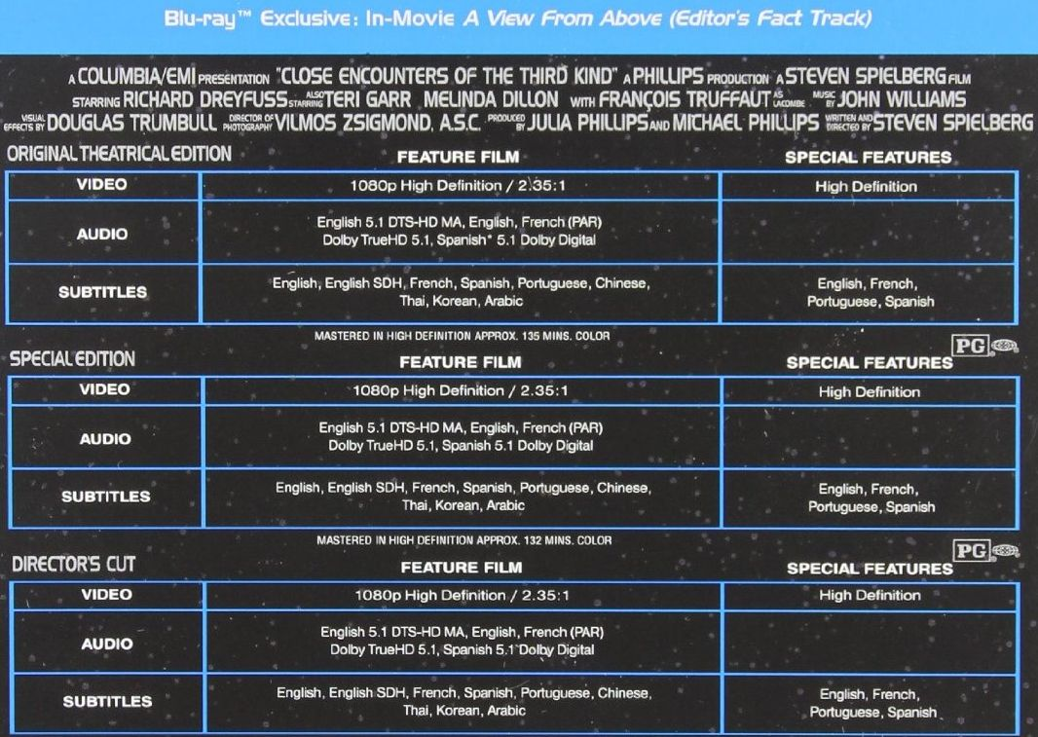
How Many Expressions?

Slide 82
26.1 Related Expressions
Not possible to accurately convey moving image language expressions, particularly for videodiscs, using authorized access points
Misleading (too little info)
or
Cost exceeds benefits (give all)

Slide 83
2.15 Identifiers for Manifestation (02x)
Source: Any source
020 ǂa 1567305113
020 ǂa 9781419839368 ǂq (set)
024 1_ ǂa 883929135271
028 42 ǂa 61168048 ǂb Universal Studios Home Entertainment
028 42 ǂa 33661 ǂb Warner Home Video ǂq (disc 1)
028 42 ǂa 33661 ǂb Warner Home Video ǂq (set)
*Be sure to include identifiers for the level being described (disc)
Notes:
Remember to include identifiers for the level being described. If you are cataloging one disc from a set or pack, be sure to include the disc identifier. Ideally, include disc and set identifiers in all cases.

Slide 84
4.5 Restrictions on Use
540 ǂa Includes public performance rights. *
*Copy-specific info.; use local note; do not include in shared cataloging
(506 restrictions on access note or 540 restrictions on use?)

Slide 85
PCC Guidelines for Provider Neutral Records for Online Resources
http://loc.gov/aba/pcc/scs/documents/PCC-PN-guidelines.html
040 ǂe pn
Single bibliographic record for all iterations of an online resource
Includes only information applicable to all manifestations with the same content (except “based on” notes and variant titles)
Notes:
useful in shared cat environment in our marc environment with no support for sep desc of frbr entities
kludge
works pretty well for books; not so much for video

Slide 86
PCC Guidelines for Provider Neutral Records for Online Resources
If basing description on a record from a previous manifestation:
Hard to identify “original” manifestation
Don’t carry over information that isn’t applicable to online version (special features, accompanying material)
Be sure the manifestation describes the same expression (language, accessibility)
Notes:
Most ebooks are images; literal reproduction of a specific manifestation
Link between streaming video and earlier manifestations not so clear
hard to cat streaming video; no good fast forward; credits often cut
hard to be sure have same expression (language, accessibility)
Supposed to be identical manifestations, but this is hard with video

Slide 87
PCC Guidelines for Provider Neutral Records for Online Resources
MARC field 347 (Digital File Characteristics) defined in holdings format
https://www.loc.gov/marc/holdings/hd347.html

Slide 88
Resources
OLAC Best Practices
DVD-Video and Blu-ray Video
http://olacinc.org/sites/default/files/DVD_Blu-ray_RDA_Guide_Version_1.1.pdf
Streaming Media
http://olacinc.org/sites/default/files/Streaming_Media_RDA-April2018_a.pdf
Video Games
http://olacinc.org/sites/default/files/Video%20Game%20Best%20Practices-April-2018%20Revision-a.pdf
Stanford RDA Video Cataloging Guidelines
http://web.stanford.edu/~gdegroat/RDAvideo-cataloging-guidelines.html

Slide 89
Other OLAC Resources
Authority Tools for Audiovisual and Music Catalogers: An Annotated List of Useful Resources http://olacinc.org/authority-tools-audiovisual-and-music-catalogers-annotated-list-useful-resources
Summary Notes for Catalog Records http://www.olacinc.org/sites/capc_files/summnotes.pdf
Video Language Coding Best Practices http://www.olacinc.org/sites/capc_files/VideoLangCoding2012-09.pdf
LCGFT for Moving Images Best Practices http://www.olacinc.org/sites/capc_files/LCGFTbestpractices.pdf

Slide 90
Questions?
???

