Slide 1
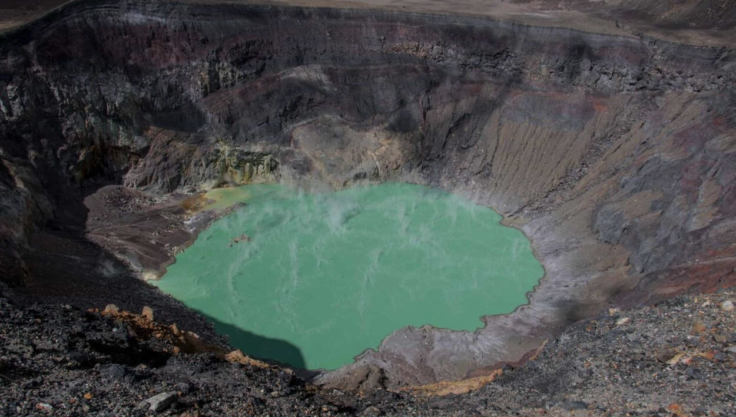


Progress in modeling volcanic gas scrubbing in volcanic lakes using gas-water-rock reactions
Allan Lerner¹, Jim Palandri², Mark Reed², Peter Kelly¹
Volcano Disaster Assistance Program (VDAP), USGS Cascades Volcano Observatory
2) Department of Earth Sciences, University of Oregon
alerner@usgs.gov
IAVCEI-CVL 2023
Santa Ana, El Salvador

Slide 2
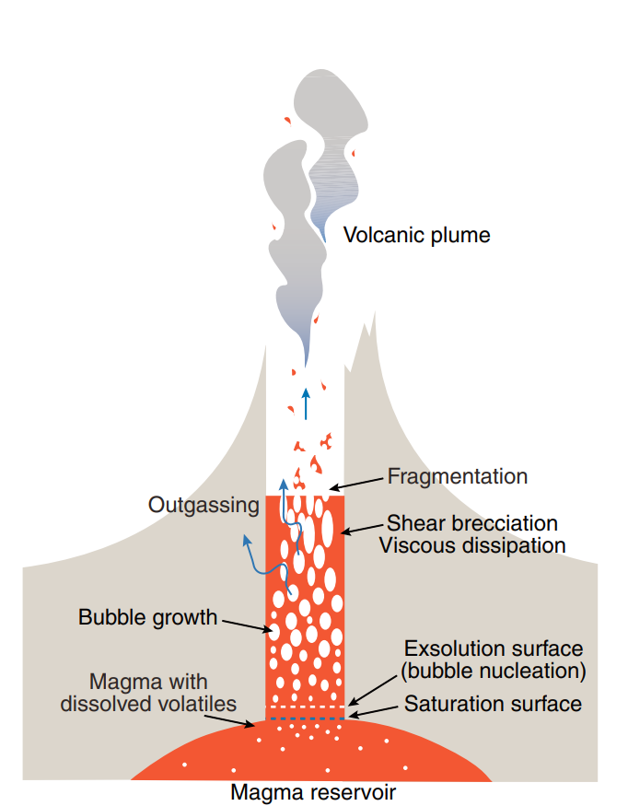
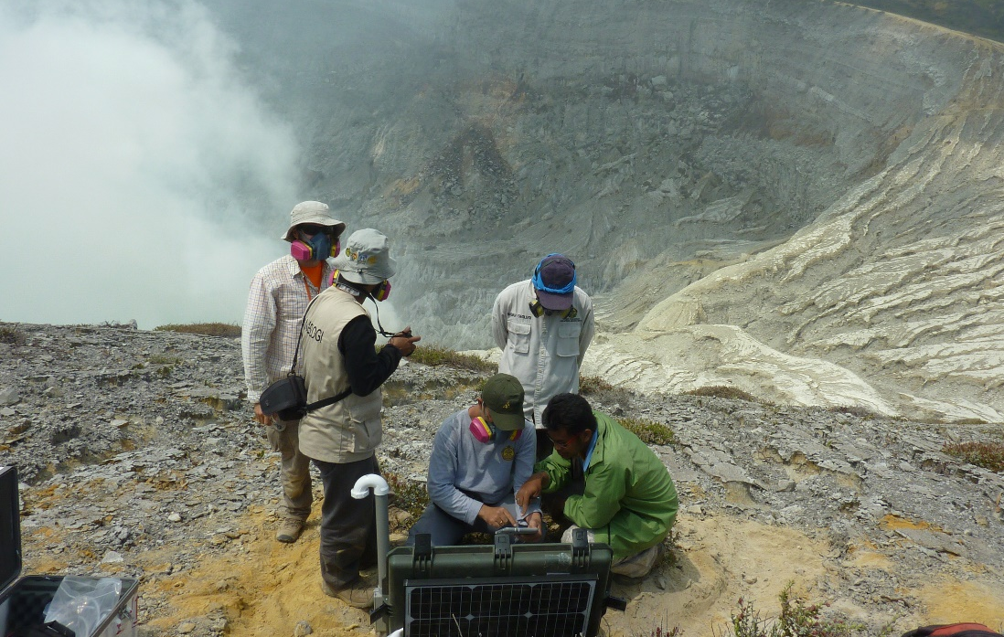
Motivation: Understanding Volcanic Processes and Hazards through Measurements of Gases and Waters
Gases as indicators of magmatic activity
Gases drive eruptions
Gas composition is linked to magma pressure, temperature, and composition
Gas emission rate is linked to amount of magma at saturation pressure
H₂O, CO₂, SO₂, H₂S,
HCl, HF, HBr…
Measuring Gas Composition
Gas emission rates
Multi-GAS
continuous analyzer
SO₂ / H₂S / CO₂ / H₂O
NOVAC - DOAS
continuous scanning SO₂ emission rates
Kawah Ijen
(Sep. 2015)
Sinabung Volcano (Aug. 2016)
Gonnerman and Manga, 2007

Slide 3
Motivation: Understanding Volcanic Processes and Hazards through Measurements of Gases and Waters
Gases as indicators of magmatic activity
Gases drive eruptions
Gas composition is linked to magma pressure, temperature, and composition
Gas emission rate is linked to amount of magma at saturation pressure
Elevated gas emissions and changing C/S ratios can be among earliest warning signs for eruption
H₂O, CO₂, SO₂, H₂S,
HCl, HF, HBr…
Shallowly exsolving S
Deeply exsolving CO₂
Volcanic Gases as “Telegrams from the Earth’s Interior”
Gonnerman and Manga, 2007

Slide 4
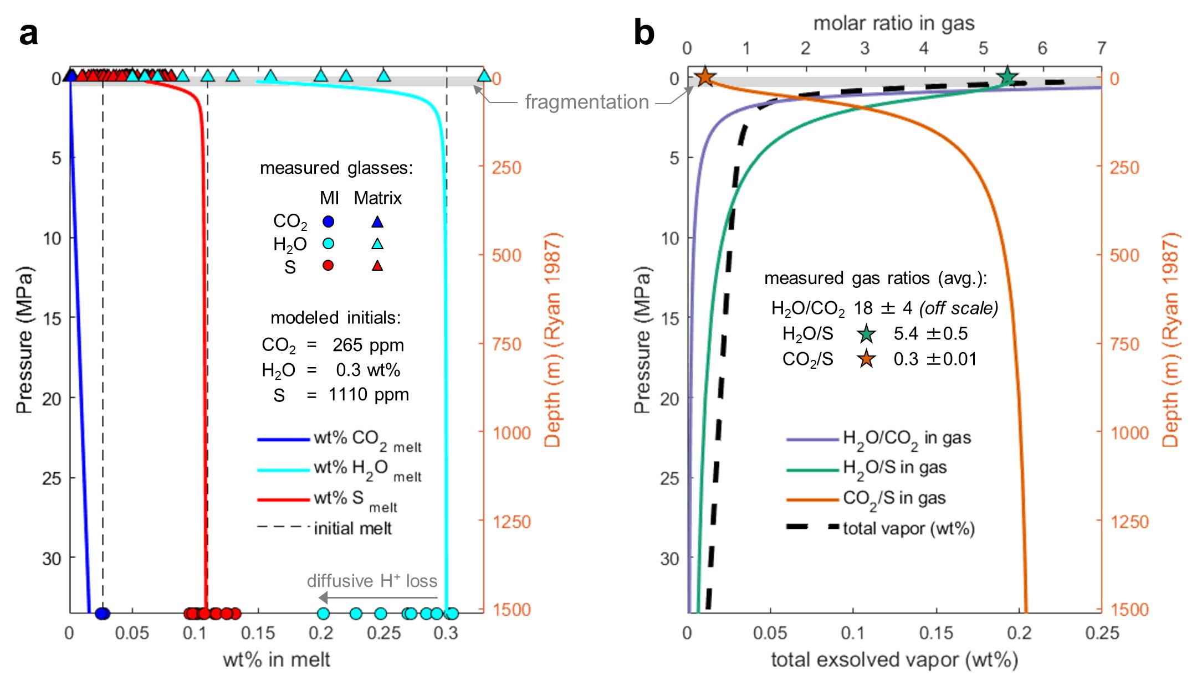
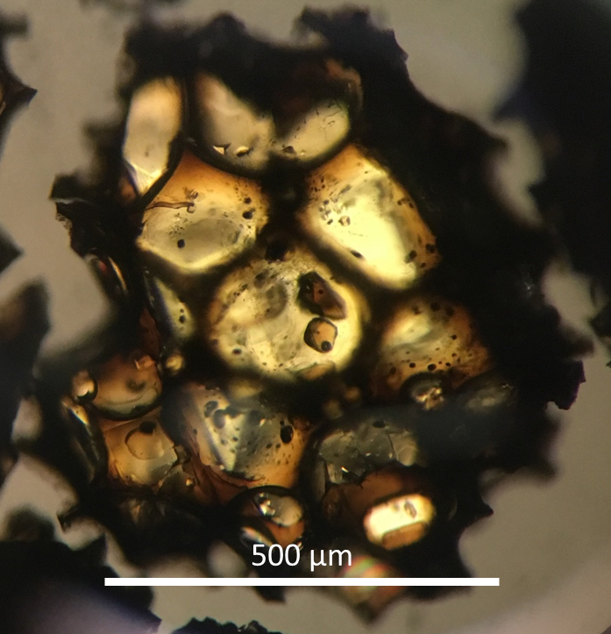
From Petrology to Degassing Models
CO₂-H₂O-SO₂ degassing model for Kīlauea
Δ = Matrix glass
measurements
= Melt inclusion
measurements
as model inputs
Lerner et al. 2021a

Slide 5
From Petrology to Degassing Models
CO₂-H₂O-SO₂ degassing model for Kīlauea
Modeled exsolved gas composition
Δ = Matrix glass
measurements
= MultiGAS
measurements
= Melt inclusion
measurements
as model inputs
Lerner et al. 2021a

Slide 6
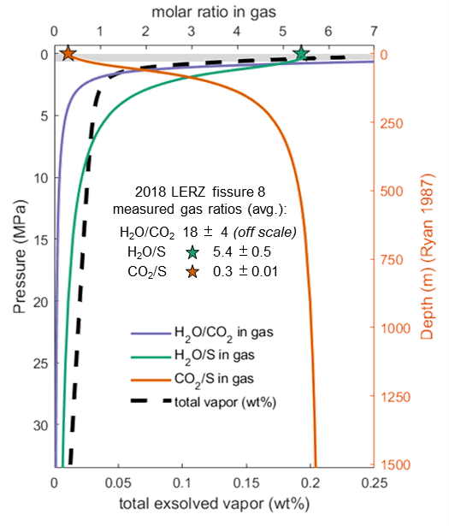
Degassing Models vs Real-world Measurements
Gas compositions
Multi-GAS
SO₂ / H₂S / CO₂ / H₂O
Modeled exsolved gas composition
Kawah Ijen
(Sep. 2015)
?
Gas emission rates
NOVAC - DOAS
SO₂ emission rates
Sinabung Volcano (Aug. 2016)

Slide 7
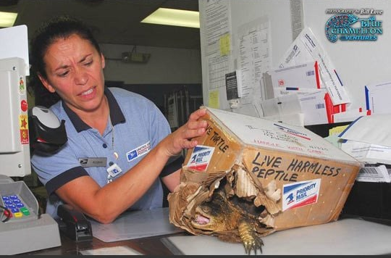
Degassing Models vs Real-world Measurements
Gas compositions
Multi-GAS
SO₂ / H₂S / CO₂ / H₂O
Modeled exsolved gas composition
Volcanic Gases as “Telegrams from the Earth’s Interior”
but sometimes telegrams are difficult to handle…
Kawah Ijen
(Sep. 2015)
?
Gas emission rates
NOVAC - DOAS
SO₂ emission rates
Sinabung Volcano (Aug. 2016)

Slide 8
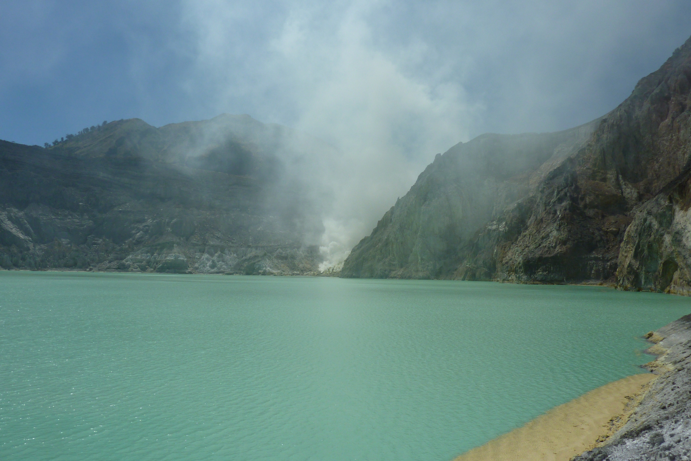
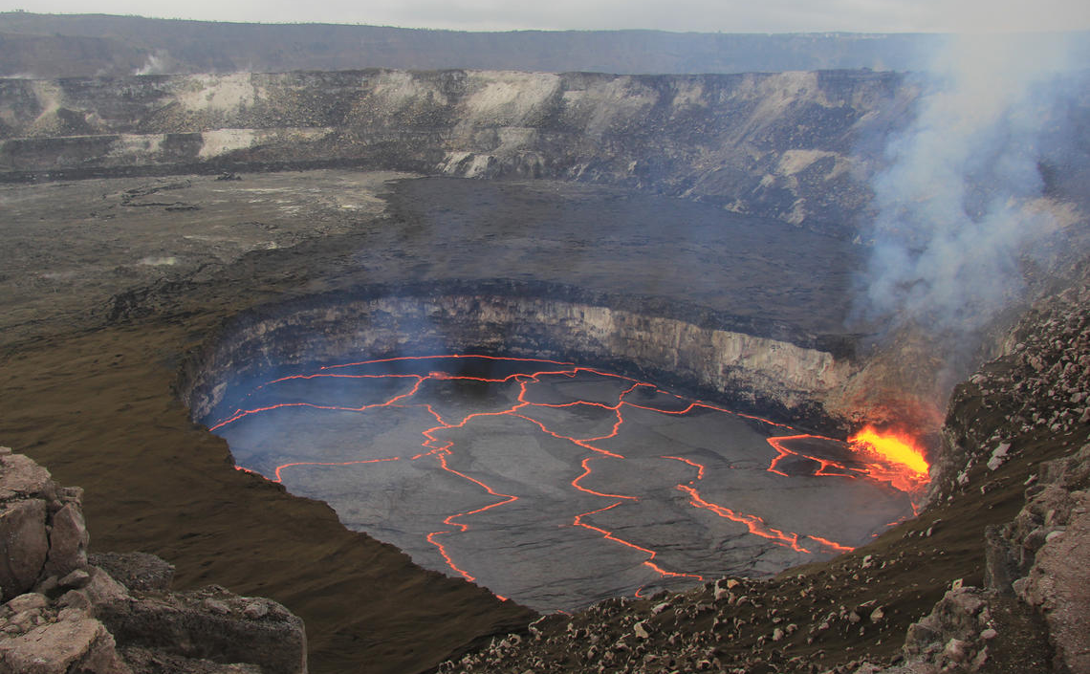
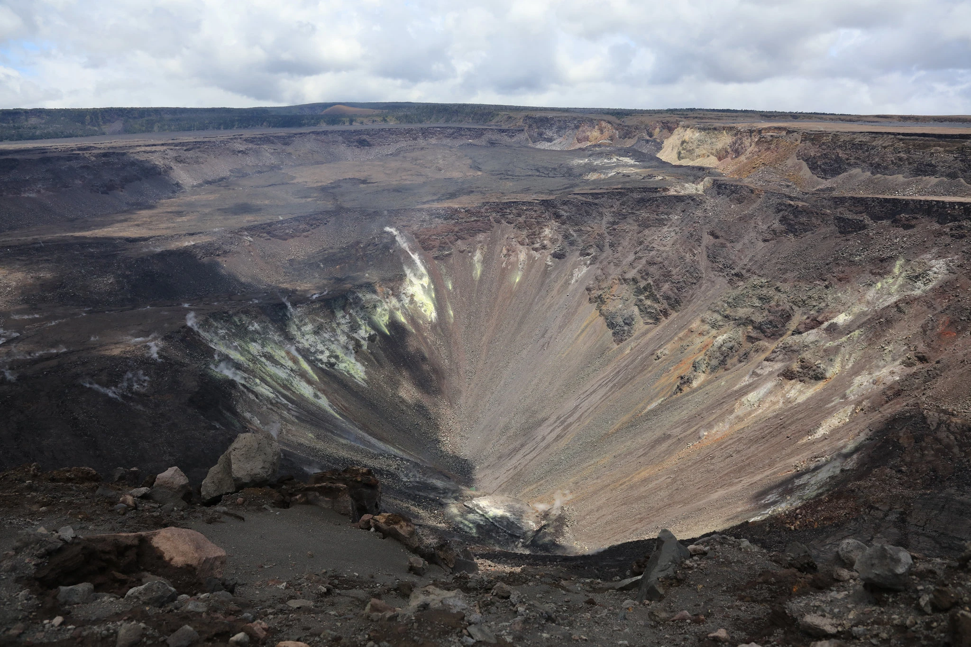
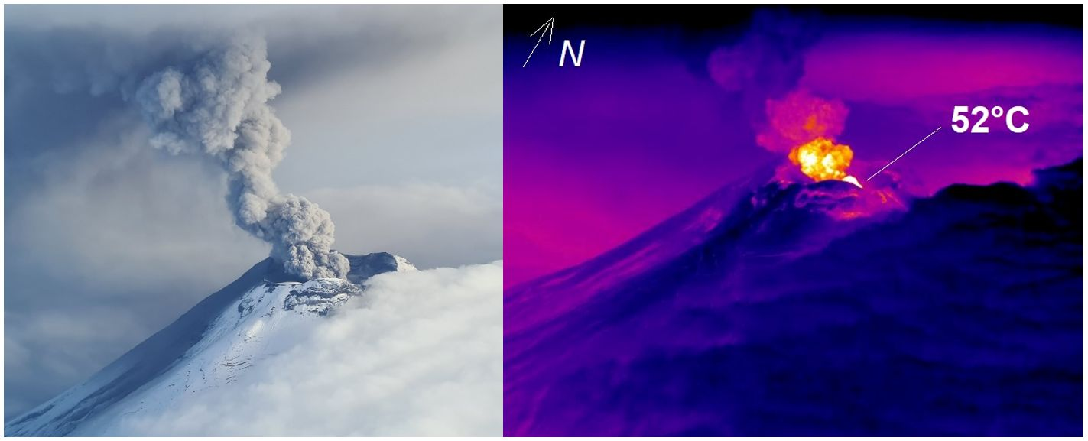
Gas reactions en-route to the surface
Kawah Ijen, Indonesia
Kīlauea, Hawaii
Halemaʻumaʻu lava lake, Kīlauea Caldera 2008 – 2018
“Dry”
Magma Degassing
↓
Surface
↓
Instruments
Degassing from fumaroles
Degassing through lake
Sep. 2015
USGS photo
Sulfur globules
USGS photo
“Wet”
Magma Degassing
↓
Wall rock reactions
↓
Water
(lake, groundwater)
↓
Surface
↓
Instruments
Cotopaxi Volcano, Ecuador
Kīlauea Caldera 2019 – 2020
water lake
Feb. 2, 2023
IG photos
USGS photo
Gas cooling + interaction with snow & groundwater

Slide 9
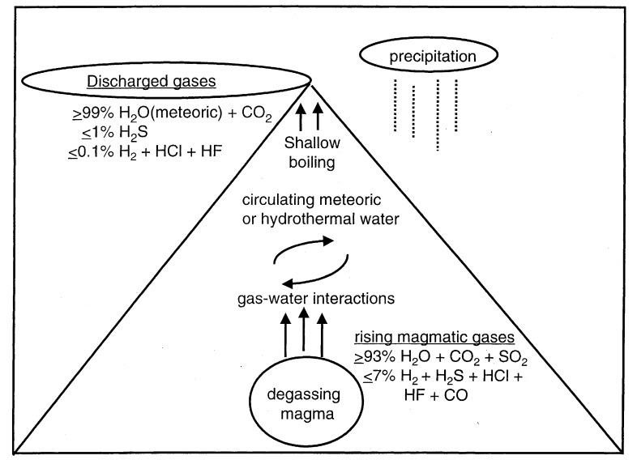
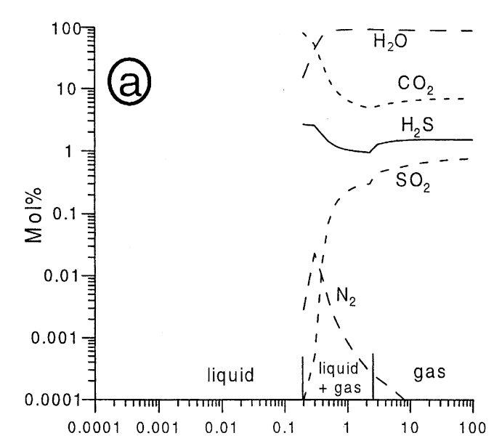
Thermodynamic Modeling of Gas-Water-Rock Reactions
Degassing through a hydrothermal system
(gas-water-rock reactions)
Gas dissolution into water
“SCRUBBING”
SO₂ “scrubbing”
Mol% in Gas Phase
Symonds et al. 2001
kg Gas Added
Increasing water mixing with gas

Slide 10
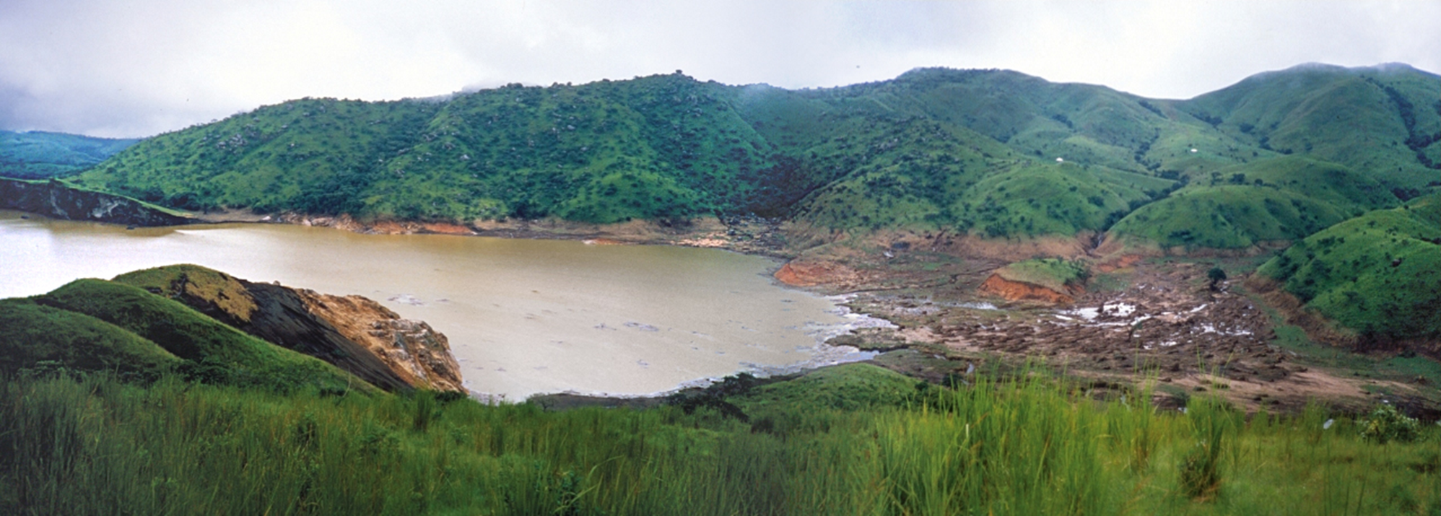
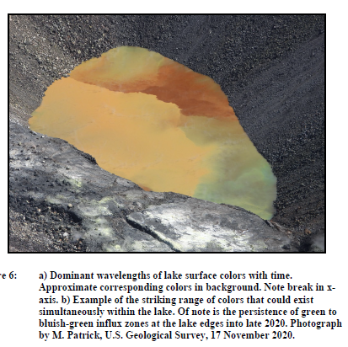
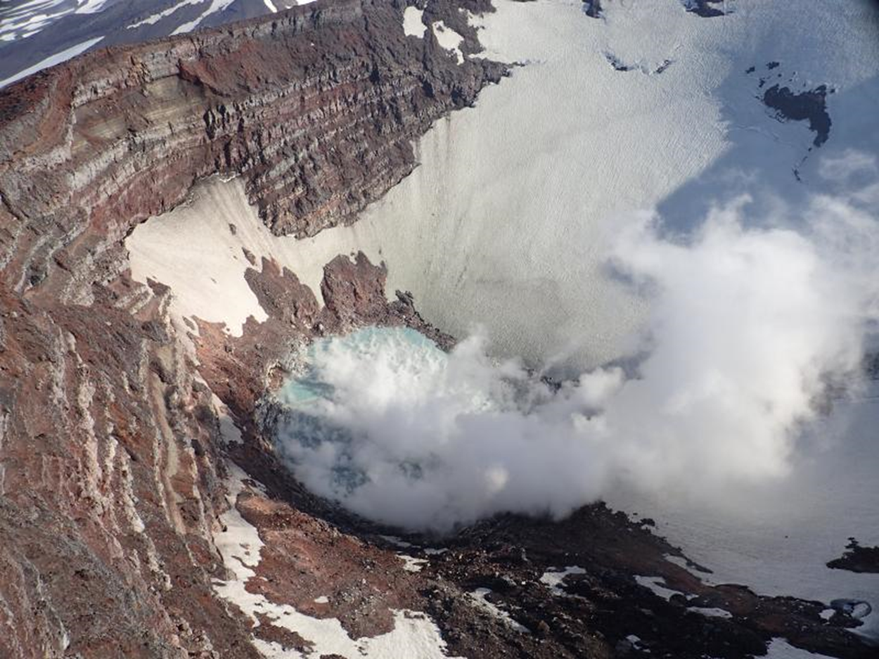
Thermodynamic Modeling of Gas-Water-Rock Reactions
Applications
Lake Nyos, Cameroon 1986
Gas dissolution into volcanic lakes and groundwater
SO₂ scrubbing (masking of gas emissions during unrest)
CO₂ scrubbing and accumulation at depth (e.g., Lake Nyos)
Gas precipitation and condensation with ascent and cooling
Gas modification from reactions with conduit rocks and groundwater
Water (e.g., volcanic lake and hydrothermal fluids) modification from wall-rock reactions
Redox reactions
pH changes with gas inputs vs rock neutralization
Mineralization and pathway sealing
Kīlauea Caldera water lake 2020
Nadeau et al.,
in review
Korovin Volcano (Alaska)
crater lake
2019
GOALS
Improved interpretation of volcanic gas emissions and volcanic lake water measurements
Inform on CO₂/S and H₂S/SO₂ gas ratios
Quantify effects on gas scrubbing on lake chemistry (e.g., SO₄²⁻, Cl⁻) and acidification
Identify tracer species that can inform about unseen subsurface processes (e.g., sensitivity of SO₂ vs CO₂ to scrubbing and differential behavior of trace elements [Hg/Cu, Hg/Pb, Cu/As])
AVO photo

Slide 11
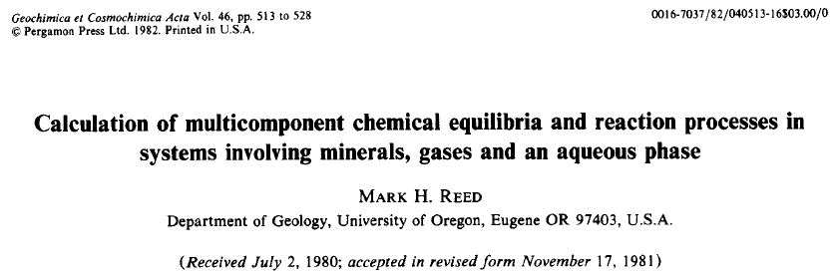
Thermodynamic Modeling of Gas-Water-Rock Reactions
SOLVEC, CHIM (ongoing since 1982)
→ Thermodynamic-driven simultaneous solution for solving multicomponent equilibria
→ Model from the perspective of the liquid
→ Models how liquid composition changes with ascent, cooling, reaction with gas and rocks
More Well-known Geochemical Modeling Programs
Geochemist’s Workbench
PHREEQC
EQ36
Fluid-focused models
Cost € $ £ ¥ (Geochem. Workbench)
Difficulties in ease-of-use (PHREEQC, EQ36)
P-T limitations in use beyond default: 0 – 300°C, 1 bar (all programs)
SURVEY!
1) Who knows about these programs?
2) Who USES these programs?

Slide 12
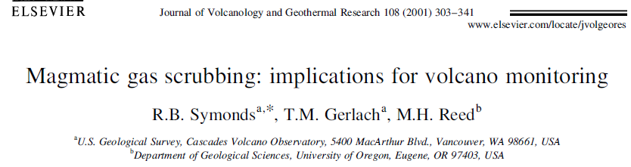
Thermodynamic Modeling of Gas-Water-Rock Reactions
SOLVEC, CHIM (ongoing since 1982)
→ Thermodynamic-driven simultaneous solution for solving multicomponent equilibria
→ Model from the perspective of the liquid
→ Models how liquid composition changes with ascent, cooling, reaction with gas and rocks
GASWORKS (ongoing since 1993)
→ Model from the perspective of the gas
Models how gas composition change with ascent, cooling, reaction with liquids and rocks
Original use was understanding gas sublimates and metal sulfides, chlorides, fluorides, etc at Augustine Volcano
Includes thermodynamic information from >500 gas species (vs <30 in other databases)
Wide range in P-T conditions to magmatic: e.g., 600 – 1200°C
No cost (just ask Mark Reed for access)
*Difficult for beginners to use (command-line based)*

Slide 13
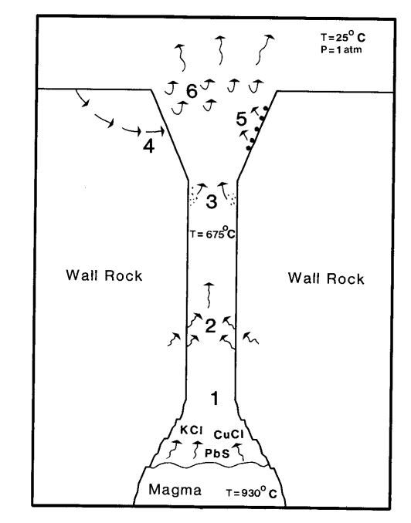
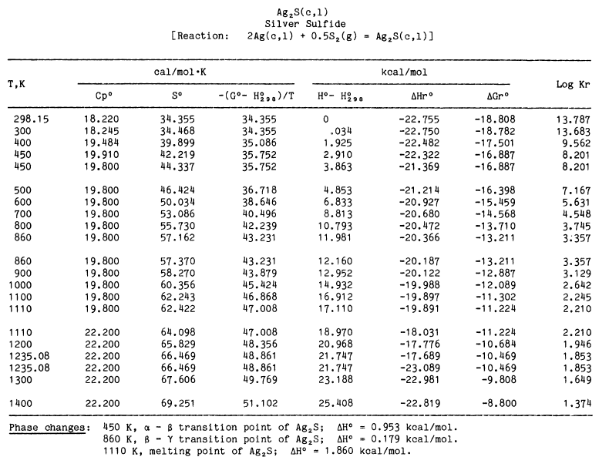

Progress in Updating GASWORKS Model and Database
DATABASE Updating
Review and digitize original thermodynamic data tables + include new references (>55 gases) since last GASWORKS edition
e.g., Robie and Hemingway 1995, Holland and Powell 2011 databases
JANAF thermodynamic tables (1964, 1971, 1985, 1998 editions)
MODEL Updating
Rebuilding numerous “lost” data references and subroutines since publications of Symonds in the early 2000s
Test reproducibility of initial GASWORKS models
Make original Fortran code more user-friendly (e.g., Python wrappers & GUIs )
Better documented workflow for common volcanic geochemical applications
Enable widespread access to the community
Hopefully ready well before CVL 12!
Pankratz et al 1987
Symonds and Reed 1993

Slide 14
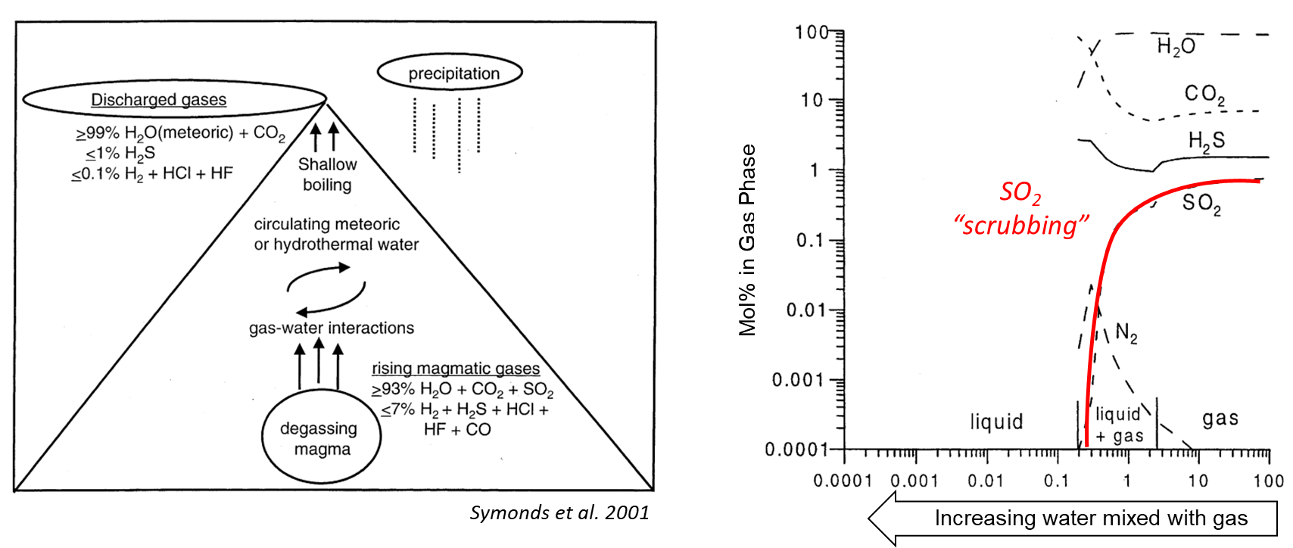
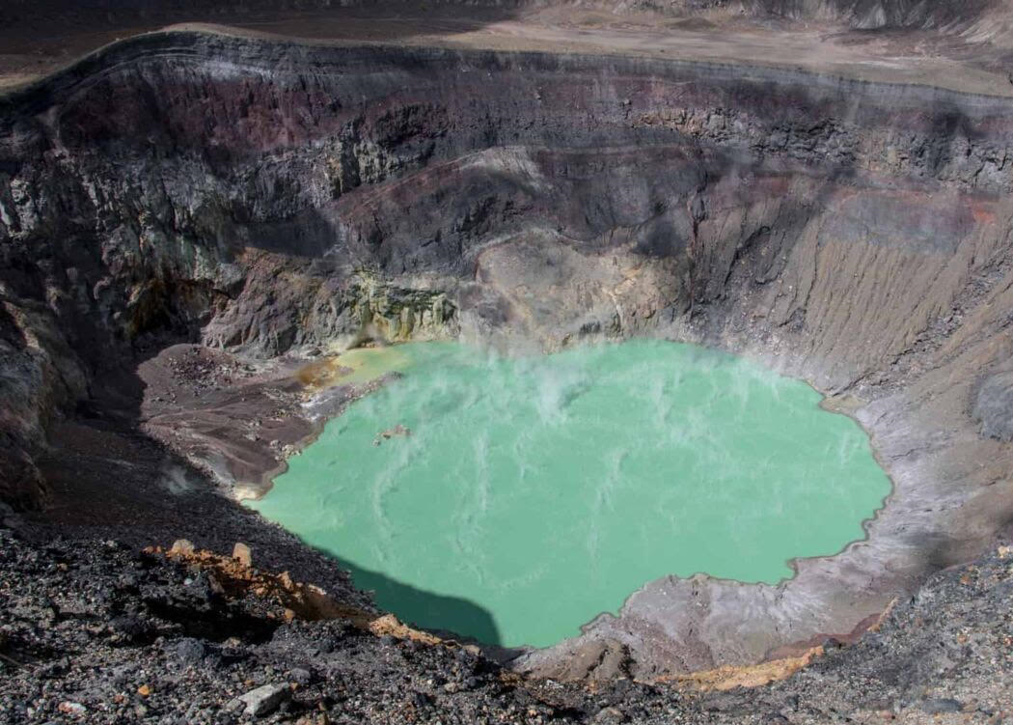
Obrigado pela sua atenção!
Questions, comments: alerner@usgs.gov
Santa Ana, El Salvador
Lake Nyos, Cameroon 1986
Kīlauea Caldera water lake 2020

